Slide 1
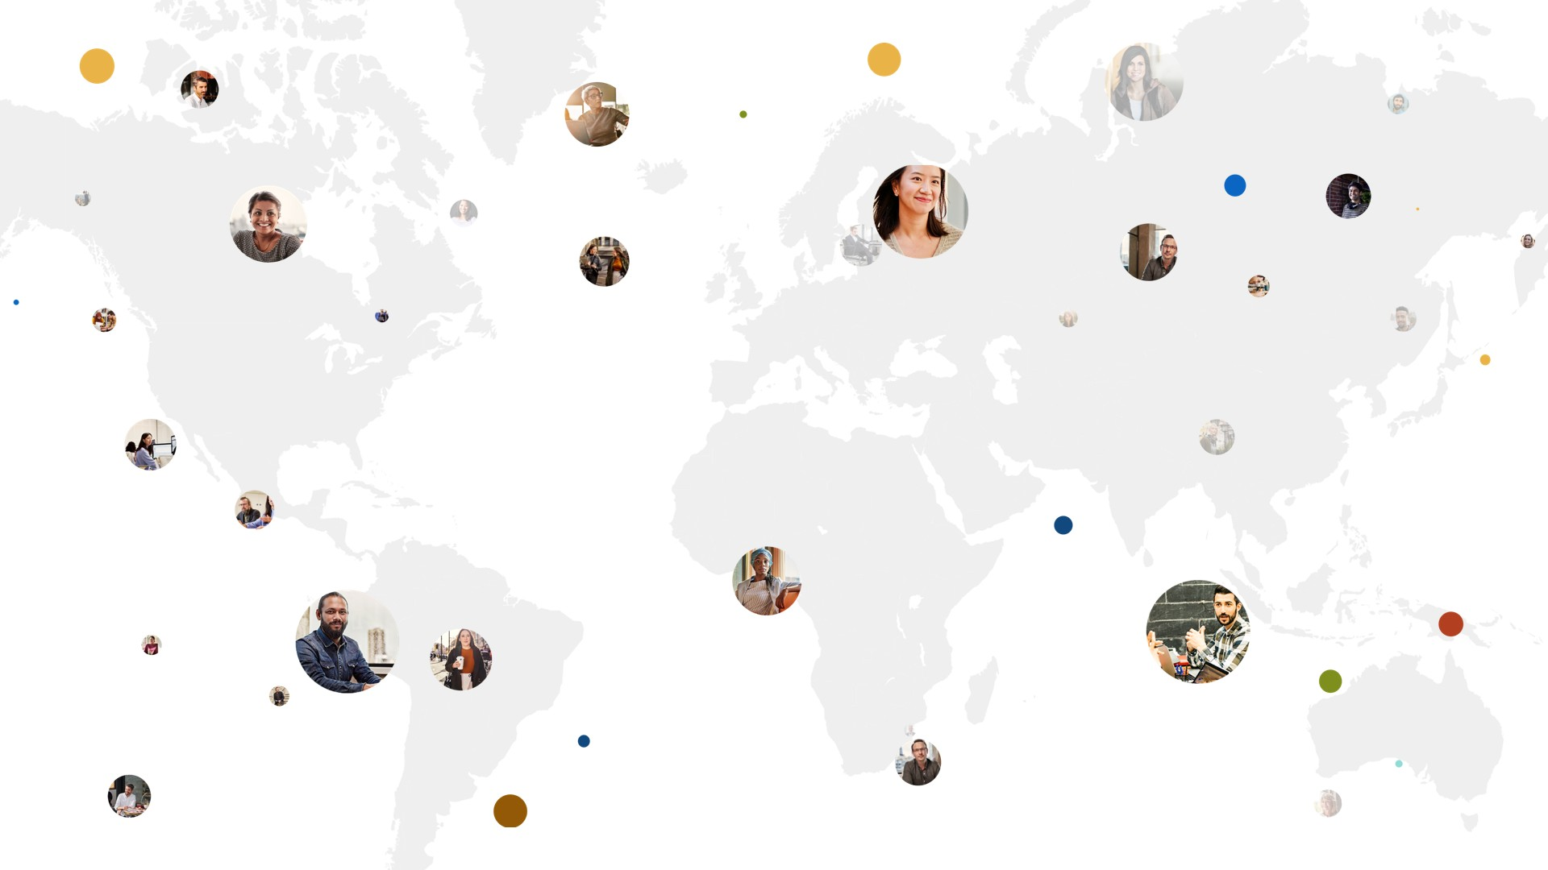
Accelerating skilling to ensure an inclusive economic recovery aka.ms/acceleratehouston
September 9, 2020

Slide 2
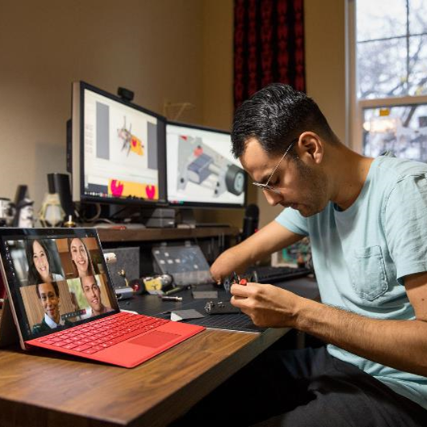
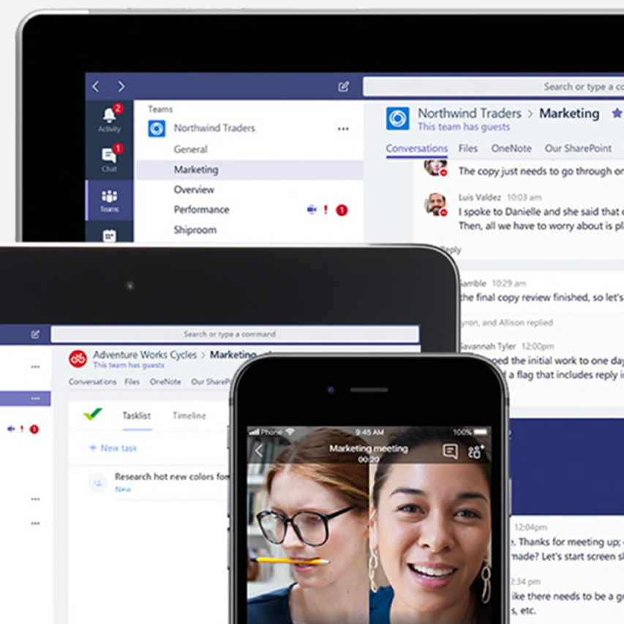
The problem we need to solve
A global economic crisis
A different
“hybrid economy”
A new skilling challenge
Need for new partnerships
Notes:
COVID-19 has created a global economic crisis, forcing tens of millions of people out of work.
Some of the jobs that have been lost will not be coming back and those jobs that do come back will look different than before. This is because companies have had to digitally transform at an accelerated pace, first to respond to the pandemic and now to help rebound in a post-pandemic economy.
As companies large and small drive efficiencies through this accelerated digital transformation, what is clear is that these employers will require more employees to have more digital skill, skills that will help adapt to what some are calling the new ‘hybrid economy’.
A hybrid economy is one where some employees will continue to work remotely while others return to the workplace, and where some consumers will return to shops and restaurants while others will want or need to be served remotely. It is an economy where the workplace and the marketplace will be increasingly more reliant on technology with the jobs skills to match.
Microsoft is estimating that the global labor market will need around 150 million new tech jobs over the next five years, with many other traditional jobs becoming tech enabled. But we cannot wait that long. We need to take collective action now to stem the employment impacts of the pandemic or we will see further social and economic disparity and an ever-widened skilling gap.
And this impact will go beyond the workforce, creating a systemic effect on the ability of companies, industries, and even countries, to be able to effectively respond and recover, let alone reimagine their economy in a post-pandemic world.
We recognize that Microsoft is in a unique position to help 25 million job seekers, but this isn’t a challenge any one company can address alone. This requires a partnership between tech companies and employers, non-profit groups, and government workforce agencies connect with this effort. While it is not the entire solution, helping those whose jobs have been impacted by the COVID-19 economic crisis gain new digital skills can play a big role.

Slide 3
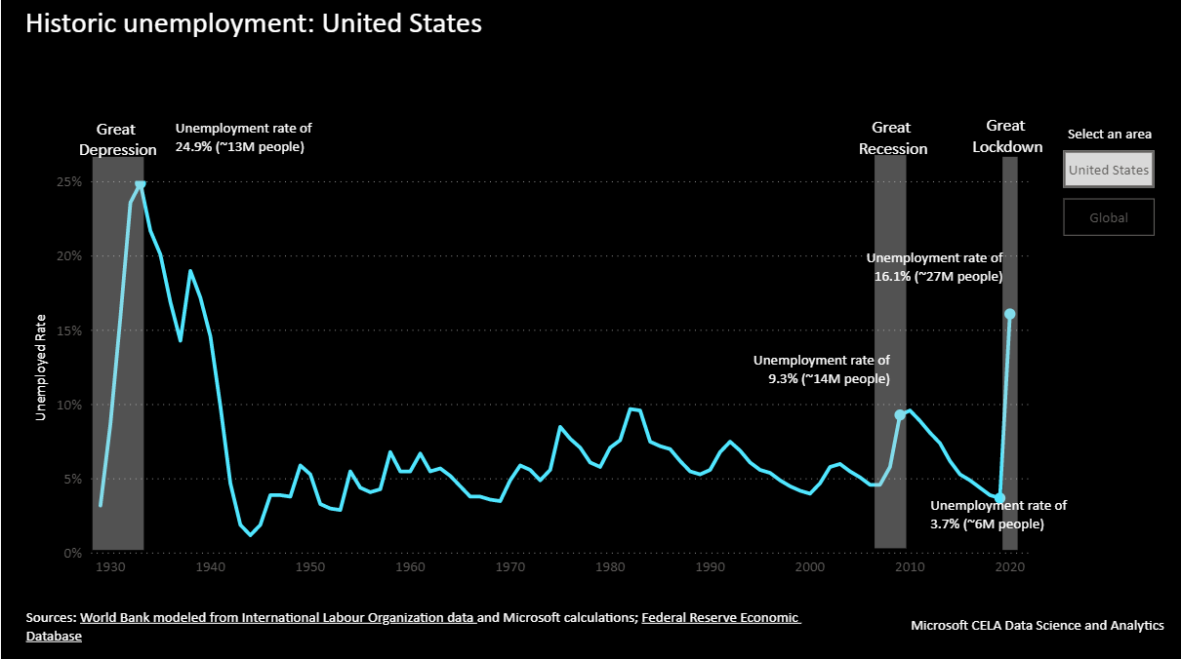

Slide 7
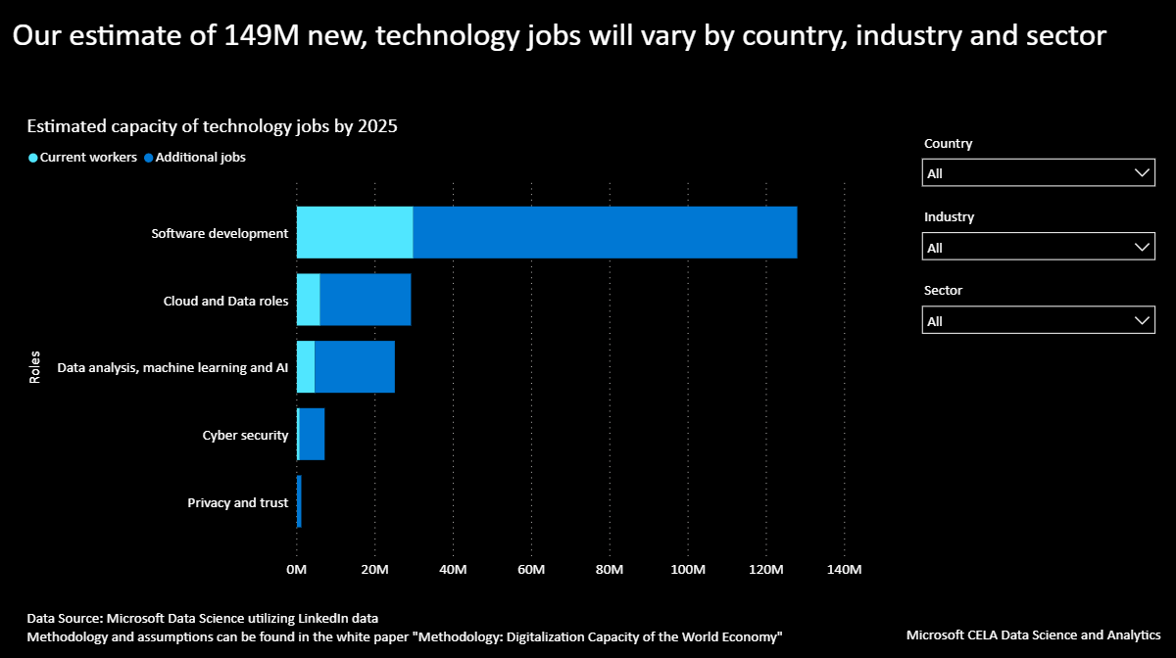

Slide 8
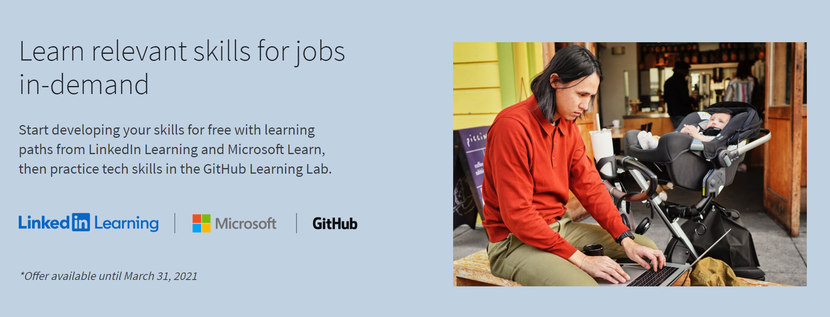
August Workforce Update: Houston

Slide 9
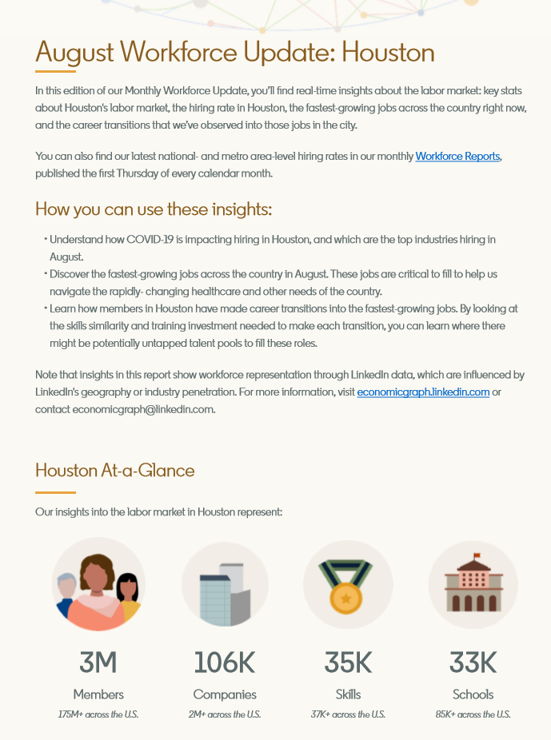
Notes:
At this crucial moment in history, it’s our responsibility to help lead a global effort to ensure the tens of millions of unemployed workers from the COVID-19 crisis have the opportunity to be empowered with digital skills they need to pursue the jobs of today and tomorrow.
Reopening and rebuilding the global economy will require people be equipped with new skills. Microsoft is in a unique position to increase access to learning for people all over the world - ensuring that people from all backgrounds and in every industry sector, will be learning in-demand skills, at the right time, in an accessible way.
We can see where the transformation is going, and we can help people throughout the entire learning continuum to fully participate in the digital economy. If the world fails to take significant action today by private sector and governments to stem the grave economic impacts of unemployment, it will result in accentuated economic disparity and significant skilling gap across a broader set of the population.
This impact will go beyond the workforce to have a systemic effect on the ability of companies, industries and communities to realize the full potential of this digital transformation.

Slide 10
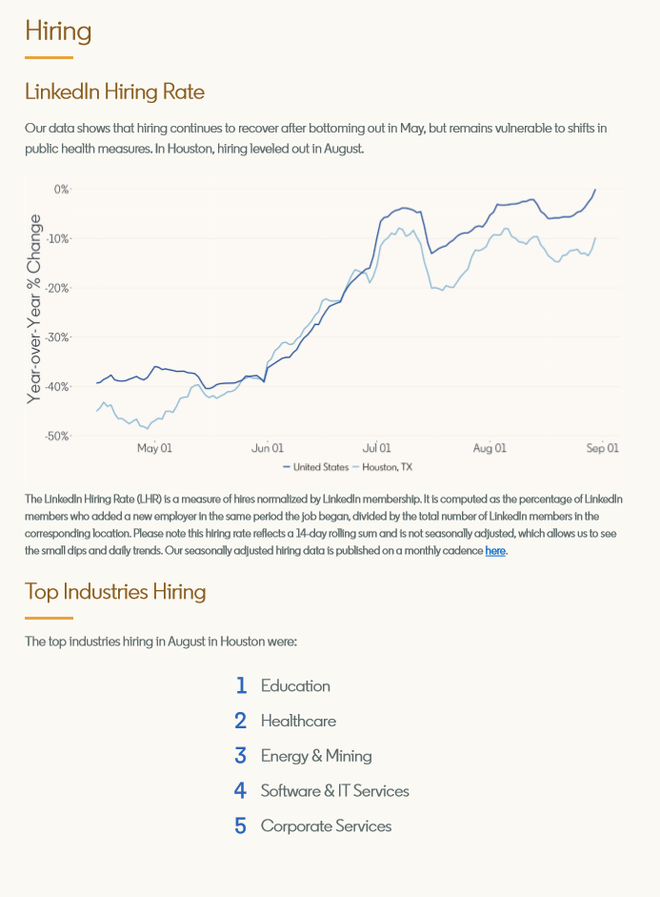

Slide 11
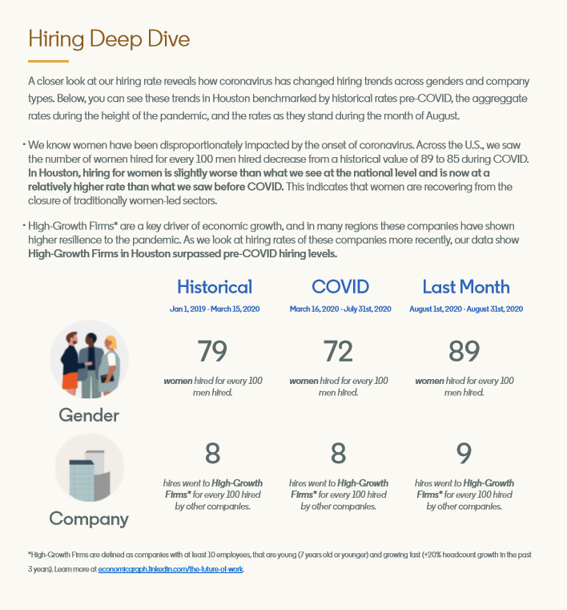

Slide 12
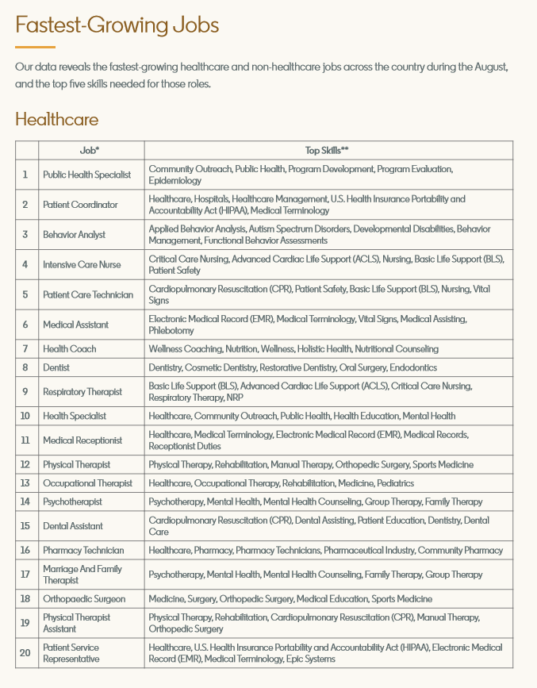
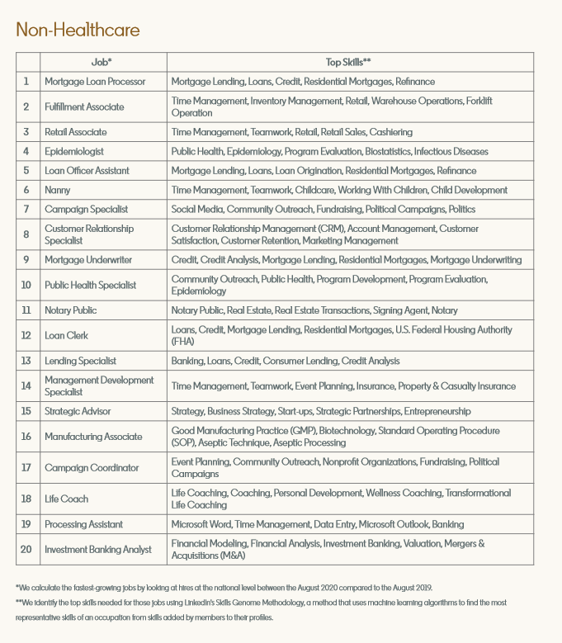

Slide 14
Our goal
Microsoft to help 25 Million job seekers
worldwide acquire new digital skills for the post-pandemic Economy
Notes:
At this crucial moment in history, it’s our responsibility to help lead a global effort to ensure the tens of millions of unemployed workers from the COVID-19 crisis have the opportunity to be empowered with digital skills they need to pursue the jobs of today and tomorrow.
Reopening and rebuilding the global economy will require people be equipped with new skills. Microsoft is in a unique position to increase access to learning for people all over the world - ensuring that people from all backgrounds and in every industry sector, will be learning in-demand skills, at the right time, in an accessible way.
We can see where the transformation is going, and we can help people throughout the entire learning continuum to fully participate in the digital economy. If the world fails to take significant action today by private sector and governments to stem the grave economic impacts of unemployment, it will result in accentuated economic disparity and significant skilling gap across a broader set of the population.
This impact will go beyond the workforce to have a systemic effect on the ability of companies, industries and communities to realize the full potential of this digital transformation.

Slide 15
Curated learning path
An immediate skilling initiative to reach
25 million people
Tests and certifications
Job seekers
Connections
to jobs
Employability tools
Notes:
We are bringing together and integrating three sets of offerings to meet the needs of job seekers:
A four-part comprehensive approach
Free access to learning content from across Microsoft, LinkedIn and GitHub
Discounted industry-recognized Microsoft certification exam for underserved job seekers
Free access to employability tools
Free connections to jobs
Grants to non-profits to serve people in greatest need.
Labor market insights from LinkedIn’s Economic Graph

Slide 16
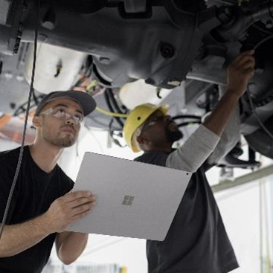
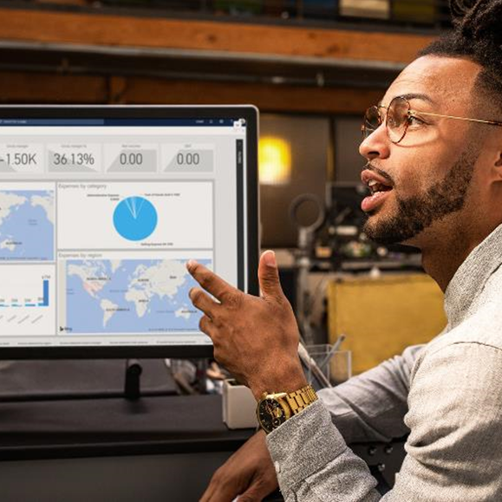
Invest in individuals to attain key digital skill
Advocate for public policy to support skilling
Create incentives for employers
Put innovation and data to work
Notes:
An effective, lasting response will require coordinated action from government and the private sector. In addition to sharing useful data with governments, we will use our voice to advocate for public policies that will be critical to drive systems change and legislative priorities to support employees and job seekers to skill, reskill, and upskill for roles in the post-COVID-19 economy.
As governments make substantial investments to respond to urgent public health and economic needs, Microsoft and LinkedIn recommend that countries focus on three key policy areas to ensure an inclusive economic recovery post-COVID-19 and beyond:
Invest in individuals to attain key digital skills: Increase opportunities for individuals to attain key technology skills by expanding availability of funding to individuals. Increased access to skills training should include online tools and services that enable life-long learning as well as funding to existing workforce programs focusing on technology and skills.
Incentives for employers to hire and upskill: In order to get as many people back to work as possible, employers, particularly small businesses, will need:
Incentives to hire new employees and upskill incumbent employees to advance in their career paths.
Support for work-based training programs
Support for transitional employment, which would provide subsidies for time-limited, wage-paid work experiences
Leverage the power of innovation and data: Leverage data across multiple sources (including assessments and online tools) to provide critical insight into the skills that may lead to in-demand roles.
Millions of people worldwide will need information about what jobs will become available in the post-COVID economy, what skills will be needed for those jobs, where to attain the skills, and how they will pay for them.
To support this, governments must support innovative public and private solutions to make sure that this information is available in as timely and user-friendly way as possible. That means encouraging interoperable learning records and other data integration to help job seekers and employers identify in-demand skills and growth areas, while encouraging governments to open up government data sets for public use
(optional) We’ve already seen several governments take important steps to invest in skills development for their citizens. For example:
In New Zealand, the Government invested approximately one billion USD to make vocational training courses free – for all ages – over the next two years in order to help people who have lost their jobs retrain and also allow new employees in some essential services to train on the job.
In Europe, an important component of the European Commission’s “New Skills Agenda for Europe,” is it promotes Europass, which will offer people better tools to present their skills and obtain useful real-time information on skills needs and trends which can help with career and learning choices by working with other services across the labor and education and training systems to allow an easier exchange of information and data.
In the United States, the Pledge to America’s Workers American Workforce Policy Advisory Board, established by the White House is developing proposals focused on investments in learning pathways, skills-based hiring, and the modernization of education and training to accelerate reskilling and facilitate innovation in workforce development

Slide 17
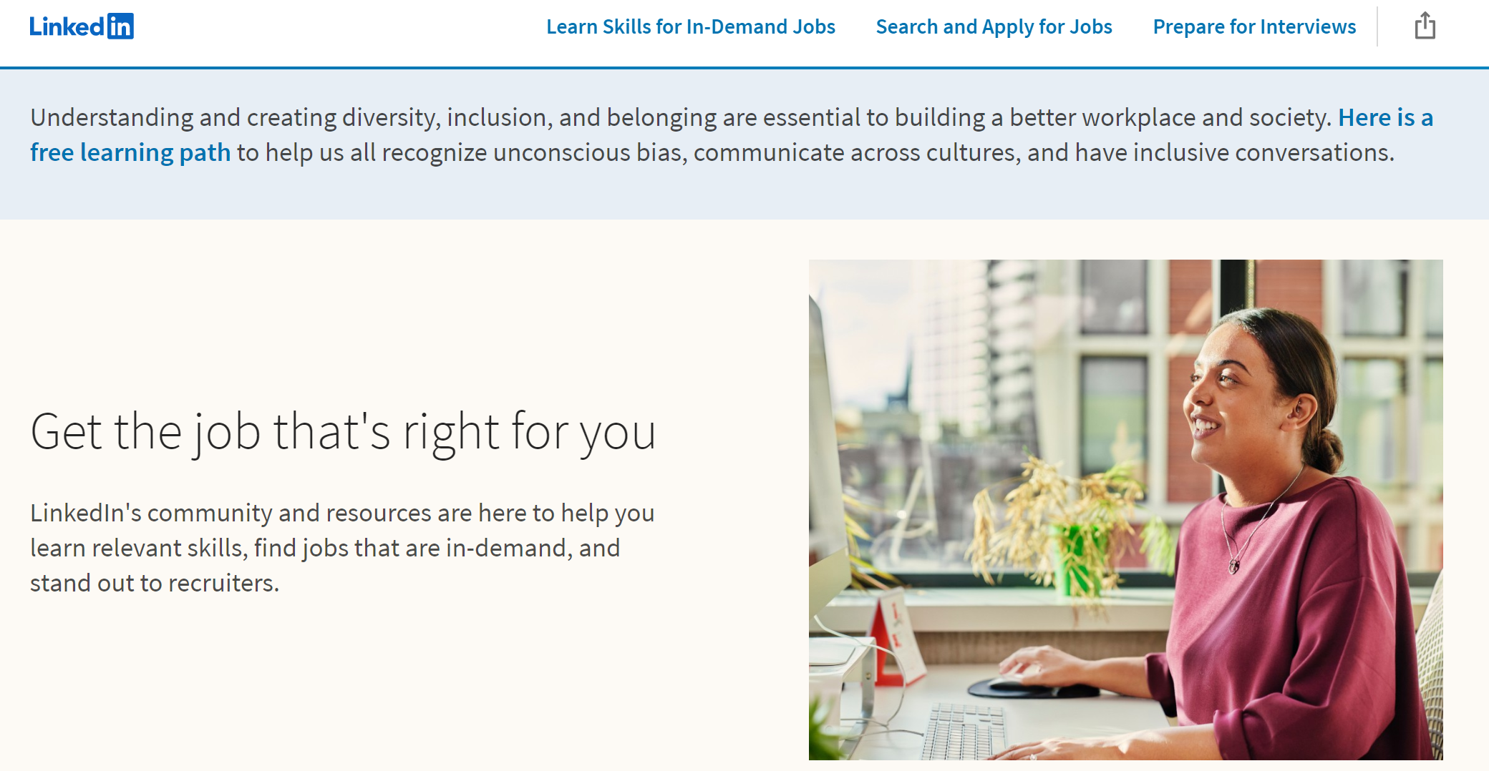
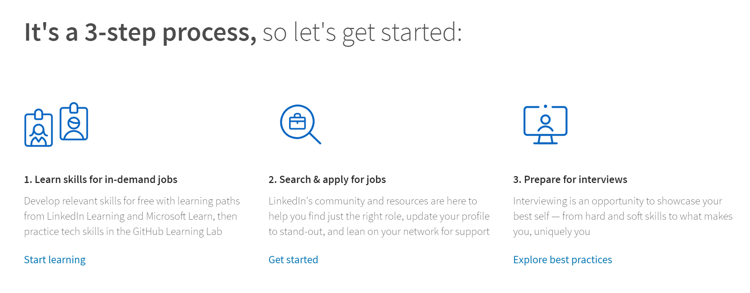
https://opportunity.linkedin.com/en-us

Slide 20
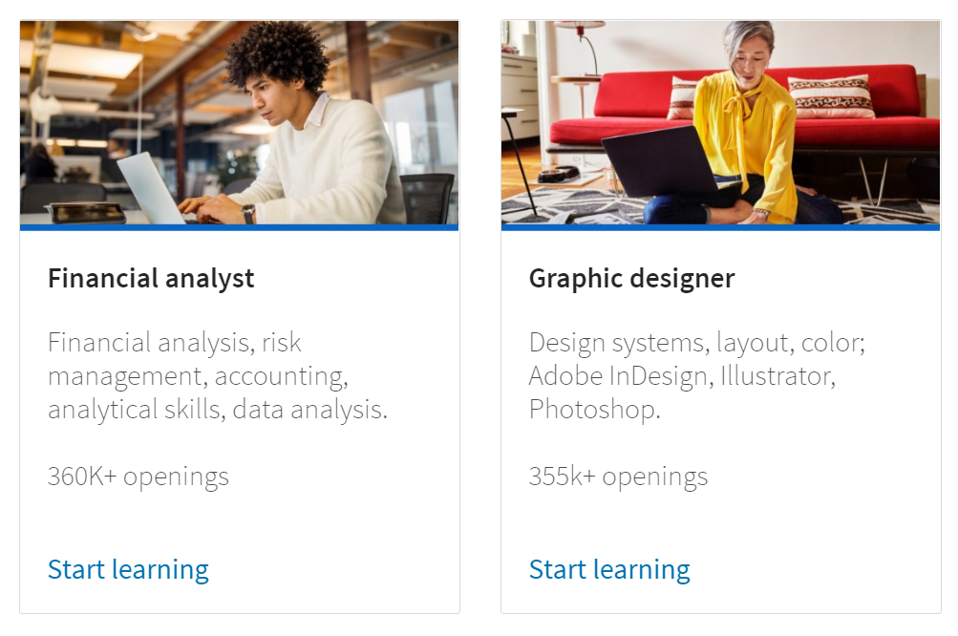

Slide 22
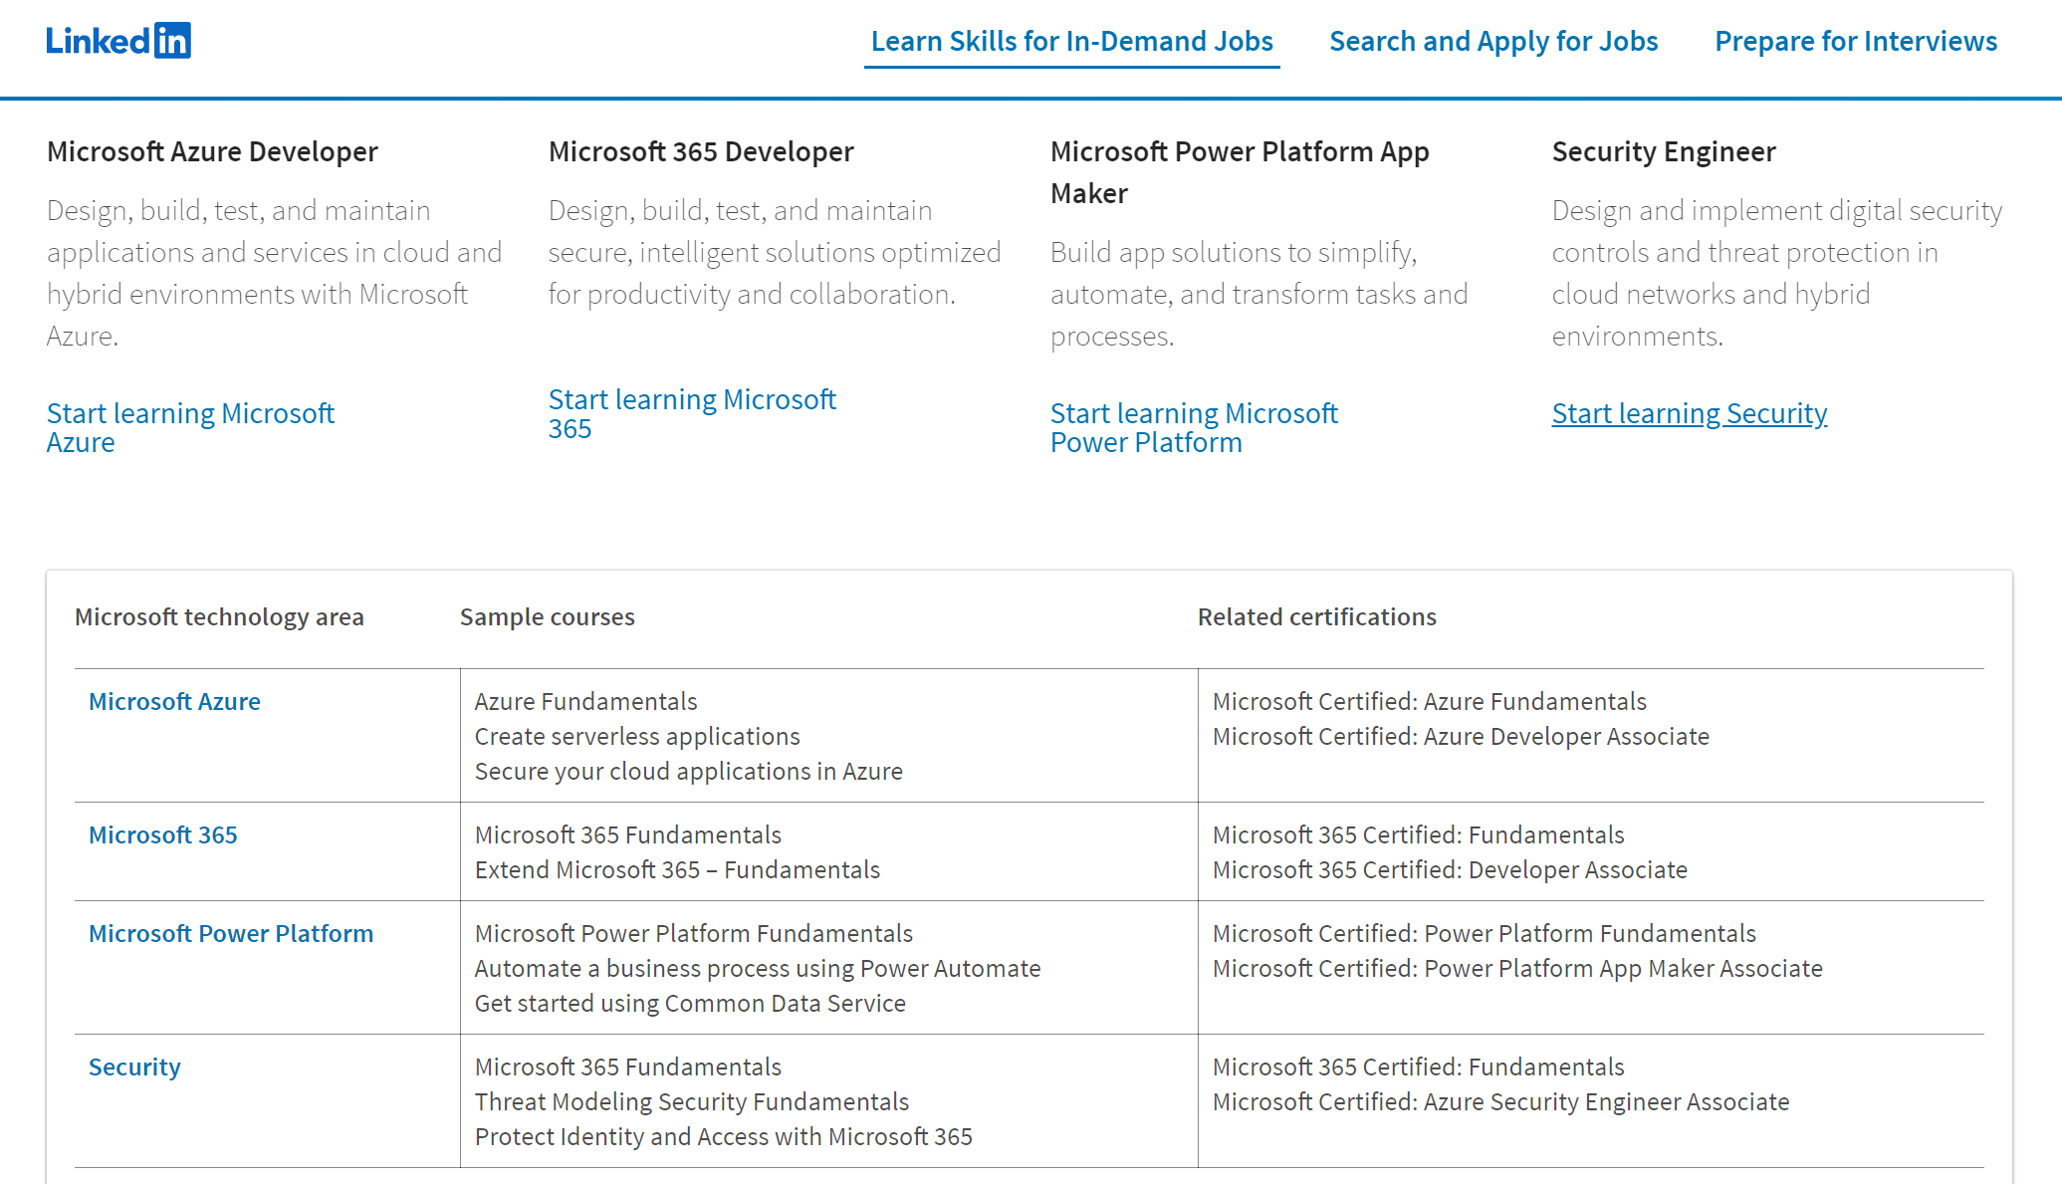

Slide 24
aka.ms/acceleratehouston
Notes:
For decades, Microsoft has been committed to closing the skills gap. But the time has come to further accelerate these efforts and build partnerships that help job seekers worldwide reskill and rejoin the workforce.
Reopening and reimaging the global economy is bigger than any one company, industry, or country.
Together, we can help people who have lost their jobs due to COVID-19 gain the skills they need to pursue the jobs of today and tomorrow

