Slide 1
Office of Business Opportunity FY 2018 Proposed Budget Presentation
May 23, 2017

Slide 2
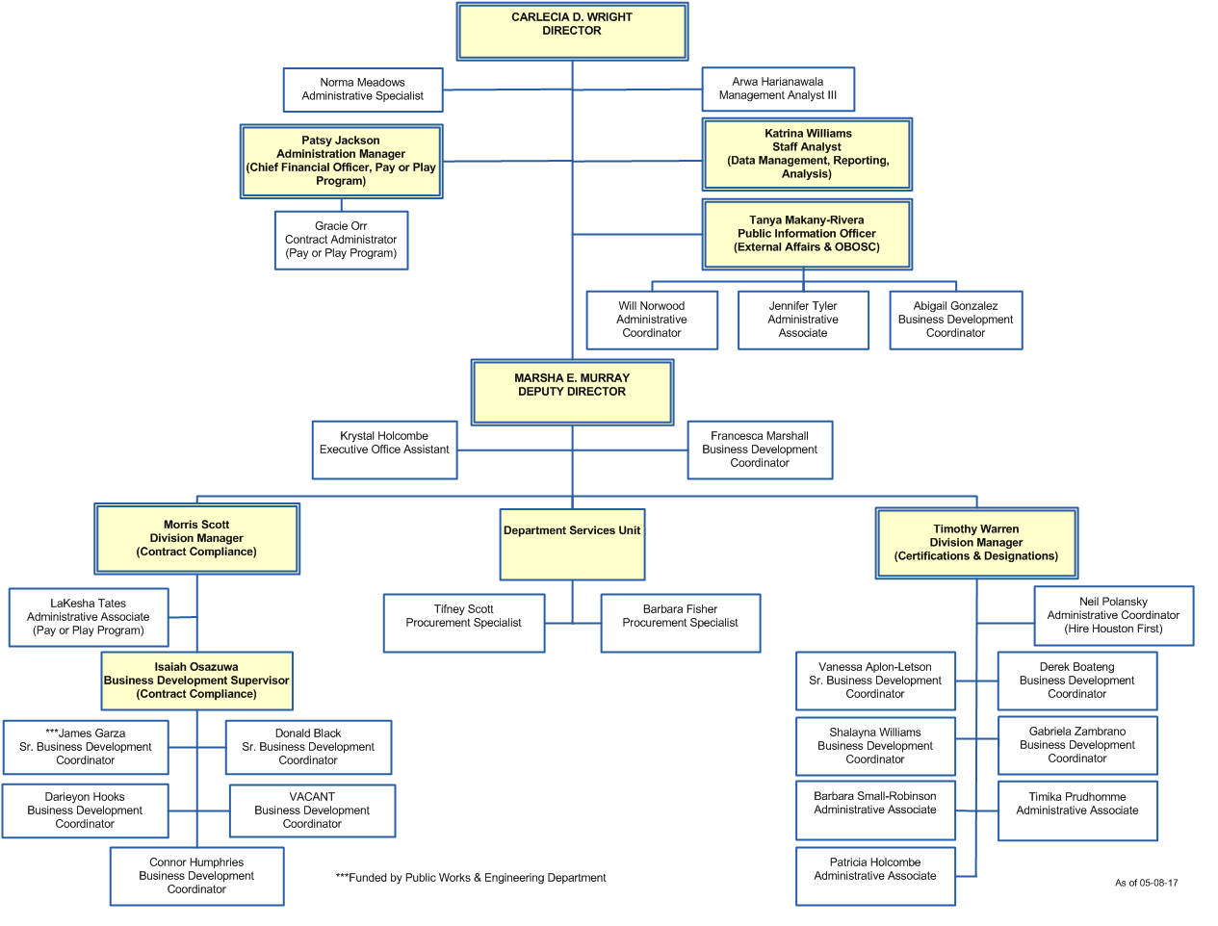
Organizational Chart

Slide 3
FY 2018 Department Initiatives

Slide 4
Revenues By Funds ($ in thousands)

Slide 5
FY 2018 Revenues Highlights
The FY 2018 budget for Fund 1000 reflects a 0.5% increase from the FY 2017 budget estimates. This equates to a $645 increase.
FY 2018’s budget for Fund 2424 reflects a 0.5% increase from the FY 2017 budget estimates. This equates to a $6,000 increase in revenue for FY 2018 due to the amount of interest that is anticipated to be collected for the Pay or Play Program.
It is also projected that more contractors will opt to pay into the Contractor Responsibility Fund in FY 2018 if the requirements for mandatory insurance as stipulated in the Affordable Care Act is removed.

Slide 6
Expenditures By Funds ($ in thousands)

Slide 7
FY 2018 Budget Expenditures Net Change (in thousands)

Slide 8
FY 2018 Expenditures Highlights
The FY 2018 budget for Fund 1000 reflects a 0% change in expenditures from the FY 2017 estimated budget.
In the proposed FY 2018 budget, OBO’s operating costs declined by 4.7%. This decrease however, was absorbed by the increase in HITS’ Application Services fee.
FY 2018’s budget for Fund 2424 reflects a $125,000 decrease. This resulted in a 14.3% decrease from the FY 2017 estimated budget. A significant amount of this decrease is due to budgetary adjustments in the Emergency TeleHealth Navigation (ETHAN) Program’s change of Scope for year 2 of the program.

Slide 9
OBO Functional Organizational Chart (in thousands)
OFFICE OF BUSINESS OPPORTUNITY
FUND 1000
29.5 FTEs $3,049
OBO Solutions Center
3.9 FTEs $318
Provides free business assistance and monitors business creation and job development by systematically tracking clients.
Certification and Compliance
25.6 FTEs $2,732
Consists of Certification and Designations, Contract Compliance, Department Services and Administration.

Slide 10
OBO Functional Organizational Chart (in thousands)
OFFICE OF BUSINESS OPPORTUNITY
FUND 2424
2 FTEs $747
Contractor Responsibility Fund
2 FTEs $747
Provides oversight of the Pay or Play Program and is responsible for program revenue collections, administrative operations, financial oversight, and monitoring of funds.

Slide 11
Questions

Slide 12
Appendix
Department Demographic Breakdown (Gender & Ethnicity)
FY 2017 Accomplishments

Slide 13
OBO Staff Demographic Breakdown

Slide 14
Department FY 2017Accomplishments
BUILD UP HOUSTON
In January 2017, the Office of Business Opportunity partnered with Houston Community College to launch the 3rd Cohort of Build Up Houston. In its second year, seven certified firms participated. In May 2017, eight small business owners will graduate from the program. Build Up Houston is a comprehensive, seven month program designed to increase the capacity and success of small businesses in the construction service industry with doing business in the City of Houston. The program utilizes curriculum provided by Interise, a non-profit organization, focused on helping established small business owners take their companies to the next level for continual growth and success. Interise has an award-winning curriculum developed and refined by working hand-in-hand with small business owners and national business experts. Interise has established themselves as a proven leader in educating and training established business owners to grow their businesses.
INTERAGENCY MENTOR PROTÉGÉ PROGRAM (IMPP)
The City of Houston, Metropolitan Transit Authority of Harris County, Houston Independent School District, Port of Houston, Houston Community College, and the Houston First Corporation have teamed together for the 5th year of the Interagency Mentor Protégé Program (IMPP). IMPP exists to strengthen effective working relationships and fosters long term stability between established firms and local agencies with emerging historically underutilized businesses. The goals of IMPP is to enhance business skills and broaden the base of historically underutilized businesses by providing the knowledge and experience of established firms. This year’s program began on May 2nd with 20 certified firms. Over 160 applications were received for the 2017 cohort of the IMPP.
Notes:
Last year’s LiftOff Houston! Business Plan Competition was held on November 15, 2014. Capital One Bank awarded a total of $30,000 in prizes to three winners in the categories of Innovation, Service and Product.
The Hire Me Now! Job Fair highlighted the Tweet My Jobs! Platform as a way for employers to expand their reach in recruiting. It also provided job seekers a way to easily see the types of jobs available in the Houston area.
There are currently over 71,800 jobs posted as open in the Houston area

Slide 15
Department FY 2017 Accomplishments Cont’d
TURNAROUND HOUSTON
In March 2016, Mayor Turner kicked off a series of resource fairs to address the barriers to employment that many Houstonians face. OBO, in collaboration with the Houston Health Department, various other City departments, community resource agencies, organizations, and employers, offer participants access to job training, resume writing, tattoo removal, social service agencies, educational institutions, counseling, and intervention to help hard to employ Houstonians turn their lives around. Since its inception, essential services have been provided to nearly 1,200 Houstonians. In FY 2017, a total of four Resource Fairs were conducted that yielded 724 attendees.
ECONOMIC DEVELOPMENT DIVERSITY DASHBOARD
The Office of Business Opportunity worked with the Economic Development Office to design the Economic Development Diversity Dashboard (EDDD), an application created to allow external agencies and organizations to report the participation of certified and Hire Houston First firms. The system is currently available and allows each TIRZ to enter their own data. Automated MWSBE Participation Reports are available in the EDDD System for TIRZ.
SUPER BOWL LI
OBO partnered with the Super Bowl LI Host Committee to promote their opportunities in the small business community, with a focus on Minority and Women Business Enterprises (MWBE) within the Houston area that were ready and able to perform work on contracts for the 2017 Super Bowl. To ensure that businesses were able to take advantage of this unique opportunity, OBO certified 68 firms for the Super Bowl. The Mayor’s Office of Special Events was charged with monitoring utilization and contract awards.
E
D
D
D
Notes:
Last year’s LiftOff Houston! Business Plan Competition was held on November 15, 2014. Capital One Bank awarded a total of $30,000 in prizes to three winners in the categories of Innovation, Service and Product.
The Hire Me Now! Job Fair highlighted the Tweet My Jobs! Platform as a way for employers to expand their reach in recruiting. It also provided job seekers a way to easily see the types of jobs available in the Houston area.
There are currently over 71,800 jobs posted as open in the Houston area

Slide 16
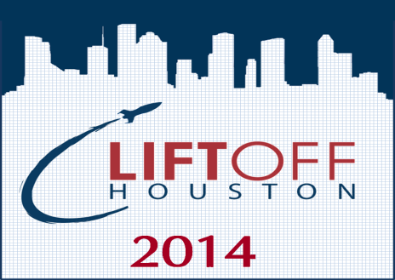
Department FY 2017 Accomplishments Cont’d
LIFTOFF HOUSTON!
In the first half of FY 2017, $30,000 was awarded to three participants in the City of Houston's Business Plan Competition. In its fourth year, Liftoff Houston! held 18 workshops that provided training to 839 individuals. This initiative is funded by Capital One Bank. Liftoff Houston! will launch again in June, 2017.
VIRTUAL LEGAL LAB
In FY 2016, OBO partnered with Vinson & Elkins, LLP to create the Virtual Legal Lab - a program that affords small businesses the opportunity to have one-on-one skype sessions with a licensed attorney to answer legal questions that they may have about their business. The program has hosted four Legal Labs so far in FY 2017, with a total of 30 small business owners participating.
DISPARITY STUDY
The Office of Business Opportunity, in collaboration with the Legal Department, hired a consultant to conduct a Citywide Disparity Study covering five years of City procurements. The Study will evaluate the extent of marketplace discrimination, if any, against minority-owned, women-owned, and disadvantaged businesses, as it relates to their participation on City of Houston construction and professional services contracts, as well as procurement of goods and services. The Study is estimated to be completed in the first quarter of FY 2019.
Virtual Legal
Lab
Notes:
Last year’s LiftOff Houston! Business Plan Competition was held on November 15, 2014. Capital One Bank awarded a total of $30,000 in prizes to three winners in the categories of Innovation, Service and Product.
The Hire Me Now! Job Fair highlighted the Tweet My Jobs! Platform as a way for employers to expand their reach in recruiting. It also provided job seekers a way to easily see the types of jobs available in the Houston area.
There are currently over 71,800 jobs posted as open in the Houston area

Slide 17
FY 2018 Performance Measures Fund 1000
Customer Measures | Priorities | FY 16 Actual | FY 17 Budget | FY 17 Estimates | FY 18 Estimates
New Certified Firms | Services & Infrastructure | 257 | 400 | 400 | 400
New Hire Houston First Designations | Services & Infrastructure | 460 | 250 | 250 | 275
Turnaround Houston | Complete Communities |  |  |  | 750
Liftoff Houston! Business Plan Competition | Complete Communities |  |  |  | 500
Labor Standards | Services & Infrastructure |  |  |  | 60%
Business Process Measures | Priorities | FY 16 Actual | FY 17 Budget | FY 17 Estimates | FY 18 Estimates
Certification Processing Timeframes (days) | Services & Infrastructure | 90 | 90 | 90 | 90
MWSBE Contract Participation – Construction | Services & Infrastructure | 22% | 34% | 34% | 34%
MWSBE Contract Participation – Professional Services | Services & Infrastructure | 41% | 24% | 24% | 24%
MWSBE Contract Participation – Purchasing | Services & Infrastructure | 15% | 11% | 11% | 11%

Slide 18
FY 2018 Performance Measures Fund 1000 (Cont’d)
Business Process Measures | Priorities | FY 16 Actual | FY 17 Budget | FY 17 Estimates | FY 18 Estimates
Expenditures: Adopted Budget vs Actual Utilization | Sound Financial Management | 97% | 98% | 97% | 98%
Revenues: Adopted Budget vs Actual Utilization | Sound Financial Management | 118% | 100% | 100% | 100%

Slide 19
FY 2018 Performance Measures Fund 2424
Customer Measures | Priorities | FY 16 Actual | FY 17 Budget | FY 17 Estimates | FY 18 Estimates
Business Process Measures | Priorities | FY 16 Actual | FY 17 Budget | FY 17 Estimates | FY 18 Estimates
Ratio of Play Option Contracts | Services & Infrastructure | 65% | 65% | 65% | 65%
Expenditures : Adopted Budget vs Actual Utilization | Sound Financial Management | 59% | 98% | 100% | 98%
Expenditures : Adopted Budget vs Actual Utilization | Sound Financial Management | 197% | 100% | 136% | 100%

Slide 20
Thank You

