Slide 1
City Council FY2019 Proposed Budget Presentation
May 9, 2018

Slide 2
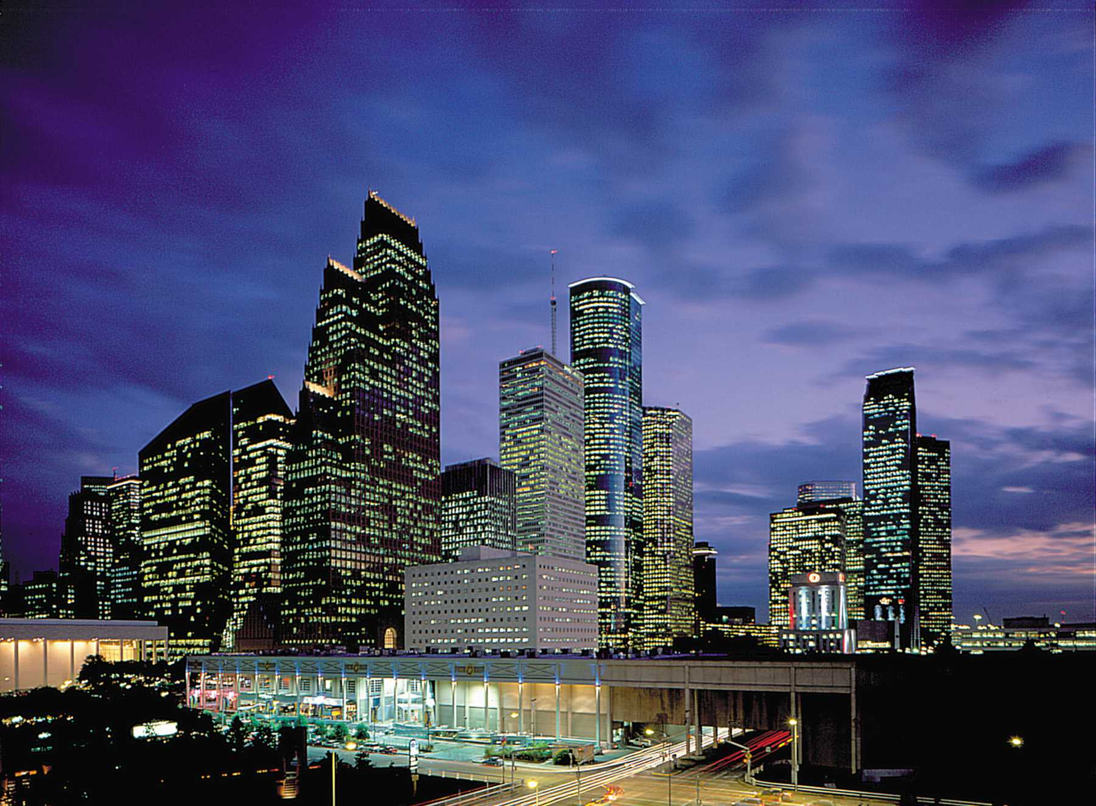
Council Member Larry Green worked diligently to make a
change in the City of Houston and especially in “District K”
CM Green you will be missed!

Slide 3
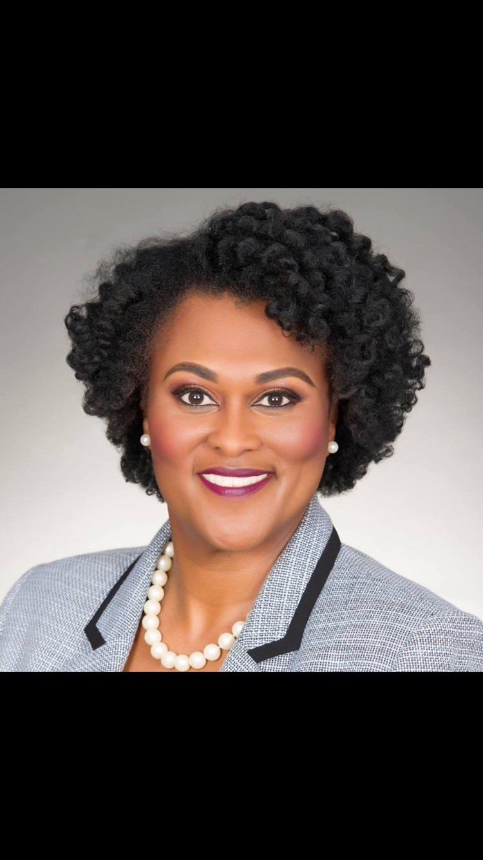
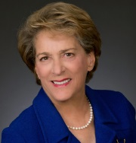
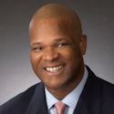
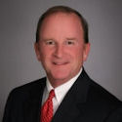
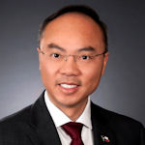
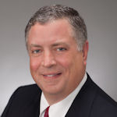
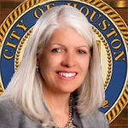
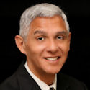
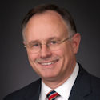
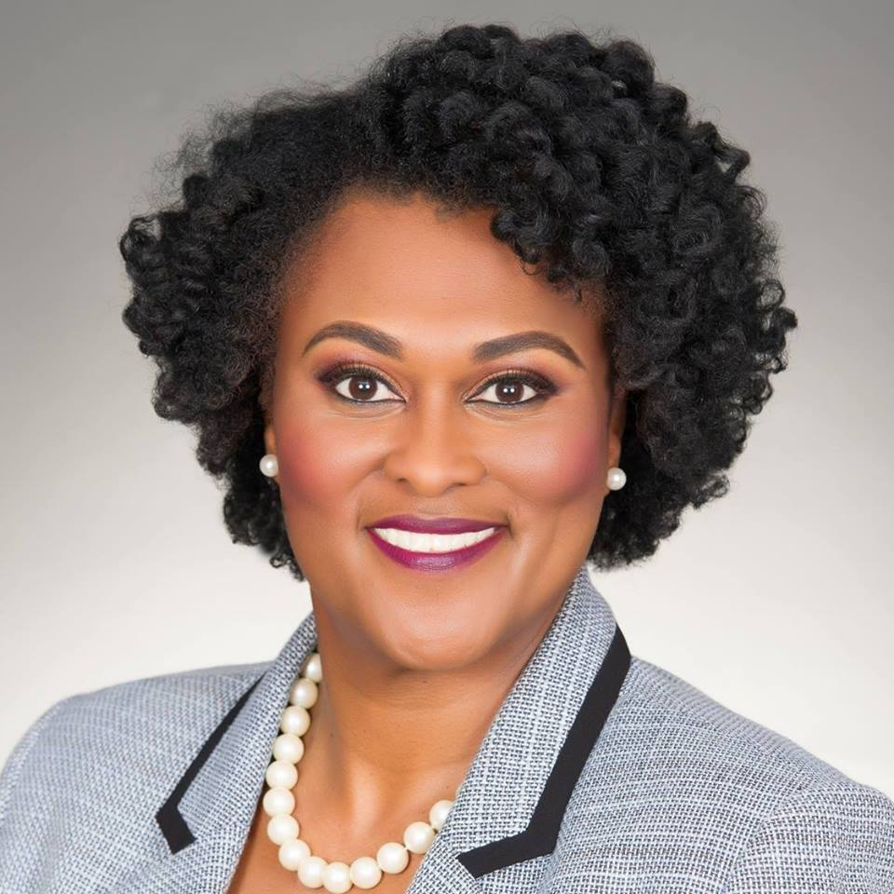
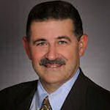
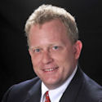
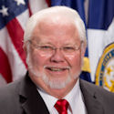
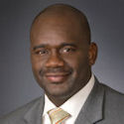
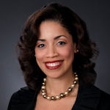
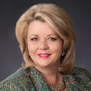

Slide 4
City Council’s Org Chart –
FTE’s for FY18 – 77.5
FTE’s for FY19 – 82.7
City Council
5500
FTEs: 82.7
Exp.: 10,054,519
District A – Stardig
5500010001
FTEs: 5.6
Exp.: 438,962
District B – Davis
5500010002
FTEs: 5.6
Exp.: 438,962
District C – Cohen
5500010003
FTEs: 5.0
Exp.: 438,962
District D – Boykins
5500010004
FTEs: 5.0
Exp.: 438,962
District E - Martin
5500010005
FTEs: 4.8
Exp.: 438,962
.
District F – Le
5500010006
FTEs: 5.0
Exp.: 438,962
District G – Travis
5500010007
FTEs: 4.2
Exp.: 438,962
District H – Cisneros
5500010008
FTEs: 7.0
Exp.: 438,962
District I – Gallegos
5500010009
FTEs: 5.3
Exp.: 438,962
District J – Laster
5500010017
FTEs: 5.0
Exp.: 438,962
District K – CM-Elect Castex-Tatum
5500010018
FTEs: 5.2
Exp.: 438,962
Position 1 – Knox
5500010010
FTEs: 5.7
Exp.: 438,962
Position 2 – Robinson
5500010011
FTEs: 4.6
Exp.: 438,962
Position 3 – Kubosh
5500010012
FTEs: 5.0
Exp.: 438,962
Position 4 – Edwards
5500010013
FTEs: 5.0
Exp.: 483,962
Position 5 – Christie
5500010014
FTEs: 4.7
Exp.: 438,962
City Council General
5500010016
FTEs: 0.0
Exp.: 556,127
Council District Service Fund
5500020001-5500020011
FTEs: 0.0
Exp.: 2,475,000

Slide 5
Budget Comparison (FY18 TO FY19)
Adopted FY18 Budget was $9,978,068
Operating Budget - $7,021,312
$438,832/Office (16)
Proposed FY19 Budget is $10,054,519
Operating Budget - $7,023,392
$438,962/Office (16)
Summary:
Municipal Pension decreased by $5,687 and IT increased by $2,357. An adjustment by IT in the amount of $5,403 was made to the FY18 operating budget. Operating budget was increased by .03%

Slide 6
Budget Comparison (FY18 TO FY19)
Adopted FY18 Health Benefits - $481,756
FY18 Increase - $41,064 (Total $522,820)
Proposed FY19 Health Benefits - $556,134
Summary:
Health Insurance increased by $33,314. This is due to the number of employees hired within the fiscal year.

Slide 7
Budget Comparison (FY18 TO FY19)
FY18 Council District Service Fund (CDSF) Carry Forward
$868,524
FY19 Council District Service Fund (CDSF) Carry Forward
Undetermined (Contingent on Mayor Turner’s approval)

Slide 8
Budget Comparison (FY18 TO FY19)
Adopted FY18 Council District Service Fund - $2,475,000
$225,000/District Office (11)
Proposed FY19 Council District Service Fund - $2,475,000
$225,000/District Office (11)
Summary:
Proposed FY19 Council District Service Fund remained the same amount as FY18.

Slide 9
Increase/Decrease Houston Information Technology Services
EGIS Revolving Fund Services increased by $503
Increase is due to updated allocation basis.
Voice Services increased by $987
Increase is due to updated allocation basis.
Application Services increased by $10,941
Changes are due to various contractual increases including:
Infor, SAP and Microsoft Office 365 software.
Data Services decreased by $6,960
Decrease is due to "one-time" or non-recurring cost in FY2018.

Slide 10
Increase/Decrease Houston Information Technology Services
Voice Labor decreased by $253
Decrease is due to updated allocation basis.
KRONOS Service Chargeback decreased by $2,861
Decrease is due to updated allocation basis.

Slide 11
FY2019 Operating Budget
.76% - Supplies
4.32% - Other Services & Charges
94.92% - Personnel

Slide 12
COUNCIL DISTRICT SERVICE FUND MAJOR PROJECTS
Harvey Cleanup
Sidewalks/Curb repairs
ADA ramps
Asphalt Overlay
Street Lights
Speed Cushions
Hike and Bike Trails
B-Cycle Stations
My Brother’s Keeper
Concrete Panel Replacements
Assisted With Several HPARD projects
HPD Overtime
Speed Trailers
Inter-local Agreement with Harris County Constable Precinct 1 (Purchased Cameras – Illegal Dumping)
Rescue Vehicles for HFD
BARC (Spay and Neutering)/Trailers
Working in Conjunction with DON to cut weeded lots and cleanup excess trash
After School Programs
Electrical Boxes (Murals)
Assisted With Home Repairs for Senior Citizens
Removed Shopping Carts from the streets
Hired Part-time employees to assist with neighborhood parks and Community Centers
Specialized equipment was purchased for HPD and HFD

Slide 13
COUNCIL DISTRICT SERVICE FUND OVERVIEW

Slide 14
Questions

