Slide 1
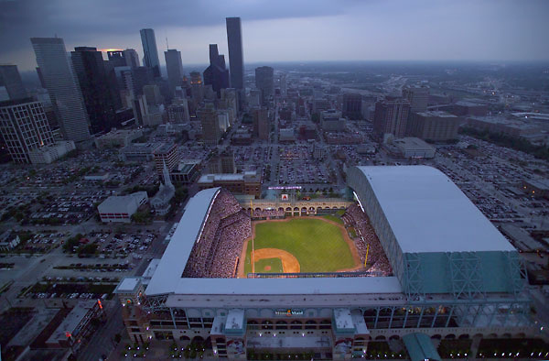
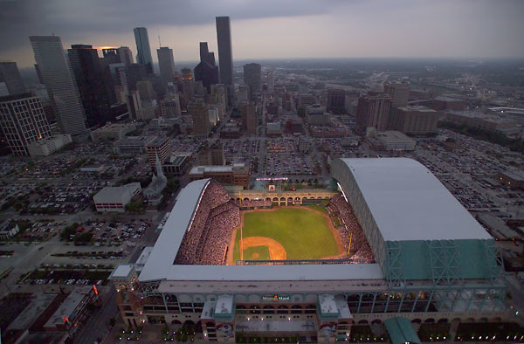
General Services Department
FY2019 Proposed Budget
Budget Presentation
C.J. Messiah, Jr.
Director
May 10, 2018
Cynthia Rushing, CPA,MBA
CFO

Slide 2
Organizational Structure
- Department Wide -
C.J. Messiah, Jr.
Director
FTEs: 304.8
Mayor’s
Director of Communications
Finance
Department
GSD Proposed Budget
$ 72,794,227
Jacquelyn Nisby
Chief of Staff
Council Liaison /PIO
Regina Patrick
Administrative Specialist
Property Management,
Environmental
FTEs: 176.6
Design & Construction,
In-House Renovation,
Real Estate
FTEs: 76.2
Security Management
FTEs: 38.0
Finance &
Administrative Services
FTEs: 14.0
$46,825,962
$14,308,936
$9,596,262
$2,063,067
Emitte Roque
Richard Vella
Vacant
Cynthia Rushing
Total Number of FTEs: 304.8

Slide 3
Total Revenues by Fund
($ in Thousands)
 | Fund | FY2017 Actual | FY2018 Budget | FY2018 Estimate | FY2019 Proposed | Variance FY2019 Proposed/ FY2018 Estimate | % Change
 | General Fund (1000) | $5,975 | $4,513 | $5,906 | $6,178 | $272 | 4.6%
 | Project Cost Recovery Fund (1001) | $3,822 | $4,414 | $4,414 | $4,542 | $128 | 2.9%
 | In-House Renovation Fund (1003) | $4,086 | $4,818 | $4,694 | $5,968 | $1,274 | 27.1%
 | Maintenance, Renewal and Replacement Fund (2105) | $16,266 | $19,226 | $20,723 | $19,226 | ($1,497) | (7.2)%
 | Total | $30,149 | $29,914 | $35,737 | $35,914 | $177 | .50%
Note: Major revenue changes in the General Fund
$1,565 increase due to GSD and HPW security staff consolidation
$823 for revenue collected from the proceeds of the sale of land at 800 Dorsett Street
$561 for revenue collected from the proceeds of the sale of land at 15085 Bellaire
General Services Department
Notes:
Sale of Land
Does not include 800 Dorsett ($865k)
“The Center” (Foundation for the Retarded)
$5 Million was collected in January that retired the Note Payable; therefore, no more interest payments required.
Notes:
Other General Fund revenues include:
Building space fees;
facility rental fees;
Vending machine concessions
Refer to pages 8, 9,and 10 in the Power Point presentation for all other funds increases.

Slide 4
Total Expenditures by Fund
($ in Thousands)
Fund | FY2017 Actual | FY2018 Budget | FY2018 Estimate | FY2019 Proposed | Variance FY2019 Proposed/ FY2018 Estimate | % Change
General Fund (1000) | $39,715 | $42,209 | $42,002 | $43,058 | $1,056 | 2.5%
Project Cost Recovery Fund (1001) | $3,822 | $4,414 | $4,414 | $4,542 | $128 | 2.9%
In-House Renovation Fund (1003) | $4,086 | $4,818 | $4,694 | $5,968 | $1,274 | 27.1%
Maintenance, Renewal and Replacement Fund (2105) | $14,624 | $19,226 | $20,723 | $19,226 | ($1,497) | (7.2)%
Total | $62,246 | $70,667 | $71,833 | $72,794 | $961 | 1.3%
Note: Major changes in the General Fund and Maintenance, Renewal and Replacement
$1,565 increase due to GSD and HPW security staff consolidation
Maintenance, Renewal and Replacement (MRR) Fund variance is due to $1,497 FY2017 Fund Balance booked in FY2018 to support on going MRR Projects.
General Services Department
Notes:
Mayor’s Kush Program
Mayor’s office approved the security services at the Central Library and Herman Square through June 30, 2017. - $180,000.
FY2018 General Fund budget submission of $42,209 does not include funding of $253,514 for the continuation of Mayor Turner’s “Kush/Transient” program.

Slide 5
General Fund (1000)
FY2019 Proposed Budget
FY2019 Proposed Budget of $43,058
Personnel vs Non Personnel Costs
Notes:
Mayor’s Kush Program
Mayor’s office approved the security services at the Central Library and Herman Square through June 30, 2017. - $180,000.
FY2018 General Fund budget submission of $42,209 does not include funding of $253,514 for the continuation of Mayor Turner’s “Kush/Transient” program.

Slide 6
Project Cost Recovery Fund (1001)
FY2019 Proposed Budget
The IT Application Services charge is a Restricted account projected by Finance.
FY2019 Proposed Budget of $4,542
All expenses for this fund are recovered from Capital Improvement Plan(CIP) bond funds for project management services performed by the department’s Design and Construction Division.
Personnel vs Non Personnel Costs
Notes:
Mayor’s Kush Program
Mayor’s office approved the security services at the Central Library and Herman Square through June 30, 2017. - $180,000.
FY2018 General Fund budget submission of $42,209 does not include funding of $253,514 for the continuation of Mayor Turner’s “Kush/Transient” program.

Slide 7
In-House Renovation Fund (1003)
FY2019 Proposed Budget
FY2019 Proposed Budget of $5,968
Personnel vs Non Personnel Costs
Notes:
Mayor’s Kush Program
Mayor’s office approved the security services at the Central Library and Herman Square through June 30, 2017. - $180,000.
FY2018 General Fund budget submission of $42,209 does not include funding of $253,514 for the continuation of Mayor Turner’s “Kush/Transient” program.

Slide 8
MRR Fund (2105)
Maintenance, Renewal and Replacement Fund
FY2019 Proposed Budget
FY2019 Proposed Budget of $19,226
MRR - Reactive-Emergency | $7,922
MRR - Security Maintenance | $1,300
MRR - Preventive Maintenance | $10,003
Personnel vs Non Personnel Costs
Notes:
Mayor’s Kush Program
Mayor’s office approved the security services at the Central Library and Herman Square through June 30, 2017. - $180,000.
FY2018 General Fund budget submission of $42,209 does not include funding of $253,514 for the continuation of Mayor Turner’s “Kush/Transient” program.

Slide 9
Department Budget Reductions
($ in Thousands)
Fund | FY2017 | FY2018 | FY2019 | 3 - Year Total
General Fund (1000) | $419 | $392 | $535 | $1,346
Services | $127 | $286 | $506 | $919
Personnel - Civilian Cost | $292 | $106 | $29 | $427
Full-Time Equivalents - Civilian (FTE's) | 2.60 | 1.50 | 0.50 | 4.60
FY2017 – Initiatives included the elimination of 2.6 FTEs, reduce Supplies and Services.
FY2018 - Initiatives included the elimination of 1.5 FTEs, reduction in Security Services, frequency in Land and Ground Services and Consultant Services.
FY2019 - Initiatives included the elimination of .5 FTE, reductions in travel for training, funding for Project management software implementation maintenance for FY2019, and the termination of the ESCO contract with Schneider, which cancels the annual Performance Assurance Support Services (PASS) payment.
General Services Department
Notes:
Mayor’s Kush Program
Mayor’s office approved the security services at the Central Library and Herman Square through June 30, 2017. - $180,000.
FY2018 General Fund budget submission of $42,209 does not include funding of $253,514 for the continuation of Mayor Turner’s “Kush/Transient” program.

Slide 10
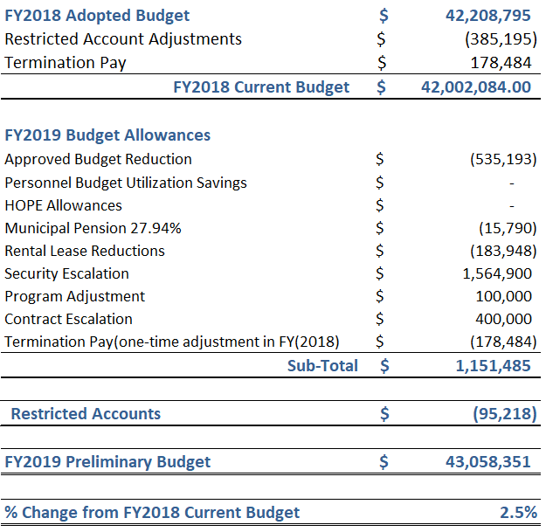
Budget Expenditures Net Change
General Fund - 1000
Notes:
Eliminate the Communication Specialist position.
Eliminate unarmed security guard services at Magnolia MSC @7037 Capitol and BARC Pet Adoption.
Eliminate the part-time employee assigned to graffiti abatement.
Reduce amount budgeted for management consulting services.
Reduce mowing frequencies from 32 to 23 annually at 52 facilities and reduce mowing 28 vacant lots from 9 times per year to 6 times per year with contractor, Bio Landscape.

Slide 11
FY2018 Expenditure Highlights
Variance
$1,056,367
FY2019 Proposed Budget $43,058,351
FY2018 Estimate $42,002,084
$1,565 increase due to HPW and GSD Security Consolidation
($535) decrease as approved in GSD’s budget reduction submission.
General Fund - 1000
Notes:
Total FTE’s (Full-time equivalent employees) = 134.1 with 8.9 Vacant or New positions

Slide 12
FY2018 Expenditure Highlights
Variance
($1,496,825)
FY2019 Budget $19,225,803
FY2018 Estimate
$20,722,628
Remained Flat
The Maintenance, Renewal and Replacement Fund
provides funding to maintain and replace systems in buildings as they approach the end of their useful life cycle. It allows the department to address development and maintenance of the physical infrastructure of these facilities.
MRR Fund -2105
Maintenance, Renewal and Replacement Fund
Notes:
Total FTE’s (Full-time equivalent employees) = 74.9 with 9.6 Vacant positions

Slide 13
FY2018 Expenditure Highlights
Project Cost Recovery Fund - 1001
Variance
$128,061
FY2018 Estimate
$4,414,070
FY2019 Budget $4,542,131
The increase in this fund is due to personnel, pension obligation and restricted accounts.
In-House Renovation Fund - 1003
Variance
$1,149,995
FY2019 Budget $5,967,942
FY2018
Estimate
$4,817,947
The increase in this fund is due to the planned renovation of two Fire Stations 31 and 43 in the CIP Plan that was delayed due to Hurricane Harvey along with the planned renovations of fire stations 17 and 19 in FY2019.
Services Chargeback Funds
Notes:
Fund 1001 Total FTE’s (Full-time equivalent employees) = 36.2 with 5.0 Vacant positions
Fund 1003 Total FTE’s (Full-time equivalent employees) = 29.0 with 2.0 Vacant positions

Slide 14
Functions - All Funds
GSD
Director
FTEs: 304.8
$72,794,227
Property Management,
Environmental
FTEs: 176.6
Design & Construction,
In-House Renovation,
Real Estate
FTEs: 76.2
Security Management
FTEs: 38.0
Finance &
Administrative Services
FTEs: 14.0
$46,825,962
$14,308,936
$9,596,262
$2,063,067
Janitorial / Operations
Preventive, Corrective and Predictive Maintenance
Routine and Emergency Repairs
HVAC, Mechanical, Electrical and Plumbing Repairs
Environmental Services
Asbestos/Lead/Mold/
Abatement/Demolition
Soil Remediation
Underground Storage Tank Removal/Installation
CIP Planning
Capital Design & Construction Projects
Construction Inspections
Civic Art Administration
Job Order Contracting
Task Order Contracting
In-House Planning / Design
In-House Renovation
Real Estate
Acquisition
Disposition
Leasing
Access Control
Badging
CCTV
Investigations
Security Guard Services
Security Assessments
Preventive Maintenance
Cyber-Lock Electronic Key Program
HPW Security Team Consolidation
Financial Services
Budgeting
Reporting
Payables
KPI Reporting
Administrative Services
Contract Compliance
Training & Development
Director’s Office
General Services Department

Slide 15
General Services Department
Questions
FY2019 Proposed Budget

Slide 16
FY2018 Demographic Profile
Total number of employees: 270

Slide 17
Snapshot of Building Portfolio
Property Management
Average Age of Buildings
City Building Characteristics | City of Houston | Nationwide *
Average Age | 39 | 43
Median Date Built | 1978 | N/A
Built before 1950 | 4% | 28%
Built between 1950 and 1969 | 30% | 45%
Built between 1970 and 1984 | 33% | 17%
Built after 1985 | 33% | 10%
*2012 Parsons Facilities Condition Assessment Report
General Services Department

Slide 18
Performance Measures s
Fund | Customer Measures | FY2017 Actual | FY2018 Budget | FY2018 Estimate | FY2019 Budget
1000 | Building Operations Work Orders Completed | 3,060 | 3,300 | 3,061 | 3,060
2105 | Maintenance Work Orders Completed | 17,980 | 18,500 | 15,433 | 16,555
1000 | Card Access Changes Processed | 24,743 | 18,000 | 15,960 | 16,555
1000 | City Identification Badges Processed | 9,144 | 6,400 | 10,139 | 8,000
1000 | Special Events Requiring Security Staffing | 56 | 55 | 68 | 75
 | Business Process Measures
1000 | Environmental Projects Completed | 190 | 200 | 241 | 200
1001 | Job Order Contract/Task Order Contract Projects | 283 | 280 | 285 | 300
1003 | Build-Out Projects and Facility Improvements/Repairs | 77 | 65 | 72 | 60
1003 | Facility Condition Assessment (FCA) Repairs | 4 | 10 | 0 | 0
2105 | Facility Conversion Cyber Locks Installed | 5 | 12 | 4 | 6
2105 | Facility Security Equipment Assessments | 36 | 24 | 112 | 75

