Slide 1
[Department of Neighborhoods] FY2019 Proposed Budget Presentation
May 17, 2018
Notes:
Next slide, please.

Slide 2
Org Chart
DEPARTMENT OF NEIGHBORHOODS
110.1 FTEs $11,255,702
Director’s Office
9.9 FTEs $1,289,009
Provides executive support and leadership to all divisions of the department. Provides all divisions with services in budget, purchasing, receiving grants, receiving funds and account payables.
Inspections & Public Service
72.2 FTEs $7,268,521
Enforces City codes pertaining to dangerous buildings, weeded lots, junked motors vehicles and unlawfully placed signs upon the City’s right-of-way. Responds to emergencies caused by natural disaster. Provides timely and effective customer service to the public.
Citizens’ Assistance Office
11.0 FTEs $988,178
Through community liaisons, ensures responses and resolutions to Mayoral priorities, community complaints, provides education about city services to the community, and supplements other city departments with project staffing. Primary liaison to Super Neighborhood Association & CIP meetings.
Anti-Gang Office
15.0 FTEs $1,490,045
The division develops and implements programs that serve youth, families, and communities through direct services, volunteer initiatives, collaboration, outreach, education, and policy development.
Office of New Americans and Immigrant Communities
2.0 FTEs $219,949
In partnership with community-based organizations and volunteers reaches out to Houston’s diverse community of immigrants, ex-patriates and refugees to facilitate successful civic, economic and cultural integration as members of our community. The division oversees the Welcome Houston Committee, the iSpeak Houston Language Access Program, Citizenship Month, World Refugee Day, and Citizenship Forums.
Notes:
Next slide, please.

Slide 3
Revenues By Funds ($ in thousands)
Fund | FY17 Actual | FY18 Budget | FY18 Estimates | FY19 Proposed | Variance FY19 Prop/FY18 Budget | % Change
General Fund | $3,087 | $4,233 | $3,739 | $2,414 | $ (1,325) | (35.4%)
Total | $3,087 | $4,233 | $3,739 | $2,414 | $ (1,325) | (35.4%)
Notes:
Next slide, please.

Slide 4
FY2019 - Revenues Highlights
The FY2019 Budget reflects a reduction in revenue due to one-time revenue transfer of $2.1 million from HPW Building Inspector Special Fund for FY2018.
Notes:
Next slide, please.

Slide 5
Expenditures By Funds ($ in thousands)
Fund | FY17 Actual | FY18 Budget | FY18 Estimates | FY19 Proposed | Variance FY19 Prop/FY18 Budget | % Change
General Fund | $11,143 | $11,358 | $11,358 | $11,256 | $ (102) | (0.9%)
Total | $11,143 | $11,358 | $11,358 | $11,256 | $ (102) | (0.9%)
Notes:
Next slide, please.

Slide 6
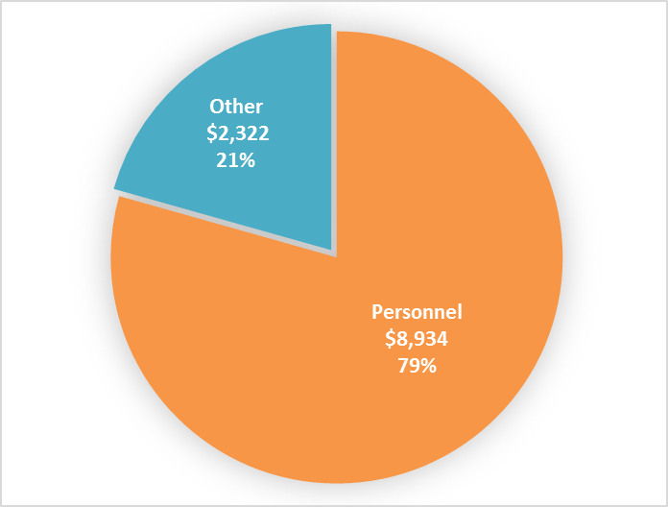
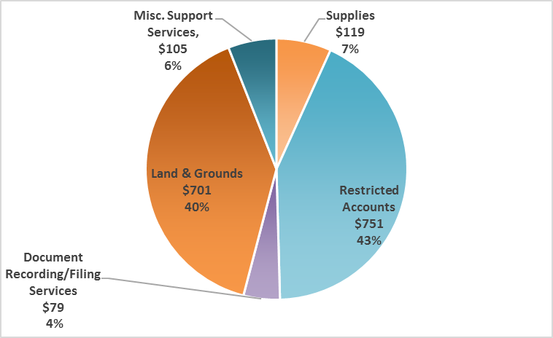
FY19 Personnel vs Non Personnel (one fund per slide)
($in thousands)
Notes:
Next slide, please.

Slide 7
Department Budget Reductions (in thousands)
Fund | FY17 | FY18 | FY19 | 3-Year Total
General Fund | $196 | $26 | $523 | $745
Total | $196 | $26 | $523 | $745
Notes:
Next slide, please.

Slide 8
Department Budget Reductions Cont. (in thousands)
FY 2017 Budget Reductions:
Elimination of 2 positions within Volunteer Initiatives Program and Inspection and Public Services. (reduction includes all operating cost associated with Volunteer Initiatives Program
Volunteer services no longer provided as an independent division.
Decrease in funds for Supplies and Services
FY 2018 Budget Reductions
Reduction in Temporary staffing.
One time Special Transfer of all inspector positions from General Fund to HPW Building Inspector Special Fund ($2.1M).
FY 2019 Budget Reductions
Elimination of 1 Community Outreach Coordinator position within the Director’s Office.
Outreach and awareness efforts will be coordinated amongst 3 remaining staff members.
Reduction of funds available to support overages from limited funding available through Community Block Grant Funds (CDBG) funds.
Notes:
Next slide, please.

Slide 9
FY2019 Budget Expenditures Net Change (in thousands)
Notes:
Next slide, please.

Slide 10
FY2019 - Expenditures Highlights
The FY2019 Budget includes a reduction of $523,023 for department savings initiative.
Notes:
Next slide, please.

Slide 11
Functional Org Chart (in thousands)
DIVISION | FTE COUNT | BUDGET COSTS $
Director’s Office 110001 | 9.9 | 1,290
Inspections & Public Services 110002 | 72.2 | 7,267
Citizens Assistance Office 110003 | 11.0 | 988
Anti-Gang 110004 | 15.0 | 1,490
Volunteer Initiatives 110005 | 0 | 0
Office of New Americans and 110006 Immigrant Communities | 2.0 | 220
People with Disabilities 110007 | 0 | 0
Education Affairs 110008 | 0 | 0
Sign Enforcement 110009 | 0 | 0
Notes:
Next slide, please.

Slide 12
Questions

Slide 13
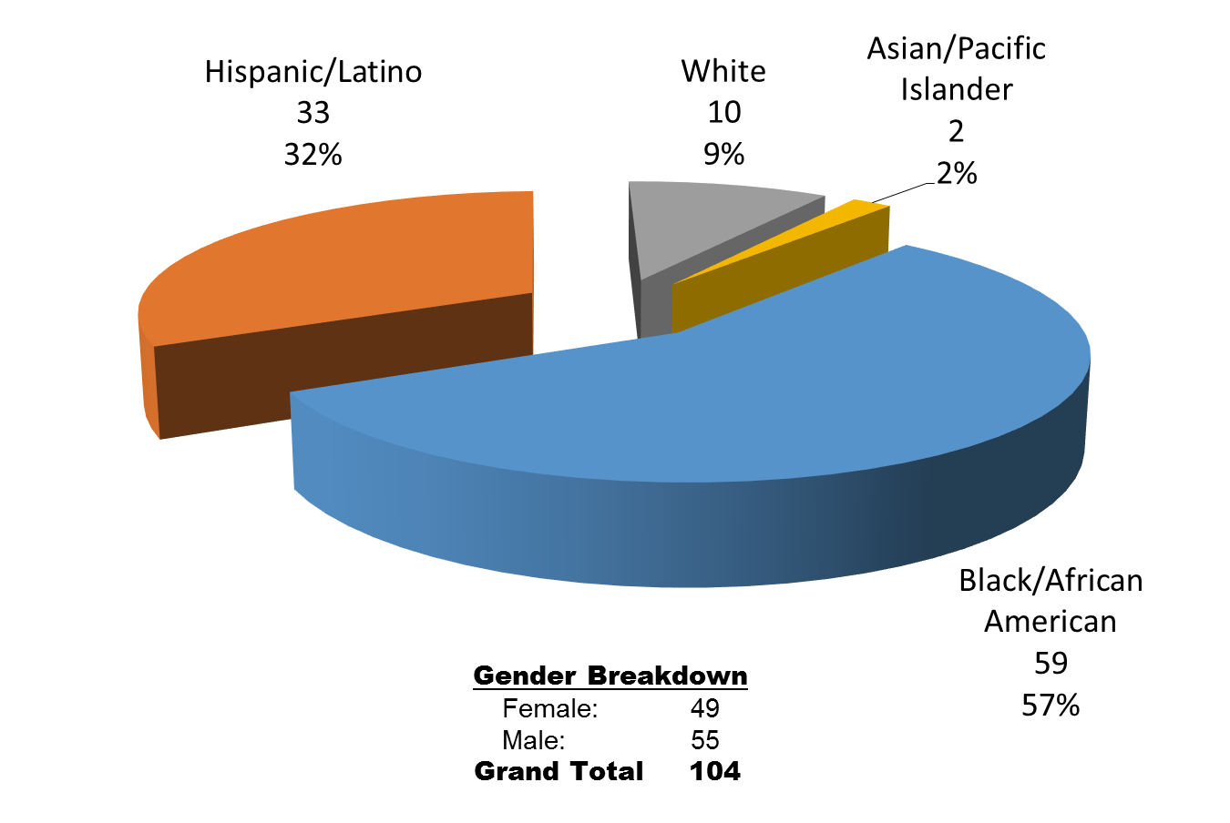
Appendix DEPARTMENT DEMOGRAPHICS GENERAL FUND

Slide 14
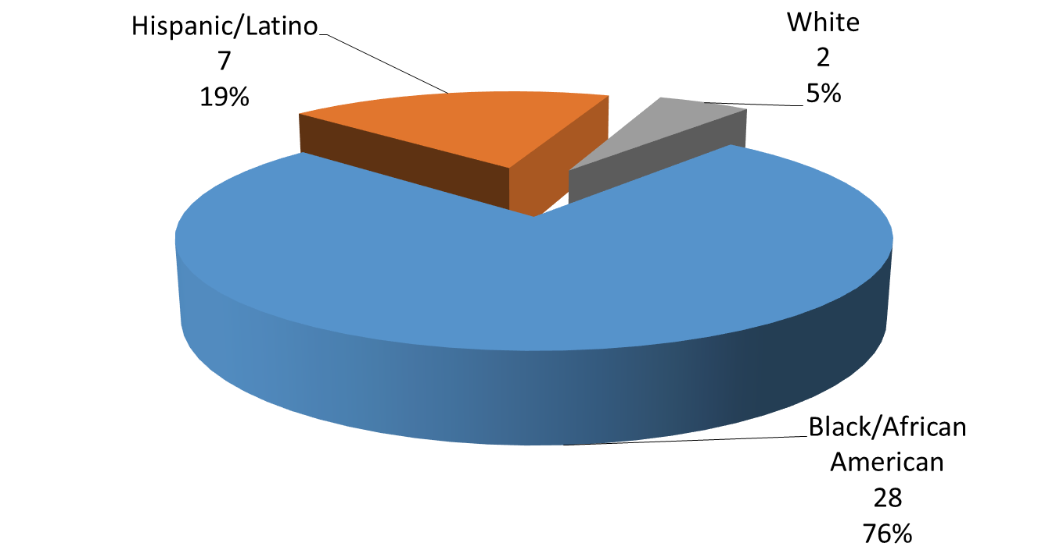
Appendix DEPARTMENT DEMOGRAPHICS CDBG FUND

Slide 15
FY 2019 Performance Measures
Customer Measures | Priorities | FY17 Actual | FY18 Budget | FY18 Estimates | FY19 Proposed
Percent of anti-Gang Program Youth Who Completed Program Services | Public Safety, Complete Communities | 84% | 89% | 90% | 90%
Percent of Anti-Gang Youth Who Reoffend | Public Safety, Complete Communities | 4% | 10% | 10% | 10%
Youth Served Through Anti-Gang Programs | Public Safety, Complete Communities | 6,242 | 6,500 | 6,821 | 6,500
Business Process Measures | Priorities | FY17 Actual | FY18 Budget | FY18 Estimates | FY19 Proposed
Average Daily Inspections | Public Safety, Complete Communities | 286 | 320 | 300 | 320
Average Days from Inspection to Initial inspection | Public Safety, Complete Communities | 13 | 10 | 25 | 10
Dangerous Buildings Demolished | Public Safety, Complete Communities | 542 | 425 | 425 | 425
Junked Motor Vehicles Resolved | Public Safety, Complete Communities | 2,991 | 3,000 | 3,000 | 3,000
Weeded Lots Cut | Public Safety, Complete Communities | 11,800 | 10,000 | 9,299 | 10,000

