Slide 1
City Council FY2020 Proposed Budget Presentation
May 8, 2019

Slide 2
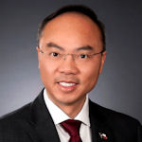
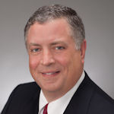
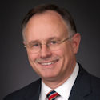
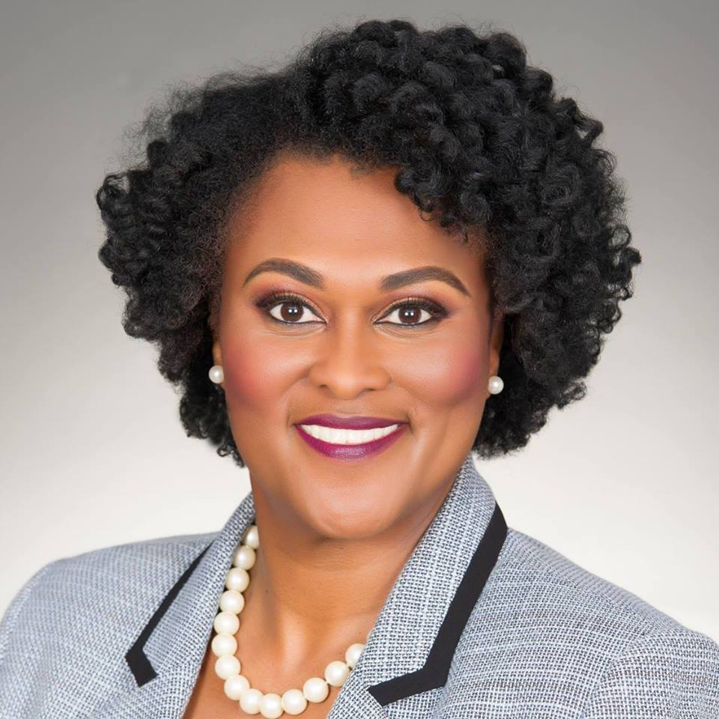
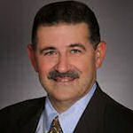
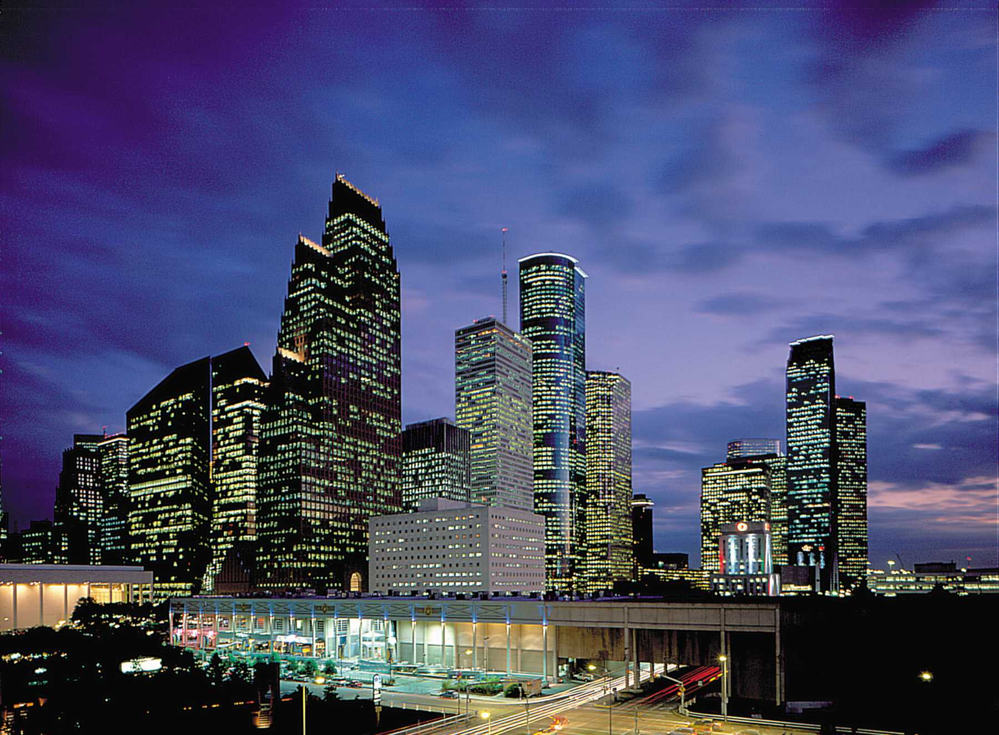
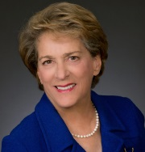
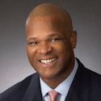
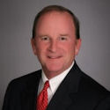
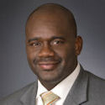
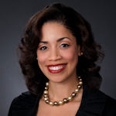
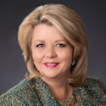

Slide 3
City Council’s Organization Chart
FTE’s for FY19 – 71.6
FTE’s for FY20 – 83.3
City Council
5500
FTEs: 83.3
Exp.: 10,694,237
District A – Stardig
5500010001
FTEs: 5.0
Exp.: 459,967
District B – Davis
5500010002
FTEs: 6.4
Exp.: 459,967
District C – Cohen
5500010003
FTEs: 5.0
Exp.: 459,967
District D – Boykins
5500010004
FTEs: 4.8
Exp.: 459,967
District E - Martin
5500010005
FTEs: 5.0
Exp.: 459,967
.
District F – Le
5500010006
FTEs: 5.0
Exp.: 459,967
District G – Travis
5500010007
FTEs: 5.0
Exp.: 459,967
District H – Cisneros
5500010008
FTEs: 6.6
Exp.: 459,967
District I – Gallegos
5500010009
FTEs: 5.0
Exp.: 459,967
District J – Laster
5500010017
FTEs: 5.0
Exp.: 459,967
District K – Castex-Tatum
5500010018
FTEs: 5.0
Exp.: 459,967
Position 1 – Knox
5500010010
FTEs: 5.0
Exp.: 459,967
Position 2 – Robinson
5500010011
FTEs: 4.4
Exp.: 459,967
Position 3 – Kubosh
5500010012
FTEs: 5.0
Exp.: 459,967
Position 4 – Edwards
5500010013
FTEs: 5.3
Exp.: 459,967
Position 5 – Christie
5500010014
FTEs: 5.8
Exp.: 459,967
City Council General
5500010016
FTEs: 0.0
Exp.: 584,759
Council District Service Fund
5500020001-5500020011
FTEs: 0.0
Exp.: 2,750,000

Slide 4
Appendix
Department Demographic Breakdown (Gender & Ethnicity)
Gender
Females – 41 (55.41%)
Males – 33 (44.59%)
White – 33 (44.59%)
Black/African American – 22 (29.73%)
Hispanic/Latino – 11 (14.86%)
Asian/Pacific Island – 8 (10.81%)
Ethnicity

Slide 5
Budget Comparison (FY19 TO FY20)
Adopted FY19 Budget was $10,329,519
Operating Budget - $7,023,376
$438,961/Office (16)
Proposed FY20 Budget is $10,694,237
Operating Budget - $7,359,479
$459,967/Office (16)
Adjusted FY19 Budget is $11,707,695
Operating Budget - $7,179,039
$448,690/Office (16)
Summary:
Hope Allowance (Incl. FICA & Pension) increased by $95,368. Municipal Pension decreased by $33,955. HITS increased by $119,027. Operating budget increased by 2.52% from the adjusted budget.

Slide 6
Budget Comparison (FY19 TO FY20)
Adopted FY19 Health Benefits - $556,143
FY19 Increase - $13,718 (Total $569,861)
Proposed FY20 Health Benefits - $584,759
Summary:
Health Insurance increased by $14,898. This is due to a rate increase and the number of employees hired within the fiscal year.

Slide 7
Budget Comparison (FY19 TO FY20)
FY19 Council District Service Fund (CDSF) Carry Forward
$1,208,795
FY20 Council District Service Fund (CDSF) Carry Forward
Undetermined (Contingent on Mayor Turner’s approval)

Slide 8
Budget Comparison (FY19 TO FY20)
Adopted FY19 Council District Service Fund - $2,750,000
$250,000/District Office (11)
Proposed FY20 Council District Service Fund - $2,750,000
$250,000/District Office (11)
Summary:
Proposed FY20 Council District Service Fund remained the same amount as FY19.

Slide 9
Increase/Decrease Houston Information Technology Services (HITS)
Application Services increased by $48,221
Increase is due to HITS General Fund (GF) consolidating into
HITS Revolving Fund (RF) in FY2020. HITS (RF) includes
cost from the Director’s Office, Administration, Enterprise
Application Support and Cyber Security. Also, an increase in
the cost for Microsoft Office 365 licenses and support.
Data Services increased by $63,387
Increase is due to the cost of infrastructure/Server which
was a result of consolidating GF and RF. This cost includes
infrastructure, network and server personnel support.
Voice Services increased by $7,850
Increase is due to the cost of Voice Services personnel support
which was a result of consolidating GF and RF. Also, cost for
the Telephone Expense Management System increased
significantly in FY2020.

Slide 10
Increase/Decrease Houston Information Technology Services (HITS)
EGIS Revolving Fund Services increased by $486
Increase is due to updated allocation basis and .5%
increase in the total citywide cost.
KRONOS Service Chargeback decreased by $917
Decrease is due to updated allocation basis and a 7.3% decrease in the total citywide software cost..

Slide 11
FY2020 Operating Budget
.94% - Supplies
5.68% - Other Services & Charges
(HITS Charges – 70.5%)
93.38% - Personnel

Slide 12
BUDGET HISTORY
$11,958,208
$19,378,939
$11,956,424
$10,893,058
$11,707,695
$10,694,237
$10,592,134
$17,464,641
$10,728,090
$9,360,787
*
$1,366,074
$1,864,297
$1,228,334
$1,532,271
FY15 – Included $5,000,000.00 in CDSF (Operating and Metro);
Municipal pension - $88,392; CMs pay increase - $72,302
FY16 – Included $11,000,000.00 in CDSF (Operating and Metro);
Health benefits removed from CMs Operating budget
FY17 – Metro funding was removed from the budget;
CDSF Operating budget $2,750,000; Municipal pension increased by $142,389;
IT allowances decreased by $29,305; Health benefits increased by $18,840
FY18 – CDSF was reduced from $2,750,000.00 to $2,475,000.00
Municipal pension decreased by $122,447; IT allowances decreased by $20,130
FY19 – CDSF was increased back to $2,750,000.00; Health benefits increased by $33,314
*~75% of the surplus funds are from CDSF. These are projects that were unable to be completed within the fiscal year.

Slide 13
FY19 COUNCIL DISTRICT SERVICE FUND MAJOR PROJECTS
Sidewalks/Curb repairs/Asphalt Overlays/Speed Cushions/ADA Ramps/Concrete Panel Replacements
Street Lights
HPARD projects (Amenities, CASE, Equipment, Landscaping, Play Grounds, Portacans, SPARK)
HPD (Overtime; specialized equipment and sponsored mounted patrol horses)
Scrap Tire Recycling
Inter-local Agreement with Harris County Constable Precinct 1 (Purchased Cameras – Illegal Dumping)
Shopping Carts retrieval from the streets
Build-out of makerspaces facilities and curriculum
Neighborhood matching grants (DON)
HFD equipment (Chainsaws, Extractors, Gear cleaning, Poles)
Library books and equipment
BARC (Spay and Neutering)/Microchipping
Electrical Boxes (Murals)
Home Repairs for Senior Citizens
Fund Part-time employees to work at the neighborhood parks and community centers.
Neighborhood cleanups
Sub-Regional Mobility Study
Bay Area Houston Economic Partnership
Second Chance Job Fair
B-Cycle Stations

Slide 14
FY19 COUNCIL DISTRICT SERVICE FUND OVERVIEW

Slide 15
Questions

