Slide 1
Office of Business Opportunity
FY2020 Proposed Budget Presentation
May 16, 2019

Slide 2
Organizational Chart

Slide 3
Department Programming
Major Services
The Office of Business Opportunity is comprised of two primary divisions, Certification & Designation and Contract Compliance support the mission.
  OBO’s Certification and Designation Division administers the City’s Minority/Women/Small/Disadvantaged Business Enterprise (MWSDBE) and Persons with Disabilities Enterprise (PDBE) Programs, including the production and maintenance of the online MWSDBE/PDBE. This Division also administers the Hire Houston First Program including the production and maintenance of the online Directory of designated Hire Houston First firms.
  OBO’s Contract Compliance Division monitors contractors’ MWSDBE utilization on Purchasing, Professional Services, and Construction contracts, processing MWSDBE deviation requests, mediating disputes between the Prime and certified subcontractors, and evaluating and rating prime contractors’ Good Faith Efforts in achieving MWSDBE goals. Monitoring Labor Standards and the Employee Classification Ordinance specific to local funded and federally funded construction projects. In addition to the Labor Standards for construction contracts, Contract Compliance also monitors and enforces the City of Houston’s Prompt Pay Executive Order which requires that subcontractors working on City of Houston projects are paid their pro-rata share each month in a timely manner. The Division also ensures that prime and subcontractors pay every employee working on the project the required Prevailing Wage rate for the work performed plus overtime at the appropriate rate where applicable.

Slide 4
Department Programming (Cont’d)
Any statutory requirements of service delivery
  Penalties for failure to comply
    Failure to administer the programs could have advise impact to federal grants received by City Departments such as the Houston Police Department, Housing and Community Development Department, General Services Department, Houston Public Works Department, and Health and Human Services Department, etc.
  State, Federal or 3rd party grant/endowment support
    OBO is responsible for administering compliance of Title VI of the Civil Rights Act of 1964, 42 U.S.C. 2000d et seq. ("Title VI"). Title VI prohibits discrimination on the basis of race, color, or national origin in any program or activity that receives Federal funds or other Federal financial assistance.
    The Certification and Designation Division administers certification pursuant to: Chapter 15, Articles V & VI of the City Code of Ordinances, which consists of Ordinances 84-1309, 95-336, 98-1213 and 06-657; Executive Order 1-2; 49 Code of Federal Regulations, Parts 23 and 26; and 13 Code of Federal Regulations, Part 121. In addition, the division also administers designations for the City’s Hire Houston First local preference procurement program pursuant to: Chapter 15, Article XI HIRE HOUSTON FIRST.
    The Contract Compliance Division performs it core functions pursuant to Chapter 15, Articles V & VI of the City Code of Ordinances and Ordinances 78-1538, 84-1309, 85-2070, 85-2071, 06-91 and 08-665. The Division enforces Prevailing Wages compliance pursuant to Federal requirements and Texas Government Code - Chapter 2258.

Slide 5
Department Programming (Cont’d)
Any statutory requirements of service delivery (Cont’d)
  Mandatory matching to maintain support
Financial or societal impact of City service delivery
  N/A
Anticipated growth or reduction in populations served:
  N/A

Slide 6
Revenues By Funds
($ in thousands)
$ | FY18 Actual | FY19 Budget | FY19 Estimates | FY20 Proposed | Variance FY20 Prop/FY19 Estimates | % Change
General Fund | $183 | 591 | 481 | 634 | $153 | 31.81%
Special Revenue | $788 | 1,191 | 507 | 495 | -$12 | -2.37%
Enterprise | N/A | N/A | N/A | N/A
Total | $971 | $1,782 | $1,129 | $1,129 | $141 | 29.44%

Slide 7
FY2020 - Revenues Highlights
The FY 2020 Proposed Budget for Fund 1000 reflects a 31.81% increase from the FY 2019 Budget Estimates - an approximate increase of $153,000. The increase can be attributed to:
  The Miscellaneous Revenue for Prevailing Wages increasing by $15,000 due to the anticipated re-training of responsible staff in the Contract Compliance Division.
  The revenue that supports the OBO’s Houston Public Works Labor Standard Compliance Group increased due to health benefits, pension contribution, and municipal employees contractual pay increases.
The FY 2020 Budget for Fund 2424 reflects a 2.37% decrease of $12,000 from the FY 2019 Budget Estimates. The decrease can be attributed to:
  The revenue that supports Fund 2424, the Contractor Responsibility Fund, decreased due to the fact that the Houston Airport System only procured $13M in construction contracts in FY 18. Several design build contracts are still in design phase and will not start construction phase until later in FY 2020. The revenue from the Houston Public Works Department decreased due to an increase in the number of vendors providing health insurance to their employees and a reduction of work or no work being performed by those vendors.

Slide 8
Expenditures By Funds
($ in thousands)
Fund | FY18 Actual | FY19 Budget | FY19 Estimates | FY20 Proposed | Variance FY20 Prop/FY19 Budget | % Change
General Fund | $3,075 | $3,681 | $3,135 | $3,562 | 427 | 13.62%
Special Revenue | $843 | $1,689 | $1,689 | $1,892 | 203 | 12.02%
Enterprise | N/A | N/A | N/A | N/A
Total | $3,918 | $5,370 | $4,824 | $5,454 | $630.00 | 25.64%

Slide 9
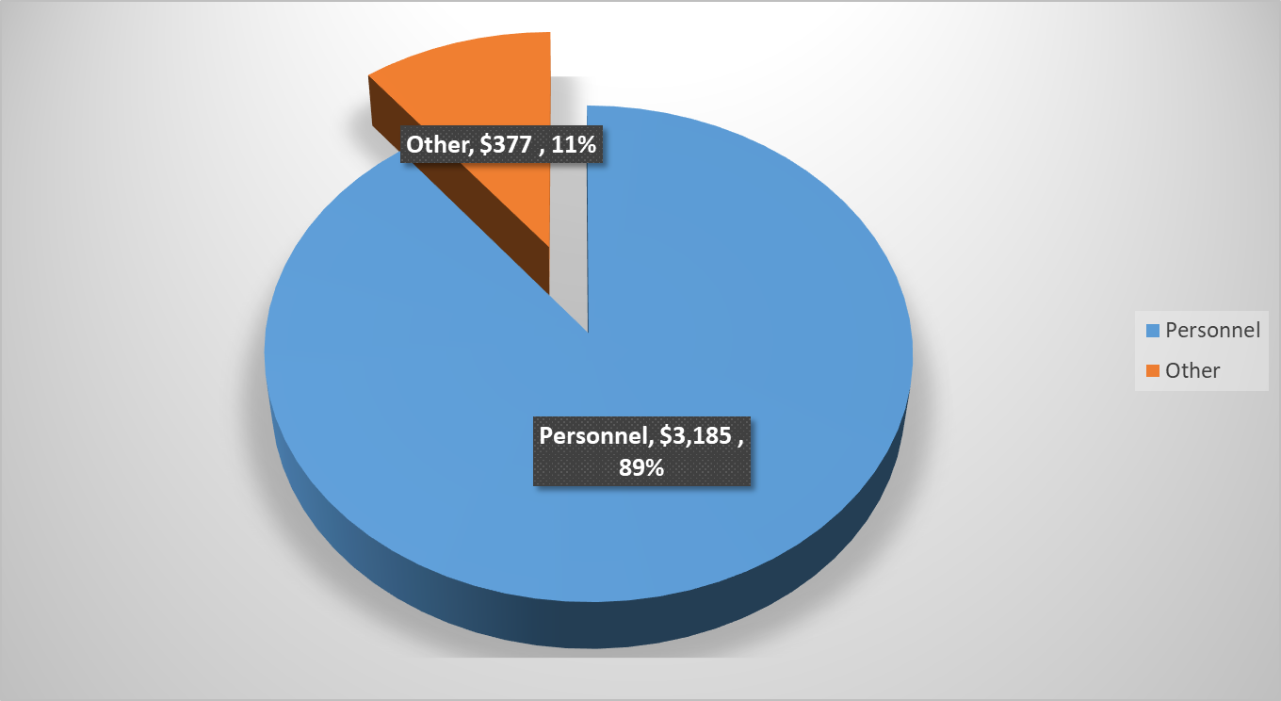
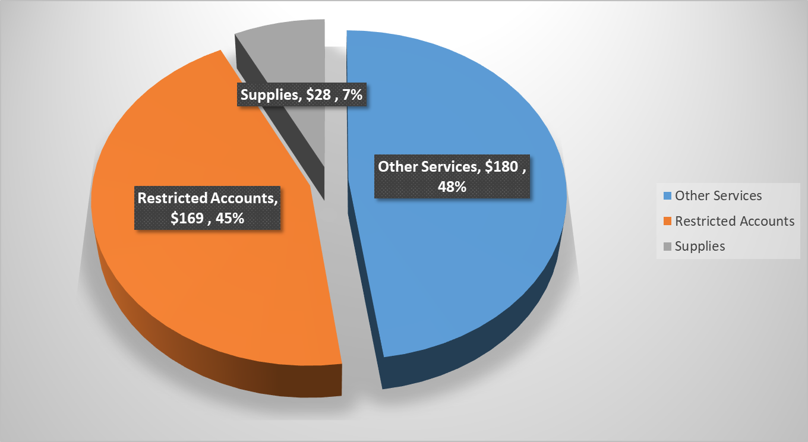
FY20 Personnel vs Non Personnel (Fund 1000)
($ in thousands)
FY 20 Proposed Budget $3,562K
Personnel vs Non-Personnel
Personnel Primary Service Functions

Slide 10
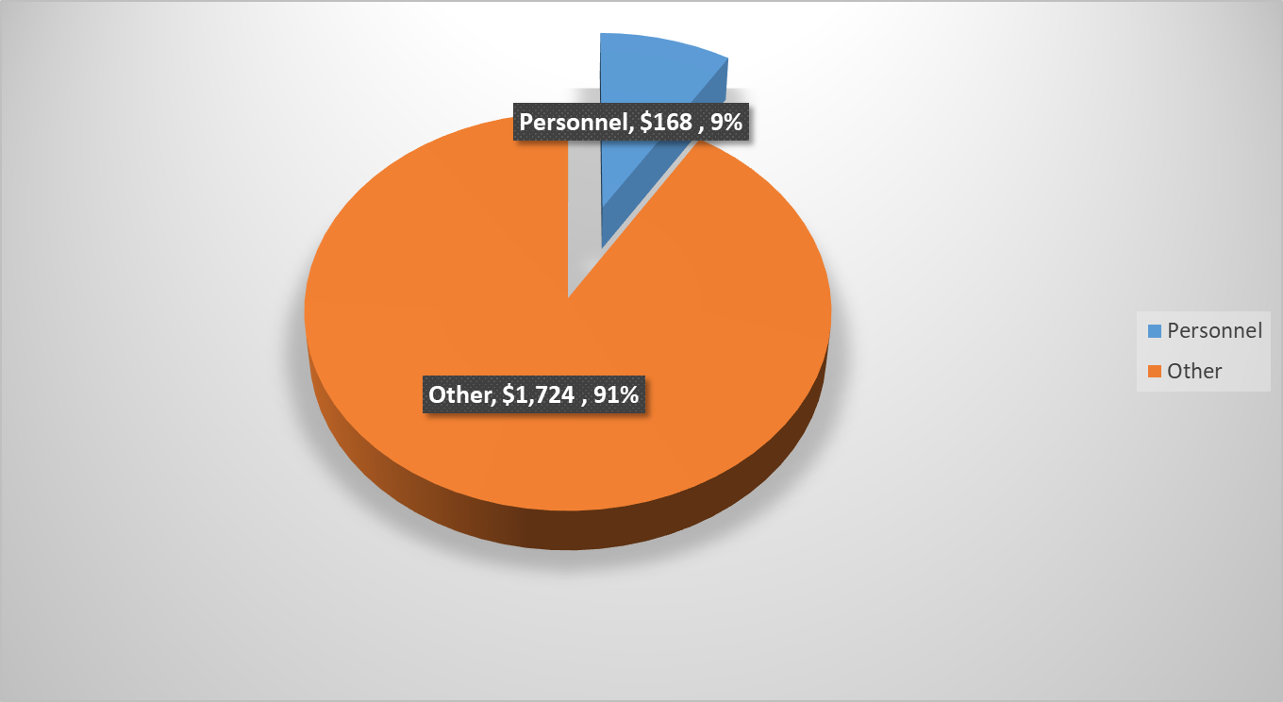
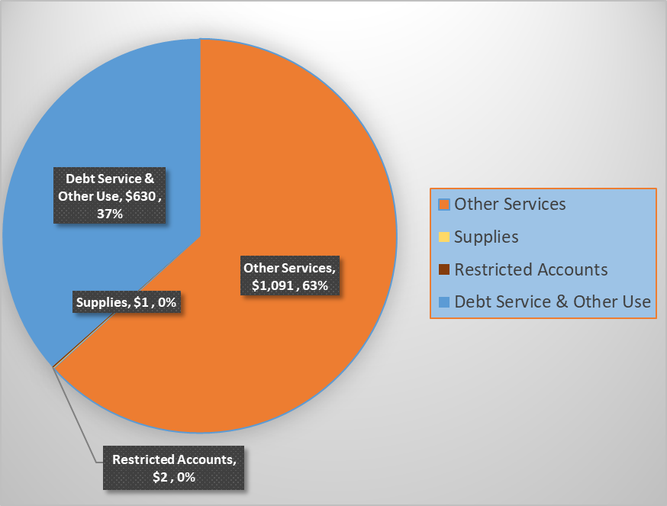
FY20 Personnel vs Non Personnel (Fund 2424)
($ in thousands)
FY 20 Proposed Budget $1,892K
Personnel vs Non-Personnel
Personnel Primary Service Functions

Slide 11
Functional Organizational Chart
($ in thousands)
OFFICE OF BUSINESS OPPORTUNITY
FUND 1000
32.2 FTEs $3,562
OBO Solutions Center
4.2 FTEs $451
Provides free business assistance and monitors business creation and job development by systematically tracking clients.
Certification and Compliance
22.0 FTEs $2,513
Consists of Certification and Designations, Contract Compliance, Department Services and Administration.
Contract Compliance
6.0 FTEs $598
Performs required work on City, State, and Federally funded projects, enforce Labor Standards Compliance requirements on contracting department’s existing contracts, coordinate compliance monitoring, enforce penalty language, and ensure the ability to effectively monitor contracts.

Slide 12
Functional Organizational Chart
($ in thousands)
OFFICE OF BUSINESS OPPORTUNITY
FUND 2424
2 FTEs $1,892
Contractor Responsibility Fund
2 FTEs $1,892
Provides oversight of the Pay or Play Program and is responsible for program revenue collections, administrative operations, financial oversight, and monitoring of funds.

Slide 13
FY20 Budget Reductions
FY20 budget reductions - $97,137:
  $57,458 – Reduces one (1) vacant, budgeted position.
    Consequences of reduction: The Division enforces Prevailing Wages compliance pursuant to Federal requirements and Texas Government Code - Chapter 2258. Contract Compliance enforces labor standards rules, as well as monitors MWSDBE utilization on contracts with goals. The division also ensures that subcontractors working on City of Houston projects are paid their pro-rata share each month in a timely manner. The current workload consists of 1,400 contracts. Approximately 15% of the contracts are federally funded. OBO is severely understaffed based on capacity and struggle with addressing compliance issues as well as contract close outs. While Houston Public Works (HPW) is offsetting this, losing any resources can have a negative impact on the quality of service. The HPW funded employees perform required work on City, State, and Federally funded projects, enforce Labor Standards Compliance requirements on contracting department’s existing contracts, coordinate compliance monitoring, enforce penalty language, and ensure the ability to effectively monitor contracts. Ideally, one (1) Business Development Coordinator (BDC) would manage 70 contracts per year. However, due to the staff shortage, currently one (1) BDC manages in excess of 200 contracts yearly. Monthly, a BDC would perform between 15 to 20 full project audits, 480 payroll audits, and 24 site visits. Without this resource, OBO would have difficulty monitoring projects, monitoring payrolls, addressing compliance issues and contract close outs which would impact service provided to the City of Houston and the business community.
  $39,679– Reduces computer supplies, printing and reproduction services, and advertising services.
    Consequences of reduction: This reduction is in OBO's General Ledger Accounts. OBO would reduce several of its General Ledger Accounts from 20.6% to 100% for such items as computer supplies, office supplies, printing and reproduction, and advertising services. Advertising services supports our memorandum of understanding agreements with various chambers, businesses, trade organizations, and other organizations which allows OBO to help promote the City's mission. It helps us to identify businesses for certification and to coordinate procurement events to identify prospective companies to work on City of Houston's contracts. This reduction would diminish our efforts to advertise the programs and services that OBO provides to the City of Houston and the business community.

Slide 14
FY20 Budget Expenditures Net Change ($ in thousands)
  .
Notes:
`

Slide 15
FY2020 - Expenditures Highlights
The FY 2020 Budget for Fund 1000 reflects an 13.62% increase from the FY 2019 Budget Estimates - an approximate increase of $427,000. A significant amount of this increase is due to:
  Funding for health benefits, pension contribution, and municipal employees contractual pay increases.
  Funding a position that is responsible for administering compliance of Title VI of the Civil Rights Act of 1964, 42 U.S.C. 2000d et seq. ("Title VI"). Title VI prohibits discrimination on the basis of race, color, or national origin in any program or activity that receives Federal funds or other Federal financial assistance.
  In addition, the budget includes an expenditure reduction of $97,137 for departmental savings initiatives.

Slide 16
FY2020 - Expenditures Highlights (Cont’d)
The FY 2020 Budget for Fund 2424 reflects an 12.02% increase from the FY 2019 Budget Estimates, which equates to an approximate increase of $203,000. A significant amount of this increase is due to:
  Funding for health benefits, pension contribution, and municipal employees contractual pay increases.
  A funding amount of $951,787 to support the Fire Department’s Emergency TeleHealth Navigation (ETHAN) Program.
  A new commitment to provide partial funding for the Police Department Call Crisis Diversion Program for $230,000.
  Continued commitment to support the Care Houston Program with an estimated cost of $400,000.
  Funding to maintain an electronic management system to effectively track all Pay or Play (POP) activities.

Slide 17
Questions

Slide 18
Appendix
Contents, to include:
  Department demographic breakdown (gender & ethnicity)
  Optional - Relevant operating information, examples:
    Customer satisfaction surveys
    Productivity or throughput trends impacted by recent initiatives

Slide 19
Budget History
($ in the thousands)

Slide 20
Department Budget Reductions
(in thousands)
Fund | FY18 | FY19 | FY20 | 3-Year Total
General Fund | $86 | $0 | $97 | $183
Special Revenue Fund | $0 | $0 | $0 | $0
Enterprise | N/A | N/A | N/A | N/A
Total
Discuss 3-year budget reductions
  FY 2018 - General Fund Budget Target - $3,028
  Budget Cut Amount: $86,204
  Personnel Utilization Savings: $49,951
  OBO cut $49,500 in funding for the Build Up Houston Program, $20,000 for the Kauffman Fasttrac NewVenture Program, and $16,704 from the General Ledger accounts for a total of $86,204.
  How many positions eliminated: 0

Slide 21
Department Budget Reductions (Cont’d)
(in thousands)
  Services impacted:
    Kauffman Fasttrac NewVenture Program. The proposed decrease impacted the continued ability to provide a valuable resource to the business community. The purpose of the Kauffman Fasttrac NewVenture 10 week program assisted entrepreneurs in the early stages of business development. The program offered essential business information and helped entrepreneurs develop their skills to build their business on a strong foundation.
    Build Up Houston Program. The decrease impacted the continued ability to provide those resources to the business community. The program was designed to increase the capacity and success of small businesses in the construction services industry. Business owners learn business development strategies, strategic planning, estimating and bidding, finance and financial management, bonding and insurance, marketing and sales, human resources, accessing capital, government contracts, and project management.
The reduction of both the Kauffman Fasttrac NewVenture and the Build Up Houston programs impacted revenue generated by future potential small businesses supporting Houston’s economy and job growth.
    General Ledger Reduction. OBO reduced most of it General Accounts by 25% to 100% to reduce administration, printing, training, travel, and supplies, etc.
  What are the unmet needs of your department to meet or exceed city service level agreement?

Slide 22
Department Budget Reductions (Cont’d)
(in thousands)
Discuss 3-year budget reductions
  FY 2020 - General Fund Budget Target - $3,562,37
  Eliminated (1) vacant, budgeted position for $59,439 and reduced computer supplies, printing and reproduction services, and advertising services by $37,698.
  Services impacted: Reduction of one (1) position affects how the Contract Compliance Division performs it core functions pursuant to Chapter 15, Articles V & VI of the City Code of Ordinances and Ordinances 78-1538, 84-1309, 85-2070, 85-2071, 06-91 and 08-665. The Division enforces Prevailing Wages compliance pursuant to Federal requirements and Texas Government Code - Chapter 2258. Contract Compliance enforces labor standards rules, as well as monitors MWSDBE utilization on contracts with goals. The division also ensures that subcontractors working on City of Houston projects are paid their pro-rata share each month in a timely manner. The current workload consists of 1,400 contracts. Approximately 15% of the contracts are federally funded. OBO is severely understaffed based on capacity and struggle with addressing compliance issues as well as contract close outs. While Houston Public Works (HPW) is offsetting this, losing any resources can have a negative impact on the quality of service. The HPW funded employees perform required work on City, State, and Federally funded projects, enforce Labor Standards Compliance requirements on contracting department’s existing contracts, coordinate compliance monitoring, enforce penalty language, and ensure the ability to effectively monitor contracts. Ideally, one (1) Business Development Coordinator (BDC) would manage 70 contracts per year. However, due to the staff shortage, currently one (1) BDC manages in excess of 200 contracts yearly. . Monthly, a BDC would perform between 15 to 20 full project audits, 480 payroll audits, and 24 site visits. Without this resource, OBO would have difficulty monitoring projects, monitoring payrolls, addressing compliance issues and contract close outs which would impact service provided to the City of Houston and the business community.
  What are the unmet needs of your department to meet or exceed city service level agreement?

Slide 23
FY 2020 Performance Measures
Fund 1000
Customer Measures | Priorities | FY18 Actual | FY19 Budget | FY19 Estimates | FY20 Proposed
New Certified Firms | Services & Infrastructure | 302 | 275 | 275 | 275
New Hire Houston First Designations | Services & Infrastructure | 301 | 250 | 250 | 250
Turnaround Houston | Complete Communities | 631 | 750 | 420 | 500
Liftoff Houston! Business Plan Competition | Complete Communities | 386 | 800 | 491 | 600
Labor Standards (Payrolls) | Services & Infrastructure |  | 25,000 | 25,000 | 32,000
Business Process Measures | Priorities | FY18 Actual | FY19 Budget | FY19 Estimates | FY20 Proposed
Certification Processing Timeframes (days) | Services & Infrastructure | 68 | 90 | 90 | 90
MWSBE Contract Participation – Construction | Services & Infrastructure | 29% | 34% | 34% | 34%
MWSBE Contract Participation – Professional Services | Services & Infrastructure | 49% | 24% | 24% | 24%
MWSBE Contract Participation – Purchasing | Services & Infrastructure | 17% | 11% | 11% | 11%

Slide 24
FY 2020 Performance Measures
Fund 1000 (Cont’d)
Business Process Measures | Priorities | FY18 Actual | FY19 Budget | FY19 Estimates | FY20 Proposed
Expenditures: Adopted Budget vs Actual Utilization | Sound Financial Management | 101% | 98% | 86% | 98%
Revenues: Adopted Budget vs Actual Utilization | Sound Financial Management | 145% | 100% | 81% | 100%

Slide 25
FY 2020 Performance Measures
Fund 2424
Business Process Measures | Priorities | FY18 Actual | FY19 Budget | FY19 Estimates | FY20 Proposed
Ratio of Play Option Contracts | Services & Infrastructure | 65% | 65% | 47% | 47%
Expenditures : Adopted Budget vs Actual Utilization | Sound Financial Management | 113% | 98% | 127% | 98%
Revenue: Adopted Budget vs Actual Utilization | Sound Financial Management | 67% | 100% | 43% | 100%

Slide 26
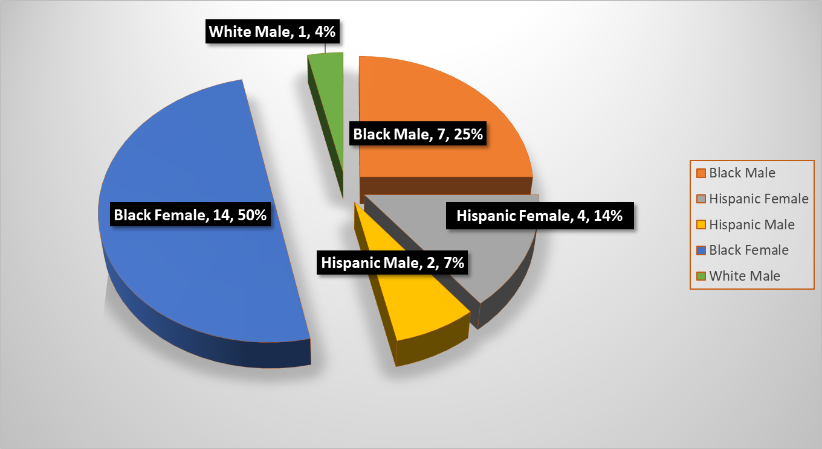
OBO FY 20 Staff Demographic Breakdown

Slide 27
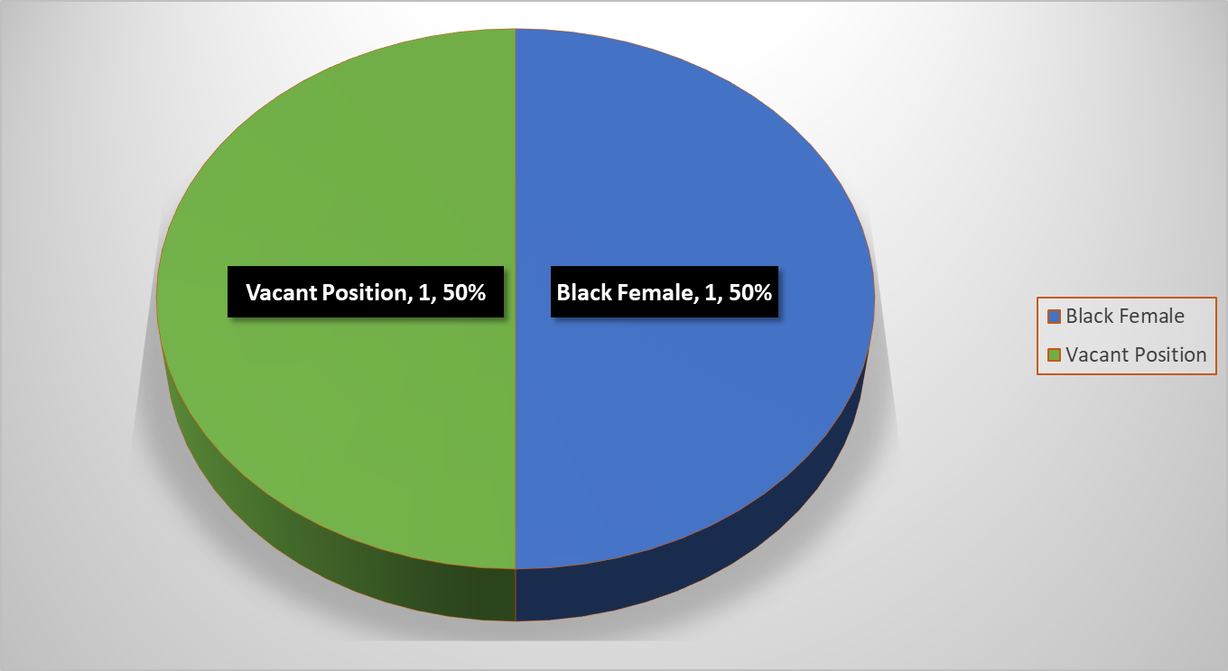
OBO FY 20 Upper Management Staff Demographic Breakdown

Slide 28


Department FY2019 Accomplishments
BUILD UP HOUSTON
In February 2018, the Office of Business Opportunity partnered with Houston Community College to launch the 4th Cohort of Build Up Houston. In August 2018, 10 small business owners graduated from the program. Build Up Houston is a comprehensive, seven-month program designed to increase the capacity and success of small businesses in the construction service industry doing business in the City of Houston. The program utilizes curriculum provided by Interise, a non-profit organization, focused on helping established small business owners take their companies to the next level for continual growth and success. Interise has an award-winning curriculum developed and refined by working hand-in-hand with small business owners and national business experts. Interise has established themselves as a proven leader in educating and training established business owners to grow their businesses.
INTERAGENCY MENTOR PROTÉGÉ PROGRAM (IMPP)
The City of Houston, Metropolitan Transit Authority of Harris County, Houston Independent School District, Port Houston, Houston Community College, and the Houston First Corporation teamed together for the 6th year of the Interagency Mentor Protégé Program (IMPP). IMPP exists to strengthen effective working relationships and fosters long term stability between established firms and local agencies with emerging historically underutilized businesses. The goals of IMPP is to enhance business skills and broaden the base of historically underutilized businesses by providing the knowledge and experience of established firms. Over 80 applications were received for the 2018 cohort of the IMPP. The 2018 program began on May 1st and graduated 20 certified firms, who were paired with a mentor and encouraged to bid on a RFP. The 2019 program is underway, with nearly 70 applications received for the 20 available slots.
Notes:
Last year’s LiftOff Houston! Business Plan Competition was held on November 15, 2014. Capital One Bank awarded a total of $30,000 in prizes to three winners in the categories of Innovation, Service and Product.
The Hire Me Now! Job Fair highlighted the Tweet My Jobs! Platform as a way for employers to expand their reach in recruiting. It also provided job seekers a way to easily see the types of jobs available in the Houston area.
There are currently over 71,800 jobs posted as open in the Houston area

Slide 29

Department FY2019 Accomplishments (Cont’d)
TURNAROUND HOUSTON
The Turnaround Houston Initiative is playing a pivotal role in the City’s recovery efforts. Utilizing Workforce Disaster Funds received by the Texas Gulf Coast Workforce Board from the Texas Workforce Commission, the City of Houston and the Texas Gulf Coast Workforce Board-Workforce Solutions, have partnered to host events for the explicit purpose of hiring individuals who were: 1) displaced from their jobs as a result of Harvey; 2) have been unemployed for 10 consecutive weeks or more and are substantially looking for employment; or 3) are currently receiving unemployment insurance to fill temporary positions with the City to assist in its clean-up, repair of public facilities and/or humanitarian assistance to residents impacted by Harvey. Since November, 2017 there have been a total of five Turnaround Houston Disaster Recovery Hiring Events with nearly 300 individuals securing employment to fill temporary disaster related positions throughout various City departments. As of May 10, 2019, a total of 76 individuals are still actively employed, with some persons having been permanently hired into full-time roles with the City.
Thanks to a $10,000 award received from the US Conference of Mayors DollarWise Innovation Grant, OBO was able to extend the Turnaround Houston Initiative to administer the Turnaround Entrepreneurial Program (TEP). The TEP is a 5-week, curriculum based program designed specifically for previously incarcerated individuals who have a desire to be a proprietor, with a pathway to starting their own business. The first cohort of the TEP, with 13 participants, was launched in January, 2019 in the Acres Homes Complete Communities. At the full completion of the program, TEP participants received a $300 stipend for use towards their business. Program graduates also received a laptop, $25 Microsoft gift card, and a business package of office supplies, and a printer to start their businesses.

Slide 30


Department FY2019 Accomplishments (Cont’d)
BLOOMBERG ASSOCIATES SMALL BUSINESS ECOSYSTEM STUDY
In FY 2019, The Office of Business Opportunity partnered with Bloomberg Associates and other City of Houston departments to study Houston’s small business ecosystem. Bloomberg surveyed business owners to understand what they like and dislike about the ecosystem and the resources available to them. The survey results have been reviewed by OBO staff. These results, combined with other research, are being used to inform the Small Business Portal Plan. The goal is to consolidate various City of Houston services under one umbrella, making it much easier for entrepreneurs to access information critical to starting a business. A draft Small Business Portal Plan should be ready by the end of April, with a goal of beginning work on the portal before the end of FY 2019.
HBI Acres Homes Program
The Office of Business Opportunity partnered with the Home Builders Institute to design the HBI Acres Homes construction training program. This program serves young men and women (ages 18-24) in the Acres Homes community and includes introductory construction skills, exposure to the industry and its opportunities, mentorship, financial literacy, and professional skills development.
OBO has implemented a strong entrepreneurship component to this program, recognizing that the students can leverage their construction skills to create their own businesses. Through organizations such as SCORE and the OBO Solutions Center and Certification Divisions, students are now exposed to business design and implementation, marketing, MWBE certification with the City, and the professional skills needed to operate and develop a business.

Slide 31


Department FY2019 Accomplishments (Cont’d)
LIFTOFF HOUSTON!
In the first half of FY 2019, $30,000 was awarded to three participants in the City of Houston's Business Plan Competition. In its sixth year, Liftoff Houston! held 18 workshops that provided training to approximately 2,411 individuals. This Initiative is funded by Capital One Bank. Liftoff Houston! will launch again in June, 2019 and is working with the Spanish-language LANZATE business plan competition to increase participation in both events.
VIRTUAL LEGAL LAB
In FY 2016, OBO partnered with Vinson & Elkins, LLP to create the Virtual Legal Lab - a program that affords small businesses the opportunity to have one-on-one skype sessions with a licensed attorney to answer legal questions that they may have about their business. The program has hosted five Legal Labs in FY 2019, with a total of 12 small business owners participating.
DISPARITY STUDY
The Office of Business Opportunity, in collaboration with the Legal Department, hired a consultant to conduct a Citywide Disparity Study covering five years of City procurements. The Study will evaluate the extent of marketplace discrimination, if any, against minority-owned, women-owned, and disadvantaged businesses, as it relates to their participation on City of Houston construction and professional services contracts, as well as procurement of goods and services.
Virtual Legal
Lab
Notes:
Last year’s LiftOff Houston! Business Plan Competition was held on November 15, 2014. Capital One Bank awarded a total of $30,000 in prizes to three winners in the categories of Innovation, Service and Product.
The Hire Me Now! Job Fair highlighted the Tweet My Jobs! Platform as a way for employers to expand their reach in recruiting. It also provided job seekers a way to easily see the types of jobs available in the Houston area.
There are currently over 71,800 jobs posted as open in the Houston area

Slide 32
Thank You

