Slide 1


Mayor Sylvester Turner
Solid Waste Management Department
Curbside Recycling
and Glass Drop-off Program
Regulatory and Neighborhood Affairs Presentation
August 25, 2016

Slide 2


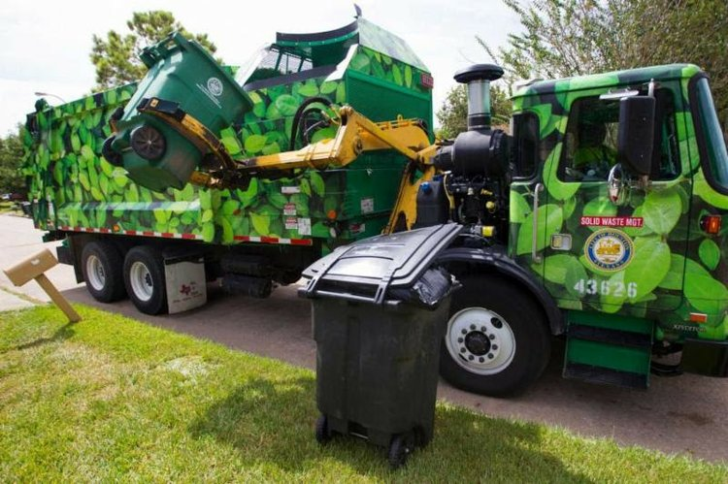

Presentation Overview
Harry Hayes, Director
Sylvester Turner, Mayor
Changes to the curbside recycling program
Current glass recycling options
Upcoming improvements the curbside recycling program
August 25, 2016

Slide 3
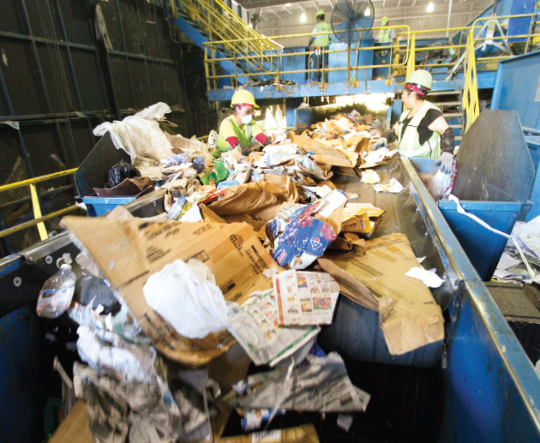
Changes in the industry
Harry Hayes, Director
Sylvester Turner, Mayor
Why such a dynamic shift in pricing?
  Nationally, as contracts renew, processors are recovering their full plant operation costs. The value of recycled materials has plummeted over the past 3 years with virgin material being a cheaper alternative to recycled content in many cases.
Future of facilities
  Mixed waste processing
  Waste-to-fuel plants
  Emerging technologies
August 25, 2016

Slide 4
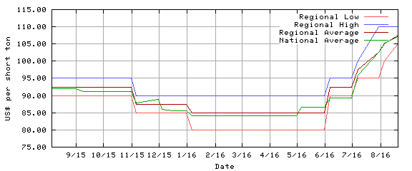
Cardboard Value
Harry Hayes, Director
Sylvester Turner, Mayor
August 25, 2016

Slide 5
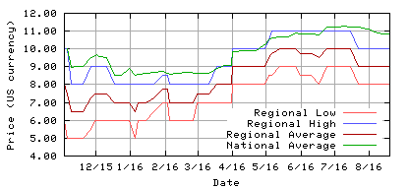
Baled PET Value
Harry Hayes, Director
Sylvester Turner, Mayor
August 25, 2016

Slide 6
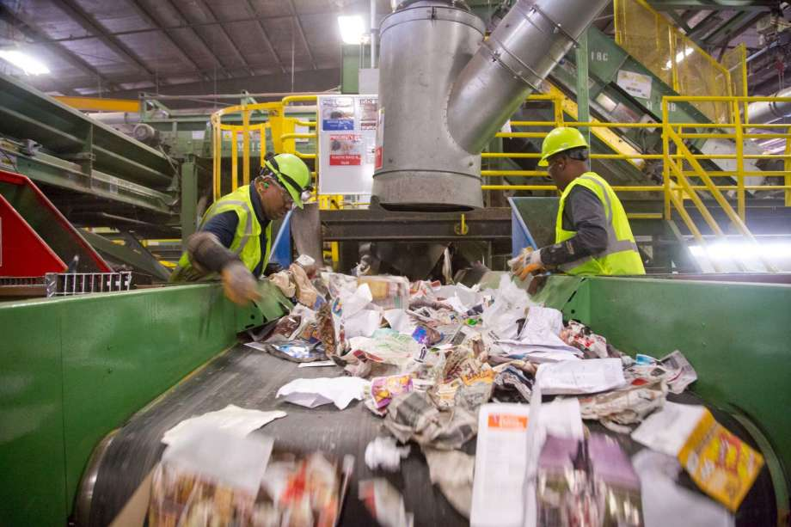
Program Changes
Harry Hayes, Director
Sylvester Turner, Mayor
March 2016: The City of Houston signed a new two (2) year $5.8M recycling contract with Waste Management.
Glass removed as a viable single-stream material based on market/processing issues..
Contract terms included:
  $90 per ton processing fee
  Glass removed from recycling program
  WM guaranteed at least 75% of the City’s recycling stream
August 25, 2016

Slide 7

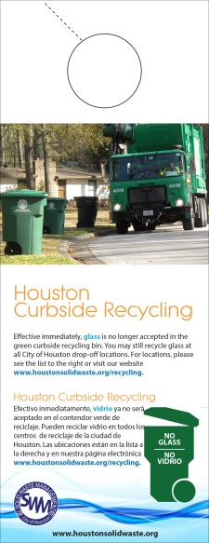

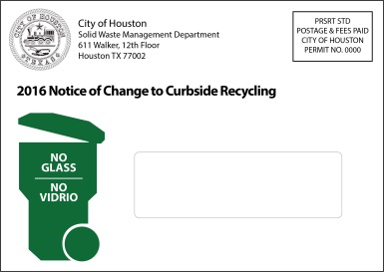
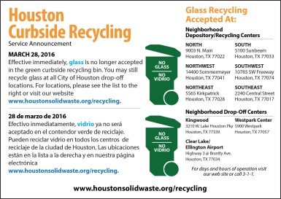
What Are We Doing?
Harry Hayes, Director
Sylvester Turner, Mayor
Launched a comprehensive “ No Glass: No Vidrio” program to educate residents about the removal of glass from the curbside recycling program
Worked with Council members and community associations to assist in delivering the message to residents about removing glass from the recycling “green” bins
Identifying those areas within the City with high contamination rates in order to present enhanced education programs
Direct Mail
Postcard mailers
Door Hanger
Bill Insert
August 25, 2016

Slide 8
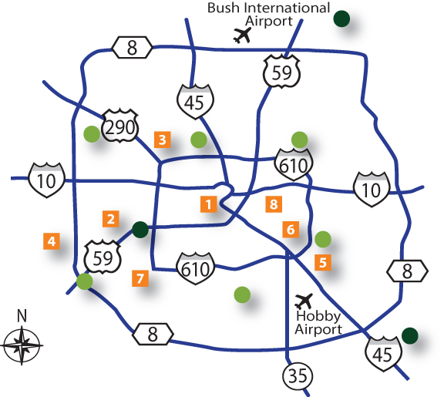
What’s being done?
Harry Hayes, Director
Sylvester Turner, Mayor
Partnered with Strategic Materials Inc., HPARD, The Salvation Army & HHD to launch a glass drop-off program with locations around the City. There are currently eight (8) locations operational, with an additional two (2) to come online within the next few months
Salvation Army Family Store & Donation Center
2208 Washington Ave, accessible 24 hours
Sharpstown Park
6600 Harbor Town Drive, accessible during park hours
T.C. Jester Park
4201 T C Jester Blvd, accessible during park hours
Alief Community Park
11903 Bellaire Blvd, accessible during park hours
Glenbrook Golf Course
8205 N Bayou Dr, accessible during park hours
Mason Park
541 S 75th St, accessible during park hours
Westbury Methodist Church
5200 Willowbend Blvd, accessible during business hours
We Can Recycle
723 N Drennan St, accessible during business hours
Community Glass Recycling Drop-off Centers
City Neighborhood Drop-off Centers
City Neighborhood Depository/Recycling Centers
August 25, 2016

Slide 9
New contract?
Harry Hayes, Director
Sylvester Turner, Mayor
  Total tons and cost of curbside recycling program
  March 2016 – June 2016
  Removing glass has generated nearly 4,000 tons less for processing
  Recycling program is tracking $228,890 less than budgeted through June 2016
  In July 2016, the department began using Independent Texas Recyclers to process up to 25% of the curbside single stream. This contract has resulted in better logistics and cost savings with the single stream program.
9 Curbside Recycling Program
August 25, 2016

Slide 10
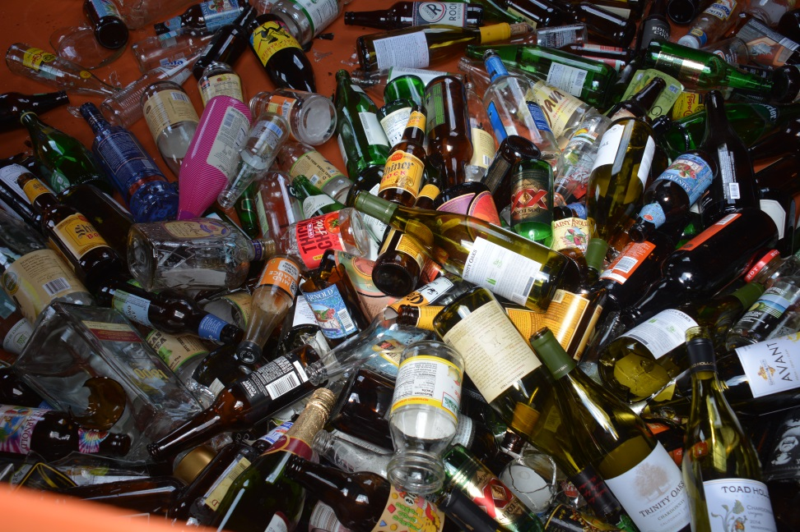
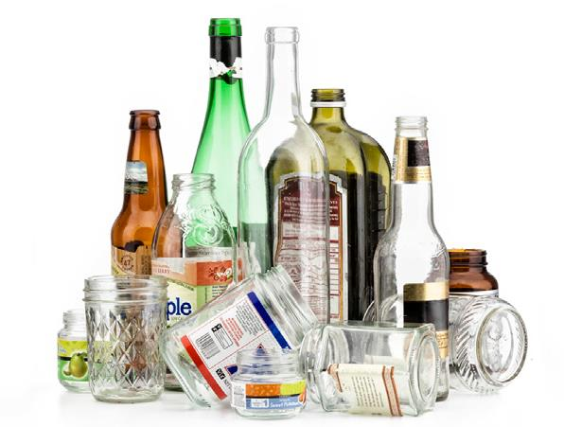
Next Steps?
Harry Hayes, Director
Sylvester Turner, Mayor
  Final Draft of a Request For Proposal (RFP) is being worked with Strategic Procurement Department (SPD).
  Glass collected from drop off location
10 Curbside Recycling Program
August 25, 2016

Slide 11
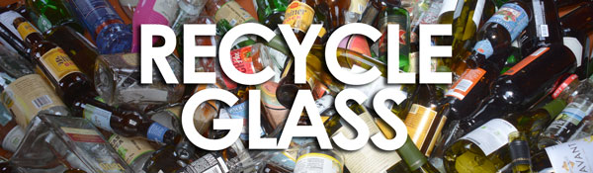
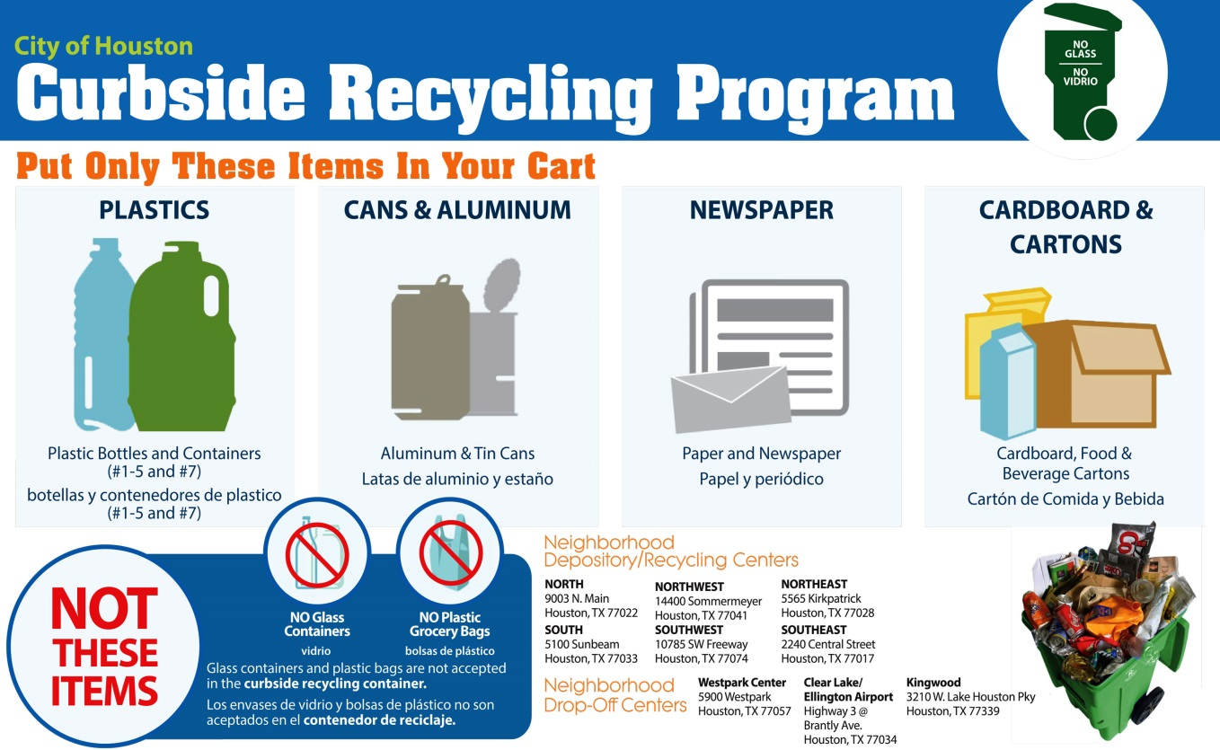
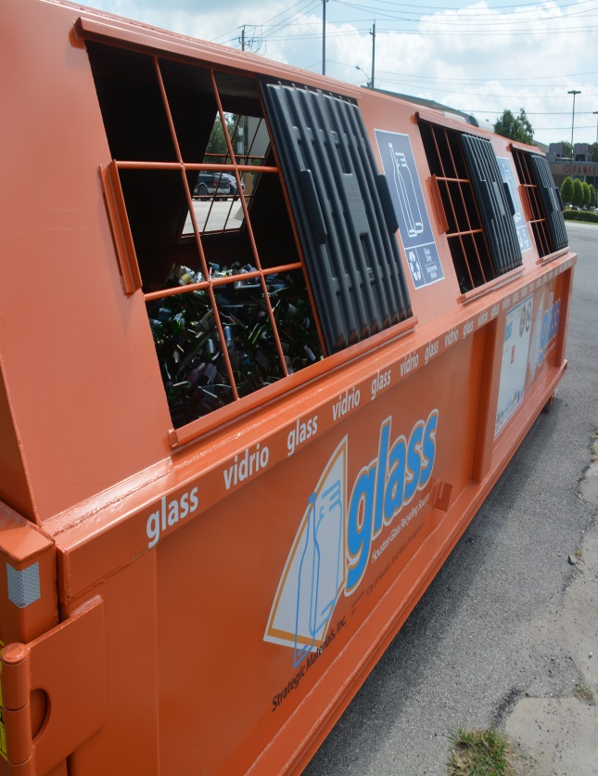
Questions?
Harry Hayes, Director
Sylvester Turner, Mayor
August 25, 2016

