Slide 1
KINGWOOD / LAKE HOUSTON UPDATES
CAROL ELLINGER HADDOCK, P.E.
DIRECTOR

Slide 2
STORM LINE INSPECTIONS
Bear Branch
Elm Grove
Forest Cove
Greentree Village
Hunters Ridge
Kings Crossing
Kings Forest
Kings Point
Kingswood Village
Kingwood Place Village
Lakeshore
Magnolia Point (Huffman)
Mills Branch
Sand Creek Village
South Woodland Hills
Woodstream Village

Slide 3
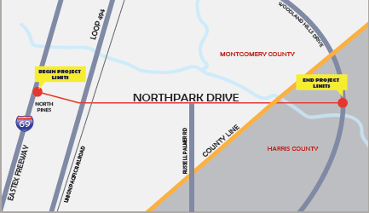
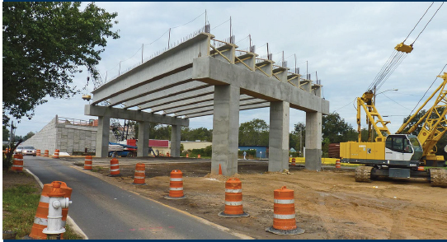
NORTH PARK DRIVE OVERPASS
LOCATION IH-69 TO RUSSELL PALMER
BUDGET $38.8M
TYPE MOBILITY & DRAINAGE
START FALL 2020
COMPLETION FALL 2021

Slide 4
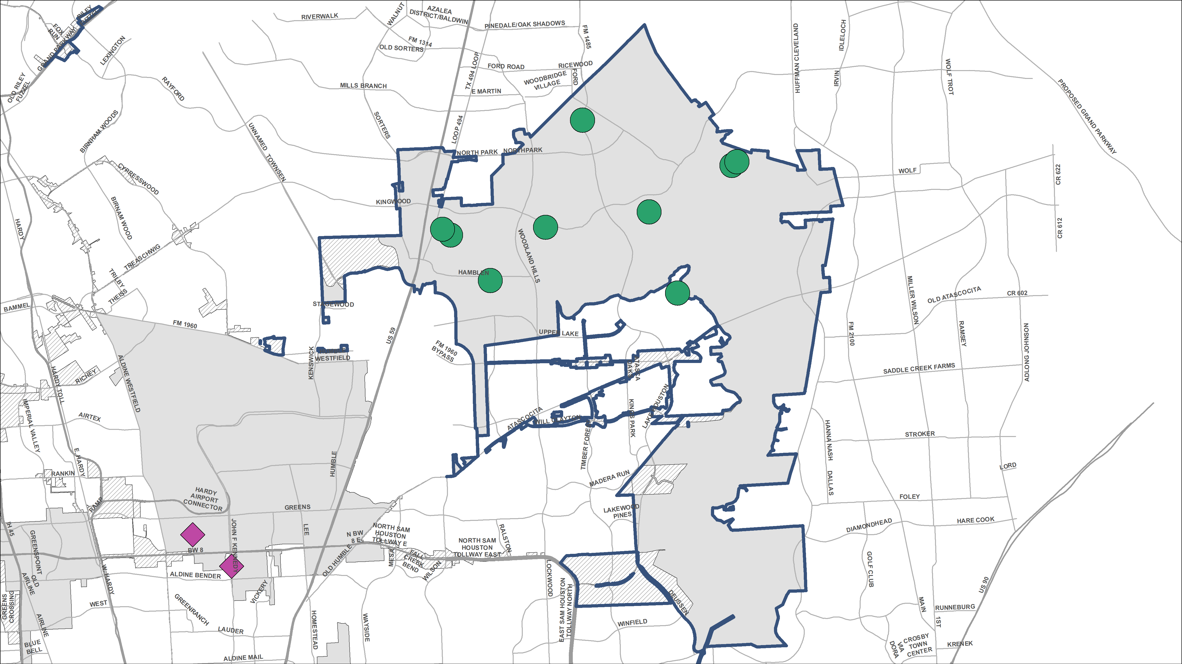
PLANNED REHAB PROJECTS
DISTRICT E
(NORTH)
DRAINAGE
PAVEMENT

Slide 5
Northeast water purification plant
site construction

Slide 6
Lake Houston
dam REPAIRS
safety improvements
Tropical Storm Imelda impacts

Slide 7
thank you!

