Slide 1
Fair Housing Ambassador Resource Guide

Slide 2
Table of Contents
Introduction
What is Housing Discrimination?
Outreach Materials
Fair Housing Words and Phrases
Fair Housing Maps
Eviction Flowchart
Fair Housing Laws and Regulations
Appendix

Slide 3
1. Introduction

Slide 4
Introduction
Thank you for promoting understanding and awareness of fair housing laws in Houston through the Fair Housing Ambassador Program. We believe the most effective manner of sharing information with Houstonians is through the people that they know and trust who are active in their own neighborhoods. We thank you for raising your hand to be a part of this effort.
This resource guide consolidates fair housing information to be an accessible resource for fair housing advocates and ambassadors. Here you will find:
An outline of the basics of housing discrimination
Downloadable posters about each protected class
Information on how to file a federal fair housing complaint
Fair Housing Basics and Tenant Landlord presentations
Some of our favorite fair housing resources

Slide 5
How to Use This Document
This toolkit is a resource for fair housing advocates and ambassadors to provide fair housing content and help with the planning outreach activities.
With its specific focus on renters’ rights and slide share style layout, we hope this toolkit will be a useful resource for you as you design your outreach strategies for this program as well as a tool you find yourself returning to for your outreach needs again and again.
The guide can be read as a manual or section at a time as needed. Ambassadors are welcomed to use any of its slides for presentation purposes.

Slide 6
2. What is Housing Discrimination?

Slide 7
What is Housing Discrimination?
Housing discrimination is the illegal practice of discriminating against residential renters or homebuyers based on race, color, religion, national origin, sex, familial status or disability.
If you have questions about fair housing or housing discrimination, please call the Fair Housing Hotline at 832-394-6200 ex. 5 or email fairhousing@houstontx.gov
If you believe you’ve been discriminated against, please review the information on slides 9-12 and contact one of the listed agencies.
WHAT IS FAIR HOUSING?
Audience: Tenants
Link: https://www.youtube.com/watch?v=cyahBccVxmw (from North Carolina)
TOP 10 FAIR HOSUING MISTAKES
Audience: Landlords
Link: http://www.youtube.com/watch?v-toSowgJb3PM

Slide 8
What Are My Rights?
The Texas Young Lawyers Association and the State Bar of Texas have created a handbook that explains many of the questions and legal issues that arise in a landlord-tenant relationship.
Tenants’ Rights Handbook in Texas:
English
Spanish

Slide 9
How to File a Housing Discrimination Complaint
All complaints must:
Specify one or more of the following types of housing discrimination: race, color, national origin, religion, sex, disability or familial status
Must identify harm (ex: could not secure housing)
Agencies that enforce fair housing laws (details on following slides)
Greater Houston Fair Housing Center
Texas Workforce Commission, Civil Rights Division
U.S. Department of Housing and Urban Development (HUD)

Slide 10
Greater Houston Fair Housing Center
Who can apply: Residents of the Greater Houston metropolitan area
To file a complaint call for an initial phone interview and/or schedule an appointment, or complete the online form.
You must submit your complaint within one calendar year of the date of discrimination.
Phone: (713) 641-3247
Online Form: https://www.houstonfairhousing.org/file-a-complaint
Website: http://www.houstonfairhousing.org

Slide 11
Texas Workforce Commission, Civil Rights Division
Who can apply: Residents of Texas
You must submit your complaint within one calendar year of the date of discrimination.
Complaints must be filed via an online form: https://apps.twc.state.tx.us/HDISS/hdiss?execution=e1s1
Complaints cannot be provided over the telephone
For questions: (512) 463-2642
Website: https://www.twc.texas.gov/partners/housing-discrimination

Slide 12
U.S. Department of Housing and Urban Development (HUD)
Who can apply: All U.S. residents
You must submit your complaint within one calendar year of the date of discrimination.
Complaints can be filed online, through email, through the mail or by phone. More information here: https://www.hud.gov/program_offices/fair_housing_equal_opp/online-complaint
Complaints cannot be provided over the telephone
For questions: (512) 463-2642
Website: https://www.hud.gov/program_offices/fair_housing_equal_opp

Slide 13
3. Outreach Materials

Slide 14
Fair Housing Marketing Outreach Materials
City of Houston
https://houstontx.gov/housing/fair-housing/index.html
Follow the link to find copies of all of the Fair Housing posters featured in the Breaking Down Barriers found in the Appendix of this document.

Slide 15
Fair Housing Marketing Outreach Materials
National Fair Housing Alliance
https://fairhousingresourcecenter.wordpress.com/
The National Fair Housing Alliance has a series of print, Radio and TV PSAs, along with Fair Housing Videos, Deaf and Hard of Hearing Videos and series of Brochures on Fair Housing.
Topics Include: Resources for Discrimination against all protected classes, Foreclosure Prevention, Diversity and Inclusion, and Predatory Lending
Translations available in the following languages: Arabic, Russian, Spanish, Chinese, Korean, Tagalog, Vietnamese

Slide 16
Fair Housing Marketing Outreach Materials
HUD’s Fair Housing and Equal Opportunity Office
http://www.hud.gov/program_offices/fair_housing_equal_opp/marketing
The FHEO marketing site has a series of print, radio and social media PSAs, as well as booklets, brochures and logos.
Topics Include: Sexual Harassment, Natural Disaster Relief, National Origin and general awareness campaigns
Translations are available in the following languages: Arabic, Chinese – Simplified, Chinese – Traditional, Korean, Russian, Spanish, Tagalog and Vietnamese

Slide 17
4. Fair Housing Words and Phrases

Slide 18
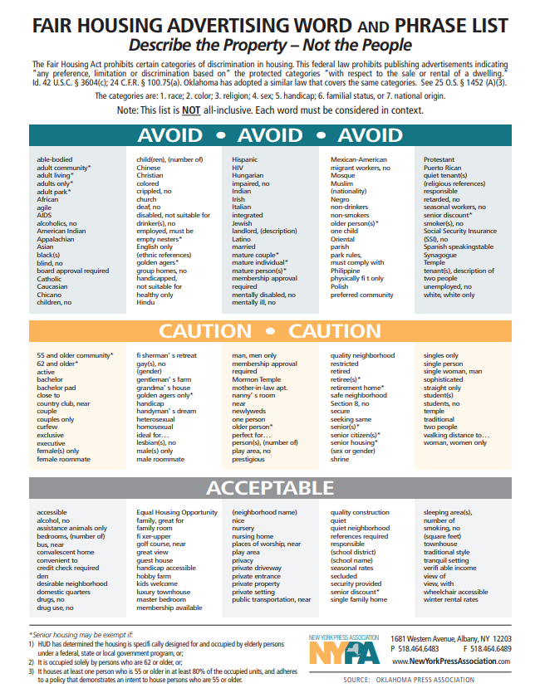
Fair Housing Advertising Word and Phrase List Link: https://ranww.org/documents/resources/fairhousingterms.sflb.pdf

Slide 19
5. Fair Housing Maps

Slide 20
Houston Fair Housing Maps
In this section we have included several of the maps we use most often in our fair housing presentations that illustrate the effects housing discrimination has had in Houston. Included here are:
Historic Houston HOLC Map
HOLC Map overlain on modern Houston
Where residents live by race/ethnicity
Social Vulnerability Index

Slide 21
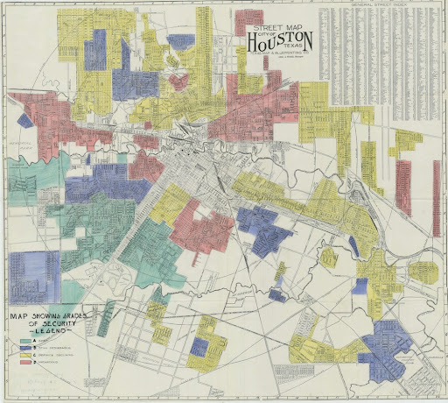
Houston Fair Housing Maps
Redlining: Historic
Homeowners’ Loan
Corporation (HOLC) Map
Map Legend
Best: Green, Still Desirable: Blue
Declining: Yellow, Hazardous: Red
For more information on redlining and the
HOLC maps’ impact on segregation in American
cities: https://bit.ly/31rj2t7

Slide 22
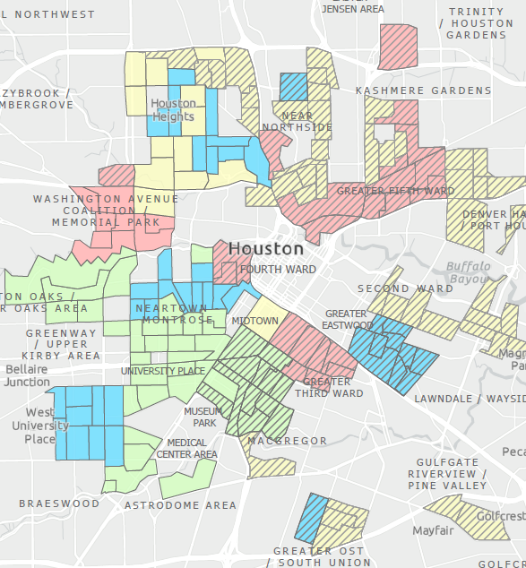
Houston Fair Housing Maps
Redlining and Houston Today
Hatched areas indicate neighborhoods
that as of 2017 are majority minority.
Source: Source: 2017 American Community Survey, 5-Year; Rogers, Susan, OffCite, “Hazardous: The Redlining of Houston Neighborhoods”
For more information on the HOLC map and its impact on Houston: https://www.understandinghouston.org/blog/legacy-of-redlining-in-houston

Slide 23
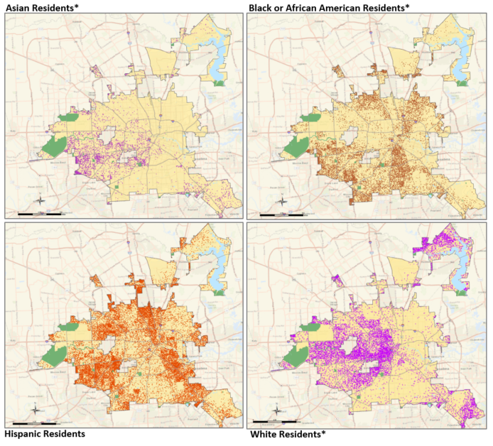
Houston Fair Housing Maps
Where residents live
by race/ethnicity
Source: 2017 American
Community Survey, 5-Year

Slide 24
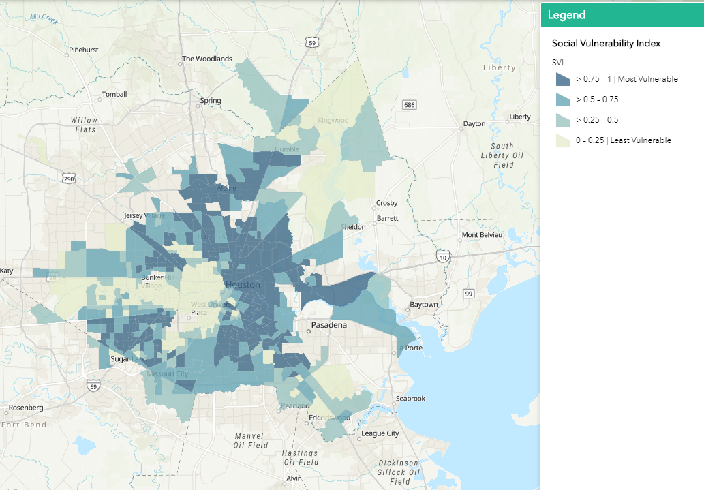
Houston Fair Housing Maps
Social Vulnerability Index
https://mycity.maps.arcgis.com/apps/webappviewer/index.html?id=cf898b52e6b54762813ab09057034042

Slide 25
6. Eviction Flowchart

Slide 26
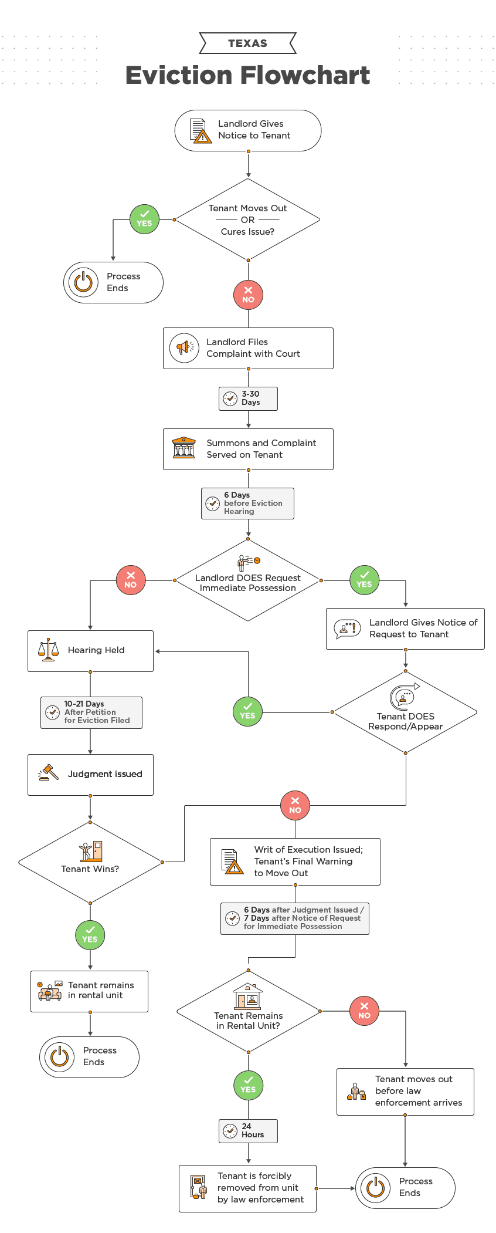
Evictions in Texas Flowchart
We have included in the next few slides a zoomed in version of the flowchart to the left. This flowchart is an excellent resource for those seeking a user-friendly explainer of the Texas eviction process.
For copies of the flowchart and detailed descriptions: https://ipropertymanagement.com/laws/texas-eviction-process

Slide 27
What if I Get Evicted?

Slide 28
What if I Get Evicted?

Slide 29
What if I Get Evicted?

Slide 30
What if I Get Evicted?

Slide 31
7. Fair Housing Laws & Regulations

Slide 32
The Fair Housing Act
The Fair Housing Act, 42 U.S.C. 3601 et seq., prohibits discrimination by direct providers of housing, such as landlords and real estate companies as well as other entities, such as municipalities, banks or other lending institutions and homeowners insurance companies whose discriminatory practices make housing unavailable to persons because of:
race or color
religion
sex
national origin
familial status, or
disability.
In cases involving discrimination in mortgage loans or home improvement loans, the Department may file suit under both the Fair Housing Act and the Equal Credit Opportunity Act. The Department brings cases where there is evidence of a pattern or practice of discrimination or where a denial of rights to a group of persons raises an issue of general public importance. Where force or threat of force is used to deny or interfere with fair housing rights, the Department of Justice may institute criminal proceedings. The Fair Housing Act also provides procedures for handling individual complaints of discrimination. Individuals who believe that they have been victims of an illegal housing practice, may file a complaint with the Department of Housing and Urban Development [HUD] or file their own lawsuit in federal or state court. The Department of Justice brings suits on behalf of individuals based on referrals from HUD.
Source: https://www.justice.gov/crt/fair-housing-act-1

Slide 33
Fair Housing Laws
Fair Housing Act
Title VIII of the Civil Rights Act of 1968 (Fair Housing Act), as amended, prohibits discrimination in the sale, rental, and financing of dwellings, and in other housing- related transactions, based on race, color, national origin, religion, sex, familial status (including children under the age of 18 living with parents or legal custodians, pregnant women, and people securing custody of children under the age of 18), and disability.
Title VI of the Civil Rights Act of 1964
Prohibits discrimination on the basis of race, color, or national origin in programs and activities receiving federal financial assistance.
Section 504 of the Rehabilitation Act of 1973
Prohibits discrimination based on disability in any program or activity receiving federal financial assistance.

Slide 34
Fair Housing Laws
Section 109 of Title I of the Housing and Community Development Act of 1974
Prohibits discrimination on the basis of race, color, national origin, sex or religion in programs and activities receiving financial assistance from HUD’s Community Development Block Grant Program.
Title II of the Americans with Disabilities Act of 1990
Prohibits discrimination based on disability in programs, services, and activities provided or made available by public entities. HUD enforces Title II when it relates to state and local public housing, housing assistance and housing referrals.
Architectural Barriers Act of 1968
Requires that buildings and facilities designed, constructed, altered, or leased with certain federal funds after 1969 must be accessible to and useable by handicapped persons.

Slide 35
Fair Housing Laws
Age Discrimination Act of 1975
Prohibits discrimination on the basis of age in programs or activities receiving federal financial assistance.
Title IX of the Education Amendments Act of 1972
Prohibits discrimination on the basis of sex in education programs or activities that receive federal financial assistance.
Fair Housing-Related Presidential Executive Orders
Executive Order 11063
Prohibits discrimination in the sale, leasing, rental, or other disposition of properties and facilities owned or operated by the federal government or provided with federal funds.

Slide 36
Fair Housing Laws
Executive Order 11246
As amended, bars discrimination in federal employment because of race, color, religion, sex, or national origin.
Executive Order 12892
As amended, requires federal agencies to affirmatively further fair housing in their programs and activities, and provides that the Secretary of HUD will be responsible for coordinating the effort. The order also establishes the President’s Fair Housing Council, which will be chaired by the Secretary of HUD.
Executive Order 12898
Requires that each federal agency conduct its program, policies, and activities that substantially affect human health or the environment in a manner that does not exclude persons based on race, color, or national origin.

Slide 37
Fair Housing Laws
Executive Order 13166
Eliminates, to the extent possible, limited English proficiency as a barrier to full and meaningful participation by beneficiaries in all federally-assisted and federally conducted programs and activities.
Executive Order 13217
Requires federal agencies to evaluate their policies and programs to determine if any can be revised or modified to improve the availability of community-based living arrangements for persons with disabilities.

Slide 38
8. Appendix

Slide 39
Table of Contents: Appendix
A. Presentations
1. Fair Housing Basics Presentation
2. Tenant / Landlord Presentation
B. Sample Exercise Examples

Slide 40
A. Presentations

Slide 41
Objective
The City of Houston is making two presentations available for Fair Housing Ambassadors to use to promote fair housing.
When to Use
Ambassadors may use these presentations in part or in whole. The presentations may also be paired with activities, questions and other resources intended to engage audiences so that they may develop a deeper understanding of fair housing issues.
Basics of Fair Housing
&
Tenant / Landlord Presentations

Slide 42
Fair Housing Basics Presentation

Slide 43
Objective
Gain foundational knowledge about fair housing and housing discrimination

Slide 44
Importance of Fair Housing
Social
Culture
School
Work
Health
Transit
Notes:
Where you live truly matters. Housing plays a significant role in determining your quality of life because it directly affects your access to:
Transportation and recreation in neighborhoods
Housing that is within your budget
Your Social, cultural, and educational opportunities
As well as Employment, medical services, and entertainment opportunities.
Here’s an example: Children whose families moved to neighborhoods WITH better access to opportunities by age 13, earned higher future earnings than their peers, and had higher College Attendance Rates.
Housing discrimination restricts access to these opportunities.

Slide 45
Shelley v. Kramer
Racially restrictive covenants cannot be enforced.
Fair Housing Act
Prohibits discrimination concerning the sale, rental or financing of housing based on race, color, religion, or national origin.
Fair Housing Amendment Act
Amended the Fair Housing Act to prohibit discrimination on the basis of disability and familial status.
1948
1964
1968
1974
1988
Civil Rights Act
Prohibits discrimination on the basis of race, color, religion, sex or national origin.
Fair Housing Act Amendment &
Equal Credit Opportunity Act
Amended the Fair Housing Act to prohibit discrimination on the basis of sex.
Notes:
The Fair Housing Act is a civil rights law that was created to put an end to discriminatory practices in any activities related to housing. The purpose of the Act is to ensure that every person has the right to rent a home, purchase a home, or get a mortgage on a home without fear of discrimination due to their membership or perceived membership in a certain class of people.
The prohibition of housing discrimination started with the landmark Supreme Court case in 1948, Shelley v. Kramer when the Supreme Court ruled to prohibit the enforcement of racially restrictive covenants in private contracts and such state action would be discriminatory and violate the Equal Protection Clause of the Fourteenth Amendment.
In 1964, the Civil Rights Act was passed. This Act provided general protections against discrimination on the basis of race, color, and national origin.
In 1968, the Fair Housing act was passed. This built on the Civil Rights Act by adding protections specifically around the sale, rental or financing of housing based on race, color, religion or national origin.
In 1974, sex was added to the Fair Housing Act with the Fair Housing Act and women were given the right to establish credit through the Equal Credit Opportunity Act.
Finally, in 1988, disability and familial status were added to the Fair Housing Act.

Slide 46
The Fair Housing Act Covers:
The rental or sale of housing
Housing availability
Housing terms/conditions/privileges
Housing services or facilities
Advertising
Lending and insurance
Reasonable accommodations and modifications
Harassment
Retaliation
Notes:
The Fair Housing Act covers a number of processes around housing and housing transactions. They include the rental or sale of housing, housing services and facilities, advertising, lending and insurance, reasonable accommodation and modifications for People with disabilities and for those with limited English proficiency, as well as protecting residents from harassment and retaliation.

Slide 47
The Protected Classes

Slide 48
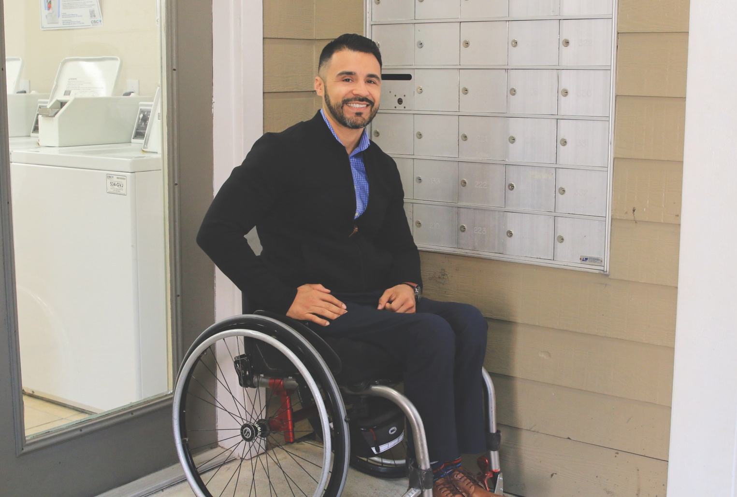
The Protected Classes
The Fair Housing Act prohibits housing discrimination against any of the following protected classes:
Race
Color
National Origin
Religion
Sex
Familial Status
Disability
Notes:
The Fair Housing Act prohibits discrimination against any of the following protected classes:
Race, Color, National Origin, Religion, Sex, Familial Status and Disability.
Let’s walk together through each class so we all are on the same page on who is covered by the class and what examples of discrimination might look like.

Slide 49
Protected Class: Race
Refers to the grouping of humans based on shared physical or genetic traits associated with an ethnic group such as:
Skin Color
Hair Texture
Facial Features
Distinctive Features
Notes:
Race is a grouping of individuals based on shared physical or genetic traits. It can include skin color, hair texture, facial, and other physical or genetic traits associated with a racial or ethnic group.
Race refers to being White, Black, Asian, Pacific Islander, etc. It’s important to note that racial discrimination includes discrimination for perceived race or being biracial. The question “what are you?” or “where is your family from” can be a sign of racial discrimination. Also, racial discrimination can occur because

Slide 50
Protected Class: Color
Refers to the pigmentation of the skin as an indication of someone’s race
Color is included separately from race because people can discriminate solely on color
Individuals with darker skin tend to experience more frequent incidents of discrimination in housing
Notes:
Color – the pigmentation of the skin as an indication of someone’s race. It’s included separately from race because people can discriminate solely on color. For example, someone can discriminate against another person whose skin is lighter or darker.
Color may, or may not, be related to race or national origin. One skin color is not more protected than another. That being said, it is important to note that color discrimination (or colorism) can occur by individuals within the same race, and that people with darker skin tend to experience incidents of discrimination in housing more frequently.
The Fair Housing Act protects against housing discrimination based on the color of one’s skin. This means that a person may not be treated differently, denied, or harassed in their home or during a housing transaction because of their skin color.

Slide 51
Protected Class: National Origin
The relationship between and individual and a state. Refers to a person’s:
Birthplace
Ancestry
Ethnic Background
Language / Limited English Proficiency
Customs
Notes:
National Origin – is the relationship between an individual and a state and refers to a person’s ancestry, birthplace, ethnic background, or language.
Discrimination based on nation of origin means discrimination based on not only where you are from, but where your family is from and your language or customs. For instance, creating more favorable rental terms for native English speakers is an obvious case of discrimination.
Of note, discrimination based on Limited English Proficiency--the limited ability to read, write, speak or understand English--can also be considered race discrimination.

Slide 52
Protected Class: Familial Status
Protects families with children under the age of 18 from discriminatory actions, including:
Legal guardians
Adoptive parents
Foster parents
Pregnant women
Grandparents w/ dependents
Any person in the process of acquiring legal custody of a child
Notes:
Familial status protects families with children under the age of 18 from discriminatory actions including couples adopting children, legal guardians of children, foster parents, grandparents with dependents, and pregnant women.
Like in the case of other protected classes, landlords should be aware of both obvious and more subtle forms of discrimination based on familial status. For instance, denying a rental property to a tenant who otherwise qualifies for a unit because he/she has a toddler child is an obvious form of discrimination.
However, cases have existed where landlords group families with small children into less desirable areas of the apartment complex. While this may be a defensive move to counter noise complaints, it unfairly restricts access to units that are otherwise available to other residents.
Other examples include restricting how families with children can use common areas, charging additional fees for children, restricting children from playing outside.

Slide 53
Protected Class: Religion
Refers to all aspects of religious belief, observance, and practice:
Overt discrimination against members of a particular religion
Indirect discrimination such as zoning to limit use of private homes as a place of worship
Notes:
The Fair Housing Act prohibits housing providers from treating renters or homebuyers differently because of their religion or because they engage in religious practices and rituals.
Discrimination includes refusing to rent or sell, charging more, or offering different terms to someone because of his or her religion.
Housing providers are prohibited from making discriminatory statements or publishing discriminatory advertising, as well as from making false statements about availability.

Slide 54
Protected Class: Sex
The range of characteristics pertaining to and differentiating between masculinity and femininity based on biological sex.
Includes prohibitions on:
Gender Stereotyping
Sexual Harassment
Discriminatory Pricing
Notes:
Sex is the range of characteristics pertaining to and differentiating between masculinity and femininity based on biological sex. Gender stereotyping , sexual harassment and discriminatory pricing all examples of discrimination based on sex.
An example of this would be…having a policy of not renting garden or basement apartments to single women for their own protection or safety.
In 2021, HUD announced that it will administer and enforce the Fair Housing Act to prohibit discrimination on the basis of sexual orientation and gender identity under the protected class of sex.

Slide 55
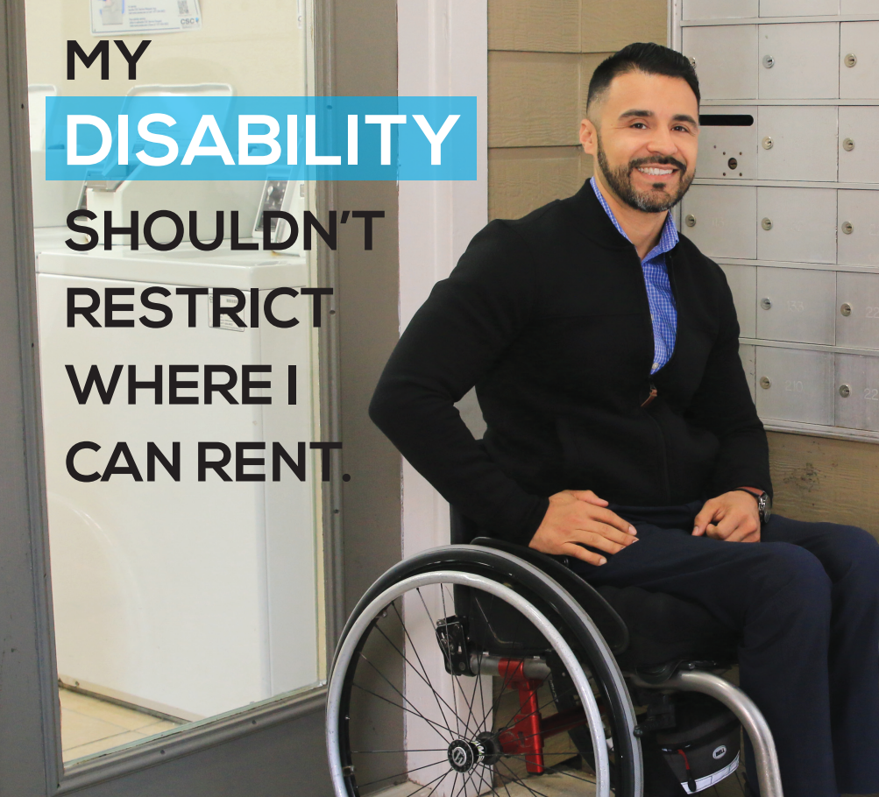
Protected Class: Disability
Includes physical, cognitive, intellectual and mental impairments if impairment substantially limits major life activities:
Self-Care
Learning
Mobility
Self-Direction
Receptive or expressive language
Capacity for independent living
Economic self-sufficiency
Notes:
The Fair Housing Act prohibits discrimination against individuals who have disabilities or who are associated with people with disabilities.
A disability is a physical or mental impairment that substantially limits major life activities, such as walking, seeing, hearing, speaking, learning, working, caring for oneself. People who are regarded as disabled or have a record of a disability are also protected.
Discrimination based on disability can also occur if a person is denied reasonable accommodations such as: allowing assistance animals or providing an assigned parking space closer to the unit….as well as reasonable modifications that would allow a person full use of housing features such as lowering cabinets and light switches, or installing a ramp.

Slide 56
What is Not Protected?
The following are not considered protected classes under the Fair Housing Act:
Source of income
Age
Marital status
Criminal record
Notes:
There are certain groups that are not directly protected under the fair housing act. However, sometimes these are associated with a protected class, so we want to make sure you are aware of these potential connections.
The following are not protected classes under the federal law:
Source of income - The State of Texas ruled that local jurisdictions could not enact laws that prohibited an owner from refusing to lease or rent to a person because of the person’s lawful source of income to pay rent, like funding from housing assistance programs. Some housing advocates believe that when landlords can discriminate against tenants based on their source of income, housing discrimination can be perpetuated since the majority of Housing Choice Voucher participants are persons of color.
Age -- Age is not a protected class, but both families with children and disabilities are, both of which can be often be tied to age discrimination.
Marital status -- can be closely associated with familial status
And Criminal Record. People with criminal records are not protected by the fair housing act – However, according to HUD, due to racial and ethnic disparities in the U. S. justice system, criminal-history-based-restrictions on access to housing are likely to disproportionately affect Black and Hispanic persons.

Slide 57
Housing Discrimination

Slide 58
Types of Discrimination
Overt Discrimination
Unequal Treatment
Disparate Impact
Notes:
Let’s take a moment to discuss what discrimination means and how it can look in practices.

Slide 59
Overt Discrimination
Actively and openly limiting access to housing on the basis of a protected class.
Example: Refusing to rent to someone solely because he was born in Saudi Arabia and is a Muslim.
Notes:
Overt Discrimination: Actively and openly limiting access to housing on the basis of protected class. An example of direct evidence would be the refusal to rent to someone solely because he was born in Saudi Arabia and is Muslim. That would represent discrimination on the basis of national origin and religion.

Slide 60
Unequal Treatment
Treating people differently based on protected class status.
Example: Requiring a renter with two children to pay twice the security deposit of a renter without children.
Notes:
Unequal Treatment: Treating people differently based on protected class status; for example, requiring a renter with two children to pay twice the security deposit of a renter without children is discrimination on the basis of familial status.

Slide 61
Disparate Impact
Having a discriminatory effect on a protected class while appearing to treat everyone the same.
Example: An apartment complex only allows people with full-time jobs.
Notes:
Disparate Impact: Having a discriminatory effect on a protected class while appearing to treat everyone the same. For example, giving preference to renting to households with people who don’t work in the local fish cannery would have a disparate impact on the Latino population if the vast majority of cannery workers are of Hispanic national origin.

Slide 62
Fair Housing and Renters

Slide 63
Fair Housing Complaints
Basis of Closed Fair Housing Complaints Filed 2011-2020
Notes:
Let’s look at the Fair Housing complaints currently being received in Houston. Here we have a pie chart depicting the fair housing complaints filed, and closed from 2011 to 2020. It shows that over the last 10 years, the two largest shares of complaints by basis are disability discrimination and racial discrimination, AND key to this discussion, most of the issues identified in complaints were related to discrimination in rental housing.

Slide 64
Fair Housing Complaints
Number of Closed Fair Housing Complaints Filed 2011-2020
Notes:
The City of Houston has 2.3 million people and almost one million households. But we have relatively low amount of housing complaints that are filed each year. On average about 100 fair housing complaints are reported—this is low for a city the size of Houston, and to be clear, it is likely not because there is a lack of discrimination.
Fair housing discrimination is highly likely to be underreported in the city of Houston. This underreporting likely stems from several sources:
people don’t know about their rights under the fair housing act
residents don’t know how to report housing discrimination or fair housing violations
residents are focused on accessing housing
And frankly, its sometimes hard to identify when housing discrimination has occurred

Slide 65
Renter Households in Houston
Most Houston households (59.7%) are renters
Almost one-quarter of renter households pay more than half of their income on rent
Nearly half are considered cost-burdened (47%)
Houstonians must earn $21.02/hr to afford an average 2-br market-rate rental
Source: U.S. Census Bureau, American Community Survey
2015 – 2019 5-year estimates
Notes:
So we’ve discussed the Fair Housing complaints we see in Houston. There’s another aspect of the Houston rental market that is a major concern in fair housing: how rent cost is affecting particular protected classes in our city.
Let’s break this down. Houston is a majority renter city! Most Houston households are renters—59.7%!
The minimum hourly wage in Texas is only $7.25 which means that a minimum-wage worker would have to work 115 hours a week to afford this rent—which means they would have to work 3 full-time jobs. Houstonians must earn $21.02 an hour to pay for an average two-bedroom rental home.
Which means the reality is over half of Houston renters pay more than 30% of their income in rent. 51% of renter households pay more than half their income in rent. We refer to this as cost-burdened.
A family that is cost burdened means they have fewer financial resources to pay for other needs such as health care, education or food.

Slide 66
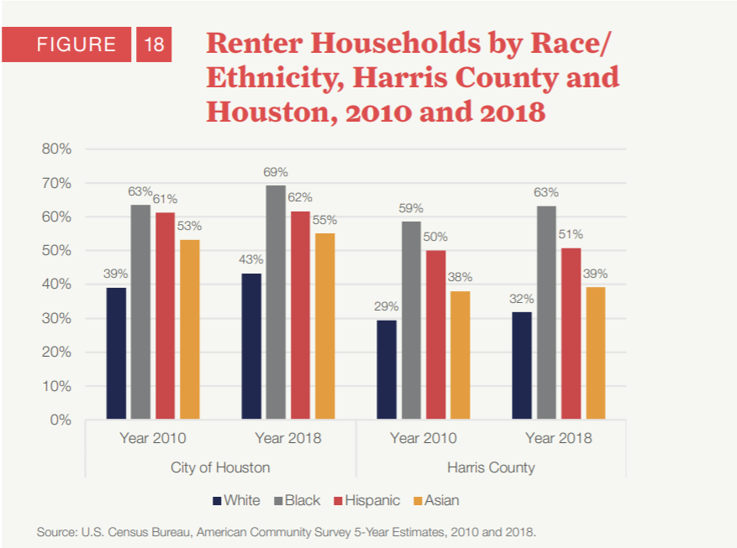
Who is Renting in the City of Houston?
More than two-thirds of Black households
Almost two-thirds of Hispanic households
Compared to only about 40% of White households
Notes:
This becomes a Fair Housing concern when we look at what is called disparate impact—or a type of unintentional discrimination in which policies, practices or in this case systems result in a disproportionate impact on a protected group.
In Houston, renters problems disproportionately impact households of color and immigrant communities:
2/3rds of Black households and Hispanic households are renters
More than half of Asian households are renters
Compared to only 40% of Non-Hispanic white households

Slide 67
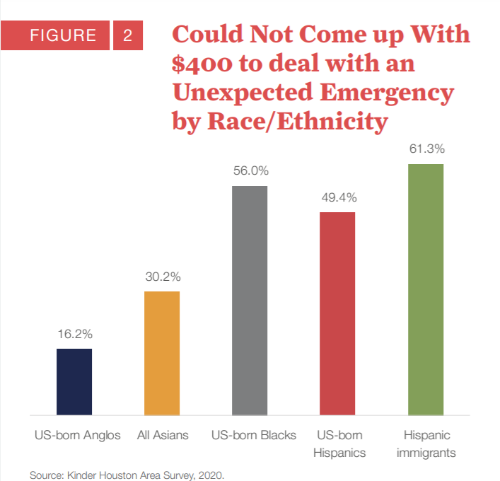
Fair Housing & Evictions
Renters’ housing insecurity leads to eviction
4.5 in 100 renter homes evicted each year (Kinder)
Total evictions in 2016: 11,082
30.36 households each day
“The chance of a tenant losing an eviction case is higher in neighborhoods that are majority Black or Latinx.” (January Advisors)
Notes:
Houston’s average eviction rate is massive at 4.5% and is the third in total evictions by city behind New York City and Indianapolis.
According to Eviction Lab’s data, in 2016 over 11,000 households faced eviction: a little more than 30 households each day
In other words, in Houston for every 100 renter homes FOUR and a HALF face eviction each year according to the Kinder Institute.
The disparate impact on Black and Hispanic households continue when we look at eviction. According to January Advisors, the Kinder Institute and Eviction Lab, the chance of a tenant losing an eviction case is higher in neighborhoods that are majority Black or Hispanic. You can see this illustrated further by the chart on the right which illustrates the financial insecurity Houston households are experiencing. With Hispanic immigrant, US-born Hispanic and US-born Black households all at or above 50% not being able to deal with an unexpected $400 emergency.

Slide 68
Disparate Impact
"Geography of evictions tells us a lot of where evictions are occurring. A lot of the high eviction neighborhoods hug the beltway where we see higher numbers of foreign-born or immigrant populations, so tenants might not know their rights to council for an eviction filing."
Luis Guajardo
Urban Policy Research Manager
Kinder Institute’s 2021 State of Housing
Notes:
Luis Guajardo from the Kinder Institute affirmed this point in the 2021 State of Housing report:
“the geography of evictions tells us a lot of where evictions are occurring. A lot of the high evection neighborhoods hug the beltway where we see higher numbers of foreign-born or immigrant populations, so tenants might not know their rights to council for an evection filing.“

Slide 69
Tenant / Landlord Presentation

Slide 70
Tenant-Landlord Relations
Notes:
Today we are going to talk about four key components of landlord-tenant relations:
Rent Readiness
Tenant Responsibilities
Landlord Responsibilities, and the
Eviction Proc
We think it is key that renters are aware of [MAKE ARGUMENT]

Slide 71
Rent Readiness
Are you ready to be a renter?
What can you afford to pay? Where do you want/need to live?
Pay old fines/fees from previous housing unit
Criminal background check will be performed
Complete application accurately
Tell the truth
Include all household members
Pay all funds required
Lease Agreement
READ YOUR LEASE!!!
Strike out undesirable statements
Keep a copy of your lease
Notes:
Rent Readiness
Where can you afford to live? It is a good rule of thumb to spend no more than 30% of your monthly income on rent and utilities. Many property management companies require you to have income that is 3-3 ½ times of the rent amount.
Consider where do you want/need to live? Do you have a car or do you need to live close to public transportation? Do you want to live by your job, by family, by your doctor, by your school? Take these into consideration when you are looking for a place to live. Real Estate agents do provide apartment locator services at no cost to you. Look for leasing specials to get discounts on rent.
Find the place that meets your needs
This will be your sanctuary
Make sure you feel safe
Make sure to tell the truth on the application and provide thorough credit history.
Your lease application can be turned down for:
Lies and omissions on the application can be another reason for a lease turn-down.
Previously broken leases on your record can weigh against the tenant.
No listed income or poor credit history can cause a lease turn-down.
Deferred adjudications may weigh against the tenant.
The question is usually have you been convicted? Do not include arrests that did not lead to a conviction.
Read the entire lease before you sign, make sure you agree with all statements, don’t sign without reading the entire lease, strike out undesirable statements like no unannounced entry and warning of adverse actions.
Do not accept statements like these:
The landlord or manager may enter your home at any time.
The landlord or manager will not give advance notice in the case of eviction.
The landlord or manager may take non-exempt property for back rent.
The landlord or manager may end your lease because you are an “undesirable tenant.”
The landlord can sue you at any time and you aren’t able to protest (possibly using mediation).
If your landlord will not agree to taking out these phrases, try to rent elsewhere.
Some of these clauses are standard on HAR / TAR leases.

Slide 72
Tenant Responsibilities
At Move-In
Schedule a walk-through
Submit written work orders, if needed
Document move-in conditions
Complete application accurately
During Your Stay
Pay rent on-time
Adhere to the lease
Keep your unit clean
Submit written work orders
Be a good neighbor
Lease Is Up
Renewal & Rent Increases
Schedule a walk-through
Document move-out conditions
Leave a forwarding address
Notes:
At Move-In
Schedule a walk-through
Submit written work orders, if needed
Document move-in conditions
Complete your application accurately
During Your Stay
Pay rent on-time
Adhere to the lease
Keep your unit clean
Be a good neighbor
When submitting repairs in writing from your landlord:
Take 2 copies of written request into the leasing office and ask them to initial and date your copy. This is your proof that you made the request. Emails may work.
If you call and make the request, the purpose of calls are not always recorded and will not stand up as proof in court.
Don’t perform the repairs and deduct the costs from the rent!
You can call 311 (if you actually live in the City limits for Houston) if no repairs occur after your written request was presented and enough days went by and the landlord remains unresponsive.
Ask that inspectors be sent to your complex to inspect your unit.
You will get a service request number when you call 311. Wait at least a week to call back if there is no City inspector comes in.
This information is detailed in a handout, which will be distributed at the end of the presentation.
Inside environmental (Mold, Rats, Roaches, and Bedbugs, Smells). 832-393-5750
Outside environmental (Raw sewage, Broken Stairwells, and other thing that may deemed an injury Hazard. 832-393-5730
Lease Is Up
Renewal & Rent Increases:
A couple of things to note:
The landlord has no limits to any rent increases. Texas is a market-driven state.
Rent controls do not exist in the State of Texas or the City of Houston.
The Governor may introduce rent controls for up to thirty (30) days in response to a natural disaster such as a hurricane or damaging tropical storm. If a natural disaster occurs and the governor does declare rent controls in the area, only the legislature can extend the rent controls beyond the 30 days
Rent can only be increased at the end of your current lease, as long as proper notification is provided.

Slide 73
Breaking Your Lease
READ YOUR LEASE!!!
Stipulations for early lease termination
If no stipulations, you must adhere to the lease
Read the lease to see how many days you need to give notice
Four ways to break your lease in Texas
Active military orders to move
Protective Order against a household member
Police report documenting a sexual assault at the unit
Constructive Eviction
Ways that you CANNOT break your lease
Purchase of a home
Relocating for new job or to take care of a relative
Crimes such as general assault, burglary of unit
Notes:
READ YOUR LEASE!!!
Read the lease before you sign it in the first place and refer to the lease when seeking to leave or break the lease.
Four ways to break your lease
You are allowed to leave your lease without further financial responsibility for the following reasons:
Active military orders to move
Domestic violence (Violence Against Women Act of 1994 (VAWA)) as evidenced by a restraining order/police report
Sexual assault at the unit (Violence Against Women Act of 1994 (VAWA)) as evidenced by a police report
Constructive Eviction, but you must take your landlord to court first
Ways you CANNOT break your lease
Examples of actions that will not allow you to get out of a lease:
Purchase of a new home prior to the end of your lease.
You get a new job or are transferred to another city.
You have to move to take care of a relative.
Crimes such as general assault, burglary, damage to property, etc.
The landlord may assess the rent for the remainder of the lease period. (In other words, charge you for all remaining months of the lease period.)
You may be responsible for damages (or costs) the landlord incurs in trying to lease the dwelling to another tenant (like advertising costs, or unrented periods of time).
Take documentation to prove to the court that the actions you are stating actually took place (documents, pictures, witnesses, etc.)

Slide 74
Deposit & Damages
Small Claims Court (or JP Court)
Security Deposit not Returned
Damages up to $10K
Notes:
KEEP YOUR SECURITY DEPOSIT for more than 30 days after you move to a new home unless a few conditions apply. The conditions include:
You do not leave a forwarding address;
You leave owing rent;
Within 30 days the landlord gives you an itemized list of how your deposit was spent on repairs for damages you did to the house or apartment.
If, after thirty (30) days, you have received a negative reply or no reply at all, you may sue in Small Claims Court.
Write down the amount of money you believe you deserve (under $10,000.00) and why you believe the landlord owes it to you.
Because you are suing, you must have proof of the reasons you deserve the money.
Example: Your furniture was left in the rain for several hours while your landlord was moving it. You feel you deserve the money it will take to repair the damages.

Slide 75
Landlord Responsibilities
Warrant of Habitability
Access
Repairs
Property Management
Notes:
Now let’s discuss the responsibilities of landlords:
Warrant of Habitability
The Texas law, Warrant of Habitability, states that the landlord must provide safe, clean, and habitable housing for the tenant.
Any warrant of habitability court action taken by a tenant must be filed in the District or County Court, and cannot be filed in the Justice of the Peace Courts.
A landlord may not retaliate against a tenant within 6 months.
A landlord has no duty to repair damages or defects caused by the tenant or the tenant’s family or guests.
OF NOTE: This law prohibits a tenant from withholding rent when a landlord fails to make repairs.
This law covers only the very basic conditions that affect the tenant’s health or safety, and does not include comforts that a tenant may expect but do not effect these basic needs.
Safety
Examples of health issues include, but are not limited to:
Mold
No hot water
No utilities
Vermin infestation
Examples of safety include, but are not limited to:
Need to have keyed deadbolt and keyless deadbolt on all main exterior doors. This includes garage entry, if applicable.
Peepholes also need to be on all main exterior doors.
Sliding glass doors need both pin lock and security bar.
Window latches must be installed on every window.
The landlord cannot retaliate against a tenant for asking for security devices.
A landlord cannot KEEP YOU OUT OF YOUR HOME for any reason. If you are locked out by your landlord, he or she must leave a note saying where the key is.
You are not required to pay back rent to receive the key.
If he or she will not give it to you, call a lawyer. You might also call the police.
Health and safety issues need to be taken care of within 48 hours; all other repairs should be done in 7 days.
Inside environmental (Mold, Rats, Roaches, and Bedbugs, Smells). 832-393-5750
Outside environmental (Raw sewage, Broken Stairwells, and other thing that may deemed an injury Hazard. 832-393-5730
CUT OFF YOUR UTILTIES. -Since 2010, landlords cannot cut any utilities by Texas statutes.
Access
If you have a disability and require reasonable accommodations or modifications, your landlord must comply. You may be responsible for paying for your own modifications. Will discuss this further in a moment.
Property Management
KEEP AREAS USED BY ALL TENANTS IN SAFE CONDITION, including stairs and other areas.
LET TENANTS ENJOY THEIR HOME.
TELL YOU ABOUT KNOWN PROBLEMS in the unit, such as a leaky roof or bad plumbing.
Your home must also be safe and livable.
Hot water, heating, plumbing, etc. should be adequate.
If your City of Houston home isn’t kept in a livable condition, contact 311 and give your address and zip code.
They will refer you to the City’s Housing Code Division, Building Inspection Division, or Health Department, as needed.
A landlord has no right to come into your home without your permission, except in an emergency such as fire, unless your lease says otherwise. The landlord would be trespassing, and you may wish to contact a lawyer.
If he or she deliberately conceals this type of information, you have the right to consider the lease broken and to move out without paying any rent.
You should contact a lawyer if you plan to do this.

Slide 76
Reasonable Accommodations and Modifications
Grab Bars
Roll Under Sink
Widened Doorways
Ramps
Notes:
A reasonable accommodation is a change in rules, policies, or practices that may be necessary to afford a person with a disability an equal opportunity to use or enjoy a dwelling. A reasonable accommodation can be allowing a tenant to transfer to an mobility or accessible unit without a transfer fee.
Pictured are reasonable modifications. Reasonable modifications can be structural modifications such as:
Installing grab bars, low or no step shower, hand held shower nozzle, seating installed in the shower
Removing lower cabinets underneath the sink to allow for someone using a wheelchair
Widening doorways for tenants using walkers and wheelchairs
Ramps to allow people using wheelchairs to access their unit

Slide 77
Constructive Eviction
Removal of
Front Door
Landlord Entering Unit
Lockouts
Disconnected Utilities
Notes:
If the tenant is late on paying rent or unit has been damaged/destroyed by the tenant or guests, the landlord must exercise the proper protocols to evict the tenant.
If the tenant tries to pay the rent and the landlord refuses to accept rent, go back with a check or money order, bring a witness and document it.
Use devices to record your attempt to pay the rent.
Don’t use fellow tenants as the witness – this may compromise their standing in the landlord / management’s eyes.
Doctrine of Constrictive Eviction
The landlord has a duty to remedy units in disrepair that make it impossible or extremely difficult for the tenant to occupy the unit by removing the front door, disconnecting the utilities, locking the tenant out with no instructions on how to gain access to the unit, and entering the unit without notice. Many things constitute constructive eviction, while others do not. If you are not sure, call a lawyer.
Constructive Eviction is the only way to be get out of your lease without being asked to leave.
The judge has to be able to see from your timeline and sequence of events to show that you provided the landlord ample opportunity to remedy the situation.
Once the judge agrees, you are free of further obligation to pay rent if you move as soon as possible as a result of this action.
Constructive Eviction is anything that keeps me from enjoying decent, safe, and sanitary housing.
The tenant may be eligible for prorated rent, security deposit, or other actions.
Also, the landlord constantly trespasses (enters your apartment without your knowledge or consent)
Lockouts
Landlord can lock you out for non-payment of rent if lease has a lockout provision. Generally lock is changed
Manager must leave a note stating how to gain access. You must have 24 – 7 availability to enter your unit
Landlords can hold onto electronic equipment, but it must be stored for 30 days & returned when delinquent payments have been submitted to the landlord.
Payment of any monies owed cannot be a condition of being allowed into the rental unit.
If the manager refuses to allow the delinquent tenant access to the unit, the tenant can file suit in the same Justice of the Peace Court that would be used by the landlord to evict the tenant. (This is based on the zip code of the complex.)
The tenant can sue for one (1) month’s rent, plus a $500 penalty and $100 for filing fees based on the landlord’s illegal lockout.
If the tenant offers the landlord the monies owed during that thirty (30) day period, the landlord must return the tenant’s possessions.
If more than thirty (30) days have passed, the landlord can sell the tenant’s possessions and apply the proceeds to the tenant’s bill. Any additional money beyond what the tenant owes the complex is to be returned to the tenant.
Lockouts need to be covered in the lease agreement.
They must let you in your unit within 2 hours of your contacting them to let you in.
If the landlord / management does not let you in, you may go to the Justice of the Peace Court and file for a Writ of Re-entry ($30.00).

Slide 78
Eviction
3-Day Notice
Do Not Move
If Forced
Notes:
Now let’s discuss the eviction process. It’s important that renters understand the process so that they can advocate for their rights.
The landlord may give you from one (1) to thirty (30) days to move must be given to the tenant personally, by mail, or posted on the inside of the front door.
YOU DO NOT HAVE TO MOVE within this landlord imposed timeline.
Landlord CANNOT use force
Call 911 if landlord uses force

Slide 79
Eviction
Justice of the Peace Court Notice
Go to Court
File an Appeal
Notes:
Justice of Peace Court
Next you’ll receive an official eviction notice with a court date on the back.
Go to court on the date assigned to you, and the Judge will decide when you have to move.
If you do not appear in court on the given date, you will most likely lose by “default.”
Appeals Process – you must file in County Court within 5 days of the hearing.
Pauper’s Affidavit -- You can ask the court to waive or suspend filing fees by filing a pauper's affidavit. Be prepared to provide information regarding your income and other personal financial details.
But also be prepared to move out quickly.
It may be a good idea to store most of your goods or belongings elsewhere.
This gives you the ability to move without having your property “handled” by others.
Writ of Possession occurs:
After the eviction judgment is made;
If no appeal is made by the tenant; and
The landlord files a Writ of Possession in the JP Court.

Slide 80
Forcible Entry & Detainer Evictions
Notes:
Constable’s Office handles actual eviction
Constable’s Office is the only one that can evict. Not your landlord. Call 911 if landlord uses force

Slide 81
B. Sample Exercise Examples

Slide 82
Small Group Exercise: Breaking Down Barriers

Slide 83
Exercise: Breaking Down Barriers
Objective
The purpose of this exercise is to better understand the barriers to fair housing choice and housing discrimination and promote dialogue around fair housing.
When to Use this Exercise
For large or small community meetings and focus groups with 3 or more participants
Social distancing modification: Consider holding discussion groups outside or via video conferencing software or conference call

Slide 84
Exercise: Breaking Down Barriers
What you’ll need
Two staff members or volunteers to be a Facilitator and a Notetaker
A group of 3 or more people to participate
Pen and paper to record responses
Copies of the “I am Protected” PSA flyers found at http://www.houstontx.gov/housing/fair-housing.html

Slide 85
Exercise Instructions
Before the event, the Facilitator will select one or more protected classes to discuss. At the event, the Facilitator will distribute the printed PSAs of the selected protected class(es) to the participants. The Facilitator will introduce the exercise by reading the following out loud:
“Today we will examine how the protected classes experience barriers to fair housing choice. We will begin by reviewing the City of Houston’s PSA flyer on the protected class of (insert chosen protected class). Then, I will review some facts and examples of housing discrimination against the protected class. Afterwards, we will discuss ways that you think would reduce housing discrimination against the protected class.”
The Facilitator will then read the Facilitator Information called “Breaking Down Barriers” for the selected protected class PSA. For each protected class, after the Fair Housing Facts has been read, the Facilitator will moderate a discussion using the Discussion Questions at the end of the Facilitator Information. The Notetaker will take detailed notes to record the feedback from the participants.

Slide 86
Breaking Down Barriers: Race/Color
Fair Housing Facts
Although most fair housing discrimination goes unreported because people do not know how they are protected through the Fair Housing Act, housing complaints can reveal trends about the types of housing discrimination that is occurring in the area.
According to the National Fair Housing Alliance’s 2018 Fair Housing Trends Report, almost one in five fair housing complaints was based on race.
In Houston, housing discrimination based on race is significantly higher than the nation with almost one third of HUD fair housing complaints filed in 2010-2018 based on race.
Examples of Housing Discrimination based on Race/Color
A homeowner quotes a higher home price to Black homebuyers than to White homebuyers.
A realtor shows homes located in low-income neighborhoods only to people with darker skin color.
A Black renter is told there is plenty of availability on the phone, but when they visited the apartment complex, they are told no apartments are currently available.
An apartment manager enforces community rules differently—or fails to make needed repairs—for residents of certain races.
A potential renter is promised an answer on their application, but no one calls back and no returns their calls.
Discussion Questions
Have you or anyone you know experienced housing discrimination based on color and/or race? If so, what happened and how did you react?
Do you believe that discrimination in financial practices in housing, such as offering higher mortgage rates to only people of a certain race/ethnicity, is a barrier to fair housing choice in Houston? Why or why not?
How would you educate people who might face discrimination based on race/color about the Fair Housing Act and empower them to report acts of housing discrimination?

Slide 87
Breaking Down Barriers: National Origin
Fair Housing Facts
Although national origin is the third most reported type of housing discrimination in Houston, the number of complaints based on national origin is likely very low most likely because foreign-born residents may not report housing discrimination due to citizenship status, language barriers, and lack of knowledge about the Fair Housing Act. Additionally, residents may face discrimination on the basis of national origin even though they were born in the United States, due to assumptions made about the way the person looks or speaks.
According to the National Fair Housing Alliance’s 2018 Fair Housing Trends Report, the fourth most frequent basis of discrimination was national origin, receiving 6.8% of all fair housing complaints nationwide. In Houston, national origin is the third most reported type of housing discrimination at 9.3% of all closed HUD fair housing complaints filed from 2010-2018.
Examples of Discrimination based on National-Origin
A realtor refuses to assist a homebuyer who has limited English proficiency.
A landlord says a Vietnamese couple must live in a specific building with other Vietnamese families.
A landlord refusing to process applications because no social security number (or other identification available only to U.S. citizens and documented residents) is available.
Advertising property for sale or rent only in non-English languages.
Refusing to provide documents in a tenant’s primary language.
Discussion Questions
Have you or anyone you know experienced housing discrimination? If so, what happened and how did you react?
In Houston, almost one-third (29%) of the population is foreign born, and almost half (48%) speak another language other than English at home. Is the acceptance of foreign-born residents an issue in Houston? How would you increase neighborhood acceptance for foreign-born Houstonians?
How would you educate foreign-born residents about the Fair Housing Act and empower them to report acts of housing discrimination?

Slide 88
Breaking Down Barriers: Familial Status
Fair Housing Facts
Familial status is the third most frequent basis in the United States for discrimination with 9.3% of all housing complaints. In Houston, familial status was the basis of 6.3% of all closed fair housing complaints filed between 2010 and 2018.
According to a study by HUD, 3 out of 5 persons did not know it was illegal to treat households with children differently from households without children.
Examples of discrimination against familial status include a landlord refusing to rent a unit to a parent with a child, a landlord charging a higher security deposit to families with children, or increasing rent because a resident brings a child into the household.
Recent Case: Hamas v. Woodcrest Condominiums Association
Complaint: Woodcrest Condominiums Association allegedly violated the Fair Housing Act by restricting families with children to first floor units. The plaintiffs were a young couple that were steered to a first-floor unit because they planned to have children. A single woman in the process of obtaining custody of her minor nephew was denied permission to live with her nephew in her third-floor unit.
Outcome: The Woodforest Condo Association revised their bylaws to remove the requirement restricting families with children to first floor units and restrictions on children’s conduct in common areas. In addition, board members and employees were required to receive fair housing training.
* The above example is about a condominium association, but the same would also apply to rental units.
Discussion Questions
Have you or anyone you know experienced housing discrimination? If so, what happened and how did you react?
What can be done to reduce housing discrimination against familial status?
Did you know it was illegal to discriminate against families with children? Why do you think so few people are aware of this law?
How could children be educated about the Fair Housing Act and housing discrimination?

Slide 89
Breaking Down Barriers: Disability
Fair Housing Facts
Housing discrimination on the basis of disability can be easier to identify than other types of discrimination, as it usually involves a denial of a request for a reasonable accommodation or modification (such as widening doorways or installing ramps and grab bars) to make the home more accessible. According to the National Fair Housing Alliance’s (NFHA) 2018 Fair Housing Trends Report, the majority of fair housing complaints involved persons with disabilities - 56.7% of all cases.
The Department of Justice and the NFHA has filed almost 100 cases against developers and owners of multifamily properties, alleging the housing is non-compliant with the design and construction requirements of the Fair Housing Act. These cases have affected more than 70,000 homes and resulted in more than $33 million in compensation to those impacted. These cases have also made more homes in multifamily properties of accessible to persons with disabilities.
Discussion Questions
Have you or anyone you know experienced housing discrimination? If so, what happened and how did you react?
How would you work with multifamily rental housing developers to increase the number of newly constructed accessible units for persons with disabilities?
How would you work with landlord and property management companies to become compliant with design and construction requirement of the Fair Housing Act?
How would you educate the public about housing discrimination based on disability?
What are ways to empower people with disabilities to become fair housing advocates?

Slide 90
Breaking Down Barriers: Religion
Fair Housing Facts
According to a 2019 Pew Research Center survey, six out of ten American adults (63%) say being Muslim hurts someone’s chances for advancement in American society, while thirty-one percent (31%) say it hurts their chances a lot. One in five American adults also said being Jewish hurts someone’s chances in getting ahead, while fifteen percent (15%) say the same about being evangelical.
Recent Case: United States v. San Francisco Housing Authority
Complaint: In 2004, the San Francisco Housing Authority was alleged to have violated the Fair Housing Act by practicing a pattern of discrimination against public housing residents on the basis of religion. San Francisco public housing residents alleged religious harassment, including verbal abuse, racial slurs, threats, assaults, vandalism, and robbery, and that the housing authority had knowledge of the harassment but failed to take reasonable steps to protects its tenants as required by law. The alleged victims of harassment were residents of the Muslim faith. The United States contended that the harassment of residents of Iraqi descent and Muslim faith increased following the terrorist attacks of September 11, 2001.
Outcome: The San Francisco Housing Authority was ordered to pay $200,000 to compensate victims of discrimination and required to modify its civil rights policy to ensure prompt action in response to complaints, to establish a civil rights complaint hotline with a language translation service, to train its employees to identify and respond to civil rights complaints, and to submit to monitoring by the Department of Justice and the Department of Housing and Urban Development.
Discussion Questions
Have you or anyone you know experienced housing discrimination? If so, what happened and how did you react?
How would you educate the public about housing discrimination against religion?
How can more accepted faiths help to educate the public about housing discrimination against religion, especially for the religions that face the most discrimination?
What could be done to more strictly enforce the Fair Housing Act in Houston?

Slide 91
Breaking Down Barriers: Sex
Fair Housing Facts
In recent years, the Department of Justice has increased the focus on sexual harassment in housing. Women, particularly who are poor and with limited housing options, often have little recourse but to tolerate the humiliation and degradation of sexual harassment or risk having their families and themselves removed from their homes.
According to the National Fair Housing Alliance’s (NFHA) 2018 Fair Housing Trends Report, sex is the fifth most frequent basis of discrimination in the U.S. with 6.7% of all fair housing discrimination cases in 2017.
Recent Case: United States v. Bruno
Complaint: Richard Bruno, co-owner/agent/property manager, was alleged to have engaged in a pattern or practice of quid pro quo sexually harassment of current and prospective female tenants and their minor children at several properties in and around New London, Connecticut from 2011 until 2016. Bruno often retaliated against the tenants by denying rental benefits, entering units without permission, threatening to evict tenants, or evicting these tenants.
Outcome: Bruno pleaded guilty and was sentenced on September 28, 2017 to 16 years in federal prison for producing child pornography in one of the properties he managed. He is currently incarcerated.
Discussion Questions
Have you or anyone you know experienced housing discrimination? If so, what happened and how did you react?
How would you encourage tenants experiencing harassment by their landlord or other rental property staff to report acts of housing discrimination?
Although many states and cities can prohibit housing discrimination based on additional characteristics, like sexual orientation and gender identity, neither the State of Texas nor the City of Houston recognizes any additional protected classes. Are there additional protections needed in Houston?
What can be done to include additional protected classes, such as sexual orientation and gender identity, as protected classes in Houston?

