Slide 1
Cultivating a Competitive & Diverse Economic Environment
Presented by:
Marsha E. Murray, Director
Pearl K. Cajoles, PIO/External Affairs & Workforce Development Manager
Sept. 9, 2020

Slide 2

The Office of Business Opportunity
The Office of Business Opportunity is committed to cultivating a competitive and diverse economic environment in the City of Houston by promoting the success of small businesses and developing Houston’s workforce, with a special emphasis on historically underutilized businesses and disenfranchised individuals.
Key Objectives: Educate, Connect, and Grow

Slide 3
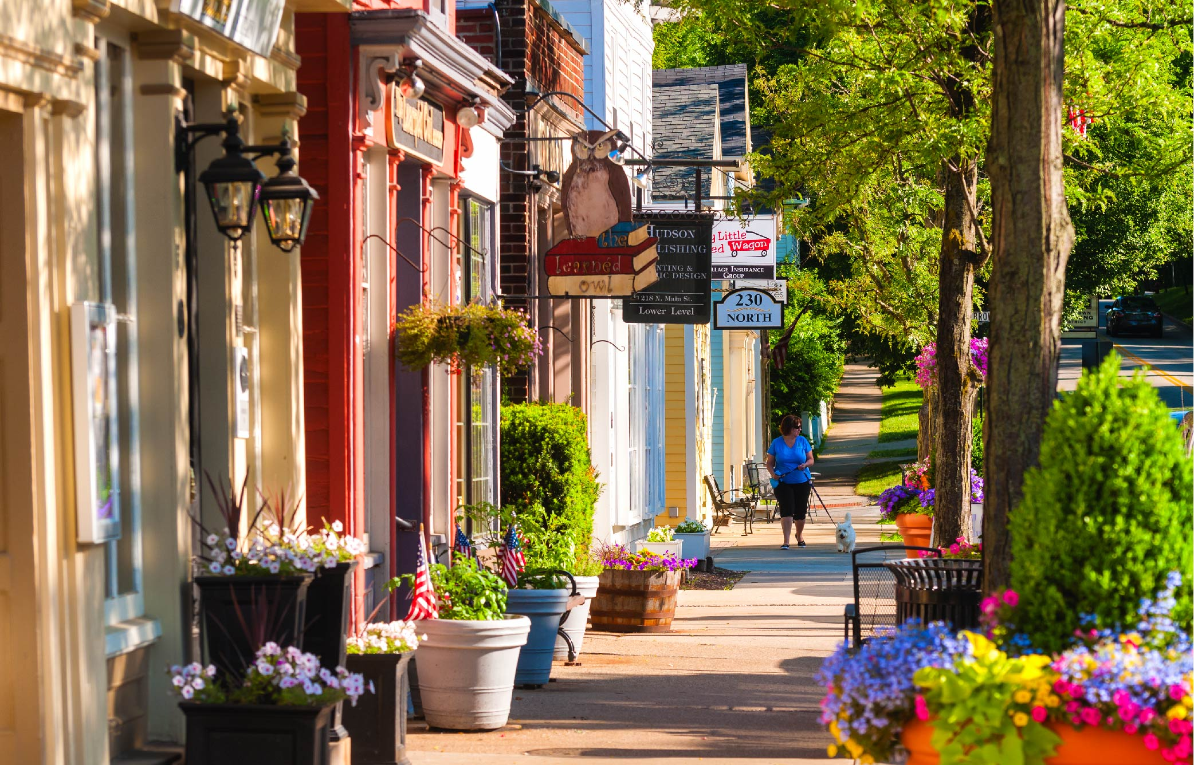
OBO Department Structure
Contract Compliance
External Affairs, Workforce Development, and OBOSC
Certification
Houston Airport System-OBO

Slide 4

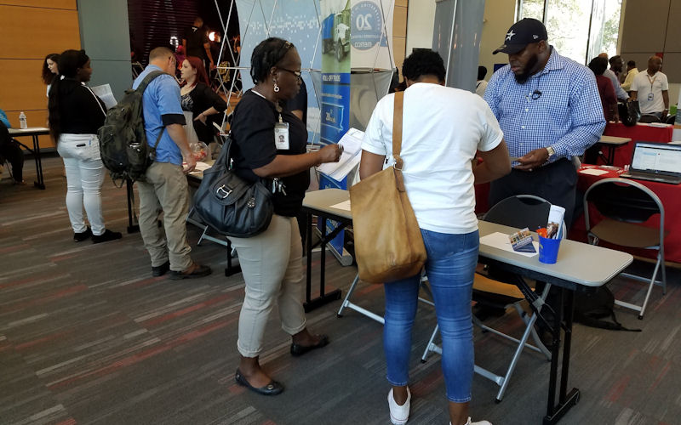
Changing with the City’s Needs
As the job sectors in Houston have become more diverse, the services of
OBO have also evolved to include workforce development.
Spearheaded TweetMyJobs Houston!
in 2013
Hosted the Hire Me Now Job Fair in 2014
Created Workforce Development arm in March 2016 with Turnaround Houston, and in alignment with Mayor Turner’s priorities
2,100
Houstonians
helped by Turnaround Houston Readiness Fairs since 2016

Slide 5
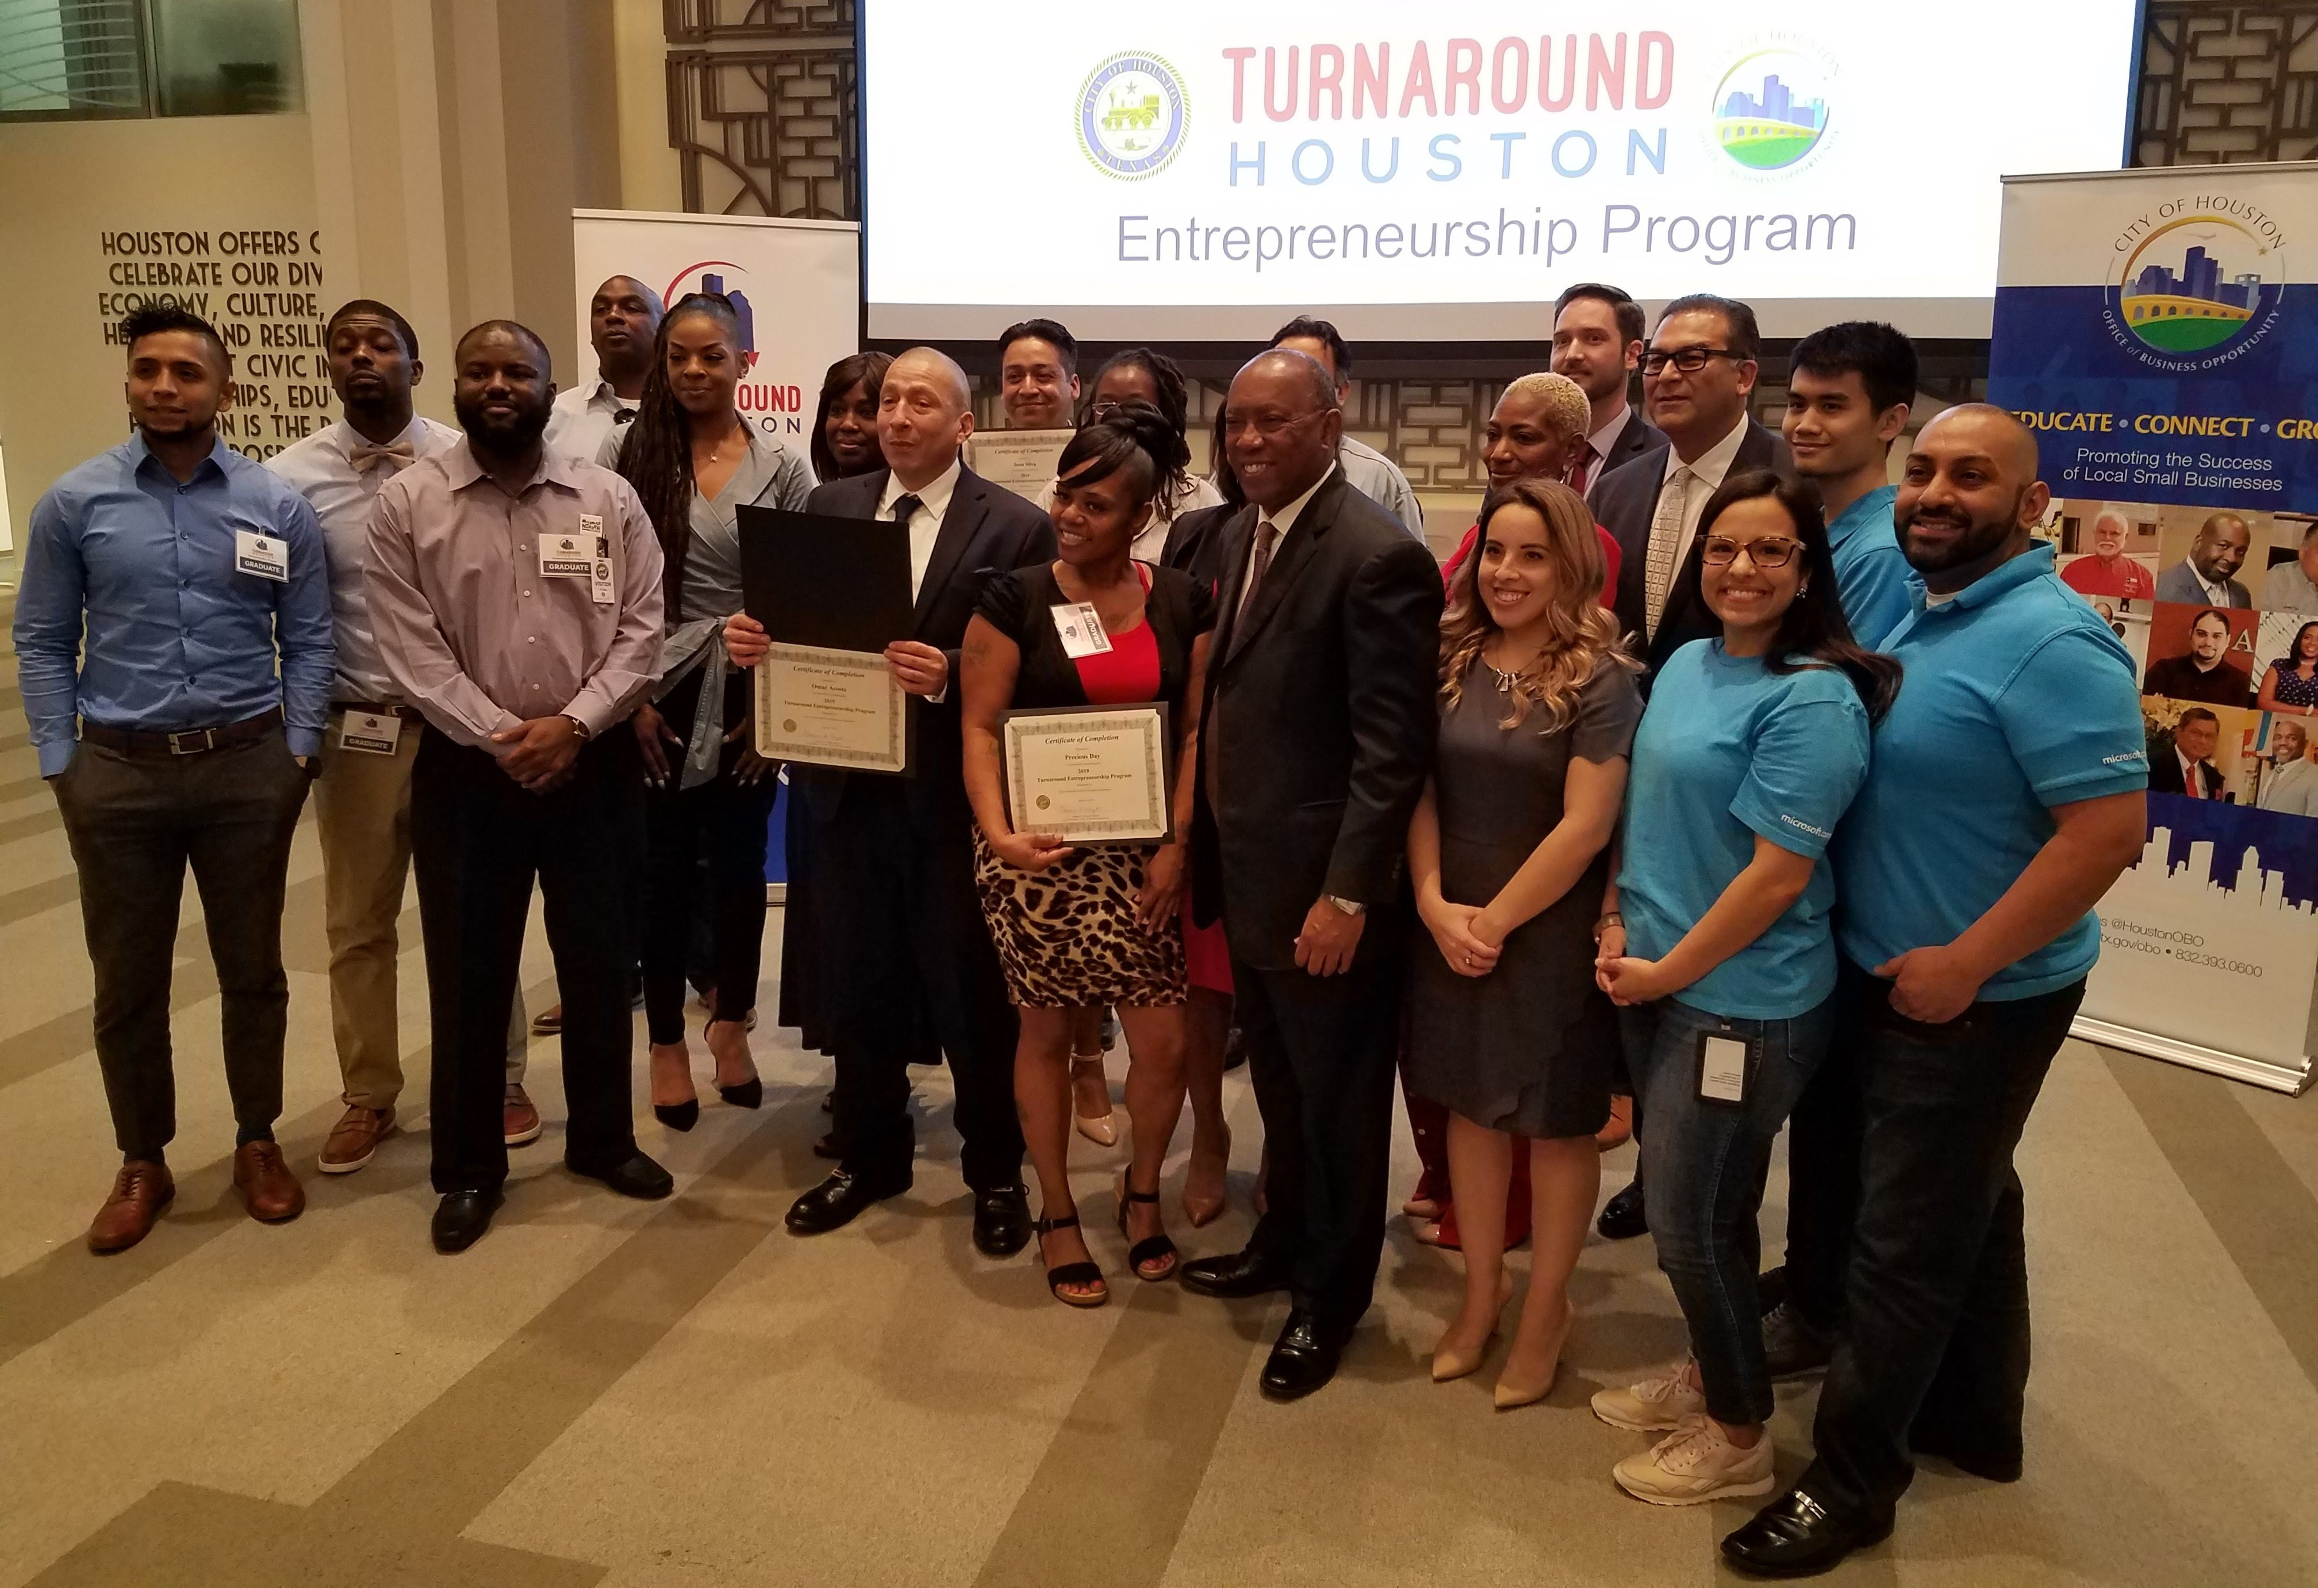
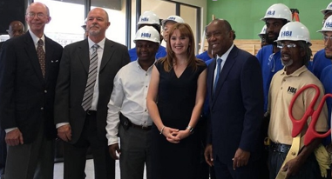
Workforce Development Programs
With the support of Mayor Sylvester Turner, as well as our community and business partners, OBO has administered the following programs:
Turnaround Houston Resource Fairs
HBI Acres Homes Construction Program
Turnaround Entrepreneurship Program

Slide 6

On the Horizon
OBO remains focused on the best ways to advance our workforce development initiatives during COVID-19 and beyond.
Virtual Turnaround Houston Fairs: Connect social service organizations and potential employers to citizens.
Connect citizens, particularly those most impacted by the pandemic, to a more diverse industry pool.
Development of On-The-Job-Training (OJT) Programs.
Identify partners for skilling and re-skilling of workers in the technology space.

Slide 7
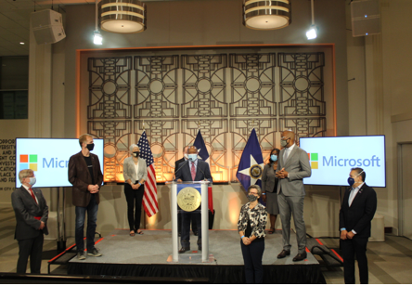
Focus on Technology & Tech Partners
Digital Technology and Innovation are among the top industries in the city.
Houston is home to 500+ digital technology companies
Also home to 8,200+ companies in tech-related industries
Tech sector has $28.1 billion impact on the local economy
228,000 employed in technology (CompTIA, 2019)
In August 2020, Mayor Sylvester Turner and Microsoft Announced the Expansion of it’s groundbreaking Digital Alliance.

Slide 8
Thank You.
Connect With Us:

