Slide 1
Houston Information Technology Services (HITS)
FY2017 Preliminary Budget Presentation
General Fund

Slide 2
Tina Carkhuff
Interim Director/ Chief Information Officer
Somayya Scott
Deputy Assistant Director
IT-Director’s Office
Tom Sorley
Deputy Director
IT-Public Safety
Troy Williams
Assistant Director
IT- Director’s Office
Philip Suber
Assistant Director
IT- Director’s Office
David LaPlante
Deputy Director
IT- Cyber Security
Reenie Askew
Deputy Director
IT- ERP/Applications
Daniel Steege
Interim Deputy Director
IT- Infrastructure

Slide 3
FY2016 Accomplishments & Highlights Enterprise Infrastructure
311 Business Continuity Project
Allows 311 employees to work remotely in the event of a weather or other event that prevents them from being at their normal work location of 611 Walker
Desktop Replacements
Replaced 1657 aging desktop computers for multiple departments so that current inventory is no more than 5-7 years of age
Verizon Phone Deployment
Citywide Verizon phone deployment
ETHAN Phase I Deployment
Deployment of Telemedicine solution to eliminate unnecessary transports
MCD IVR Integration with CSMART
Implementation of call center functionality that integrates with CSMART
Identity and Access Management Phase I
Implemented software to allow for users to reset their own passwords should they get locked out
FMD AssetWorks Deployment
Upgrade and new infrastructure for AssetWorks M5 application to support FMD
Implemented INFOR for Department of Neighborhoods
SIP Trunk Implementation for Voice Services Citywide
Implemented SIP trunking to support unified Voice over IP phone system Citywide allowing us to reduce the number of voice circuits in the City’s inventory

Slide 4
FY2016 Accomplishments & Highlights Enterprise Applications
HR SAP ESS/MSS Implementation
Implementation of Employee Self-Service and Manager Self-Service to streamline HR processes
HR SAP Affordable Care Act
Implement and delivery of IRS mandated Employer-Provided Health Insurance Forms
OBO Automated MWSBE Report
Create MWSBE Awards reports, to enable greater efficiencies and accuracy in compliance reporting
DON Infor Deployment
Implement INFOR CDR to support Department of Neighborhood inspection processes
MYR – Pothole and Road Condition Initiative Website Development
Develop a citizen facing website to provide metrics, reports, and status of road conditions
MYR – Hire Youth Program Website Development
Provide a mechanism for collaboration between the City of Houston and Corporate Partners to provide summer jobs to Houston youth
DON – Fight Blight Website Development
Provide visibility to Houston’s blighted and nuisance properties, through a citizen facing web portal
SAP Position Budgeting Control
Forecast salary and benefits cost per funded positions and establish commitments by departments, cost centers, and funding in the approved annual budget
FMD Executive Insight Reports
Identify underutilize fleet vehicles, to aid in the decision to retire or reallocate
SAP Strategy Management
Implement Citywide Performance Reporting /Performance Insight using SAP tools

Slide 5
FY2016 Accomplishments & Highlights Enterprise Cybersecurity
Payment Card Industry (PCI) Compliance
Implementation of a PCI compliant network providing security to over 1 million credit card transactions annually
Urban Area Security Initiative (UASI) Cybersecurity Grant Funded Activities ($1.5 M to date)
Cybersecurity Awareness Training Program
Design and implementation of a new Cybersecurity Awareness Program that combines phishing testing with web-based training providing updated and relevant awareness materials creating informed, Cyber-aware users
Security Incident Event Management (SIEM) Solution
Deployed a SIEM solution that logs and correlates over 2.2 billion events (logon/logoff, firewall blocks, etc.) per month from servers and network devices providing insight into attack activities and information to assist with forensic and investigative activities
Endpoint (User system) Protection Activities
Continued deployment and tuning of tools protecting the endpoint from Advanced Persistent Threats (APTs), malware & adware (over 7 million blocked/remediated monthly)
Discovery and Investigative Activities
Provided assessment, support and investigative services for multiple cybersecurity incidents (ransomware, fake purchase orders, phishing, etc.) and requests from multiple departments including HR, Legal, OIG and SPD. Perform over 1,200 TPIA & Legal search requests monthly.

Slide 6
FY2016 Accomplishments & Highlights Public Safety Radio System
Greens Road Radio Facility Opening
Joint radio support facility with Harris County
Inter-local Agreement with Harris County
Verizon In-building Contract Agreement
Allows for in-building cellular equipment to be installed
Fire Station Renovations
Houston Police Department Memorial Guard Shack Connectivity
Continued deployment and tuning of tools protecting the endpoint from Advanced Persistent Threats (APTs), malware & adware (over 7 million blocked/remediated monthly)
24-Hour Network Operations Center for HPD/HFD Radio Operations
Support of HEC IT Operations

Slide 7
FY2017 Proposed HITS Initiatives All Divisions
Microsoft Office 365 Implementation
ARA Upgrade 311 Lagan System
HEC Firehouse Upgrade
HEC – Text to 911 CAD Interface
Citywide Permitting and Work Order Management System
Multifunction Printer Replacement
GSD Aurigo Masterworks Software Deployment
ETHAN Upgrades
HFD Fire station renovations and paging upgrades
MCD Joint Processing Center Buildout
FIN Contract and Procurement Management
ARA Kronos Upgrade
Mobile App Development for ARA, HR and BARC
HR Temporary Employee Management System
FIN Cost Allocation Plan
FIN AR Data Mart –Phase II

Slide 8
HITS Functions - General Fund
Director
$23,362,802 FTEs 158.5
Director’s Office
$4,068,074 FTEs 19.5
Enterprise Applications
$6,676,001 FTEs 46.0
Enterprise Infrastructure
$7,161,211 FTEs 62.5
Public Safety
$5,457,516 FTEs 30.5
Strategic Planning
Council Support
Public Information Support
Contract Compliance
Cybersecurity
Procurement
Asset & Records Management
Operational Admin Support
Application and Database Services
SAP Business Process & Management Consulting
Web Design and App Development
Enterprise Geographical Information System (EGIS)
Incident Management
Desktop Support
Network Data Services
Network Voice Services
IT Server System Support & Maintenance
Public Safety Infrastructure Services
Subscriber Services
Field Services
Radio System Training
Houston Emergency Center IT Support

Slide 9
Budget Summary - General Fund
Fund | Revenue FY16 Budget | Revenue FY17 Preliminary Estimates | +/- $/% | Expenditure FY16 Budget | Expenditure FY17 Preliminary Estimates | +/- $/%
General Fund 1000 | $859,152 | $1,681,344 | $822,192 95.7% | $24,594,024 | $23,362,802 | -$1,231,222 -5.01%
Notes:
General Fund budget is 77% personnel costs
5% reductions - ?
FY15 budget actuals – $22.6M

Slide 10
General Fund Revenues
Category | FY15 Actual | FY16 Budget | FY16 Estimates | FY17 Preliminary Estimates | +/- $/%
Charges for Services | $566,470 | $767,664 | $803,519 | $1,549,488 | $745,969 92.8%
Direct Interfund Services | $54,240 | $91,488 | $91,488 | $131,856 | $40,368 44.1%
Miscellaneous/ Other | $2,717 | 0 | $6,493 | 0 | ($6,493) 100%
Total | $623,427 | $859,152 | $901,500 | $1,681,344 | $779,844 86.51%

Slide 11
FY2017 Revenue Highlights
Increase in radio revenues related to rate increase
Verizon rebates for retention

Slide 12
General Fund Expenditures
Category | Expenditure FY15 Actual | Expenditure FY16 Budget | Expenditure FY16 Estimates | Expenditure FY17 Preliminary Estimates | +/- $/%
Personnel Services | $17,547,889 | $18,853,470 | $18,007,089 | $18,034,252 | $27,163 0.15%
Supplies | $401,434 | $480,850 | $509,835 | $515,354 | $5,519 1.08%
Other Services and Charges | $4,587,196 | $5,259,704 | $5,429,758 | $4,813,196 | -$616,562 -11.36%
Equipment | $12,576 | 0 | 0 | 0 | 0
Non-Capital Equipment | $5,350 | 0 | $3,796 | 0 | -$3,796 -100%
Total | $22,554,445 | $24,594,024 | $23,950,478 | $23,362,802 | -$587,676 -2.45%
Notes:
This represents 34% of HITS total budget.
Increases in personnel are due in part to HOPE increases, Pension increase (+2%), Health ins. Total FTE Count- 204

Slide 13
FY2017 Expenditure Highlights
FY2017 Budget provides funding of health benefits, pension contribution and municipal employees contractual pay increases.
The FY2017 Budget includes a reduction of $323,410 for department savings initiatives.
Increase in support costs for 700 MHz radio system and continued support for the joint radio facility with Harris County.
Restructuring of Project Management Office to improve service delivery.

Slide 14
Appendix
HITS Employee Demographics
FY17 Performance Measures for General Fund
Revolving Fund 1002
HITS Network Landscape

Slide 15
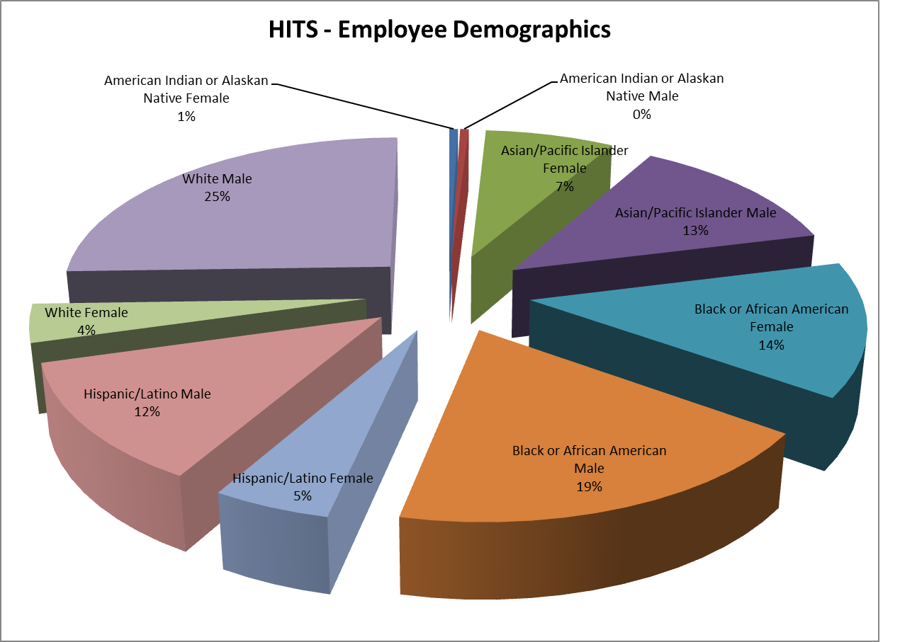
Notes:
White males- 52, White females-8
Hispanic males- 25, Hispanic females- 10
Black/African American males- 38, Black/African American females- 28
Asian/Pacific males- 26, Asian/Pacific females- 15
American Indian or Alaskan native male- 1, American Indian or Alaskan native female- 1

Slide 16
FY17 Performance Measures General Fund
Customer Measures | FY15 Actuals | FY16 Budget | FY16 Estimates | FY17 Estimates
Call Center Abandonment Rate | 7% | 7% | 17% | 10%
Customer Service Calls resolved with 5 days | 82% | 89% | 69% | 89%
Customer Services First Contact Resolution | 44% | 57% | 69% | 50%
Customer Service Rating Responses (max. score of 5) | 4 | 5 | 4 | 5
Customer Service Requests/Incidents Received | 48,225 | 45,000 | 72,023 | 55,000
Customer Service Survey Responses Received | 15% | 11% | 18% | 15%
Business Process Measures | FY15 Actuals | FY16 Budget | FY16 Estimates | FY17 Estimates
Expenditure Budget vs. Actual Utilization | 91% | 98% | 97% | 98%
Revenue Budget vs. Actual Utilization | 200% | 100% | 105% | 100%

Slide 17
Revolving Fund (1002)
On average General Fund represents 34% of total funds managed
Revolving Fund Reductions
Verizon credit $1,000,000
Telecommunications audit recoup (Reduction in telecommunications spend)
Reduction in force
Budget reduction
Notes:
Revolving fund represents 52% of HITS total budget

Slide 18
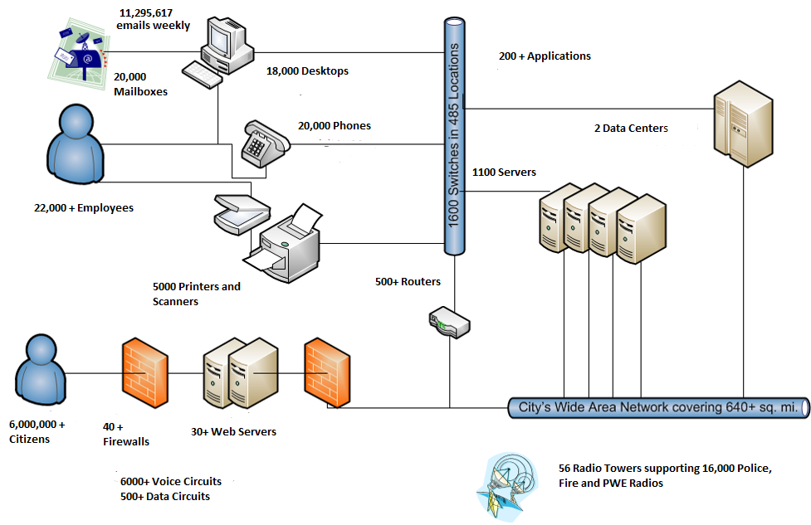
Notes:
How HITS affects the entire city

