Slide 1

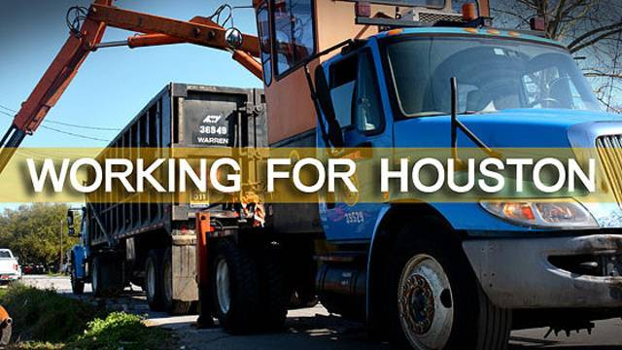
Department of Solid Waste Management
FY2020 Proposed Budget Presentation
Harry J. Hayes, Director
Sylvester Turner, Mayor
May 15, 2019

Slide 2
Department Mission
"Working to make Houston a Cleaner, Greener Place to Live"
The Solid Waste Management Department (SWMD) provides solid waste services to the citizens of Houston through the collection, disposal and recycling of discarded material in a manner that is safe, efficient, environmentally sound and cost-effective.
In addition, SWMD serves as the City’s Disaster Debris Management response team during Public Safety and Homeland Security events.

Slide 3

Department Org Chart
Director
PG 37
FTE: 19.1
Deputy Director
South Operations
PG 34
FTE: 214.4
Office of The Director
Chief of Staff
PG 30
Dep. Asst. Director
SE Operations
PG 30
Dep. Asst. Director
SW Operations
PG 30
HITS
Mayor’s Communication
Dep. Asst. Director
NE Operations
PG 30
Dep. Asst. Director
NW Operations
PG 30
Deputy Director
North Operations
PG 34
FTE: 144.4
Division Manager
PG 29
Budget, Facilities and Accounting
Assistant Director
Finance & Administration
PG 32
Senior Superintendent Facilities Maintenance
PG 27

Slide 4
Department Services

Slide 5
Department Programming
Texas Health and Safety Code Chapter 361.Solid Waste Disposal Act mandates the collection, transportation and disposal of municipal solid waste.

Slide 6
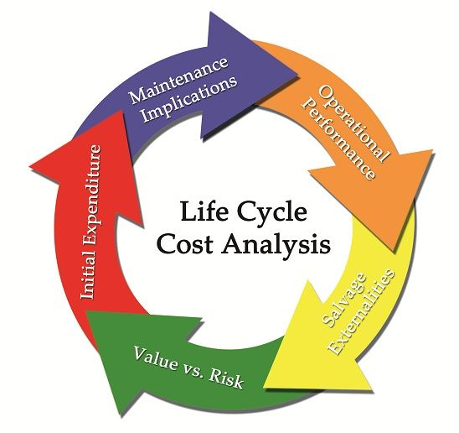

Equipment
Equipment profile based on route size that is more than a decade old
Equipment replacement schedule has been sporadic due to City’s strained finances
Spikes and bumps in equipment replacement does not comport with fleet management best practices
No sustained funding to keep operations and equipment “right-sized” to easily meet core needs
Equipment is front line for disaster response/recovery operations, working throughout major disaster debris recovery operational periods

Slide 7
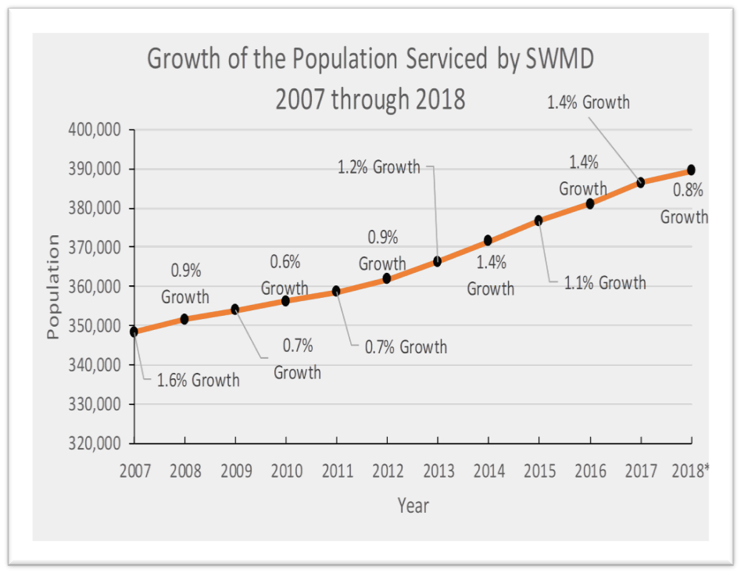
Customer Base
Since June 2007, households serviced by the City of Houston has increased approximately 12%
Inner Loop 610 has shown the largest increase in customer growth.
Route density inside the loop is an operations concern
*2018 growth percentage is a conservative estimate extrapolated
from the trend as reported Jan 2018 through June 2018

Slide 8
Revenues By Funds
($ in thousands)
 |  |  |  |  | Variance
Fund | FY18 | FY19 | FY19 | FY20 | FY20 Prop/ | %
 | Actual | Budget | Estimate | Proposed | FY19 Est | Change
General Fund | $ 5,889 | $ 5,162 | $ 5,368 | $ 5,578 | $ 210 | 3.9%
Recycling Fund | $ 4,195 | $ 4,207 | $ 4,168 | $ 4,248 | $ 80 | 1.9%
Total | $ 10,084 | $ 9,369 | $ 9,536 | $ 9,826 | $ 290 | 5.8%

Slide 9

FY2020 - Revenues Highlights
Primary revenue sources flat.

Slide 10
Expenditures By Funds
($ in thousands)
 |  |  |  |  | Variance
Fund | FY18 | FY19 | FY19 | FY20 | FY20 Prop/ | %
 | Actual | Budget | Estimate | Proposed | FY19 Budget | Change
General Fund | $ 75,116 | $ 84,922 | $ 84,922 | $ 84,957 | $ 35 | 0.0%
*Recycling Fund | $ 3,941 | $ 5,283 | $ 5,009 | $ 4,434 | $ (849) | (19.1%)
Total | $ 79,057 | $ 90,205 | $ 89,931 | $ 89,391 | $ 814 | (19.1%)
*Financial accounting based on truck/container financing.
* No revenue for recyclables.

Slide 11
FY20 Personnel vs Non Personnel Fund 1000
($ in thousands)

Slide 12
FY20 Personnel vs Non Personnel Fund 2305
($ in thousands)

Slide 13
SWMD FY2020 BUDGET
GENERAL FUND
Department $84,956,973
FTE: 436.9
Administration
FTE: 55.0
North Operations
FTE: 178.4
South Operations
FTE: 185.3
Maintenance
FTE:18.2
$30,410,938
Director’s Office
Admin Support
Contracts & Sponsorships
Utilities
Debt Service
CIP Management
Grants & Environment
Transfer Station Asset
Management
$13,086,601
Northeast Residential
Collection
Northeast Bulk Waste & Wood
Waste
Northeast Yard Waste
Northeast Recycling
Northeast Administration
Northwest Residential
Collection
Northwest Recycling
Northwest Yard Waste
Northwest Administration
$18,406,641
Southeast Residential Collection
Southeast Bulk Waste & Wood
Waste
Southeast Yard Waste
Southeast Recycling
Southeast Administration
Southwest Residential
Collection
Southwest Bulk Trash & Wood
Waste
Southwest Yard Waste
Southwest Recycling
Southwest Recycling Centers
(WP,ESC, NESC, Dead Animals)
Southwest Administration
Depositories, Roll-Off Ops
$23,052,793
Fleet Inter-fund
Spill Response (Equipment Breakdown)
Grounds & Facility Upkeep
Fuel

Slide 14





FY2020 - Expenditures Highlights
Department expenditures may be impacted by the following:
  Public Safety and Homeland Security events
  Deferred replacement of fleet, i.e. higher maintenance expense
  Higher competition for experienced CDL drivers in the transportation sector
  Continued demands for services based on population growth.
  Overtime, Vacancies, Temporary Services
  Route and equipment “right-sizing” to properly meet core needs
  Homeless Encampments Support

Slide 15
FY2020 Budget Expenditures Net Change (in thousands)
FY2019 General Fund Budget Expenditures
Net Change to FY2019 Current Budget
FY2019 Current Budget |  |  | Notes
Operating Budget |  | $ 36,349
Restricted Budget |  | $ 43,908
FY2019 Current Budget |  | $ 80,257
Explanation of FY2020 Incremental Increase/(Decrease)
FY2019 Operating Budget Adjustments
HOPE Adjustment |  | 719
Health Benefits |  | (122)
Recycling Services |  | 2,088
One-Time Funding-Refuse Disposal/Overtime |  | 2,721
Restricted Account Adjustments |  | (741)
Subtotal Operating Budget Adjustments |  | $ 4,665
% Change from FY19 Operating Budget |  | 12.8%
FY2020 Contractual or Mandated Adjustments:
Pension Allowance |  | $ 74
Health Benefits |  | (336)
HOPE Adjustment |  | 497
Fuel |  | 41
Recycling Services |  | 887
Interfund Vehicle Services |  | 779
Refuse Disposal/Overtime Adjustment |  | (2,721)
Restricted Account Adjustments |  | 558
Refuse Disposal Contract Esculation |  | 256
Subtotal Contractual/Mandated Increases |  | $ 35
FY2020 Proposed Budget
Operating and Contractual Adjustments |  | $ 4,700
FY2020 Proposed Budget |  | $ 84,957
% Change from FY19 Current Budget |  | 5.9%

Slide 16
Questions

Slide 17
Demographic Data
The department is comprised of:
  78% African American
  17% Hispanic/Latino
  3% White
  1% Asian/Pacific Islander
  1% Native American
75% of the department is male; 25% female

Slide 18
Equipment Break-Down Hours
Month | Hours
18-Jul | 929
18-Aug | 1105
18-Sep | 1081
18-Oct | 929
18-Nov | 856
18-Dec | 844
19-Jan | 751
19-Feb | 702
19-Mar | 994
19-Apr | 1014
YTD Total | 9205

Slide 19
Budget History
($ in thousands)
 | FY15 | FY16 | FY17 | FY18 | FY19 | FY20
Current Budget | $ 75,042 | $ 75,772 | $ 83,746 | $ 80,490 | $ 84,922 | $ 84,957
Actual / Projection | $ 74,794 | $ 74,564 | $ 84,111 | $ 75,096 | $ 84,922 | $ 84,957
Surplus/(Deficit) | $ 248 | $ 1,208 | $ (365) | $ 5,394 | $ 0 | $ 0

Slide 20
FY2020 Performance Measures
Customer Measures | Priorities | FY18 Actual | FY19 Budget | FY19 Estimates | FY20 Estimates
Residential Units Served | Q | 386,569 | 392,802 | 392,802 | 396,730
Solid Waste Recycling Rate | F, Q | 28% | 30% | 30% | 30%
Business Process Measures | Priorities | FY17 Actual | FY18 Budget | FY18 Estimates | FY19 Estimates
Expenditure Budget vs Actual Utilization | F | 94% | 98% | 106% | 98%
Revenues Budget vs Actual Utilization | F | 96% | 100% | 104% | 100%

Slide 21
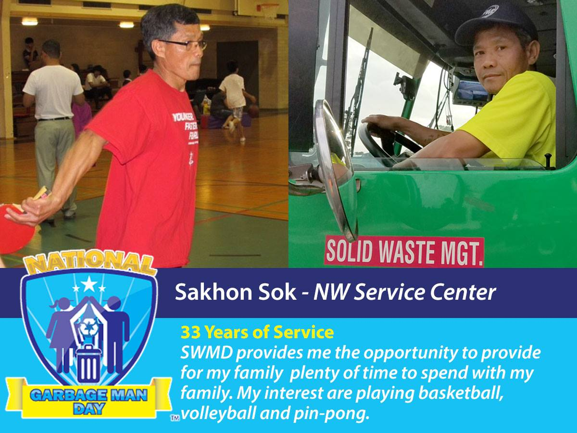
Department FY2019 Accomplishments
Waterways debris and silt removal projects
New Single Stream Recycling Contract
New long range Recycling Services Contract
Homeless Initiatives

