Slide 1
Housing and Community Affairs Committee
Keith W. Bynam, Director June 21, 2022

Slide 2
CDBG-DR 2017
Harvey Grant Update
Temika Jones, Assistant Director and CFO
Notes:
We will now move on to an update for the CDBG-DR 2017 Harvey grant.

Slide 3
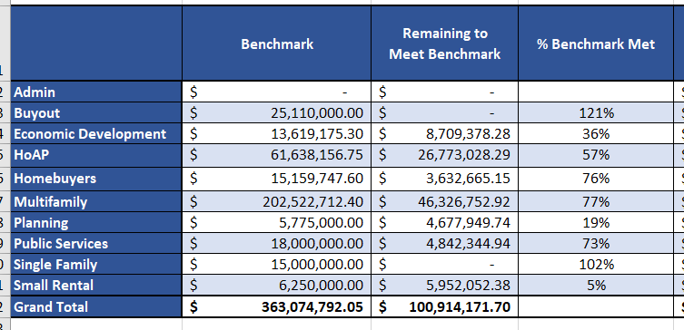
Item III.D HCD Financial Update (CDBG-DR 2017 Harvey Grant Update) As of June 15, 2022
Notes:
This table lists the performance benchmarks for June 30, 2022, which is approx. $134M more than the December 31, 2021 benchmarks. Included in this table is the % of reimbursement requests approved in relation to the benchmark total for each program.

Slide 4
HCDD
Production
Report
Temika Jones, Assistant Director and CFO
Notes:
We will now move on to an update for the CDBG-DR 2017 Harvey grant.

Slide 5
Homebuyer Assistance Program (Fiscal Year - cumulative totals)
Provides up to $30,000 to help Houstonians purchase a home.

Slide 6
Single Family Home Repair Program (Fiscal Year – cumulative totals)
The HRP repairs and reconstructs existing homes for homeowners.

Slide 7
New Home Development Program (Fiscal Year – cumulative totals)
NHDP builds new homes for sale at affordable prices

Slide 8
Other Programs
(Fiscal Year)
Projects under construction
Multifamily (FY22)
1
Projects completed
Multifamily (FY22)
21
5
10
Projects under construction
Public Facilities (FY22)
3
Projects completed
Public Facilities (FY22)

Slide 9
Other Programs
(Fiscal Year 2022)
161,978
Persons Served
Public Services
As of April 2022

Slide 10
Spending by Program Area FY22 (as of May 2022)
Total spending: $335,882,450
Note: Public Services and Other City Departments are one month behind; totals as of April 2022.

Slide 11
Comments & Questions

