Slide 1


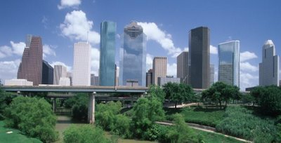
Houston Police Department
Vice Division
Spas by District Follow-Up
Captain Dan Harris
February 9, 2016

Slide 2
Agenda
The Problem With “Spas”
  Fronts for Prostitution
  Law Enforcement Access
  Eliminating the Loophole
  City Ordinance Modification & Effect
  Locating “spas” that advertise illicit services
Unregulated Massage Establishment Locations
  2015 versus 2016
Attacking the Problem
Questions

Slide 3
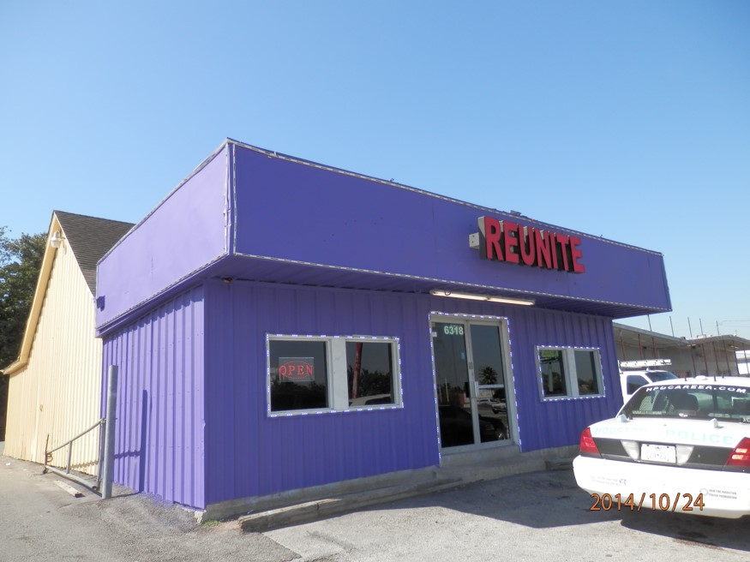
The Problem With “Spas”
A Spa By Any Other Name
Fronts for prostitution & human trafficking:
(especially international trafficking)
Spa
Modeling Studio
Massage Parlor
Reflexology Clinic
Misleading….
Law Enforcement Access:
Undercover Officers
  Enforce State Law
Uniformed Officers
  Enforce City Ordinances

Slide 4

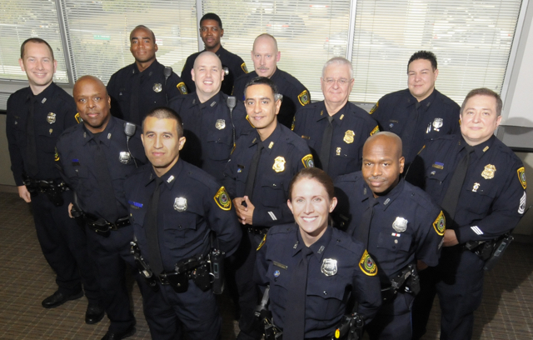
Eliminating the Loophole
City Ordinance Modification: “Massage Establishment”
Chapter 28 - Miscellaneous Offenses and Provisions, Article XII - Massage Establishments
Was: “… where massage is practiced upon the human body….”
As of Dec 2015: “…whose business includes advertising or offering a massage or other massage services…”
City Ordinance Modification: Effect
Undercover Officers – No Change
Differential Response Team Officers - Now have access
Doubles the number of officers attacking the problem

Slide 5




Locating “Spas” that Advertise Illicit Services
Popular Escort & SPA Websites
Rubmaps.com
Backpage.com
Craiglist.com
ECCIE.com
Asianbodyrubs.com
Houston-EROS.com
Spaunion.com
UBangWithFriends.com

Slide 6
Unregulated Massage Establishments as of May 2015

Slide 7
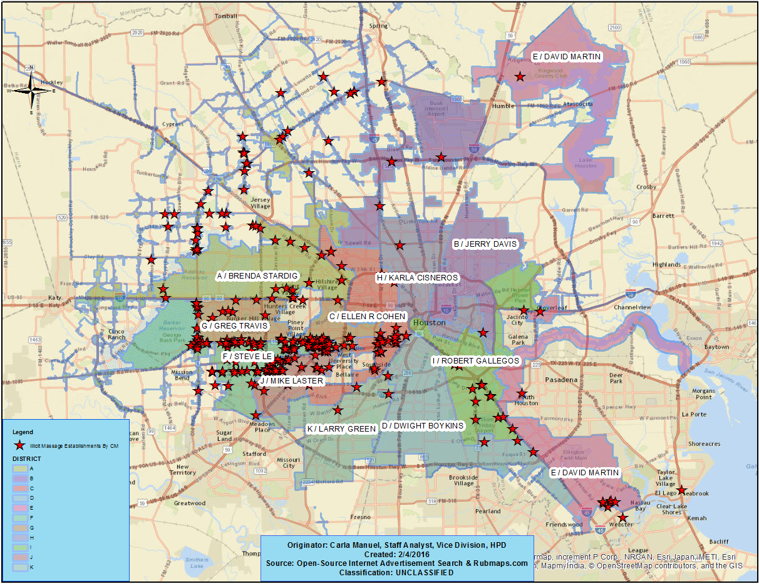
Unregulated Massage Establishments as of February 2016

Slide 8
Unregulated Massage Establishments: February 2016
DISTRICT RUBMAPS.COM ILLICIT MASSAGE ESTABLISHMENTS
Council Member | Count of Name | Percentage of Total
STEVE LE | 87 | 22%
GREG TRAVIS | 62 | 16%
MIKE LASTER | 59 | 15%
BRENDA STARDIG | 46 | 12%
ELLEN R COHEN | 31 | 8%
ROBERT GALLEGOS | 12 | 3%
DAVID MARTIN | 10 | 3%
JERRY DAVIS | 9 | 2%
DWIGHT BOYKINS | 4 | 1%
LARRY GREEN | 3 | 1%
KARLA CISNEROS | 2 | 1%
OUTSIDE AREA | 62 | 16%
Grand Total | 387

Slide 9
Attacking the Problem
Texas Penal Code:
43.02 - Prostitution
Vice Division Undercover Officers
City Ordinance:
Chapter 28 - Miscellaneous Offenses and Provisions, Article XII - Massage Establishments
Differential Response Team Officers
Money Laundering & Organized Crime:
Vice Division Undercover Officers & Harris County District Attorney
Chapter 125:
Civil Practice and Remedies Code, Title 6: Misc. Provisions,
Chapter 125: Common and Public Nuisances
HPD and City Attorney or County Attorney

Slide 10
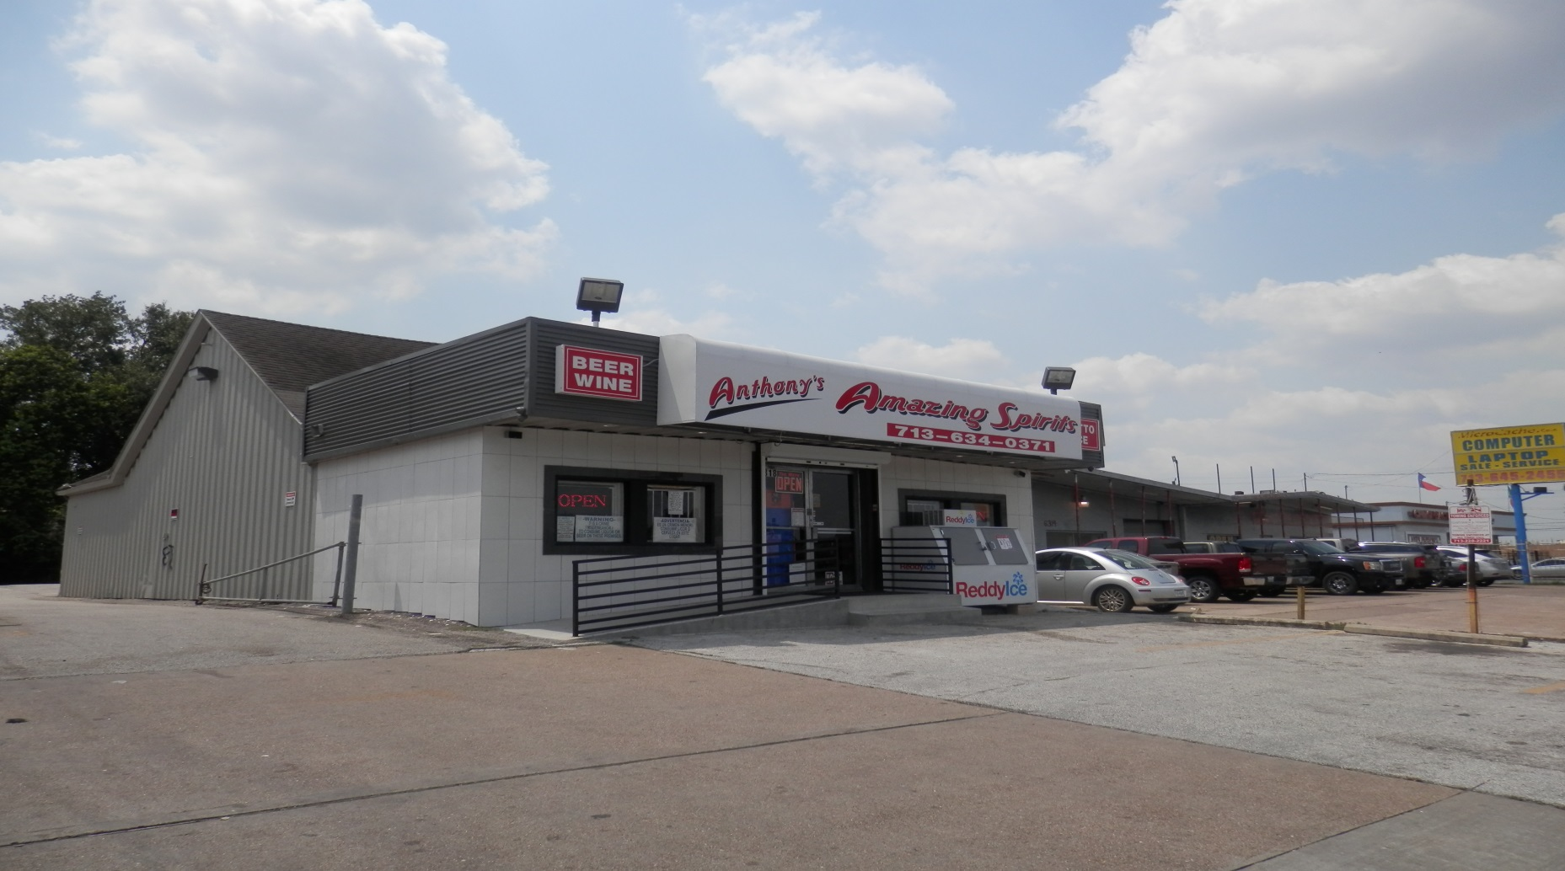
Chapter 125 – Common Nuisance

Slide 11

Questions or Comments?

