Slide 1

Gang Division
Captain Matt May
February 14, 2017

Slide 2
Gang Division
Overview and History
The Gang Division was created in 2005 as part of a mandate by city council. The department asked for 3 new Captain positions at that time and city council would only approve the 3 positions if they accepted a 4th Captain position to be used for the creation of the Gang Division. Before the creation of the Gang Division there was a centralized unit within HPD that monitored gang activity.
Staffing
1 Captain
3 Lieutenants
16 Sergeants
90 Officers
3 Locations
TAG – Texas Anti Gang Office – Pro Active Units & Intelligence Unit
Central Police Station - CRU – Crime Reduction Units
1200 Travis – G.R.E.A.T. Unit and Technical Surveillance Unit

Slide 3

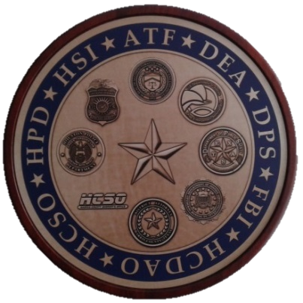
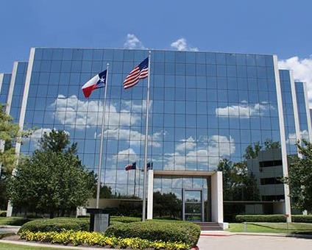
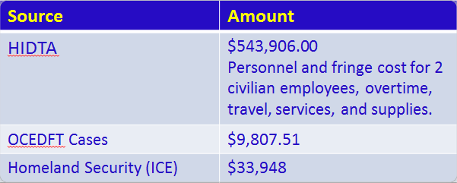
Gang Division
Texas Anti Gang Center
The TAG was created in 2012 through a $1.75 million grant from the Criminal Justice Division of the Governor’s Office. The funding continues through present. The TAG mission is to fight violent criminal gangs and transnational criminal organizations. The TAG serves as a unified headquarters for the proactive investigators, analysts and prosecutors from multiple federal, state and local agencies who routinely work joint investigations. The HPD units assigned to TAG receive funding from multiple sources.
Notes:
Houston Police Department (HPD)
Gang Division
Major Offenders Division
Harris Count Sherriff Office (HCSO)
Harris Co District Attorneys Office (HCDAO)
Texas Department of Public Safety (DPS)
Federal Bureau of Investigations (FBI)
Bureau of Alcohol Tobacco Firearms (ATF)
Drug Enforcement Administration (DEA)
Homeland Security Investigations (HSI)
Montgomery Co Sherriff Office (MCSO)
Spring Branch ISD PD
Katy ISD PD
Benefits of the TAG include access to a wide range of law enforcement databases and resources, minimization of interagency redundancies, interagency cooperation, prosecutors on site with a vested interest in the investigations, access to federal and state judicial venues, intelligence sharing, coordination of case advancement and expense sharing amongst agencies.
Most TAG investigations are long term conspiracy cases criminal organizations that are active on a regional, state, national or international scale.

Slide 4
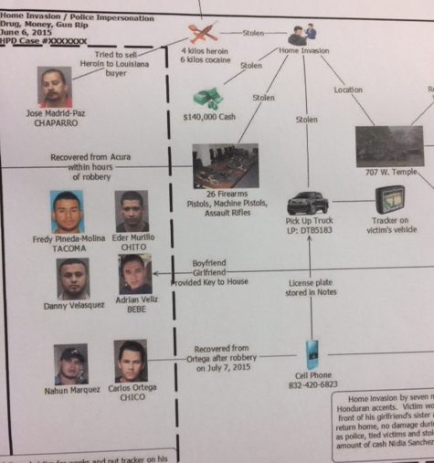
Gang Division
Proactive Investigators
Staffing:
1 Lieutenant, 3 Sergeants,
12 Officers
Long term, complex conspiracy investigations
Plain clothes and unmarked vehicles
Often partner with federal, state or local agencies to conduct joint investigations
Prosecutions at both the state and federal level
Use of sophisticated investigative techniques such as tracking devices, pen registers, communications intercepts, use of informants, link analysis
Investigations routinely result in multi-defendant prosecutions with an abundance of evidence and background as opposed to traditional reactive investigations which are often limited to the scope of a single criminal event
Funded by HIDTA
INTELLIGENCE DRIVEN

Slide 5
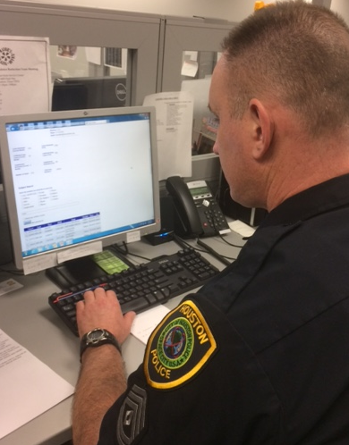
Gang Division
Gang Intelligence Unit
Staffing:
1 Sergeant, 2 Officers
Oversee and monitor all functions of Gang Tracker.
Approve or decline all gang cards entered into Gang Tracker by officers as required by state law.
Review offense reports that are coded Gang Crime and make the final determination if an offense is a Gang Crime or not.
Conduct cadet training at the academy in regards to Gang Tracker.
Conduct Divisional Gang Unit training and information sharing classes.
Respond to court orders and subpoenas regarding information maintained in the Gang Tracker database.
Housed at the TAG which allows full time access to investigators.

Slide 6
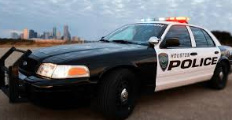
Gang Division
Crime Reduction Unit
Staffing:
1 Lieutenant, 10 Sergeants, 60 Officers
Mobile proactive uniformed enforcement
Utilized in areas experiencing high levels of gang activity and/or violent crime
Provide high visibility
Can be moved daily to address spikes in crime or in response to imminent threats of gang or violent activity
High volume of citizen and/or gang member contacts and intervention in street level criminal activity
Provide assistance to various investigative divisions and agencies in need of uniformed support

Slide 7
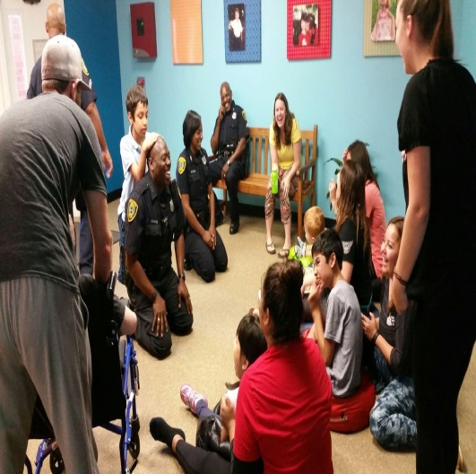
Gang Division
G.R.E.A.T. Program
Staffing:
1 Sergeant, 6 Officers
Gang Resistance Education Awareness Training Program
Gang Resistance Education Awareness Training (G.R.E.A.T.) G.R.E.A.T. is a prevention program for middle and elementary school students implemented by the Houston Police Department. Police officers teach an anti-gang curriculum to students at target HISD and Alief schools. The goal of G.R.E.A.T. is to prevent youth crime, violence, and gang involvement while developing a positive relationship among law enforcement, families and young people to create safer communities.
Notes:
Average number of school students taught per G.R.E.A.T. officer 400
Average number of school students taught by HPD G.R.E.A.T Unit 3,000
Average number of students taught through additional programs/presentations. 1,000
During the summer months the G.R.E.A.T. Unit partners with the Boys and Girls Club of Greater Houston and the Mayor Anti-Gang Office to teach the G.R.E.A.T summer program to the youth. They also attend and teach at church, civic, and community organizations. G.R.E.A.T will also be implementing a 2 week summer program at Emancipation Park in coordination with the City of Houston Parks and Recreation.

Slide 8
Gang Division
Administrative Unit/Technical Surveillance Unit
Admin Staffing:
1 Lieutenant, 1 Sergeant, 2 Officers
Handles administrative issues for the division such as attendance, monetary audits, fleet management, staffing levels, budgets, etc
The lieutenant also oversees the tech squad and the G.R.E.A.T. unit.
Tech Staffing:
1 Sergeant, 2 Officers
The Technical Surveillance Unit officers are trained and certified as required under Occupational Safety and Health Administration (OSHA) to install covert surveillance devices. They complete annual re-certification training to maintain there OSHA certification.
The TSU supports the Gang Division, all Divisional Gang Units and all federal and local agencies (FBI, ATF, DEA, HSI and HCSO) assigned to the Texas Anti-Gang Office (TAG).

Slide 9
Gang Division
State Mandates

Slide 10
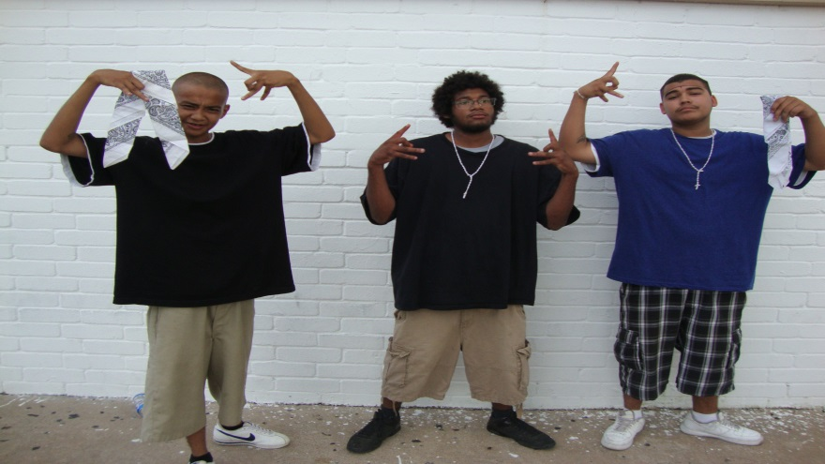
Gang Division
Collection Mandate and Legal Definition of a Gang
Art. 61. 02(a) Texas Code of Criminal Procedure and Sec 71.01(d), Texas Penal Code
  “Criminal Street Gang” : Three or more persons having a common identifying sign or symbol or an identifiable leadership who continuously or regularly associate in the commission of criminal activities.
Sec 71.01(d), Texas Penal Code
  “Criminal Street Gang” : Three or more persons having a common identifying sign or symbol or an identifiable leadership who continuously or regularly associate in the commission of criminal activities.
    This definition can apply to traditional street gangs such as Crips and Bloods as well as organized crime groups such as robbery crews with a discernable leadership.
Notes:
This definition can apply to traditional street gangs such as Crips and Bloods as well as organized crime groups such as robbery crews with a discernable leadership.

Slide 11
Gang Division
Documentation Criteria
Article 61.02 of the Texas Code of Criminal Procedure sets forth the criteria that must be met for an individual to entered into a gang database. In general, individuals must meet at least two of the following criteria for inclusion:
Self admission, internet, non judicial
Evidence that the individual uses gang dress, hand signs, tattoos or symbols
Evidence that the individual has been arrested or taken into custody with known gang members for an offense consistent with gang activity
Identification of the individual as a gang member by a reliable informant or other individual
Identification of the individual as a gang member by a person of unknown reliability
Evidence that the individual has visited a known gang members other than a family member while in a penal institution
Evidence that the individual frequents a documented gang area and associated with known gang members
Evidence of the individuals use of technology, including the internet, to recruit new gang members

Slide 12
Gang Division
Statistics

Slide 13
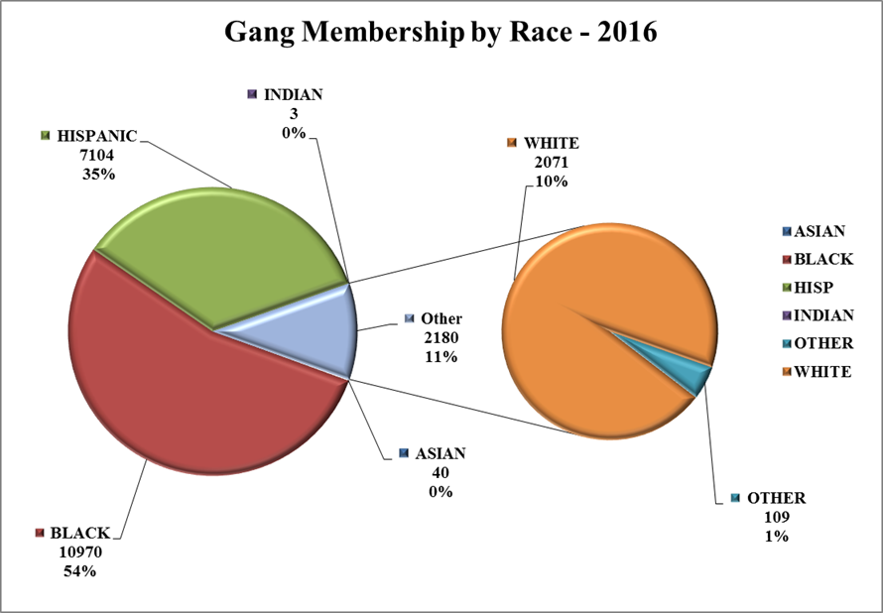
Gang Division
Gang Demographics in Houston

Slide 14
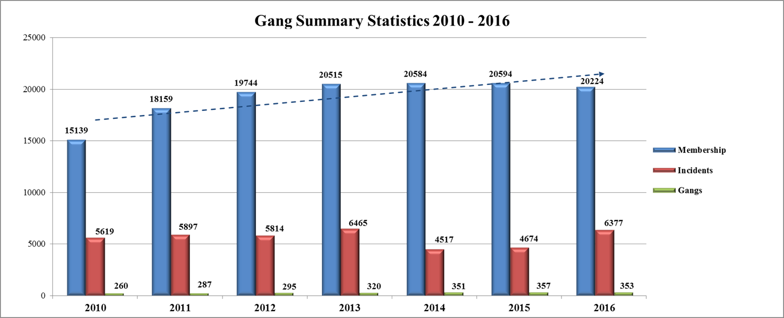
Gang Division
Total Gang Crime Compared to Membership and the number of gangs between 2010 to 2016

Slide 16
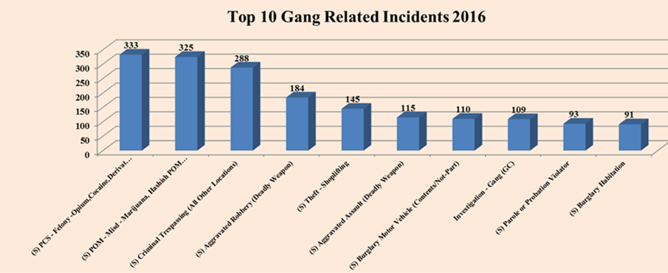
Gang Division
Top Gang Crimes in 2016
We believe that the number of identified Gang Crimes is significantly lower than the number of actual gang crimes. Crimes without a developed suspect are not considered gang crimes unless there is overt evidence of gang participation during the crime itself, such as yelling out a gang name before a shooting.

Slide 17
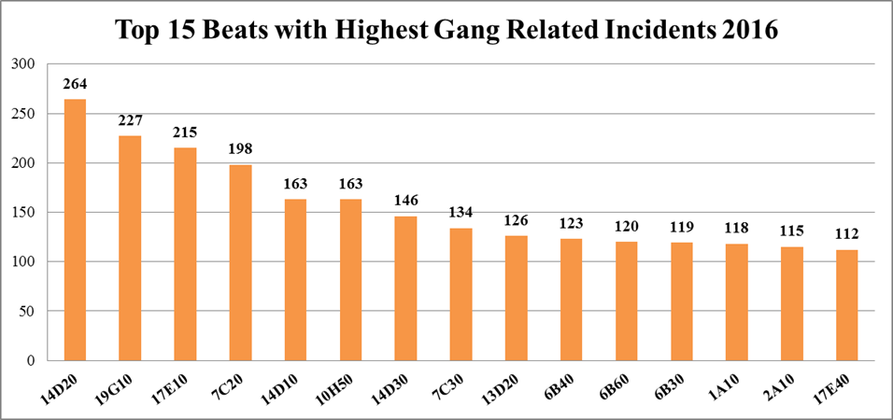
Gang Division
2016 Geographic Activity
Gang Division
2016 Geographic Activity
14D20 – Southeast
19G10 – Westside
17E10 – S. Gessner
7C20 – Northeast
14D10 – Southeast
10H50 – Eastside
14D30 – Southeast
7C30 – Northeast
13D20 – Southeast
6B40 – North
6B60 – North
1A10 – Central
17E40 – S. Gessner

Slide 18

Gang Division
Gang Related Murders
In 2016 there were 302 murders in the city of Houston. Fifty seven (57) of those were identified as gang related. This works out to a gang related murder occurring about every five (5) days.

Slide 19
Gang Division
Gang Tracker & Gangs in Houston

Slide 20
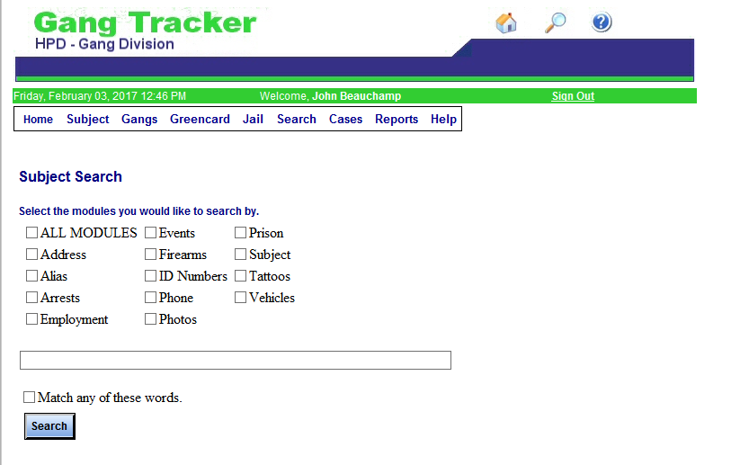
Gang Division
HPD Gang Tracker Database
Gang Tracker is the database system utilized by the Houston Police Department
Total gang members documented in Gang Tracker
19,853
Total number of gangs documented in Gang Tracker
353

Slide 21
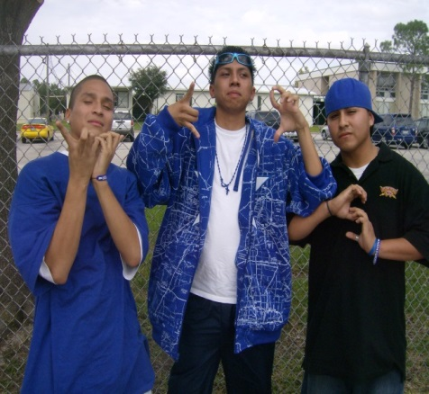
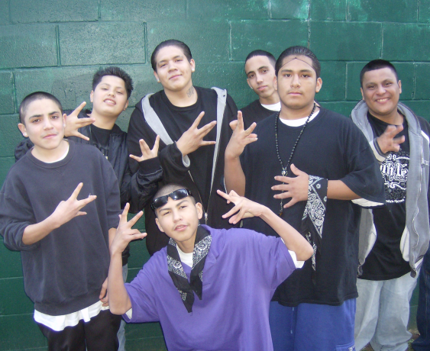
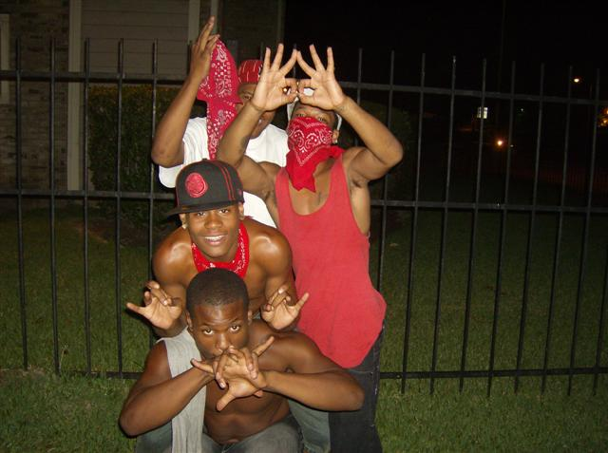
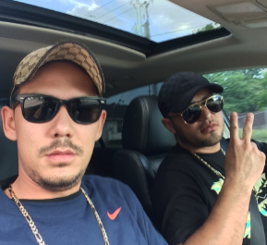
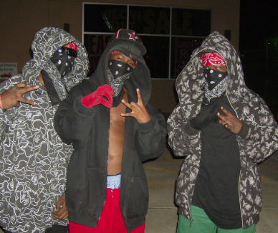
Gang Division
Gangs in Houston
Gangs are in all parts of the city.
Gangs commit a wide variety of crimes. Some are crimes of opportunity and some are well planned out long term conspiracies. They constantly affect the quality of life of those around them.
Average gang member age between age 13 to 30.
Houston has many traditional gangs the use colors and tattoos to identify themselves. But it also has many gangs that do not wear traditional gang colors or use traditional symbols and terminology.
These groups are hard to identify and investigate.
Gathering intelligence is a major key to combating gangs.

Slide 22
Gang Division
Gangs in Houston
Intelligence-led Model
In order to identify the most significant threat groups operating in the Houston area, our activities includes:
  Gathering extensive intelligence on the less traditional but very complex and organized street level gangs and organized crime groups, as well as the traditional and high level cartel organizations.
  The criminal organizations are strategically assessed in order to eradicate the problem.
  The intelligence gathered identifies emerging trends and impedes criminal expansion efforts.
  These efforts have been beneficial in directing proactive enforcement operations, as well as identifying or locating violent offenders and co-conspirators.
  Allows investigators to evaluate the value of individual targets as well as the individual target’s role within the organization

Slide 23
Gang Division
Case Example

Slide 24
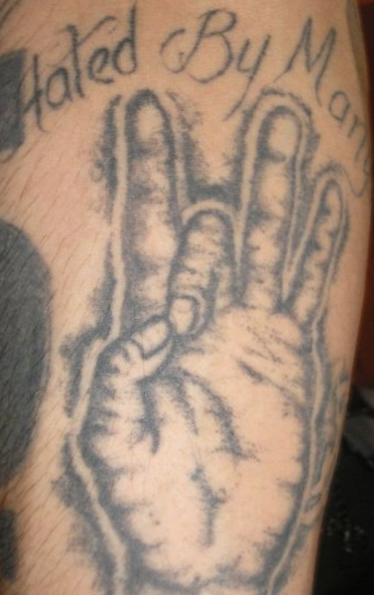


Gang Division
Case Overviews – 5th Ward Circle
5th Ward Circle is an umbrella group operating in the 5th Ward area of northeast Houston, that has smaller, individual gangs that fall under it. These include the Market Street Money Gang, Brewster Park Bitch Killers, Coke Street, 2 CC’s, and Bac Street. Their signature crimes include working in groups of three to six man teams committing night time burglaries of pharmacies, convenience stores, jewelry stores (smash and grabs), and juggings. There are approximately 450 documented members that fall under the 5WC umbrella.

Slide 25
Notes:
This map depicts the locations of the documented crimes committed by the 5th Ward Circle. This only includes the crime committed by the documented 5th Ward circle suspects not the other crimes committed by gang members under the 5th ward circle umbrella.

Slide 26
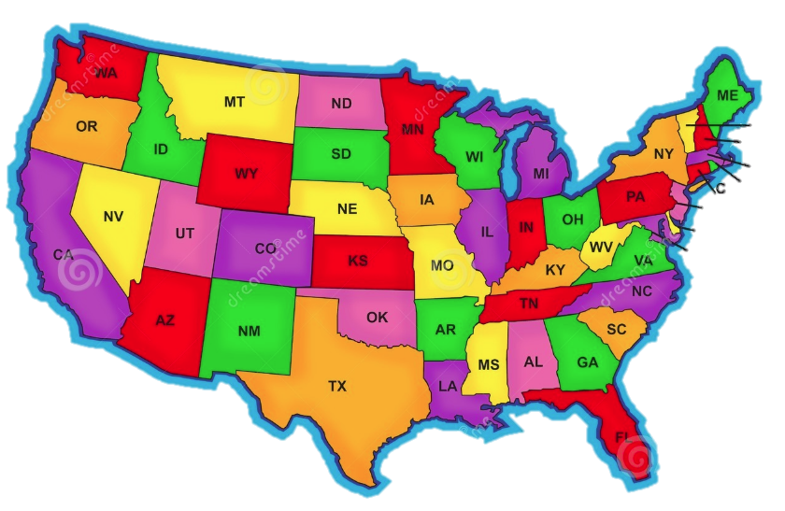
Gang Division
Case Overviews – 5th Ward Circle
The 5th Ward Circle commits crimes across the state and across the county. 5WC members have been tied to the aforementioned crimes in no less than fifteen (15) states. There have been at least ninety (90) arrests tied to 5WC members across the nation. They have adopted this strategy in order to minimize their chances of being arrested or identified by law enforcement officials who are familiar with their activities. Though they employ this strategy routinely they are still extremely active in Houston with crimes attributed to the gang reported almost daily. Routine crimes attributed to the gang include drug trafficking, home invasion robberies, and shootings.
Texas
Louisiana
Mississippi
Alabama
Florida
North Carolina
Tennessee
Virginia
Arkansas
Missouri
Illinois
Oklahoma
Colorado
New Mexico
Utah
Nevada
California
Notes:
2016 – HPD Gangs and Narcotics Division executed a search warrant in the 5th Ward area. Two 5WC gang members were arrested and a large amount cash and prescription drug were seized.
20.2 Grams of Ecstasy
262.4 Grams of Hydrocodone
48.6 Grams of Oxycodone
1004.4 Grams of Marijuana
28.9 Grams of Xanax
189.3 Grams of Soma
1198.6 Grams of Promethazine
Approximately $23,000 in cash was seized during the investigation.
Despite law enforcement successes that include state and federal prosecutions the 5WC gang continues to operate and the law enforcement effort against them continues.

Slide 27
Gang Division
END OF PRESENTATION

