Slide 1
Digital social life safety tips
Special Victims Division
Commander Le Conn

Slide 2
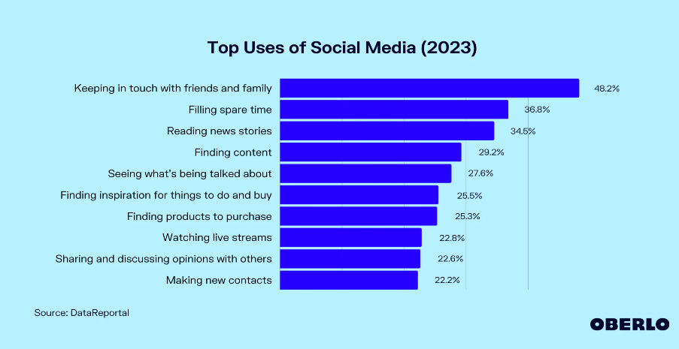
Social media usage
Notes:
Source: Why Do People Use Social Media? [Apr 2023 Update] | Oberlo
22% of usage = Making new contact

Slide 3
Investigations with social media nexus
Types of Crimes
Fraud
Robbery
Theft
Sexual Assault
Stranger cases with social media nexus
2022 = 16%
2023 = 23%

Slide 4
Social media apps
Adults
TEENS
Bumble
Grinder
Facebook
Instagram
Jacked
Snapchat
Telegram
Tinder
Grinder
Instagram
KIK
MeetMe
Mocospace
Omegle
Snapchat
Whisper
Notes:
Mocospace, Omegle, Whisper, and MeetMe are more public.

Slide 5
Safety tips meeting online
Cross check other social media accounts to confirm identity
Block and report suspicious users
Check the person’s criminal history (use legitimate companies)
Do not respond to requests for financial help
Chat online at your comfort level
Video chat before meeting in person
Notes:
Source: Online Dating and Dating App Safety Tips | RAINN
Rape Abuse Incest National Network

Slide 6
Safety tips meeting online
Wait to share personal information
Date of birth
Social Security Number
Driver’s License Number
Address
Phone number
Financial information
Notes:
Source: Online Dating and Dating App Safety Tips | RAINN
Rape Abuse Incest National Network

Slide 7
Safety tips meeting in person
Set boundaries prior to meeting
Meet in a public place during daytime hours
Share your location with friends and family members
Watch your alcohol consumption (if drinking)
Walk away or ask for help when you feel uncomfortable or unsafe
Have a good exit strategy
Plan your own transportation
Trust your instincts
You have the right to say no
Notes:
Source: Online Dating and Dating App Safety Tips | RAINN
Rape Abuse Incest National Network

Slide 8
Sexual Assault Awareness campaign
Sexual Assault Awareness Month – April
Campaign ran on HPD social media platforms ((Facebook, Instagram, Twitter, and YouTube)
Series of videos
Forensic Exam
Personal Safety related to Sexual Assault
Online Dating Safety Tips
Rideshare Safety Tips
Sexual Assault Investigator’s perspective
Victims Services

Slide 9
Online Dating Safety Tips Video
Facebook:
https://www.facebook.com/Houstonpolice
Twitter@houstonpolice
https://twitter.com/houstonpolice
YouTube:
https://www.youtube.com/houstonpolicedept
Instagram@houstonpolice
https://instagram.com/houstonpolice/
https://www.youtube.com/shorts/0bP4xAzVjrY

Slide 10
Child abuse prevention campaign
Child Abuse Prevention Month – April
Campaign ran on HPD social media (Facebook, Instagram, Twitter, and YouTube)
Series of videos
Signs of child sex abuse
Reporting child abuse
What to expect from an investigation
Internet Safety
Children’s Assessment Center Services

Slide 11
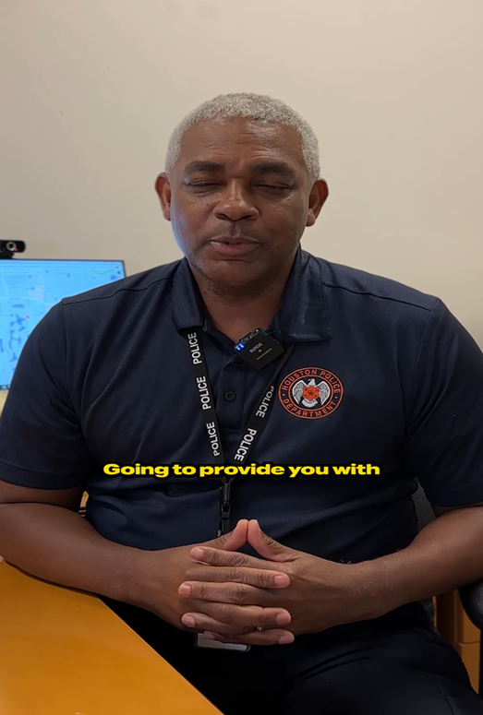
Internet Safety Video
Facebook:
https://www.facebook.com/Houstonpolice
Twitter@houstonpolice
https://twitter.com/houstonpolice
YouTube:
https://www.youtube.com/houstonpolicedept
Instagram@houstonpolice
https://instagram.com/houstonpolice/
https://www.facebook.com/Houstonpolice/videos/being-vigilant-on-the-internet-is-pivotal-in-the-push-to-end-child-abusedetectiv/916722606246642/

Slide 12
Start by believing
Victims often feel shame, guilt, confusion, loneliness
It’s not the victim’s fault
The victim could do everything right, but can still fall victim
Even if the victim does everything wrong from a safety standpoint, it does not mean that it was ok for the offender to sexually assault them or that the victim is somehow to blame. The sexual assault is caused by the wrong actions of the offender.
SVD is committed to holding offenders accountable for their actions.
Notes:
Start by Believing Campaign - EVAWI – End Violence Against Women International

Slide 13
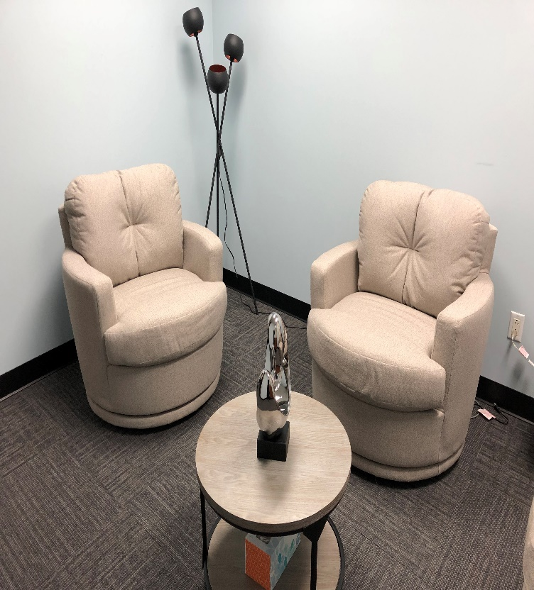
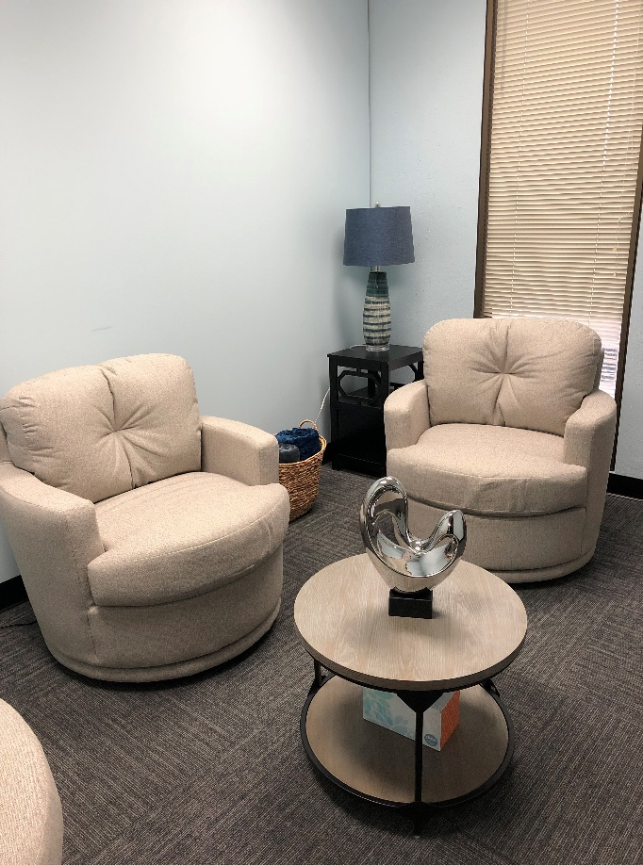
Soft interview room
Notes:
Collaboration with Project Beloved

Slide 14
Victim Services division
Main number 713-308-0080
Blue card
Rights of Crime Victims
Crime Victims’ Compensation
U Visa Information
Guidance for sexually assaulted victims

Slide 15
Please share safety videos
Facebook:
https://www.facebook.com/Houstonpolice
Twitter@houstonpolice
https://twitter.com/houstonpolice
YouTube:
https://www.youtube.com/houstonpolicedept
Instagram@houstonpolice
https://instagram.com/houstonpolice/

Slide 16
Questions?

