Slide 1
Houston police department PUBLIC SAFETY COMMITTEE fy25 Budget amendmentS 6th CADET CLASS
J. Noe Diaz, Chief of Police
Patricia cantu, assistant chief
Rhonda Smith, CFO & Deputy Director

Slide 2
Budget Amendment
6th CADET CLASS
The Administration has approved a 6th HPD Cadet class in FY25 and has provided $2.7M in the General Government Fund
2

Slide 3
HPD Cadet Classes (2023 to Present)
Count | Class # | Start Date | Beginning# Cadets | Cadet Graduates | Grad Date
1 | 256 | 6/21/2022 | 69 | 61 | 1/5/2023
2 | 257 | 9/6/2022 | 68 | 59 | 3/30/2023
3 | 258 | 11/14/2022 | 60 | 51 | 6/8/2023
4 | 259 | 1/23/2023 | 49 | 45 | 8/10/2023
5 | 260 | 4/10/2023 | 74 | 64 | 10/31/2023
6 | 261 | 6/26/2023 | 82 | 76 | 1/18/2024
7 | 262 | 9/5/2023 | 72 | 64 | 3/28/2024
8 | 263 | 11/13/2023 | 73 | 68 | 6/6/2024
9 | 264 | 1/29/2024 | 59 | 53 | 8/15/24
10 | 265 | 4/15/2024 | 79 | currently 76 | future date 11/7/24
11 | 266 | 6/24/2024 | 68 | 67 | future date 1/16/25
12 | 267 | 8/19/2024 | 46 | 46 | future date 3/13/25
*6th class
3

Slide 4
Historical Perspective
4
Notes:
Optically, each line going across represents a population change of 50,000 compared to an officer change of 50.
Although the population of Houston has significantly increased over the past 25 years, HPD’s workforce has seen a steady decline. Staffing constraints have reduced our classified staffing level to 5,166 compared to highest peak of 5,470 in 1998. Our Civilian workforce, who are also critical strategic partners, has also declined to 870 compared to 1,738 in 2009.
The projected beginning classified headcount for FY2025 is estimated to be 5,204, with plans for five cadet classes annually from FY2025 to FY2027 included in the budget. Considering regular attrition rates, it is expected that HPD will have 5,321 classified officers by the end of FY2025. Moving forward, assuming an average attrition rate of 240 per year from FY2025 to FY2027 and the full enrollment of HPD cadet classes, the anticipated classified headcount is projected to reach 5,591 by the conclusion of FY2027.

Slide 5
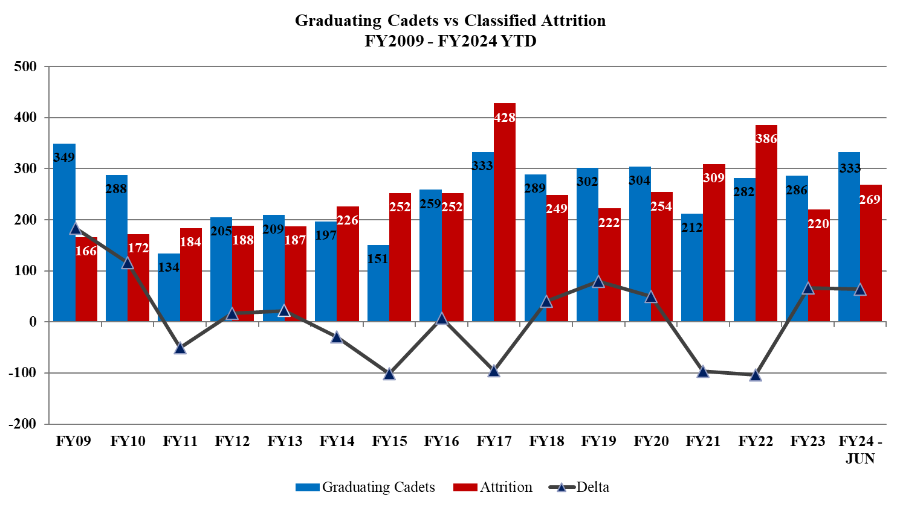
Graduating Cadets vs. Attrition
5
Notes:
Note: HPD has not returned to its headcount of 5,470 Classified Personnel (1998) despite the increase in the City’s population. The department forecasted annual attrition rate is 240.
This slide displays the annual classified attrition since FY09 when compared to the number of graduating cadets for each year.
As you can see, HPD is slowly netting positive the last couple of years, FY23 – 66 and YTD FY24 - 29 after facing a huge net decrease in FY21 – (97) and FY22 – (104).
Fiscal Graduating
Years Cadets Attrition Delta
FY09 349 166 183
FY10 288 172 116
FY11 134 184 (50)
FY12 205 188 17
FY13 209 187 22
FY14 197 226 (29)
FY15 151 252 (101)
FY16 259 252 7
FY17 333 428 (95)
FY18 289 249 40
FY19 302 222 80
FY20 304 254 50
FY21 212 309 (97)
FY22 282 386 (104)
FY23 286 220 66
FY24 - JUN 333 269 64
Classified Headcount includes EACs(3), and ACs(9)
COP is considered a Civilian

Slide 6
Summary of Staffing Levels
Current Staffing :
Classified Officers: 5,211 (vs. 5,470 in 1998)
Civilian Workforce: 880 (vs. 1,738 in 2009)
Projected Classified Officers
(5 cadet classes)
FY2024 5,204
FY2028 5,641
FY2025 5,386
* Ideal Staffing: 6,500 to 7,000
6
Notes:
Note: HPD has not returned to its headcount of 5,470 Classified Personnel (1998) despite the increase in the City’s population. The department forecasted annual attrition rate is 240.
The provided data highlights the significant staffing challenges faced by the Houston Police Department (HPD) despite a growing population in the city. Here is a summary and analysis based on the provided information:
Current Staffing Levels (as of March 31, 2024):
Classified Officers: 5,166 (compared to a peak of 5,470 in 1998)
Civilian Workforce: 870 (compared to 1,738 in 2009)
Projected Classified Officer Headcount:
Beginning of FY2025: 5,211
End of FY2025: 5,386 (considering regular attrition rates and planned cadet classes)
End of FY2028: 5,641 (assuming full enrollment of planned cadet classes and an average attrition rate of 240 officers per year)
Ideal Staffing Levels:
Classified Officers: Between 6,500 and 7,000
4. Analysis and Projections
Current Trends:
The HPD workforce has been declining over the past 25 years, with a noticeable decrease in both classified officers and civilian staff.
Despite a projected increase in classified officers by the end of FY2028, the department will still fall short of the ideal number of officers.
Cadet Classes and Attrition:
The budget includes plans for five cadet classes annually from FY2025 to FY2028. FY25 has 6 cadet classes.
Regular attrition is expected to be around 240 officers per year.
With these factors, the projected increase to 5,641 officers by FY2028 still leaves a significant gap to reach the ideal range of 6,500 to 7,000 officers.
5. Recommendations
Additional Cadet Classes:
Introducing an additional 6th cadet class of 75 officers annually could significantly contribute to closing the gap between the projected and ideal number of officers.
Calculating the impact of this additional class over the planned period can provide a clearer picture of progress toward the staffing goals.
Retention and Recruitment Strategies:
Implementing measures to reduce attrition rates could help maintain a higher number of officers.
Enhancing recruitment efforts and offering competitive benefits might attract more candidates to the cadet classes.
Civilians Workforce Reassessment:
Evaluating the roles and contributions of the civilian workforce might identify critical areas needing support to improve overall efficiency and effectiveness.
Restoring or increasing the civilian workforce to previous levels might alleviate some pressures on classified officers, allowing them to focus more on policing duties.
6. Conclusion
To address the staffing challenges and better meet the growing demands of the Houston population, HPD should consider the following actions:
Adding a 6th cadet class of 75 officers annually.
Implementing strategies to reduce officer attrition and enhance recruitment.

Slide 7
Summary of Budget Amendment
The HPD workforce has been steadily declining over the past 25 years, with a noticeable decrease in both classified officers and civilian staff. Despite a projected increase in classified officers by the end of FY2028, the department will still fall short of the ideal number of officers.
Adding a 6th cadet class for only FY2025 yields a projected staffing count of 5,641 by FY2028
Adding a 6th cadet class annually beginning FY2025 yields a projected staffing count of 5,836 by FY2028
7
Notes:
The HPD workforce has been declining over the past 25 years, with a noticeable decrease in both classified officers and civilian staff.
Adding a 6th cadet class for only FY2025 yields a projected staffing count of 5,641 by FY2028
Adding a 6th cadet class annually beginning FY2025 yields a projected staffing count of 5,836 by FY2028
Despite a projected increase in classified officers by the end of FY2028, the department will still fall short of the ideal number of officers.

Slide 8
Total Estimated Cost (FY25 Cost of Cadets)
Description |  |  | Estimated Cost
FY25 Total for 6 cadet classes |  |  | $ 8,778,081
FY25 Proposed Budget |  |  | $ 6,028,483
FY25 add 6th cadet class - Total |  |  | $ 2,749,598
Benefits (24%) |  |  | $ 659,904
Total |  |  | $ 3,409,502
Reduce Shotspotter savings |  |  | $ (700,000)
Total FY25 Additional Cost |  |  | $ 2,709,502
Anticipated Additional PPO Costs |  |  | $ 1,554,088
The Administration has approved a 6th Cadet Class for FY25 and has set aside $2.7M for HPD in the General Government Fund.
8
Notes:
Note: Total FY25 funding needed = $4.3M
Projected incremental cost for FY25 of $2.71M for Cadets (net of ShotSpotter savings)
Projected incremental cost for FY25 of $1.55M for Probationary Police Officers

Slide 9
Other Annual Costs
Background Unit - Recruiting
$232K
Psychological Services
(additional staffing)
$160K
Academy Overtime
$339K
TOTAL
$731K
9
Notes:
Other annual costs not included.

Slide 10
Questions
10

Slide 11
APPENDIX
11

Slide 12
Total Estimated Cost (Annually)
1 Additional Class of 75 Cadets/Probationary Police Officers
$42k Base Salary
Base Salary $3.2M
Other Compensation $269K
Subtotal Cost $4.2M
Benefits $1.5M
ShotSpotter Savings ($700K)
$52k Proposed Base Salary
Base Salary $3.9M
Other Compensation $269K
Subtotal Cost $5.9M
Benefits $2.1M
$5K Incentive $375K
ShotSpotter ($700K)
Ancillary Costs $1.4M
Ancillary Costs $1.4M
12
Notes:
Comment: the biggest lever we have for growing the department is thru retention.
$52k Cost Breakdown
Base Salary
Cadets $1,969,956
Probationary Officers $1,937,837
TOTAL $3,907,793
Benefits
Cadets
FICA $179,389
Health Ins $356,108
Workers Comp $22,158
Long-Term Disability $6,120
Unemployment Ins $2,625
TOTAL $566,400
Probationary Officer
Pension $707,830
FICA $32,004
Health Ins $427,329
TOTAL $1,167,163
Other Compensation Detail
Cadets
Incentive ($5k Bonus) $375,000
Probationary Officers
Third Party Disability $26,250
Equipment Allowance $87,450
TCOLE $61,158
Education Incentive $76,479
Bilingual Pay $17,967
TOTAL $269,304
Ancillary Costs Detail
Staff Overtime $133,929
Outside Training $2,700
Uniforms, Vest, Misc Supplies $332,958
BWC & Taser $127,500
Field Training Officer Salary $146,250
Field Training Officer Overtime $66,455
APX Next Radios $556,319
Cell Phone Service $18,000
TOTAL $1,384,111

Slide 13
Future Hiring Plans (6 Cadet Classes Only in FY25)
Houston Police Department
Current and Future Hiring Plans
5-Year Outlook - 6 Planned Cadet Classes Beginning FY25
April 24, 2024
 | FY24 Forecast | FY25 Proposed | FY26 | FY27 | FY28 | 5-Year Total
Classes Planned to start in FY | 5 | 6 | 5 | 5 | 5 | 26
Starting Cadets per Fiscal Year | 354 | 390 | 325 | 325 | 325 | 1,719
Classes Planned to Graduate in FY | 6 | 6 | 5 | 5 | 5 | 27
Cadets projected to graduate per Fiscal Year | 332 | 422 | 325 | 325 | 325 | 1,729
Starting Classified Headcount | 5,147 | 5,204 | 5,386 | 5,471 | 5,556
Plus: Cadets projected to graduate per Fiscal Year | 332 | 422 | 325 | 325 | 325 | 1,729
Less: Projected Attrition | (275) | (240) | (240) | (240) | (240) | (1,235)
Projected Ending Classified Headcount | 5,204 | 5,386 | 5,471 | 5,556 | 5,641
Year to Year Headcount Growth | 57 | 182 | 85 | 85 | 85 | 494
Note: assumes that the cadet class starting in December every fiscal year begins at the beginning of the month. Otherwise, HPD may graduate only 5 classes every year.
13
Notes:
Note: if HPD was to revert back to 5 cadet classes annually starting FY2026, the ending headcount is projected to be 5,641 by the end of FY28.

Slide 14
Future Hiring Plans (6 Cadet Classes Annually Beginning FY25)
Houston Police Department
Current and Future Hiring Plans
5-Year Outlook - 6 Planned Cadet Classes Beginning FY25
April 24, 2024
 | FY24 Forecast | FY25 Proposed | FY26 | FY27 | FY28 | 5-Year Total
Classes Planned to start in FY | 5 | 6 | 6 | 6 | 6 | 29
Starting Cadets per Fiscal Year | 354 | 390 | 390 | 390 | 390 | 1,914
Classes Planned to Graduate in FY | 6 | 6 | 6 | 6 | 6 | 30
Cadets projected to graduate per Fiscal Year | 332 | 422 | 390 | 390 | 390 | 1,924
Starting Classified Headcount | 5,147 | 5,204 | 5,386 | 5,536 | 5,686
Plus: Cadets projected to graduate per Fiscal Year | 332 | 422 | 390 | 390 | 390 | 1,924
Less: Projected Attrition | (275) | (240) | (240) | (240) | (240) | (1,235)
Projected Ending Classified Headcount | 5,204 | 5,386 | 5,536 | 5,686 | 5,836
Year to Year Headcount Growth | 57 | 182 | 150 | 150 | 150 | 689
Note: assumes that the cadet class starting in December every fiscal year begins at the beginning of the month. Otherwise, HPD may graduate only 5 classes every year.
14
Notes:
Note: if HPD was to conduct 6 cadet classes annually starting FY2026, the ending headcount is projected to be 5,836 by the end of FY28.

Slide 15
HPD Purpose and Mission
15

