Slide 1

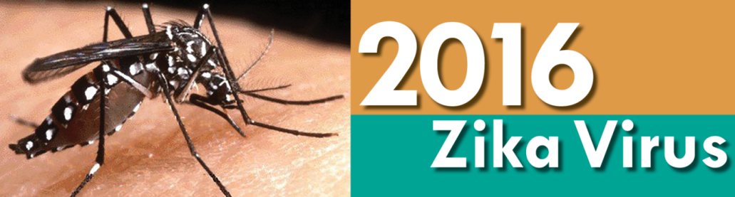

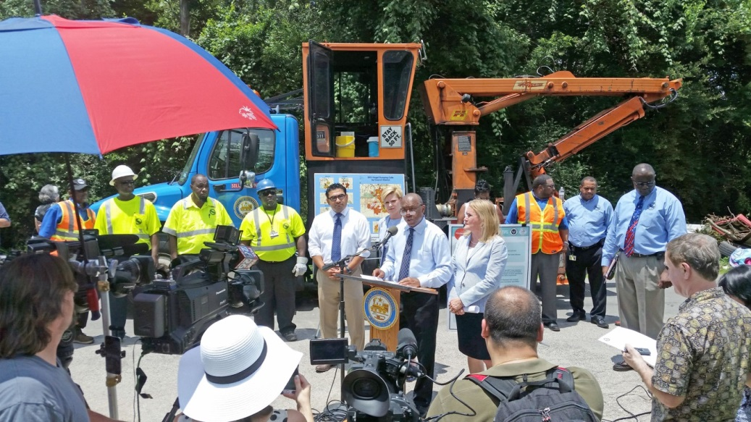

Mayor Sylvester Turner
Solid Waste Management Department
ZIKA Abatement Program
Regulatory and Neighborhood Affairs Presentation
June 16, 2016
Harry J. Hayes, Director

Slide 2


Presentation Overview
Harry Hayes, Director
Sylvester Turner, Mayor
What has happened?
What are we doing?
Why are we doing it?
Benefits of our work.
ZIKA Abatement Program

Slide 3
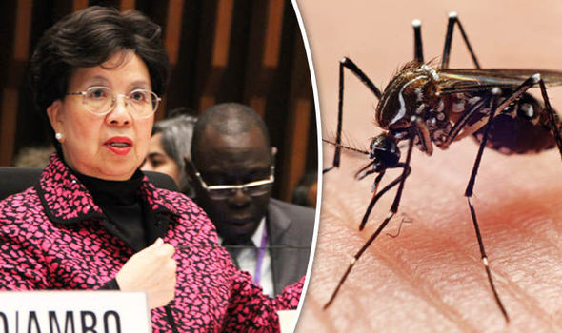
What has happened?
Harry Hayes, Director
Sylvester Turner, Mayor
February 1, 2016: The World Health Organization declared the Zika virus and its suspected link to birth defects an international public health emergency.
Data from Brazil, the epicenter of an epidemic that has hit more than three dozen countries and territories in the Americas, show that about 39 percent of 2,212 investigated cases of microcephaly are already confirmed for the rare congenital condition.
Dr. Margaret Chan, Director-General, WHO
Source: World Health Organization
ZIKA Abatement Program

Slide 4

ZIKA Transmission & Birth Defects
Harry Hayes, Director
Sylvester Turner, Mayor
Mosquito Bites
Mother to Child (Pregnancy)
  Microcephaly
  Severe Brain Defects
Sexual Contact
Blood Transfusion
Guillain-Barré Syndrome (GBS)
  GBS symptoms include weakness of the arms and legs that is usually the same on both sides of the body.
"The economic cost of Zika could be very high," said Dr. Peter Hotez, microbiologist at Texas Children's Hospital and dean of the National School of Tropical Medicine at Baylor College of Medicine. CDC
  CDC estimates lifetime medical cost between $1 million and $10 million.
ZIKA Abatement Program

Slide 5
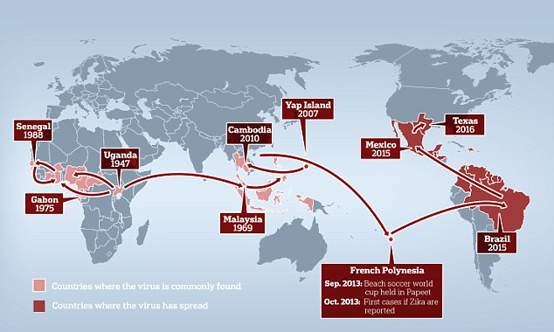
ZIKA History
Harry Hayes, Director
Sylvester Turner, Mayor
Discovered in sub-Saharan Africa in 1947
Spread across the Southern Hemisphere over the ensuing 65 plus years
Migrated from South America to North America (trade and travel)
Zika virus is primarily transmitted by the Aedes species of mosquito which is also responsible for the spread of dengue, Chikungunya and yellow fever viruses.
In most areas, the primary vector of these viruses is Aedes aegypti, with Aedes albopictus a proven or potential vector in some settings.
Well-implemented vector control against Aedes using existing tools effectively reduces the transmission of viruses spread by these vectors.
ZIKA Abatement Program

Slide 6
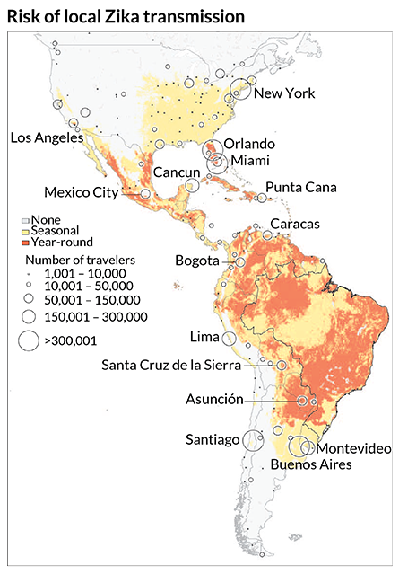
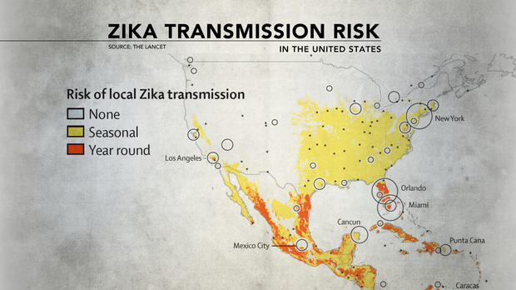
South to North America Spread
Harry Hayes, Director
Sylvester Turner, Mayor
Effects could worsen due to Brazil hosting 2016 Summer Olympics
ZIKA Abatement Program

Slide 7
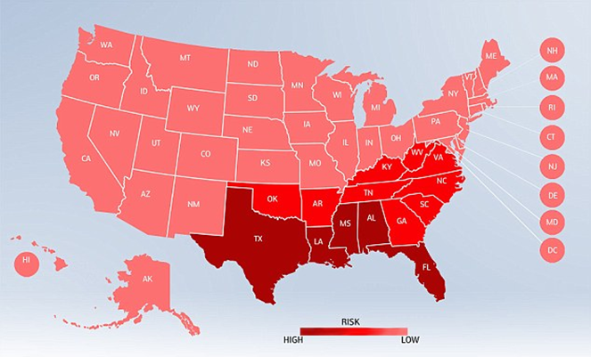
U.S. Outbreak Risk
Harry Hayes, Director
Sylvester Turner, Mayor
The states at greatest risk are those along the Gulf Coast - Texas, Louisiana, Mississippi, Alabama and Florida (dark red). – US Centers for Disease Control
ZIKA Abatement Program

Slide 8
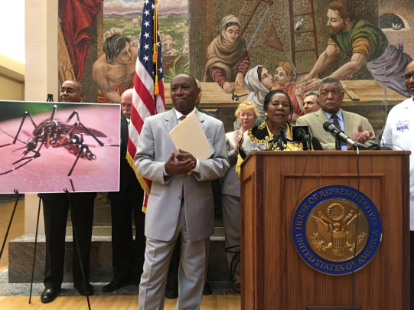
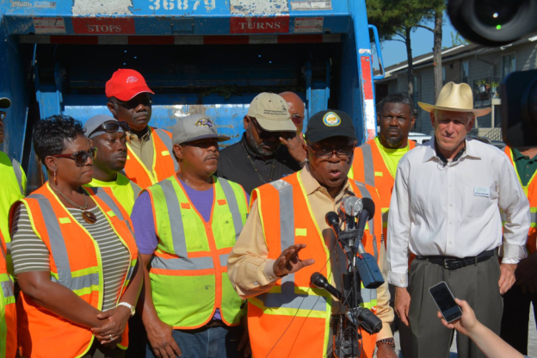
What are we Doing?
Harry Hayes, Director
Sylvester Turner, Mayor
Beginning February 2016, Mayor Turner directed various city agencies, including the solid waste department, to create business plans to aggressively abate potential breeding grounds for Zika carrying mosquitos.
  SWMD - Abatement
  HHS – Education and monitoring
  DON - Enforcement
  PWE – Ditch & Drainage Maintenance
  Medical Services – Lead Incident Command & Medical Preparations
The efforts of SWMD and other agencies help to combat the mosquito which transmits the West Nile virus.
ZIKA Abatement Program

Slide 9
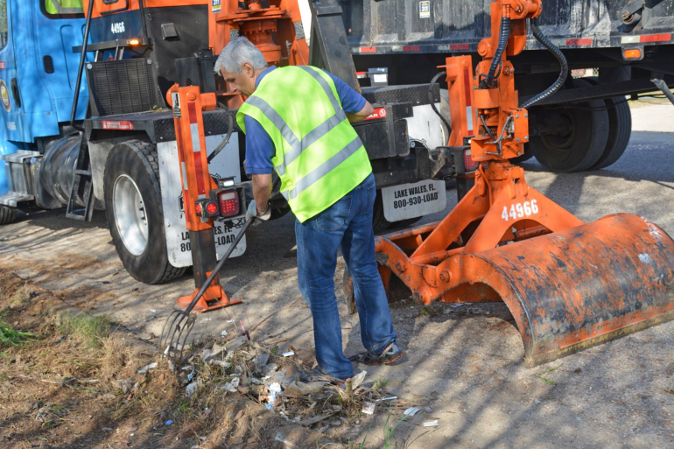
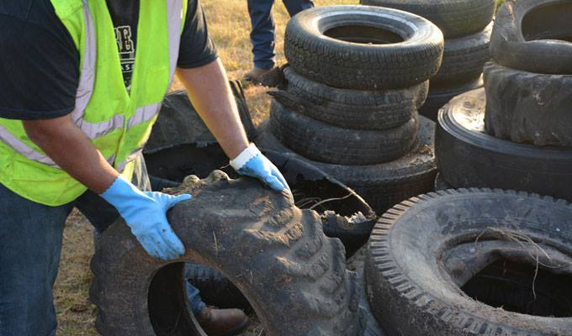
What Are We Doing?
Harry Hayes, Director
Sylvester Turner, Mayor
Use 311 Data to identify repetitive dumpsites
Work with Council members and community associations to target dumpsites
Place repetitive sites on hit list of law enforcement monitoring
Implementation of Used/Scrap tire management program with Zero Tolerance standard
HHS, DON, PWE have also increased public education and enforcement efforts to leverage the city’s preparations
Retrain Inspectors on the use of the 311 App
Created new illegal dumping report to 311 App to generate Service Requests (SRs) for Zika Abatement
ZIKA Abatement Program

Slide 10
ZIKA Abatement Efforts
Harry Hayes, Director
Sylvester Turner, Mayor
  Total tons illegally dumped debris collected in Zika abatement efforts February 2016 – June 2016
  Over 3,000 tons of illegally dumped materials and debris has been collected
ZIKA Abatement Program

Slide 11
ZIKA Abatement Efforts
Harry Hayes, Director
Sylvester Turner, Mayor
  Total illegally dumped tires collected in Zika abatement efforts
    February 2016 – June 2016
  Over 19,000 illegally dumped tires have been collected
ZIKA Abatement Program

Slide 12
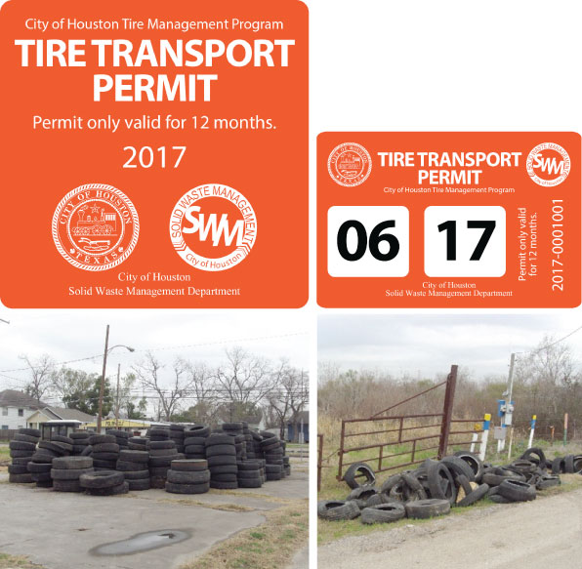
ZIKA Abatement – Scrap Tire Program
Harry Hayes, Director
Sylvester Turner, Mayor
OVERVIEW OF SCRAP TIRE PROGRAM
To combat the illegal dumping of scrap tires within the City of Houston, the Scrap Tire Ordinance was passed unanimously by City Council on October 21, 2015
Many more scrap tires produced than there are effective end markets
It costs the City of Houston, Solid Waste Management Department approximately $1 million annually to collect and dispose of illegally dumped debris including tires
Scrap Tire makes an ideal breeding ground for mosquitoes
ZIKA Abatement Program

Slide 13
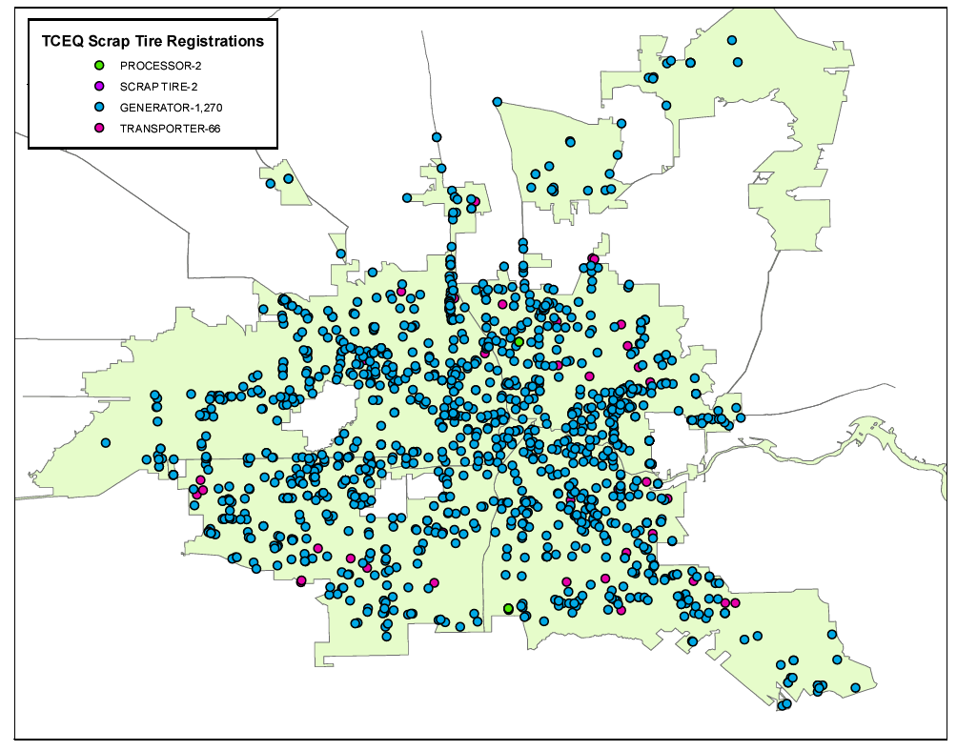
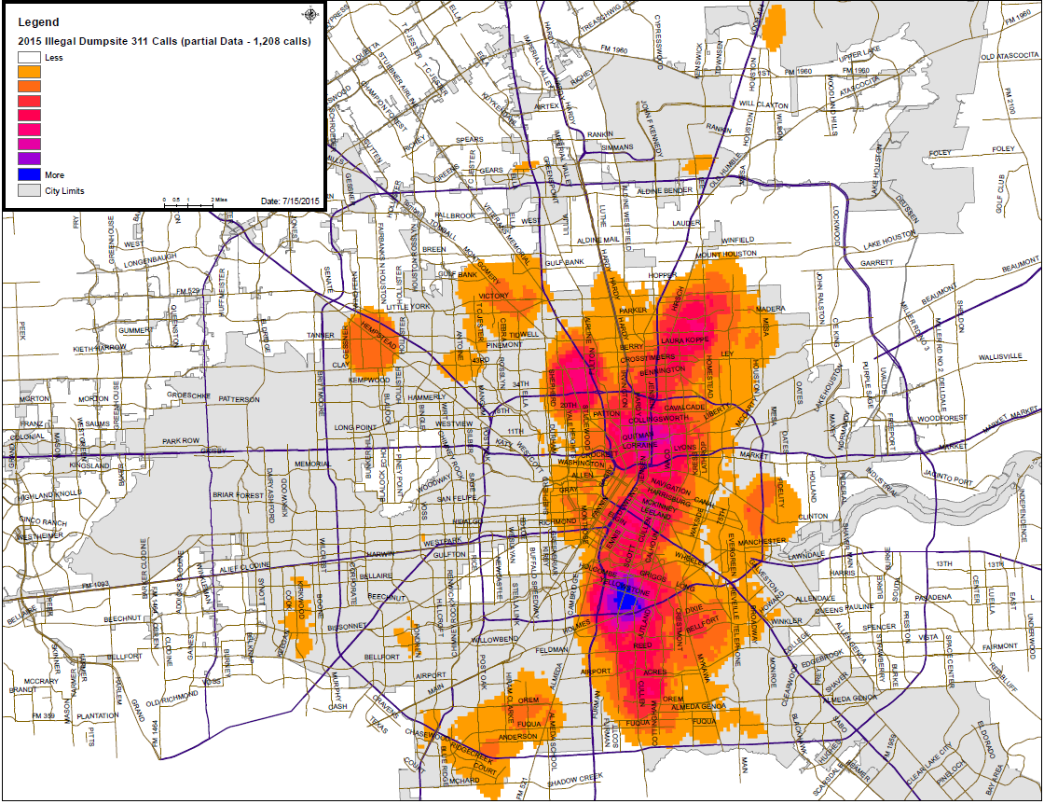
ZIKA Abatement – Scrap Tire Program
Harry Hayes, Director
Sylvester Turner, Mayor
OVERVIEW OF SCRAP TIRE PROGRAM
Over 2,000 business have been registered as either a Scrap Tire Generator or Transporter within the City limits
Illegal Scrap Tires businesses and illegal dumping are closely related
ZIKA Abatement Program

Slide 14

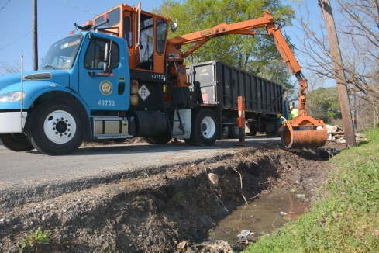
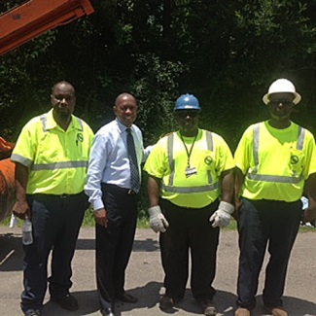
ZIKA Abatement Efforts
Harry Hayes, Director
Sylvester Turner, Mayor
RESOURCES REQUIRED
June 9, 2016, Mayor Sylvester Turner and members of the State Legislature launched aggressive push for state funds to fight the ZIKA virus
Mayor Turner is requesting assistance from the Texas Commission on Environmental Quality’s Solid Waste Disposal Fees Account, which currently has a balance of $130 million. Under changes made by the legislature in 2007, the fund may be used for an immediate response to or remediation of an emergency that involves solid waste.
Since February, the City of Houston has tackled the problem head-on by removing tons of debris and thousands of tires.
Press Conference – June 9, 2016
14
ZIKA Abatement Program

Slide 15

Questions?
Harry Hayes, Director
Sylvester Turner, Mayor
ZIKA Abatement Program

