Slide 1
Clear Lake Division Crime Stats
Cmdr. Matthew May
Sgt. Lozano / SPO. R. Buitron

Slide 2
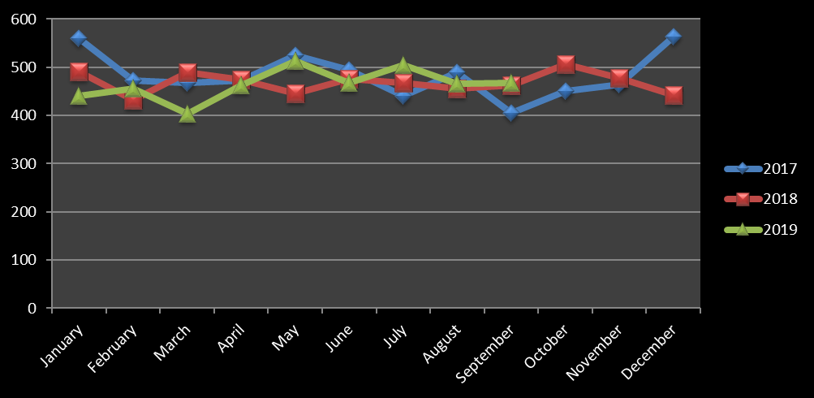
Clear Lake Division Crime Stats
Year to Date Stats: Part 1 Three Year Trend
September recorded 467 incidents an increase of 2 incidents from previous month or 0.43%

Slide 3
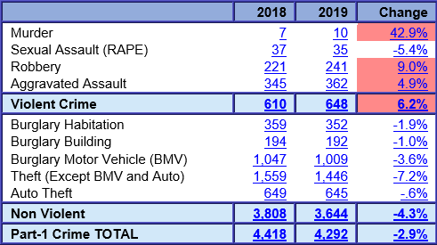
Clear Lake Division Crime Stats
Part 1 Crime Year to Date
January 1 to September 30th

Slide 4
Clear Lake Division Crime Stats
Crime with an Increase
Offense | Jul | Aug | % Change | Aug | Sep | % Change | Sep* | Oct* | % Change
Murder | 0 | 0 | 0.00% | 0 | 2 | 200.00% | 0 | 0 | 0.00%
Sexual Assault (RAPE) | 3 | 5 | 66.70% | 5 | 6 | 20.00% | 2 | 2 | 0.00%
Robbery | 21 | 20 | -4.80% | 20 | 32 | 60.00% | 6 | 8 | 33.30%
Aggravated Assault | 32 | 47 | 46.90% | 47 | 58 | 23.40% | 6 | 10 | 66.70%
Violent Crime | 56 | 72 | 28.60% | 72 | 98 | 36.10% | 14 | 20 | 42.90%
Burglary Habitation | 40 | 41 | 2.50% | 41 | 37 | -9.80% | 7 | 6 | -14.30%
Burglary Building | 18 | 20 | 11.10% | 20 | 19 | -5.00% | 3 | 5 | 66.70%
Burglary Motor Vehicle (BMV) | 136 | 108 | -20.60% | 108 | 102 | -5.60% | 25 | 20 | -20.00%
Theft (Except BMV and Auto) | 188 | 163 | -13.30% | 163 | 146 | -10.40% | 29 | 25 | -13.80%
Auto Theft | 73 | 75 | 2.70% | 75 | 65 | -13.30% | 18 | 8 | -55.60%
Non Violent | 455 | 407 | -10.50% | 407 | 369 | -9.30% | 82 | 64 | -22.00%
Part-1 Crime TOTAL | 511 | 479 | -6.30% | 479 | 467 | -2.50% | 96 | 84 | -12.50%
Part 1 Crime Monthly Change
* Current Month Comparison to 6th.

Slide 5
Clear Lake Division Crime Stats
Part 1 Violent Crime Details: Sept. 1 - 30, 2019
98 Violent Crime were recorded with 38 incidents involving a Firearm. Two Murder incidents and Six Sexual Assaults were recorded all FV related. A total of 38 incidents involving a Firearm. The Premise Apartment Complex recorded the highest incidents for Violent Crime.
 | Agg Assault | Murder | Sexual Assault | Robbery | Total
Apartment Complex | 28 | 1 | 4 | 9 | 42
Bar or Night Club | 2 |  |  | 1 | 3
Church/Synagogue/Temple | 1 |  |  |  | 1
Commercial Parking Lot |  |  |  | 1 | 1
Department or Discount St |  |  |  | 2 | 2
Highway/Road/Street | 6 |  |  | 7 | 13
Grocery Store | 1 |  |  | 3 | 4
Hotel or Motel | 3 |  |  | 1 | 4
Illicit Massage Parlor |  |  |  | 1 | 1
Lake/Pond | 1 |  |  |  | 1
Other Parking Lot |  |  |  | 1 | 1
Pawn, Resale Shop, or Fle |  |  |  | 1 | 1
Residence | 12 | 1 | 2 | 1 | 16
Restaurant | 2 |  |  |  | 2
Gas Station | 2 |  |  | 4 | 6
Grand Total | 58 | 2 | 6 | 32 | 98
 | Agg Assault | Murder | Sexual Assault | Robbery | Total
Firearm | 22 | 2 | 1 | 13 | 38
Knife | 10 |  |  | 5 | 15
Other Weapon/Means | 13 |  | 1 | 5 | 19
Strong Arm | 13 |  | 4 | 8 | 25
Threat |  |  |  | 1 | 1
Grand Total | 58 | 2 | 6 | 32 | 98
Violent Crime by Weapon Type
Violent Crime by Premise Type
Notes:
Stats for September 2019
10 Murder incidents for 2019……

Slide 6
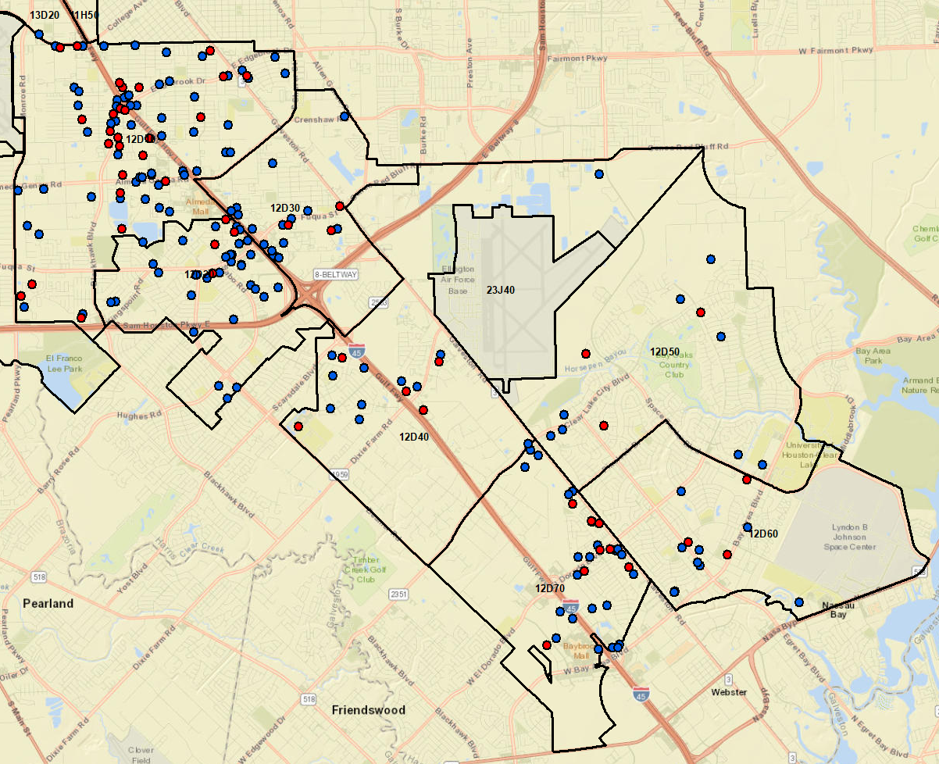
Clear Lake Division
Part 1 Crime Map
Violent Crime
Non-Violent Crime

Slide 7
Clear Lake Division Crime Stats
Part 1 Violent Crime Details: Sept. 1 – 30, 2019
Robbery
September recorded 32 Robberies with 13 involving a Firearm. Apartment Complex recorded the most incidents.
Premsie Type | Total
Apartment | 9
Bar or Night Club | 1
Commercial Parking Lot | 2
Depart/Discount Store | 2
Highway/Road/Street | 7
Grocery Store | 3
Hotel/Motel | 1
Illicit Massage Parlor | 1
Pawn/Resale Shop | 1
Residence | 1
Gas Station | 4
Grand Total | 32
Robbery Incidents

Slide 8
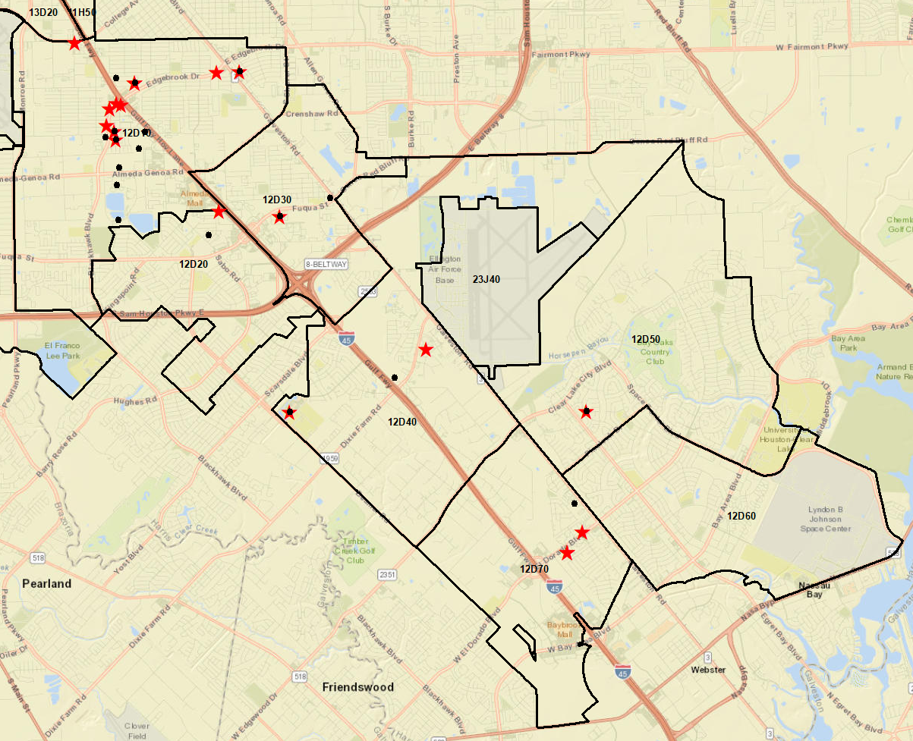
Clear Lake Division
Part 1 Violent Crime Map
Robbery Incidents:
18 incidents recorded with 9 incidents involving a Firearm
Robbery w/Firearm
Robbery
Other Incidents w/Firearm

Slide 9
Clear Lake Division Crime Stats
Part 1 Non-Violent Crime Details: Sept. 1 – 30, 2019
Burglary of Motor Vehicle (BMV) and Theft from vehicle (TMV), 121 incidents recorded with the majority of the incident recorded in Apartment Complexes and Strip Center Parking lots.
Premise | Total
Apartment Parking Lot | 32
Bank | 2
Bar or Night Club Parking | 4
Church/Synagogue/Temple | 2
Daycare | 1
Depart/Discount Store | 2
Grocery Store | 5
Gym | 2
Hospital Parking Lot | 1
Hotel/Motel Parking Lot | 1
Mall Parking Lot | 5
Parks and Recreation, Zoo | 2
Residence Driveway | 15
Restaurant Parking | 9
Road/Street/Sidewalk | 7
Gas Station | 1
Sporting Goods/Gun Shop | 1
Strip Business Center Parking | 27
Theaters Parking | 2

Slide 10
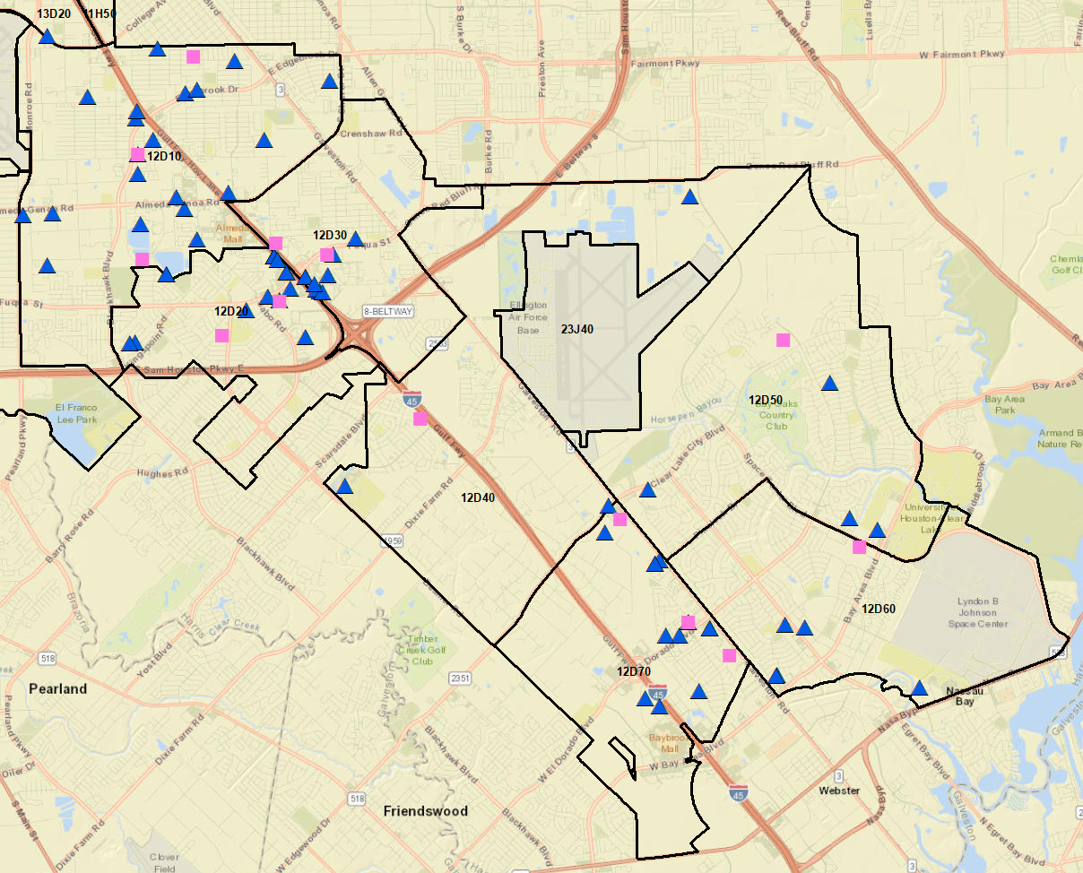
Clear Lake Division
Part 1 Non-Violent Crime Map
TMV Incidents
BMV Incidents

