Slide 1
Clear Lake/Southeast Houston Town Hall Meeting
Thursday, October 10, 2019
Space Center Houston

Slide 2
Houston Spaceport Phase One Infrastructure - Drainage Improvements
Devon Tiner, P.E., PMP
HAS City Engineer
Assistant Director – Building Standards

Slide 3
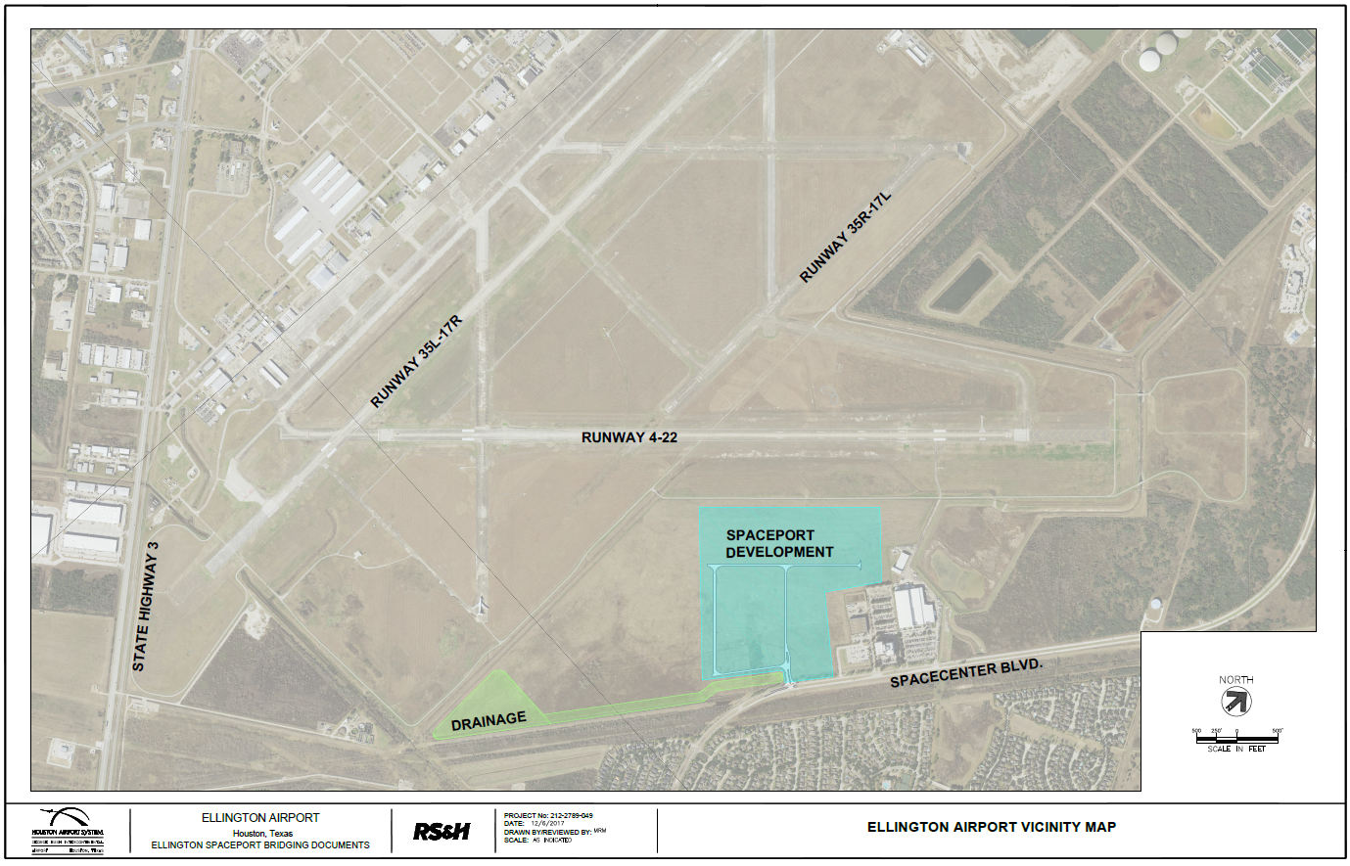
Houston Spaceport Phase One
Construction is 52% complete
Started in November 2018
Complete Construction in July 2020
$17,294,105 Contract Value
Design-Build Contract with Texas Sterling – Banicki Joint Venture

Slide 4
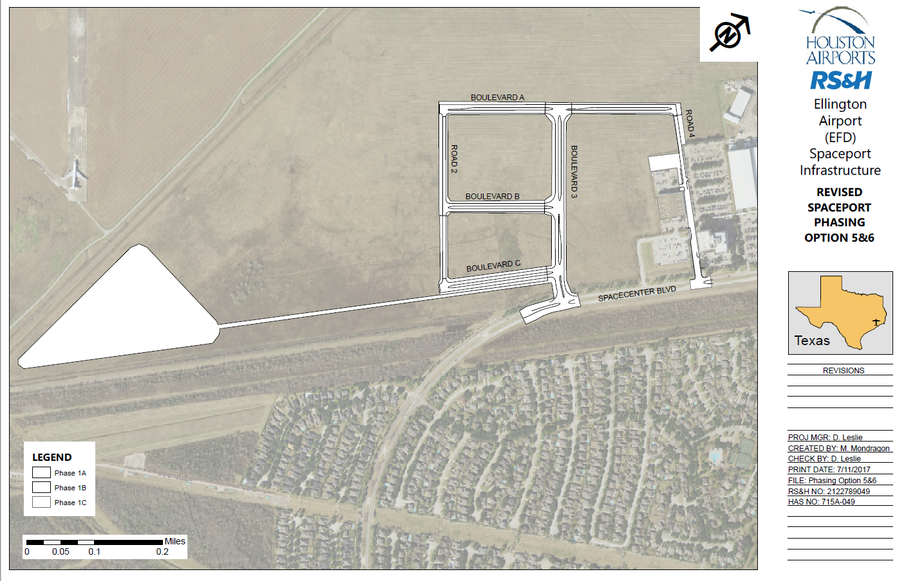
Houston Spaceport Phase One
Development Area - 95 ac.
Impervious Surface
Existing – 0%
Proposed – 70%
Detention Capacity
Required – 94.6 ac-ft
Proposed – 105.0 ac-ft
Footprint – 13.5 ac.

Slide 5
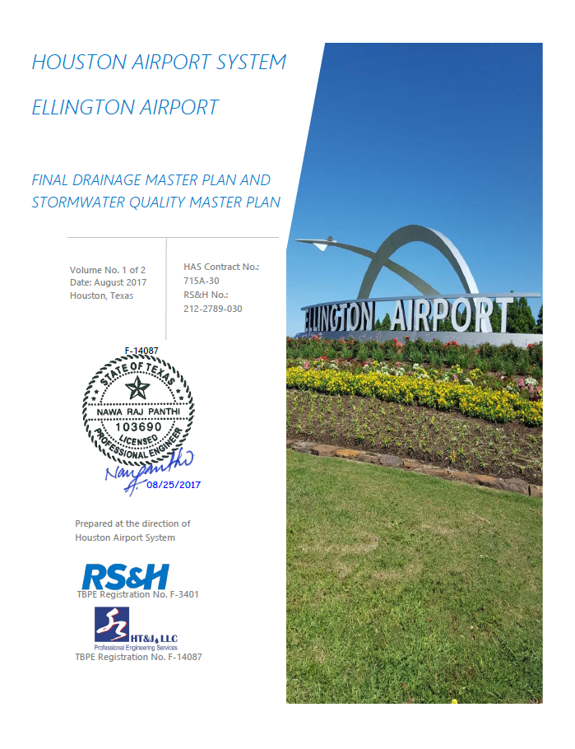
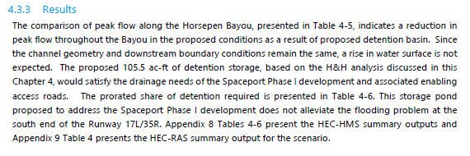
EFD Airport Drainage Master Plan

Slide 6
EFD Airport Drainage Master Plan

Slide 7
Spaceport Bridging Documents

Slide 8
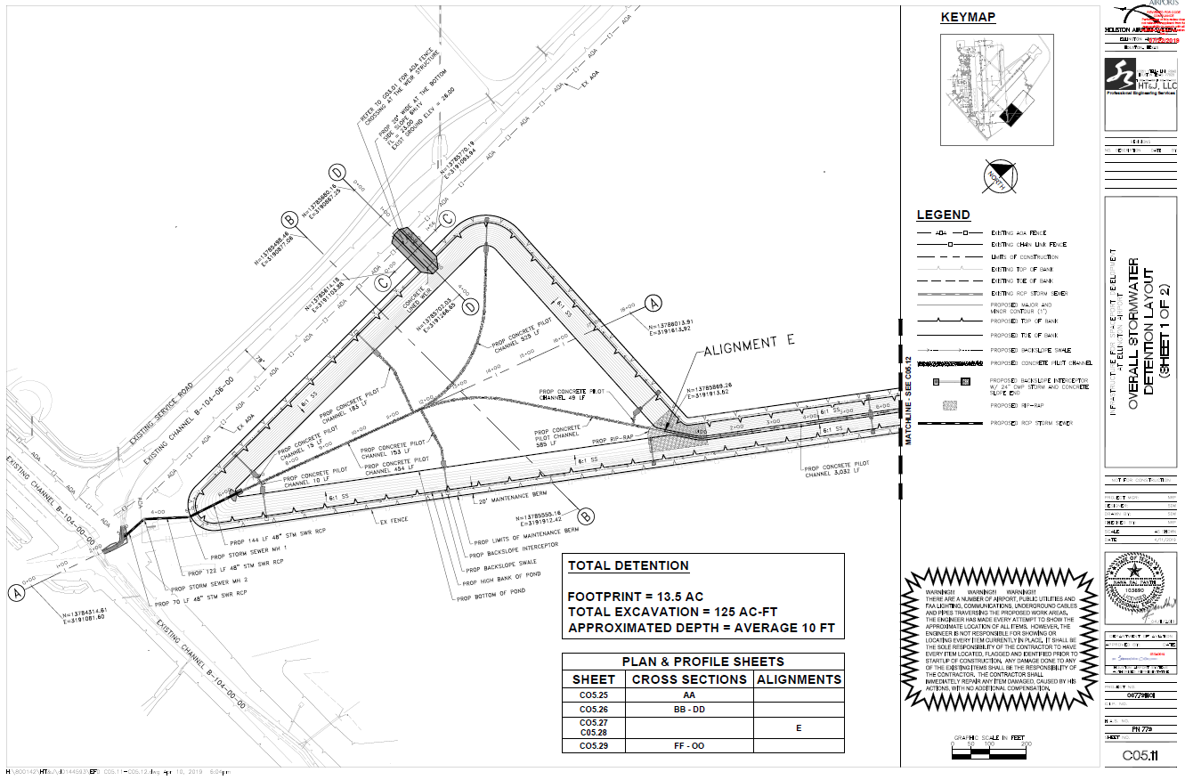
Spaceport Construction Plans

Slide 9
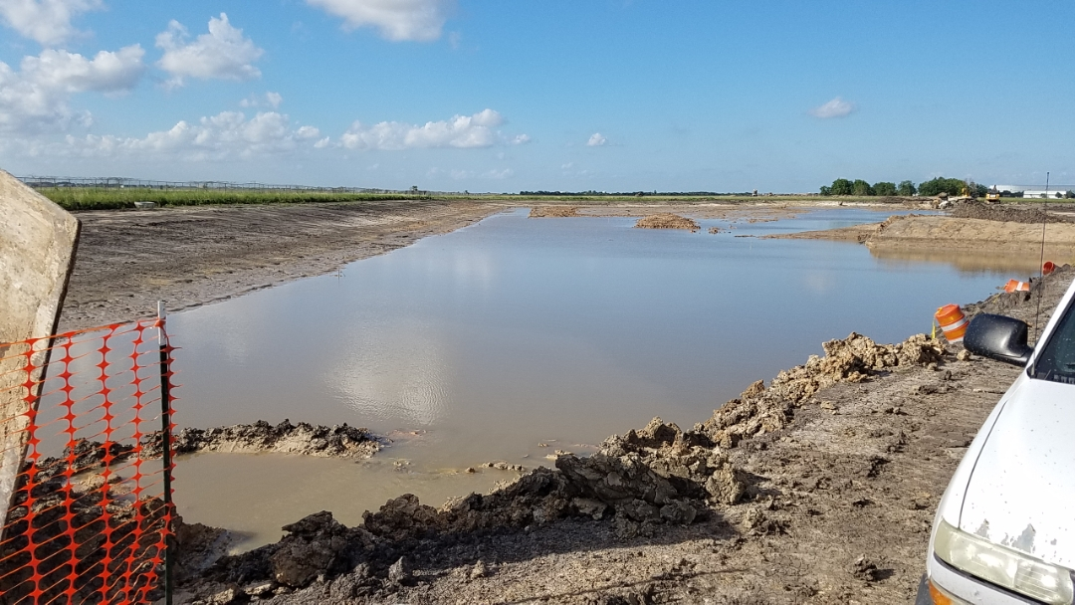
Spaceport Progress Photos

Slide 10
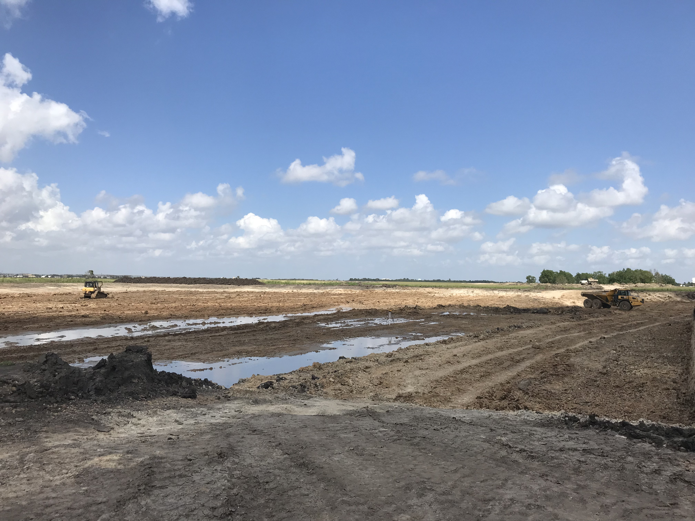
Spaceport Progress Photos

Slide 11
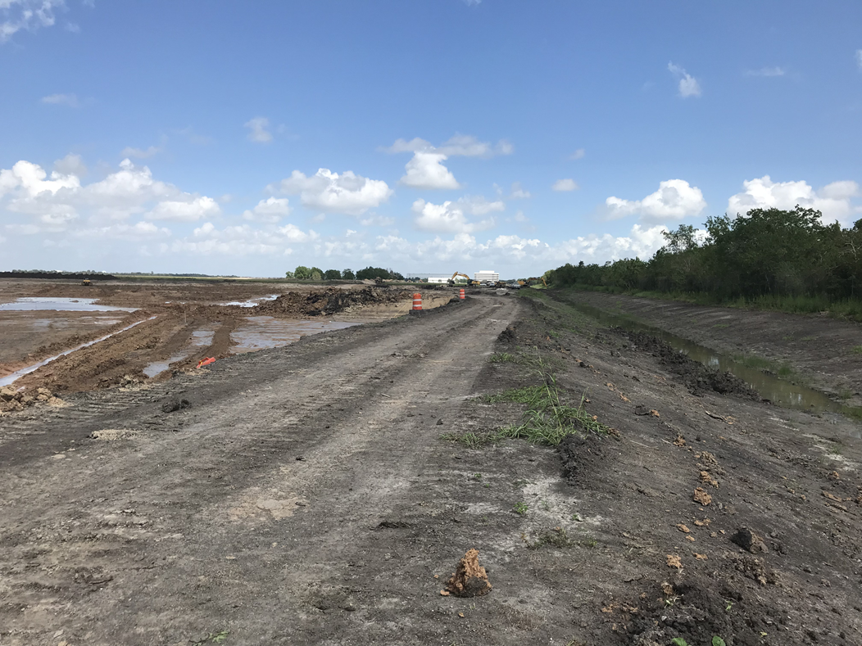
Spaceport Progress Photos

Slide 12
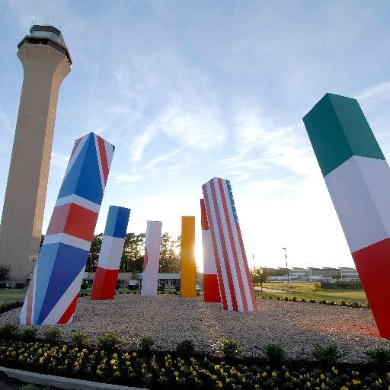
Thank You

