Slide 1
CIP Update
EL DORADO BLVD – Horsepen Bayou Bridge to Clear Lake City Blvd
Rey Guerra
Capital Improvement Program Manager
Harris County Precinct 2, Commissioner Adrian Garcia
Ben Theodore
R&B CIP Project Manager
Harris County Engineering Department

Slide 2
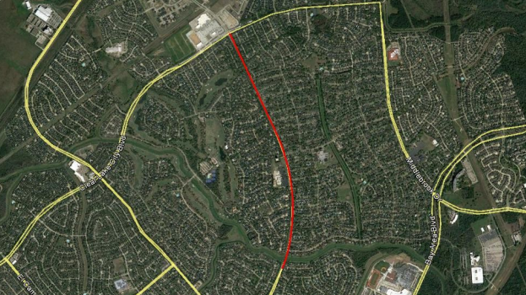
Notes:
-Limits: Horsepen Bayou Bridge to Clear Lake City Blvd
-Approx. 1.6 miles
-Widen existing roady to 4 lanes, replace existing sidewalk w/ 8-ft wide concrete trail to connect Brook Forest, Bay Oaks, Middlebrook Neighborhoods
-Joint project with the COH

Slide 4
EL DORADO BLVD – CURRENT STATUS
Study, Design, Construction
Final design being reviewed by COH, HCED
35 CenterPoint Poles to be relocated
Target: Feb 2020
Expected Bid: Oct 2019
Expected Construction Start: Feb 2020

