Slide 1
Sylvan Rodriguez Park Habitat Restoration Project
Kelli Ondracek, Natural Resources Manager

Slide 2
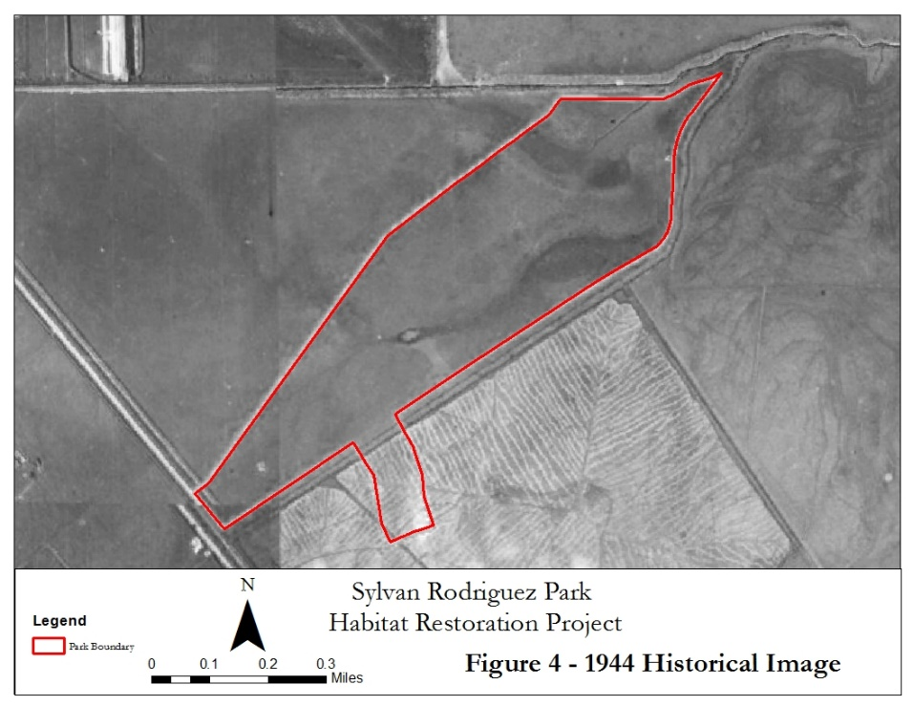
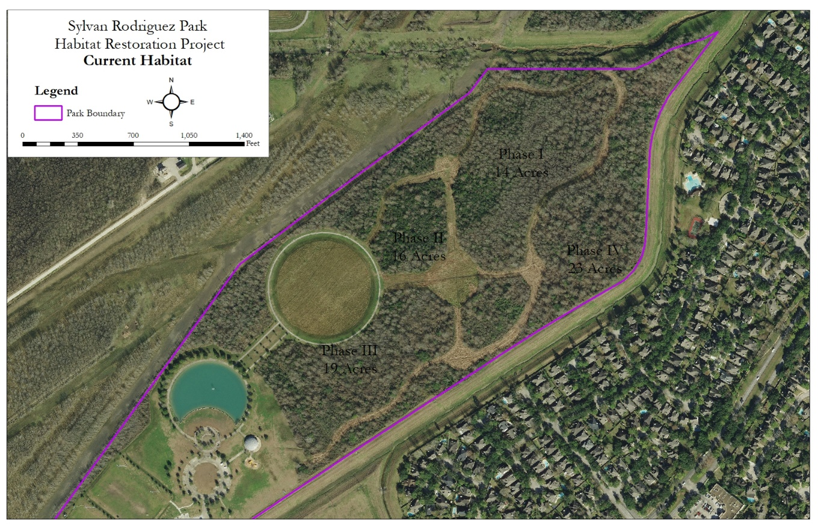
Historic vs. Current Conditions

Slide 3
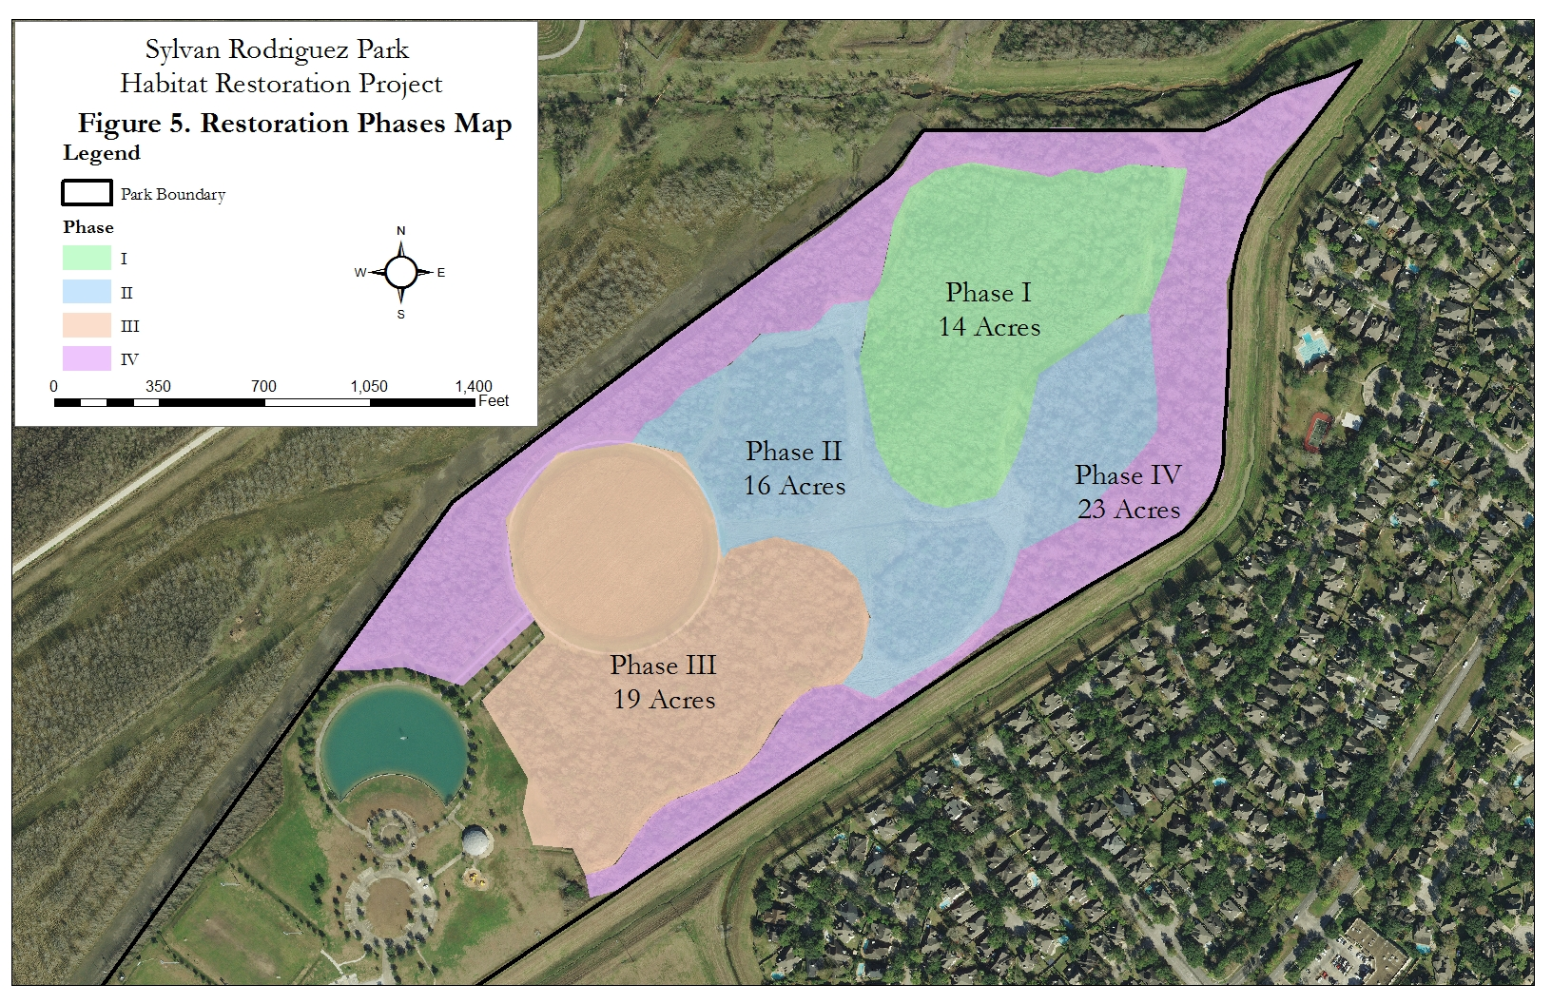
Restoration Phases

Slide 4
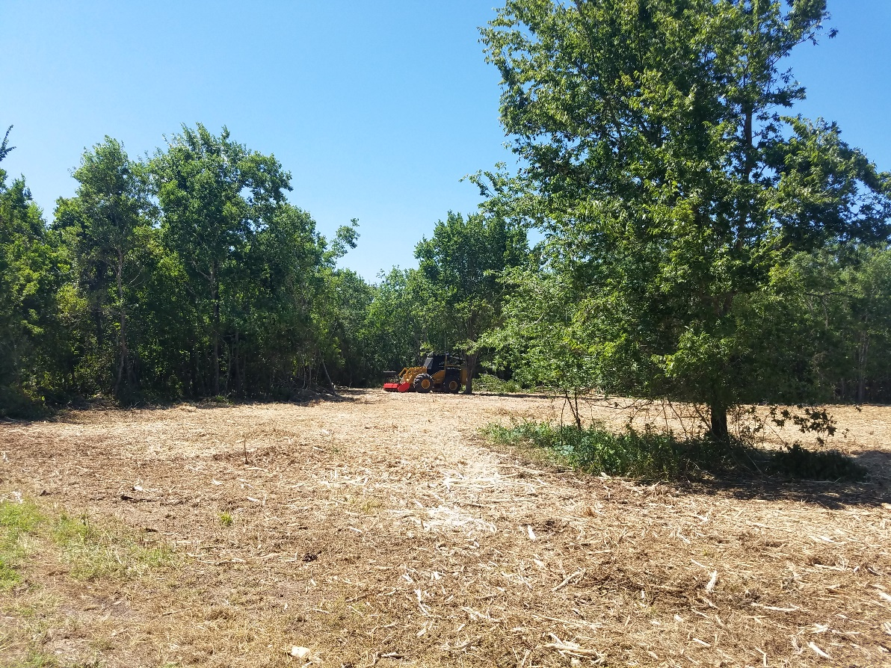
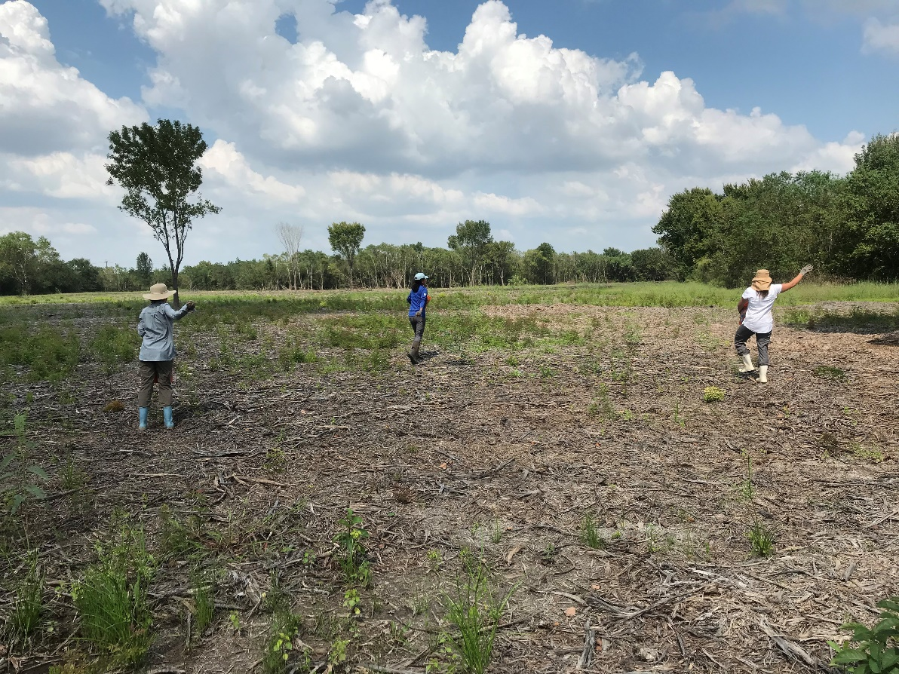
Restoration Process

Slide 5
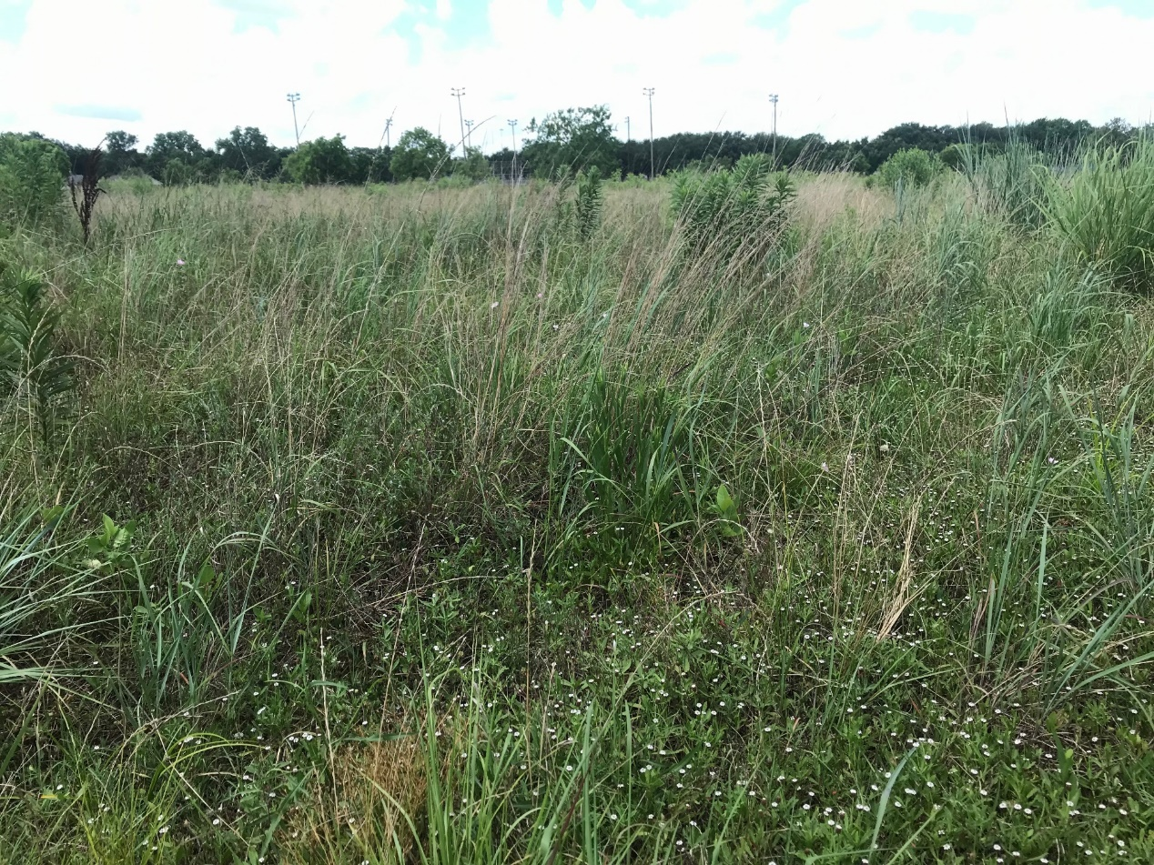
Restoration Process – Native Species
Current Methods:
Native Plant Propagation Program (10,000 gallon pots per year)
Locally Collected Seed
Local Seed Suppliers
Soil amendments
Partnerships
Remnant Prairie Rescues
Community Planting Events

Slide 6
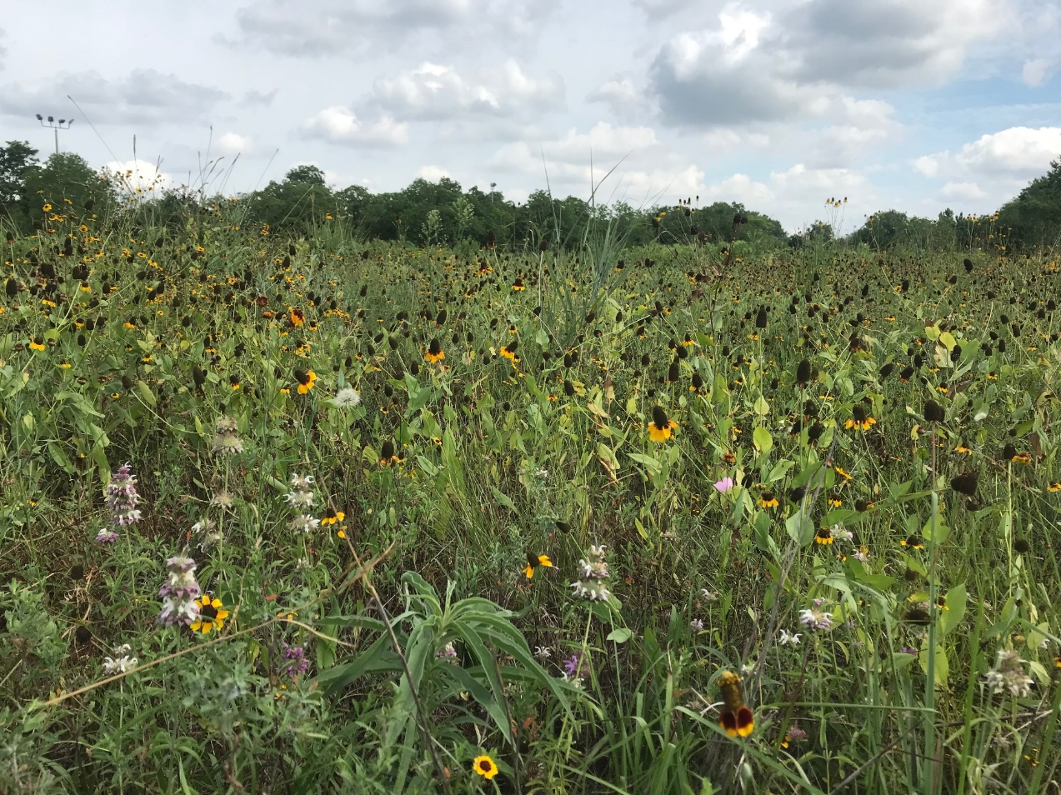
Additional Project Components
Boardwalk Construction
Interpretive Signage
Monitoring:
Vegetation Surveys
Bird transects

Slide 7
Kelli.Ondracek@houstontx.gov
Planting Events:
Saturday, November 16- 9am to 12pm
Friday, December 6- 9am to 12pm
Monthly Workdays TBD
RSVP: naturalresources@houstontx.gov

