Slide 1
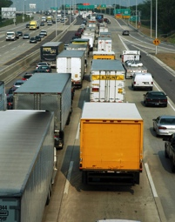
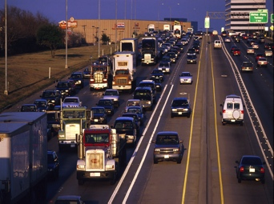
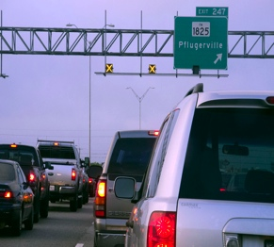
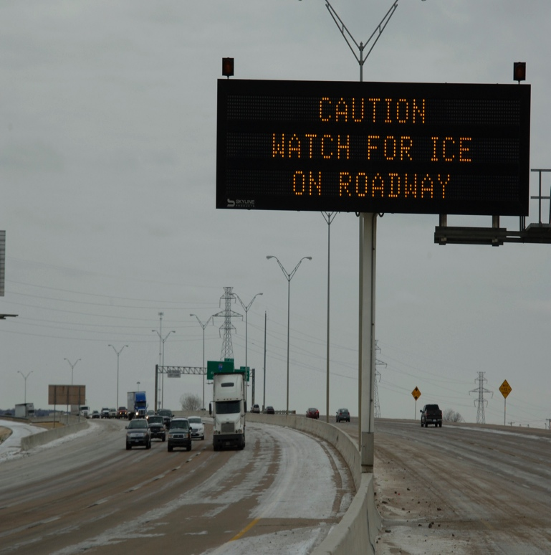
Txdot – Houston district
MONTGOMERY AREA OFFICE
Suggested uses: Presentations on policy issues.

Slide 2
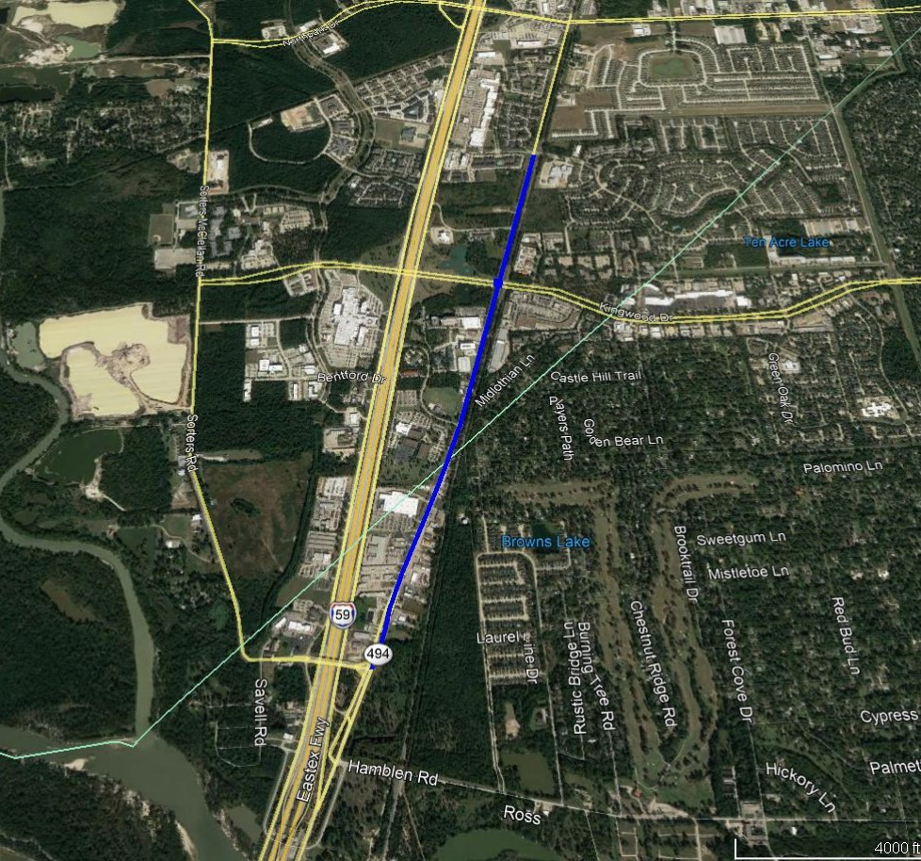
SL 494 – Project Overview
Widen and reconstruct Roadway
Upgrade Intersection at Kingwood Dr.
Improve Drainage and add sidewalks
Project began July 2019
Estimated Completion Date:
3rd Quarter 2021
Project Begin
Project End

Slide 3
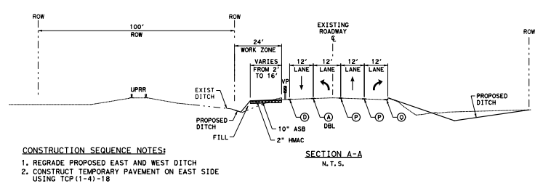
SL 494 – Construction Phasing
Phase 1
Construct Temporary Pavement Widening east side of SL 494
Construct Temporary Pavement Overlay of Kingwood Intersection

Slide 4
SL 494 – Construction Phasing
Phase 2
Move traffic utilizing existing pavement and Phase 1 temporary pavement widening.
Regrade west ditch and install proposed storm sewer trunk line.
Construct embankment, lime subgrade, stabilized base, bond breaker, and concrete pavement.

Slide 5
SL 494 – Construction Phasing
Phase 3
Move traffic to Phase 2 new pavement.
Regrade west ditch and install proposed storm sewer trunk line.
Construct embankment, lime subgrade, stabilized base, bond breaker, and concrete pavement.
Move traffic to final location

Slide 6
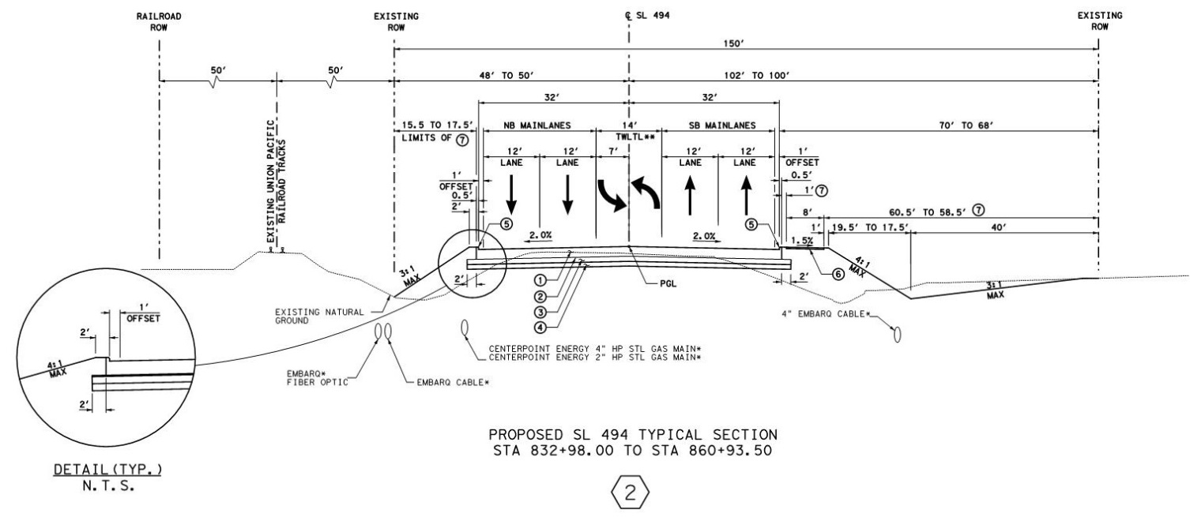
SL 494
Widen Roadway starting at Northpark Plaza
Improve Drainage

Slide 7
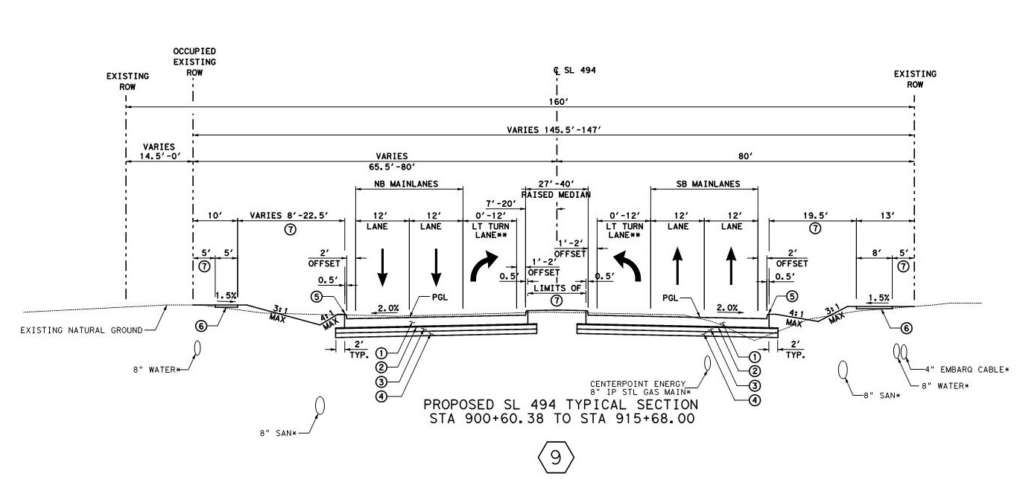
SL 494
Widen Roadway
Improve Drainage
Replace Driveways
Add Center Median

Slide 8
SL 494 – Contact Information
Adam C. Galland, PE
TxDOT Montgomery Area Office
901 North FM 3083
Conroe, Tx. 77303
(936)-538-3300
Kelly Kirby Cell: 928-254-0019
Consultant PM
Eric Bednarsky Cell: 713-412-3941
TxDOT PM

