Slide 1
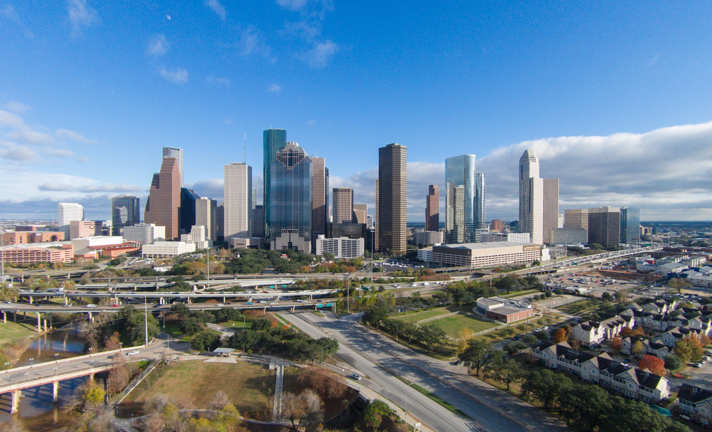

KINGWOOD TOWNHALL
RECOVERY & FLOOD MITIGATION STRATEGIES
Stephen C Costello, PE
2019

Slide 2
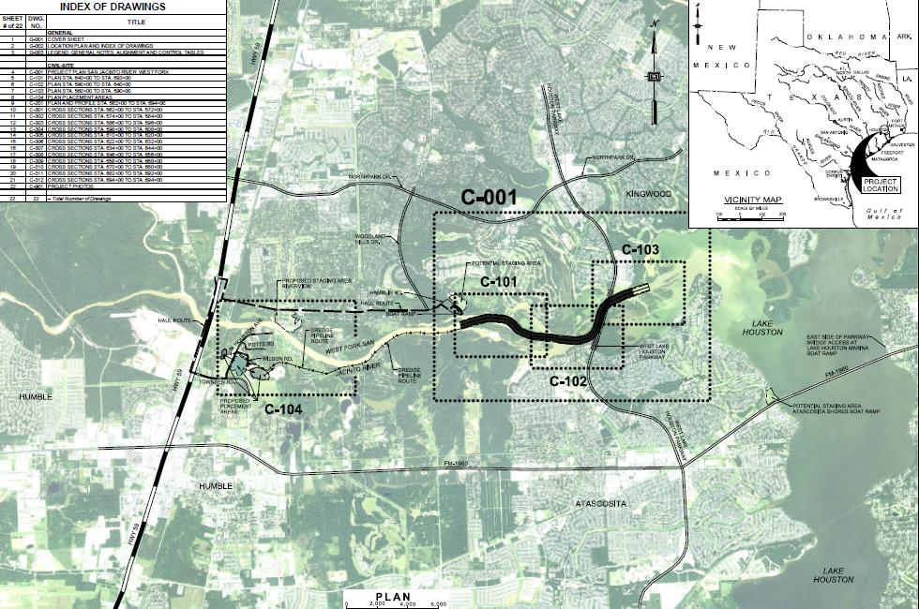
KINGWOOD TOWNHALL
CORPS DREDGING PLAN OVERVIEW

Slide 3
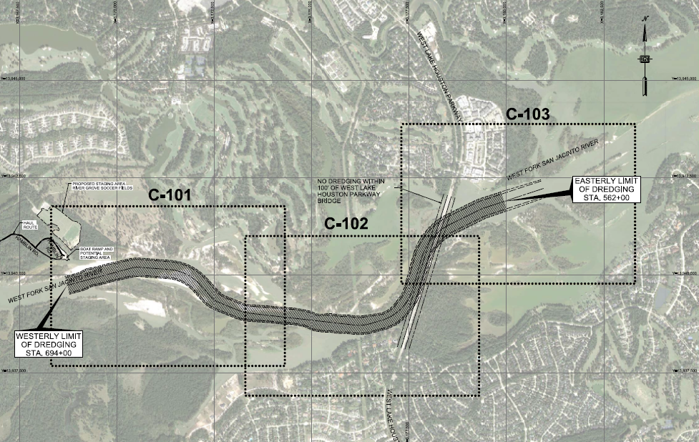
KINGWOOD TOWNHALL
CORPS DREDGING PLAN OVERVIEW

Slide 4
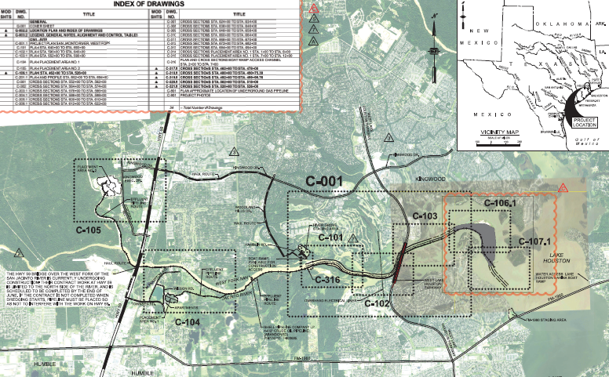
KINGWOOD TOWNHALL
CORPS DREDGING PLAN EXTENSION

Slide 5
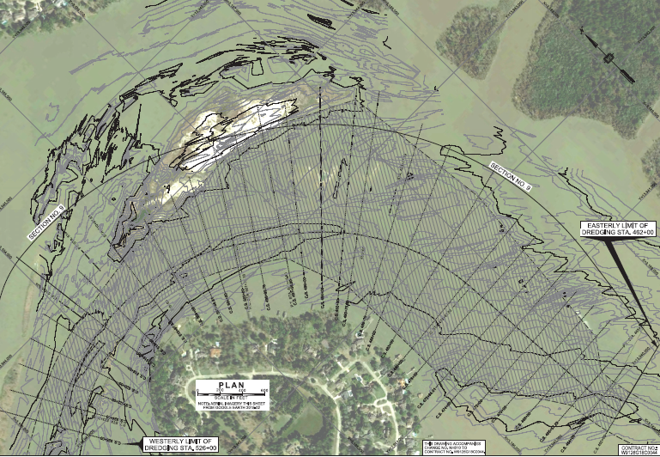
KINGWOOD TOWNHALL
CORPS DREDGING PLAN EXTENSION

Slide 6
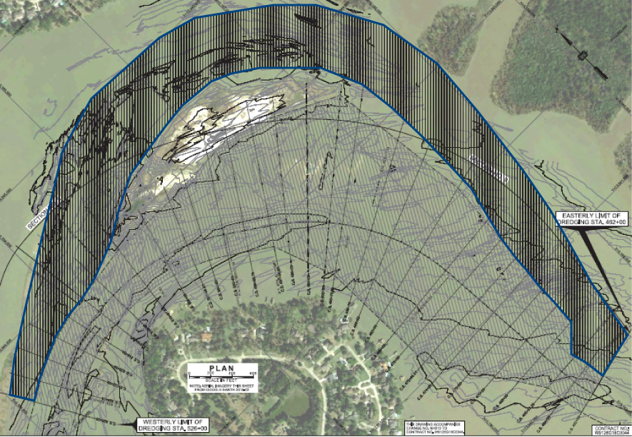
KINGWOOD TOWNHALL
CITY’S ADDITIONAL DREDGING REQUEST
Limits

Slide 7
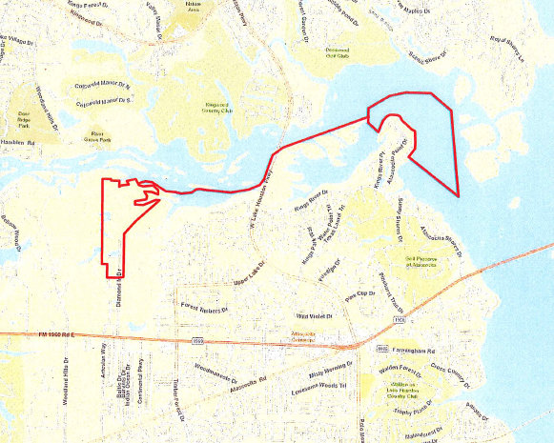
KINGWOOD TOWNHALL
FUTURE DISPOSAL SITE
Additional Dredging
Pipeline
Disposal Site

Slide 8
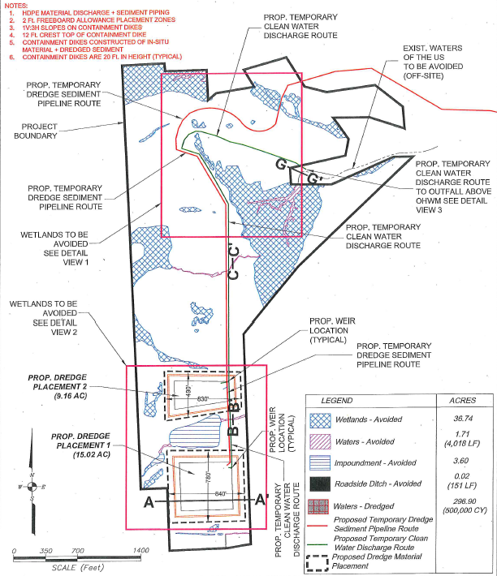
KINGWOOD TOWNHALL
PERMITTED DISPOSAL SITE

Slide 9
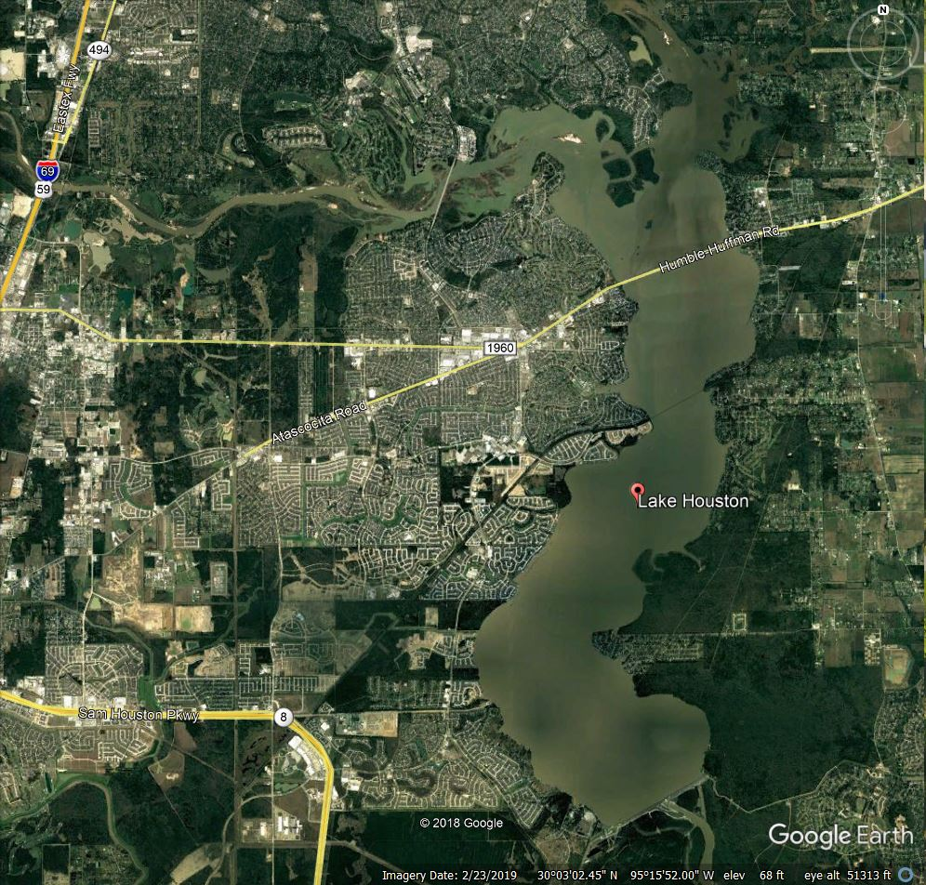
KINGWOOD TOWNHALL
FUTURE DREDGING MAINTENANCE – SB 500
Permitted Site

Slide 10
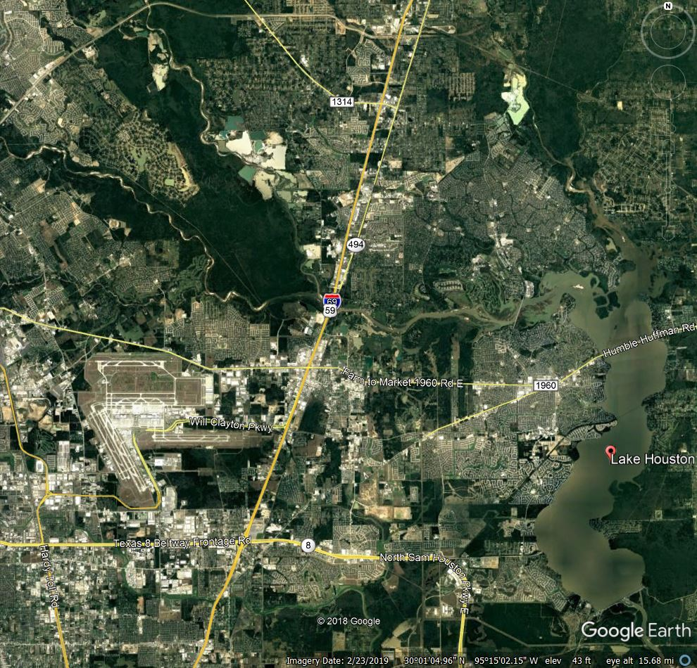
KINGWOOD TOWNHALL
FUTURE SEDIMENT CAPTURE – HB 1824
West Fork
Spring Creek
Cypress Creek

Slide 11
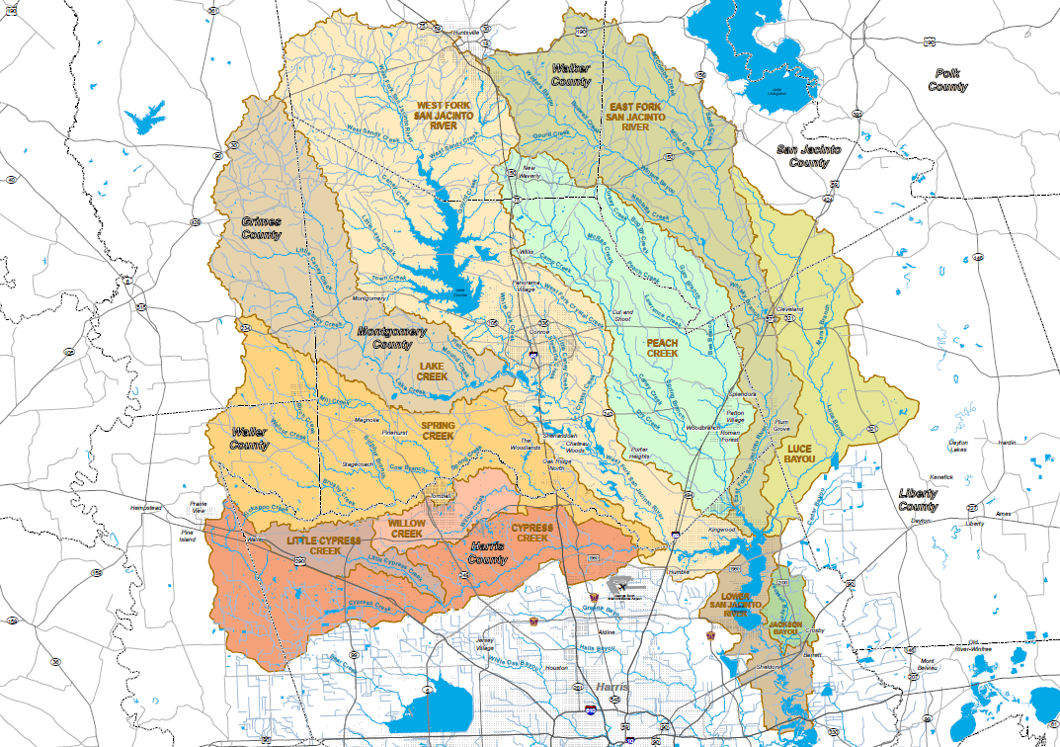
KINGWOOD TOWNHALL
HMGP - SAN JACINTO WATERSHED ASSESSMENT

Slide 12
KINGWOOD TOWNHALL
HMGP - LAKE HOUSTON DAM

Slide 13
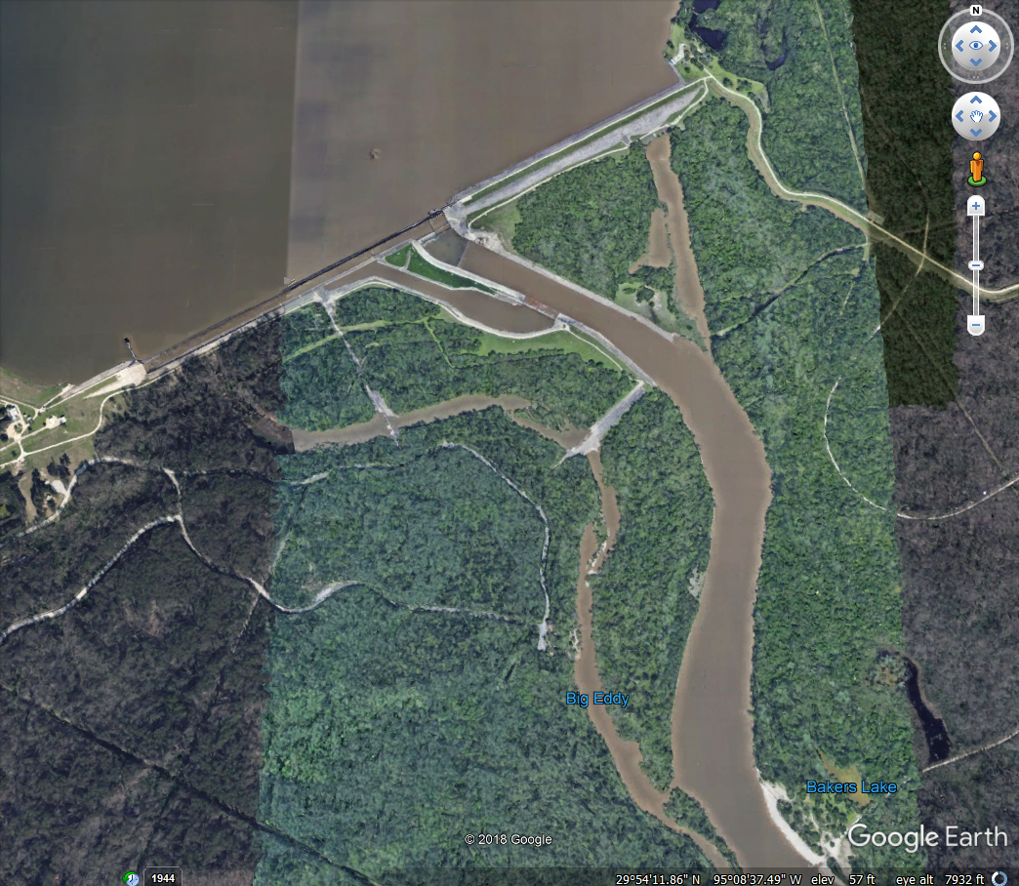
KINGWOOD TOWNHALL
HMGP - LAKE HOUSTON DAM
Alternate Location
Grant Location

Slide 14
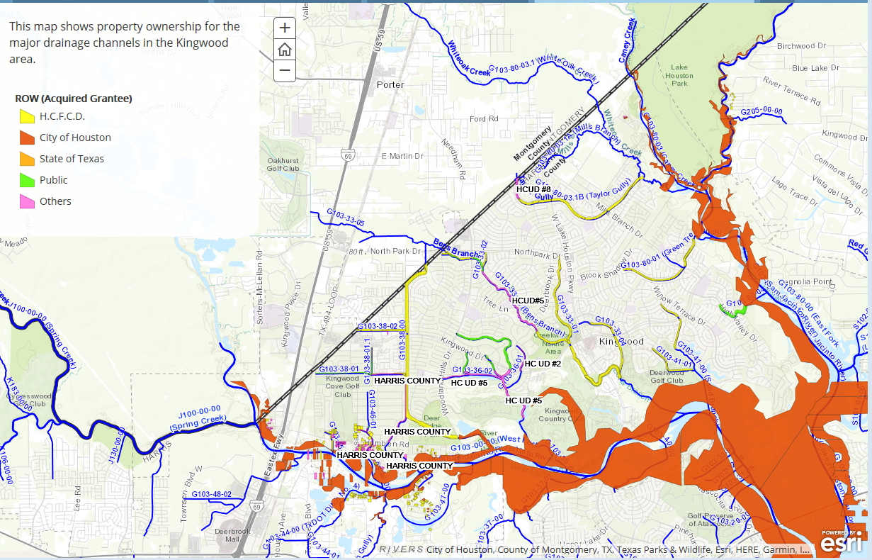
KINGWOOD TOWNHALL
KINGWOOD DITCHES – MAINTENANCE ROLES

Slide 15
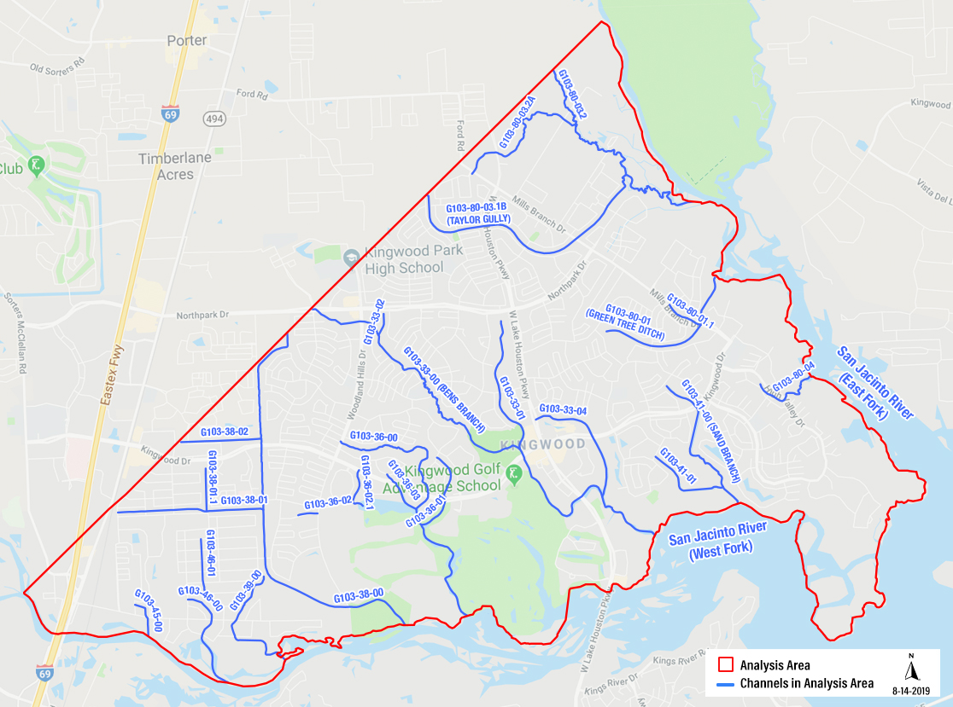
KINGWOOD TOWNHALL
KINGWOOD DITCHES – HCFCD F-14 STUDY

