Slide 1
Kingwood
Traffic Signals
Johana E. Clark P.E., PTOE
Traffic Operations Division
Public Works & Engineering Department

Slide 2
Agenda
Kingwood Signal System Overview
Updates:
Kingwood @ Royal Forest: Signal Removal Study Update
New Traffic Signal at Northpark and Hidden Pines/Woodridge
Upgrades at West Lake Houston and Kings Crossing
Upgrades at West Lake Houston and Northpark
New Traffic Signal at Kingwood and Kings Crossing
PWE Traffic Operations
Malfunctions, Comments Reporting
Comments/Questions

Slide 3
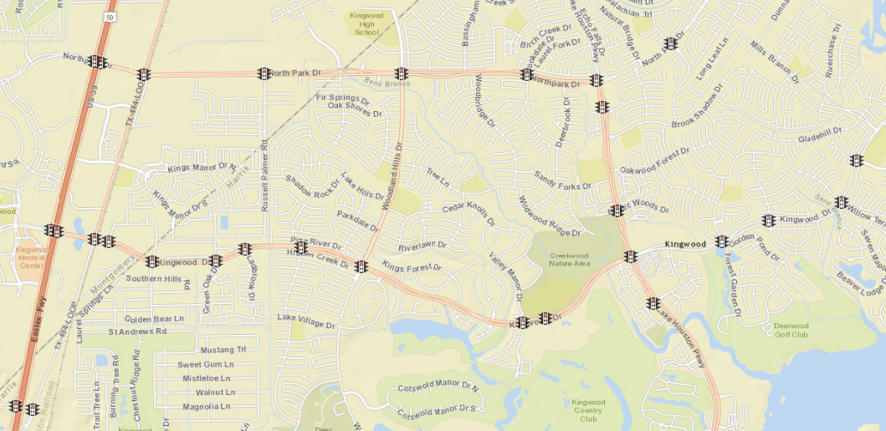
Kingwood Signal System
Northpark: >37,000 veh/day
Kingwood: >41,000 veh/day
Number of Lanes vs. Daily Traffic Volumes
Number of Lanes | Roadway Daily Capacity
2 (w/left turn lanes) | 14-16,000 vehicles per day
4 (w/left turn lanes) | 30-33,000 vehicles per day
6 (w/left turn lanes) | 40-44,000 vehicles per day

Slide 4
Kingwood Signal System
Signal Removal Study:
Kingwood @ Royal Forest
Signal Proximity Issue. One-Stage Analysis: visibility, volumes, geometrics.
Major impact Loop 494 RR Crossing. Conclusion: signal removal deferred.

Slide 5
Kingwood Signal System
New Signal: Northpark @
Hidden Pines/Woodridge
Activated February 2015. Timing Adjustments: Split NB/SB. Extended Signal Cycles.

Slide 6
Kingwood Signal System
Commercial
Signal Upgrade:
W. Lake Houston @
Kings Crossing
Large commercial development Kingwood @ W. Lake Houston.
Traffic signal upgrade at W. Lake Houston @ Kings Crossing. Design Approved.

Slide 7
Kingwood Signal System
New Signal Coming Up:
Kingwood @
Kings Crossing
Large commercial development Kingwood @ W. Lake Houston.
New traffic signal Kingwood @ Kings Crossing. Designed Approved.

Slide 8
Kingwood Signal System
Intersection Upgrades:
Northpark @
W. Lake Houston
Traffic signal upgrades. Addition of SB and EB right turn lanes. Design Stage.

Slide 9
PWE Traffic Operations
Traffic Signal Performance Improvement Program (TSPIP) FY15-16: Kingwood Timing Optimization
Preventive Signal Maintenance per FHWA
Signal Maintenance Average Response Time: 1.9hr
2,489 signalized intersections in Houston
COH average 6 flashing signals/day = 0.24%
99.75 % signals operational daily
Technology Upgrades: GPS, Power Supply, Comm.

Slide 10
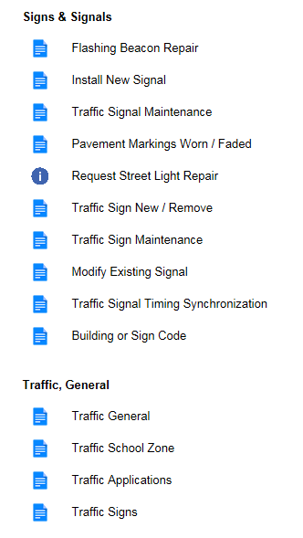
Traffic Service Requests
Houston Service Helpline:
Phone Line 311
Website: www.houstontx.gov/311
Email: 311@houstontx.gov
311 Smartphone App

Slide 11
Thanks

