Slide 1
Kingwood Community Center
October 11, 2016

Slide 3
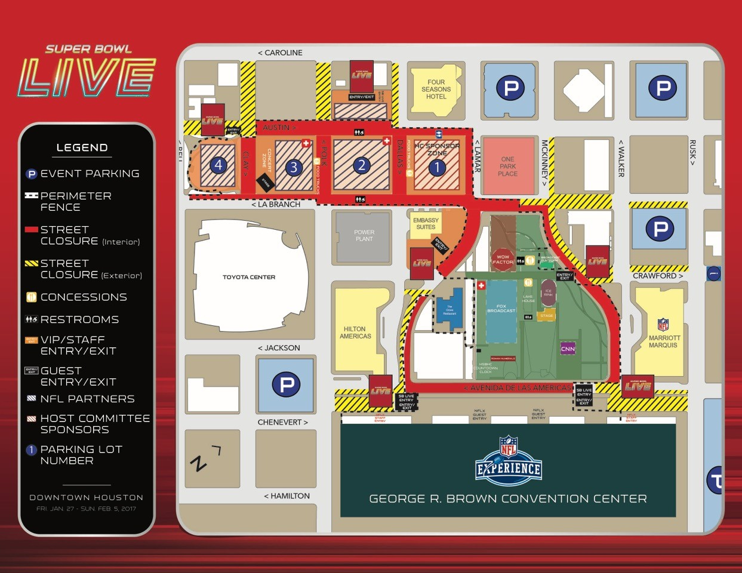

Slide 4
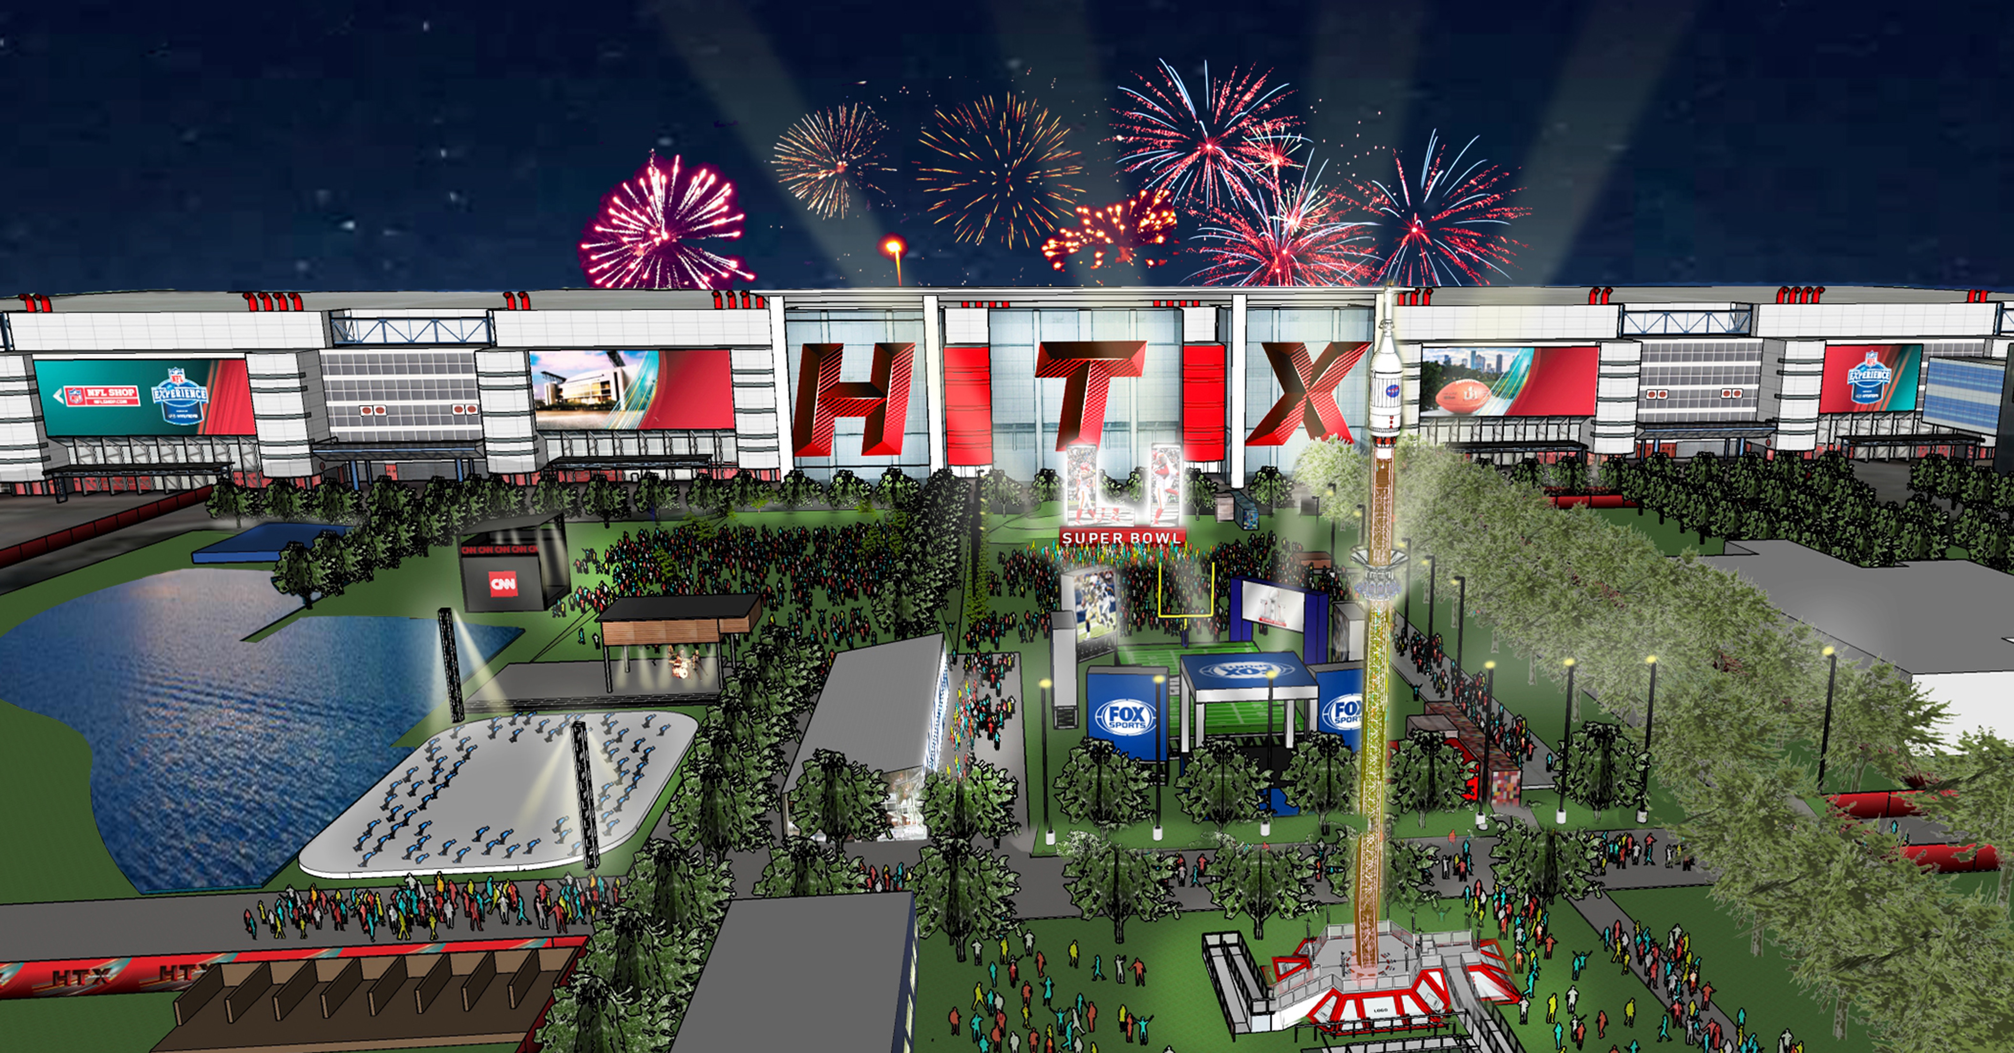
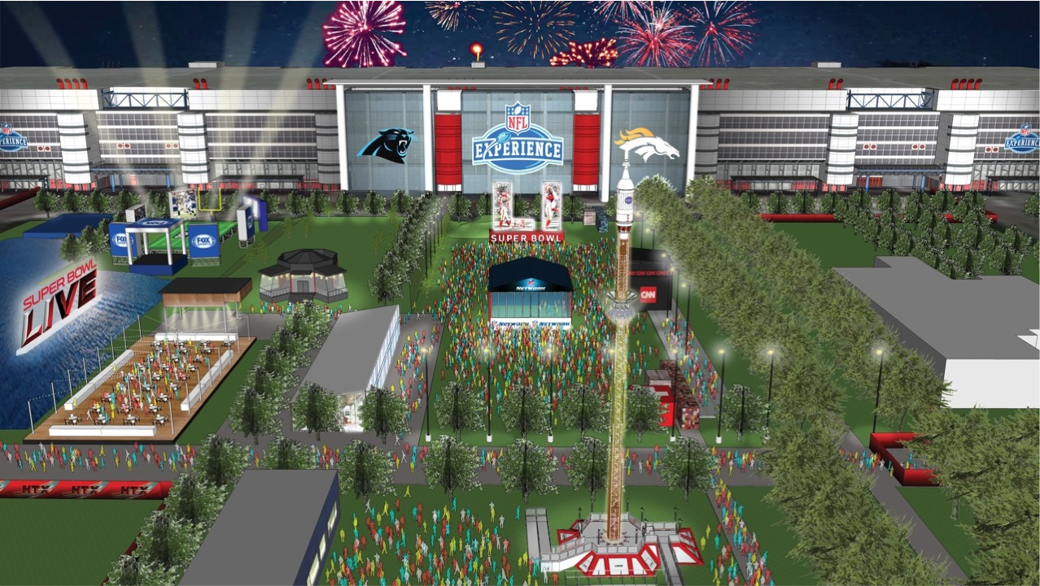
Notes:
Inside GRB
NFL Experience—NFL ticketed event
Interactive games/activities
NFL Media Center
5,000 credentialed media from around the globe
Radio Row
Social Media Command Center
Transition: “Just Outside the G-R-B will be the signature event for the Host Committee (SB LIVE)

Slide 5
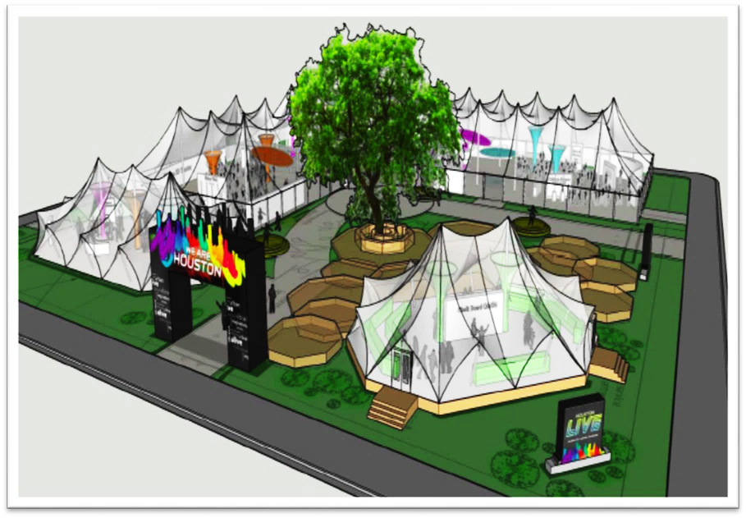
Houston LIVE
Messaging
Houston LIVE will tell the story of Houston as a Diverse, Dynamic and Dimensional City of The Future (multi-cultural, casually cosmopolitan, entrepreneurial/can-do attitude, start-ups to global HQs, undersea oil to outer space technology)
Houston is the Energy Capital of the World (high tech industry, economic growth, global leader, history of preeminence and future leader in oil/gas/new energy solutions)
Houston is the Cultural and Culinary Capital of the South (dining destination, diverse cuisine, premiere vacation spot, vibrant arts community, a welcoming “world city” with a rich and diverse cultural mix)
Houston is an Awakening Giant for Research and Innovation (Medical and bioscience research, centers of excellence like TMC3, talented workforce, top universities, multiple industries)

Slide 7
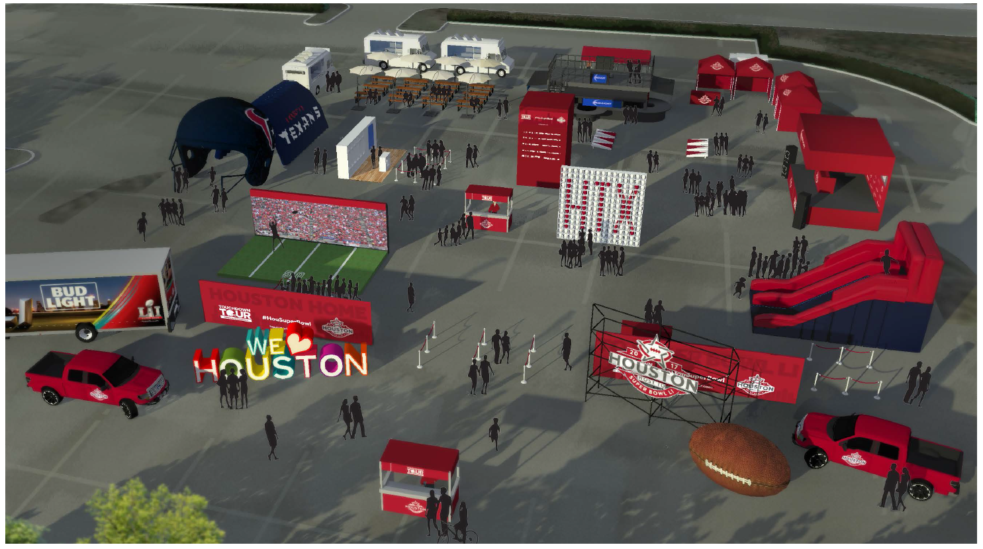

Slide 8
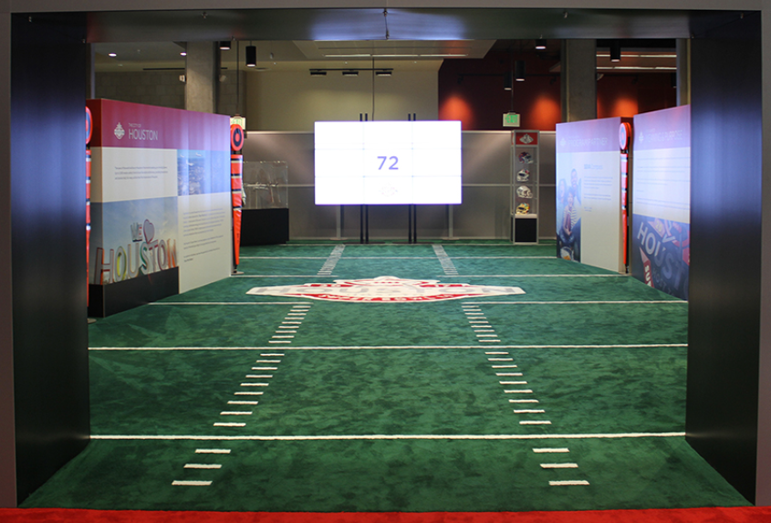
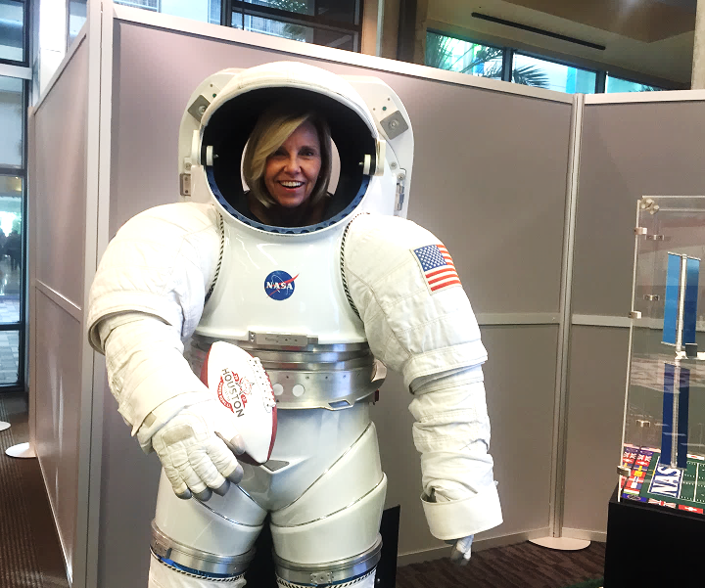
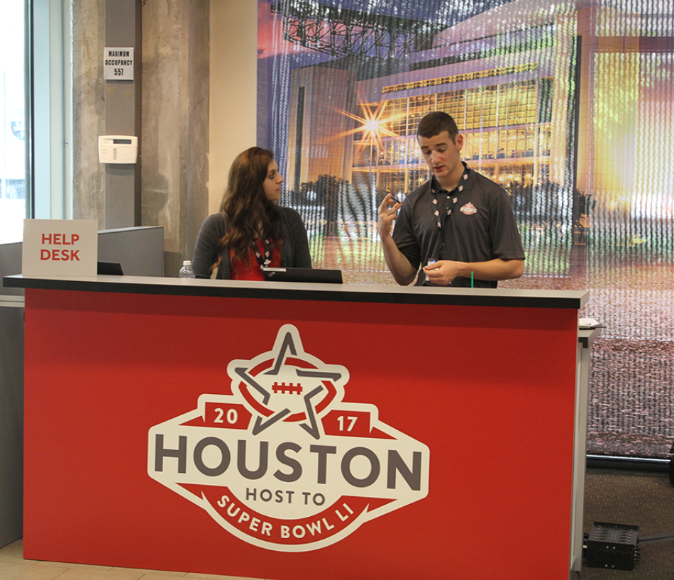
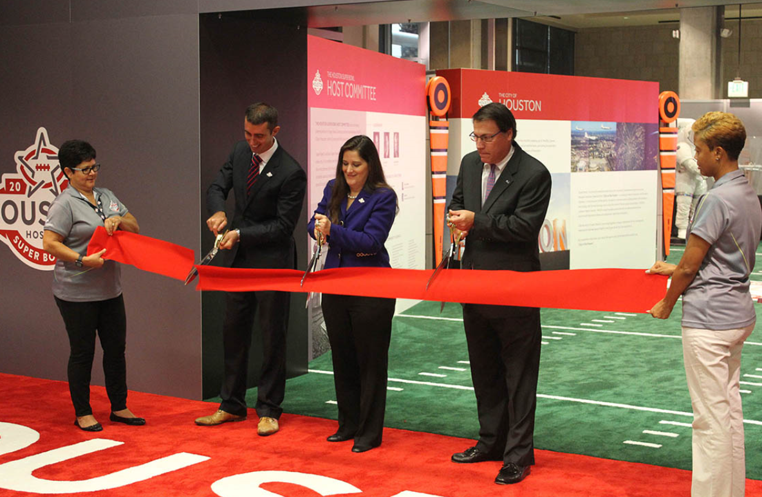
Volunteer Recruitment
Center at
Green Street
8

Slide 10
Thank You
HOUSUPERBOWL.COM

