Slide 1
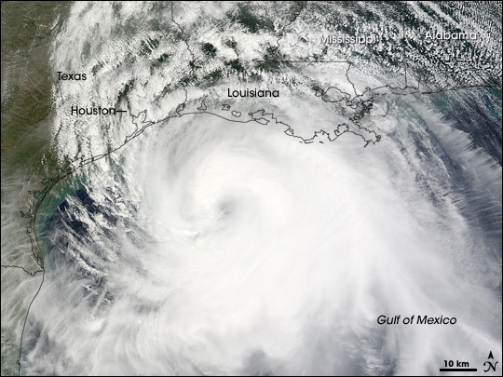
Council Member Dave Martin
Town Hall Meeting, October 13, 2016
Storm Surge Protection for Houston/Galveston
Hurricane Ike Sprawls over Gulf of Mexico,
September 12, 2008 (NOAA)

Slide 2
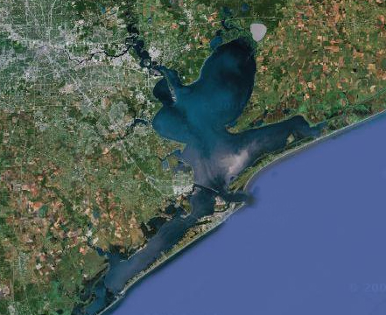
The overall strategy is to keep the ocean surge out of Galveston Bay by using a coastal barrier (the Ike Dike)
Houston Ship Channel
High
Island
Bolivar Peninsula
Bolivar Roads
Galveston Island
Existing Seawall
Intracoastal Waterway
Coastal Spine
• San Luis Pass
Notes:
The critical need is to stop the surge at the coast – this protects the entire Bay area
1. Protects from catastrophic overflows and
2. Doesn’t allow the ocean surge into the Bay which in turn prevents massive internal surges

Slide 3
Ike Surge Damages to the Environment
Damages to Galveston Bay that Hurricane Ike inflicted
Coastal habitat loss
Debris
Oyster reef destruction
Intense coastal changes/damages through erosion, re-deposition of sediments, saltwater intrusion caused by increased water levels, waves, and currents.

Slide 4
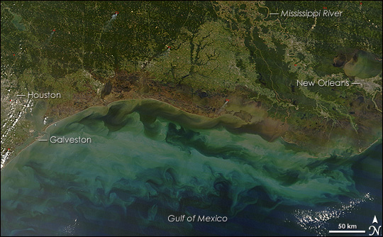
Approximate extent of dead vegetation as a result of Ike surge inundation

Slide 5
Ike Surge Damages to the Environment - Debris
The debris that Ike washed into Galveston Bay has been scattered across the Bay or left along the shoreline.
Much of the debris from the Bolivar ended up in large debris piles 20 miles away in Chambers County.
By 2009, 23,442 cubic yards of debris removed from Galveston Bay, Trinity Bay, and East Galveston Bay.
Notes:
1. galvbay.org/docs/damage_ike.doc

Slide 6
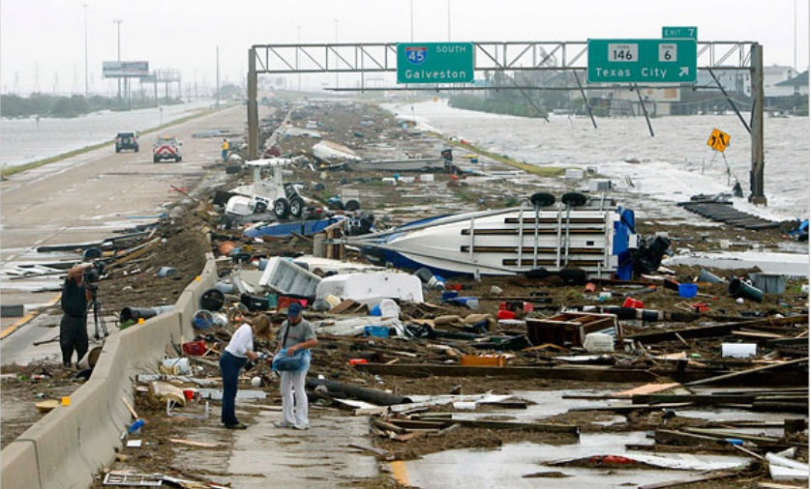
Ike Surge Damages to the Environment - Debris
The overall strategy is to keep the ocean surge out of Galveston Bay by using a coastal barrier (the Ike Dike)
Notes:
http://emilyjonathan.blogspot.com/2010_06_01_archive.html

Slide 7
Ike Surge Damages to the Environment -
Oyster Reefs Destruction
Oyster reefs were covered by large amounts of debris and sediment that hurricane Ike brought into the bay
60 percent of reefs in Galveston Bay and 80 percent of reefs in east bay were ruined by sediment deposition over reefs.
Some reefs in eastern Galveston Bay were buried by over 31 cm of sediments.
Galveston Bay lost more than 6,000 acres of oyster habitat as a direct result of Ike.
The approximate cost to return the oyster reefs to pre-hurricane status is $300 million.
It will take 20 to 25 years to recover.

Slide 8
Environmental Considerations Needed
A paradigm shift in design!
Why not use environmental considerations as design input – upfront – instead of solely using surge suppression factors and then looking at environmental impacts after-the-fact?
For more information, please contact Dan Seal, Bay Area Houston Economic Partnership, (832) 536-3255, www.bayareahouston.com

