Slide 1
Clear Lake
Traffic Signals
Traffic Operations Division
Public Works & Engineering Department

Slide 2
Outline
Clear Lake Signal System Overview
Updates:
Intersection Upgrades
New Traffic Signals
Pedestrian Crossing Improvements
Signal Operations & Geometric Improvements
I-45 Gulf Freeway TXDOT Construction
PWE Traffic Operations
Malfunctions, Comments Reporting
Comments/Questions

Slide 3
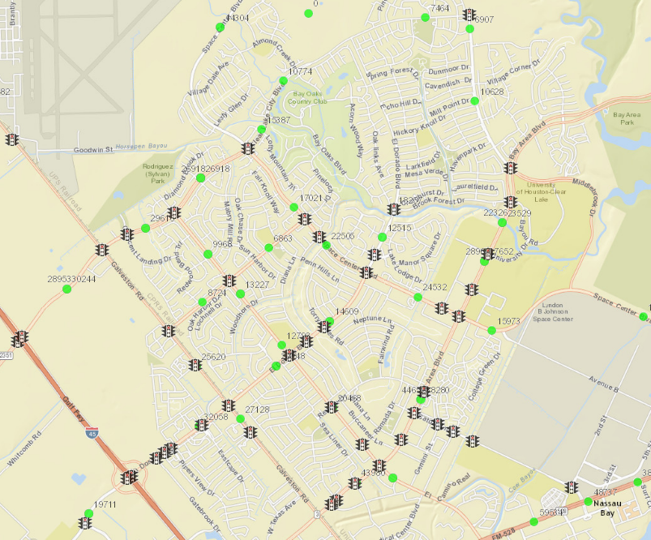
Clear Lake Signal System
Clear Lake City: >26,000 veh/day
Galveston Rd: >25,000 veh/day
Number of Lanes vs. Daily Traffic Volumes
Number of Lanes | Roadway Daily Capacity
2 (w/left turn lanes) | 14-16,000 vehicles per day
4 (w/left turn lanes) | 30-33,000 vehicles per day
6 (w/left turn lanes) | 40-44,000 vehicles per day
Bay Area Blvd: >44,000 veh/day
Notes:
Overall illustration of Clear Lake’s traffic signal system showing traffic volumes for major arterials in the area: Bay Area, Clear Lake City and SH-3 (Galveston Road)

Slide 4
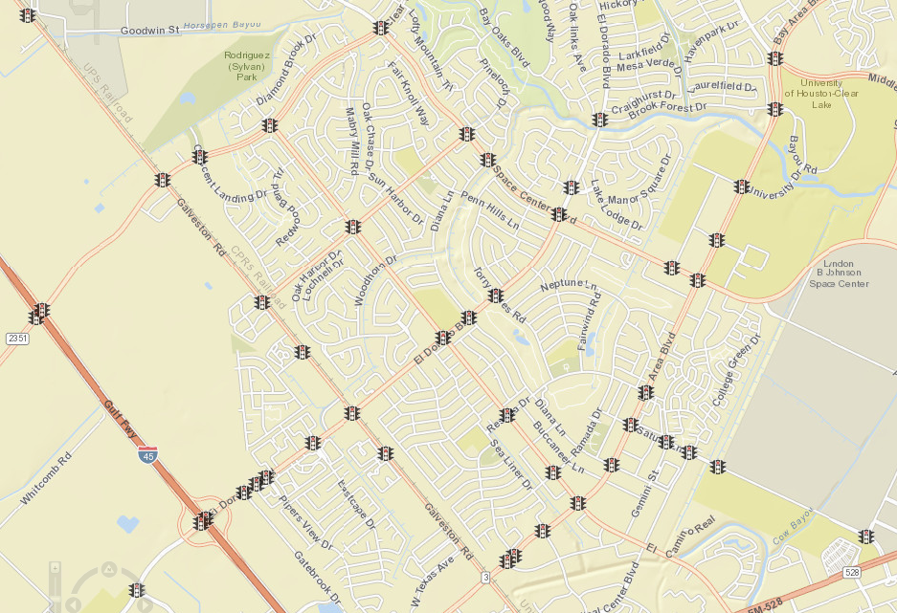
Clear Lake Signal System
Intersection Upgrades:
Clear Lake City @ Space Center
Intersection Upgrades at Clear Lake City @ Space Center.
Completed March 2016
Notes:
Signalized intersection at Clear Lake @ Space Center was completed reconstructed this last Spring now including upgraded signal infrastructure such as power supply, signal heads, accessible pedestrian signals, etc.

Slide 5
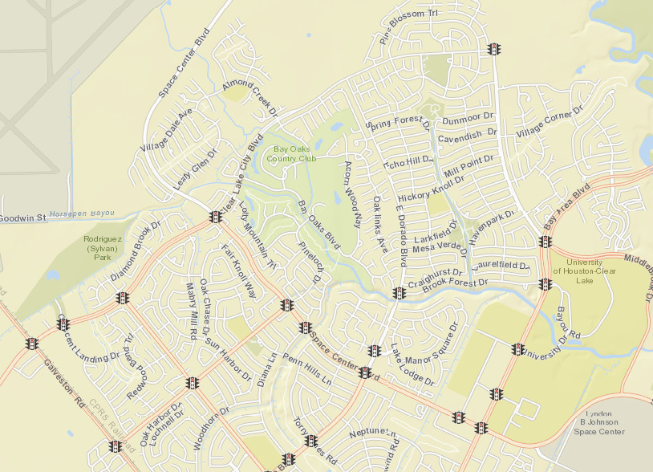
Clear Lake Signal System
New Traffic Signal:
Clear Lake City @ El Dorado
Installed and activated February 2016. Operation monitored.
Notes:
New traffic signal was installed in February at Clear Lake City @ El Dorado including upgraded signal infrastructure such as power supply, signal heads, accessible pedestrian signals, etc.

Slide 6
Clear Lake Signal System
Pedestrian Crossing Enhancements: Additional Signage at Bay Area @ Moonrock
.
Notes:
Comments received from the public regarding concerns about drivers’ disobedience at the Pedestrian Hybrid Beacon at Bay Area and Moonrock. Additional overhead “Pedestrian Crossing” and “Stop Here on Red” signs installed. Advance warning signs already in place.

Slide 7
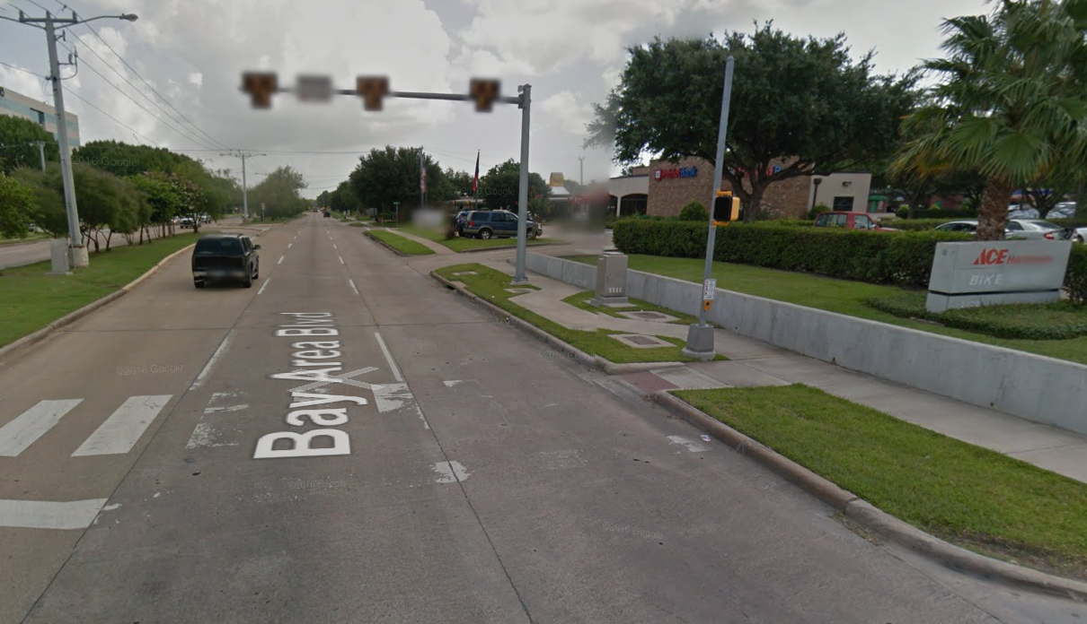
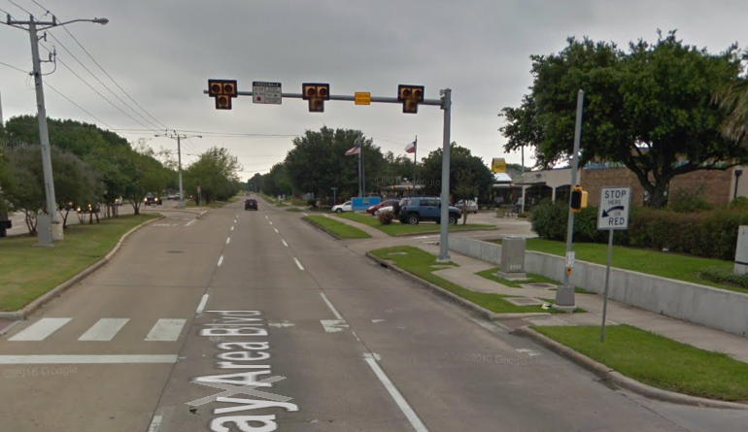
Clear Lake Signal System
‘Pedestrian Crossing’ sign
‘STOP Here On RED’ sign
.
Notes:
Comments received from the public regarding concerns about drivers’ disobedience at the Pedestrian Hybrid Beacon at Bay Area and Moonrock. Additional overhead “Pedestrian Crossing” and “Stop Here on Red” signs installed. Advance warning signs already in place.

Slide 8
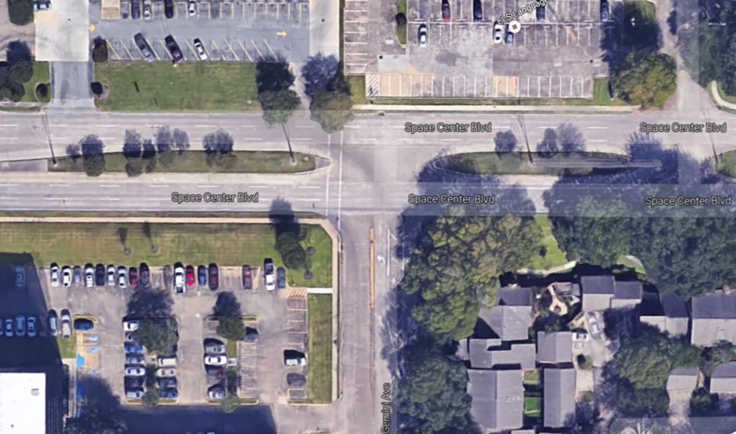
Clear Lake Signal System
Gemini @ Space Center.
Heavy U-turns on Space Center and Illegal Left-Turn Movement
Notes:
Issues reported by the community regarding U-turn maneuvers and unclear lane designation at Gemini and Space Center were evaluated and modifications prepared and completed: (a) modifying median nose to limit U-turns which were originally impacting traffic all the way to Bay Area, and (b) installing pavement markings on Gemini for clear lane assignment: single RT, LT and hatched area.

Slide 9
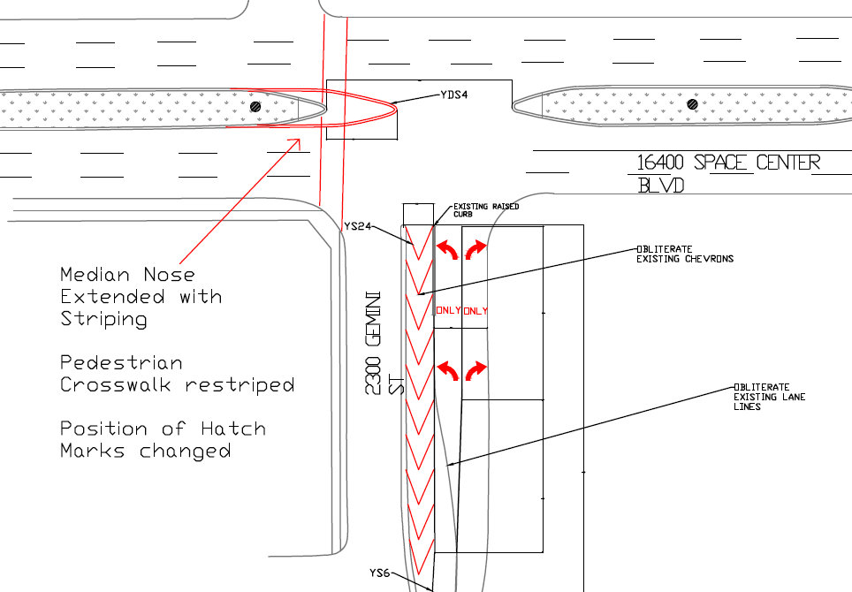
Clear Lake Signal System
Geometric improvements at Gemini @ Space Center.
Addressed U-turns on Space Center (impact at Bay Area) and channelized Gemini traffic.
Notes:
Issues reported by the community regarding U-turn maneuvers and unclear lane designation at Gemini and Space Center were evaluated and modifications prepared and completed: (a) modifying median nose to limit U-turns which were originally impacting traffic all the way to Bay Area, and (b) installing pavement markings on Gemini for clear lane assignment: single RT, LT and hatched area.

Slide 10
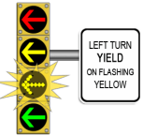
Clear Lake Signal System
Signal Operation Improvements:
Bay Area @ Space Center
Bay Area @ El Camino Real
Pedestrian crossing concerns addressed: protected only left turn signal
when pedestrians present (school hours, midday).
Notes:
Concerns were expressed by the community regarding vehicles not properly yielding right-of-way to pedestrians when crossing Bay Area lanes while the permissive left turn portion (flashing yellow arrow) was active. Timing was adjusted to allow only protected left turn mode when pedestrians are present (when peds press push button). This was implemented during school hours and midday due to heavy lunch time pedestrian demand at El Camino Real

Slide 11
Clear Lake Signal System
TXDOT Construction I-45 S.
Increased SH-3 traffic demand. Traffic signals monitored and adjusted.
Notes:
Severe congestion on I-45 due to TXDOT’s construction project (TXDOT website shows to be completed June 2017, not confirmed). Signals on SH-3 mainly have been adjusted and frequently monitored due to traffic detouring through this route.

Slide 12
PWE Traffic Operations
Traffic Signal Performance Improvement Program (TSPIP) FY16-17: Clear Lake Area Timing Optimization
Preventive Signal Maintenance per FHWA
Signal Maintenance Average Response Time: 1.9hr
2,489 signalized intersections in Houston
COH average 6 flashing signals/day = 0.24%
99.75 % signals operational daily
Technology Upgrades: GPS, Power Supply, Comm.
Notes:
A general overview of efforts by TOD: (1) TSPIP program includes Clear Lake this year for timing optimization, (2) two preventive maintenances are completed per year as FHWA recommends, (3) average maintenance response time of 1.9 hours, (4) 99.75% signals daily operational based on an average of 6 flashing signals a day, out of the 2,489 total, and (5) the City continues upgrading signalized intersections with state-of-the-art technology.

Slide 13
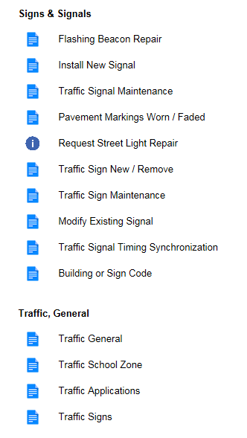
Traffic Service Requests
Houston Service Helpline:
Phone Line 311
Website: www.houstontx.gov/311
Email: 311@houstontx.gov
311 Smartphone App
Notes:
Information on means available to report any traffic related concerns/comments/complaints.

Slide 14
Thanks

