Slide 1
WATER LINE REPLACEMENT IN BRIAR COURT AREA
CONSTRUCTION COMMUNITY MEETING
WBS No. S-000035-0228-4
SABEEN SHAIKH, P.E.| PROJECT MANAGER| July 10, 2018

Slide 2
AGENDA
Overview of the Project
Project Phasing
What to Expect During Construction
Contact Information

Slide 3
OVERVIEW
Purpose: To replace and upgrade the existing water distribution system in the project area.
Construction Cost: $3.2 million
Timeline: 07/02/2018 Construction begins
    08/21/2019 Anticipated project completion
2018
2019
Summer
Construction Begins
Fall
Anticipated Completion

Slide 4

OVERVIEW
Project Scope
Replace old water distribution system with new system to provide:
Improved Water Quality
Increased Water Capacity
Compliant with Current Standards
Increased Fire Protection

Slide 5
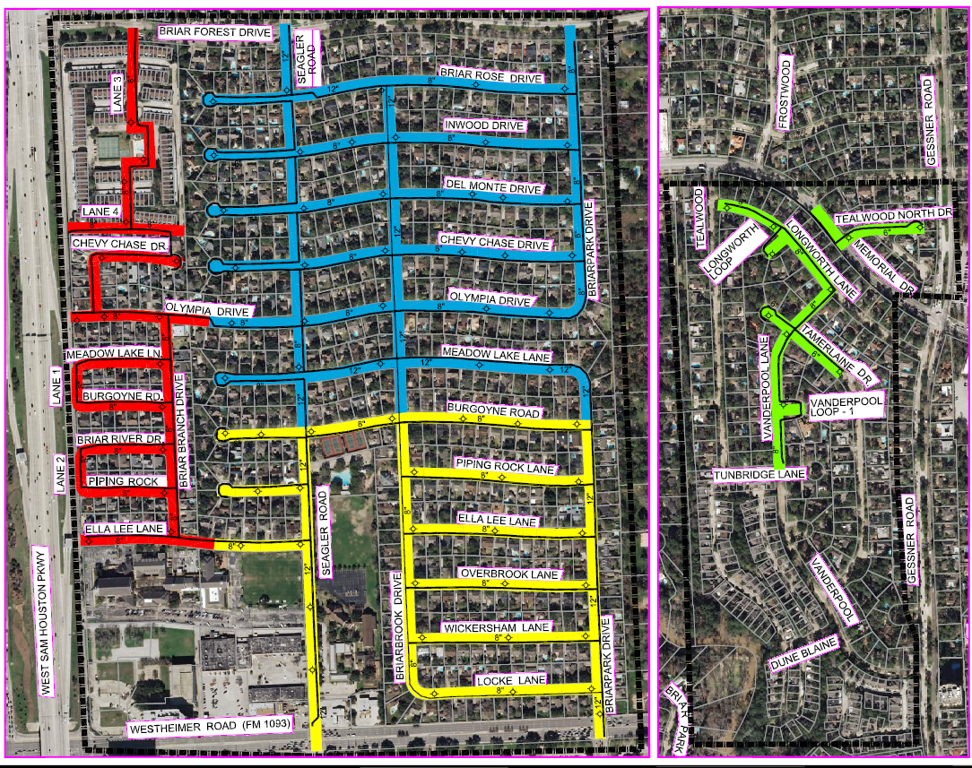
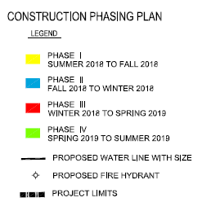
PROJECT PHASING
* SUBJECT TO CHANGES AS PROJECT UPDATES OCCUR.

Slide 6
WHAT TO EXPECT DURING CONSTRUCTION
Prepare for Construction
Construction is within City Right-of-way
Know how to report a concern or problem
Be aware of the potential service impacts
  Potential water service impacts
  Potential lane closures
  Potential school bus re-routes

Slide 7
WHAT TO EXPECT DURING CONSTRUCTION
City Right-of-Way (ROW)
City ROW generally extends 10-17 feet into your yard
Remove items of value (special landscaping features such as fountains and lawn art) within the City ROW
Document the conditions of your yard and sprinkler head locations. Contractor will do the same.
Expect temporary lane closures during the process.

Slide 8
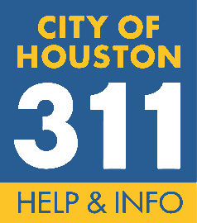
WHAT TO EXPECT DURING CONSTRUCTION
How to Report a Concern or Problem
Keep your door hanger throughout the project
  Lists phone numbers you need
  Lists the Project Number
Contact 311
  Report the project name and the project number
  Request issue be directed to Houston Public Works- Capital Projects
  Be as complete as possible with your concern
Meet the City PM or Inspector
  Will be your contact to resolve issues throughout construction

Slide 9
WHAT TO EXPECT DURING CONSTRUCTION
Potential Water Service Impacts
Planned service interruption:
  Waterline replacement - notification 24 to 48 hours in advance
  Periodic
  May last 2 to 4 hours
Accidental/Unplanned Interruption:
  The contractor will work quickly to restore services.

Slide 10

WHAT TO EXPECT DURING CONSTRUCTION
Tree Impact
Our goal is to protect all trees during construction.
  We accomplish this by working with the City Arborist.
Currently as part of this project, no trees are set to be removed

Slide 11
WHAT TO EXPECT DURING CONSTRUCTION
Potential Bus Re-Routes
School Buses
The City of Houston and the Contractor will work with all schools to minimize impacts to students, school bus schedules, and school bus stops
School buses may need to use different streets temporarily
Metro Buses
No metro bus stops will be affected or re-routed due to construction

Slide 12
WHAT TO EXPECT DURING CONSTRUCTION
Restoration
Restoration of sprinkler systems, grass, etc. will be done during the final stage of construction.
City does not approve final payment to contractor until restoration is complete.
If you have concerns:
  Document (writing, photo, etc.)
  Call 3-1-1
  Do not make the repairs yourself

Slide 13
CONTACT INFORMATION
Contact Information
  CAAN Construction Services, Inc. (constructing proposed work)
Yousef Eldiraui - President | (713) 539-5943
Karim Basboos, Superintendent | (713) 401-4812
  City of Houston Staff (oversight)
Sabeen Shaikh, Project Manager | (832) 395-2307
Charles Jones, Inspector | (281) 382-7971
HOUSTON PUBLIC WORKS | 611 WALKER STREET | HOUSTON, TX 77002 | PWECIP@HOUSTONTX.GOV
Notes:
Hien to update

Slide 14
IMPORTANT LINKS
For a complete listing of Frequently Asked Questions please visit:
https://www.publicworks.houstontx.gov/ecd/faqs.html
Today’s presentation and additional project information can be found at:
https://rebuildhouston.org/community-engagement

Slide 15
THANK YOU
Next Up
Question & Answer
Breakout session

