Slide 1
Yorkshire Area Drainage and Paving –Subproject 2 Community Meeting WBS No. M-000247-0002-4
Presented by: Ellen Maas, PE
January 11, 2018

Slide 2
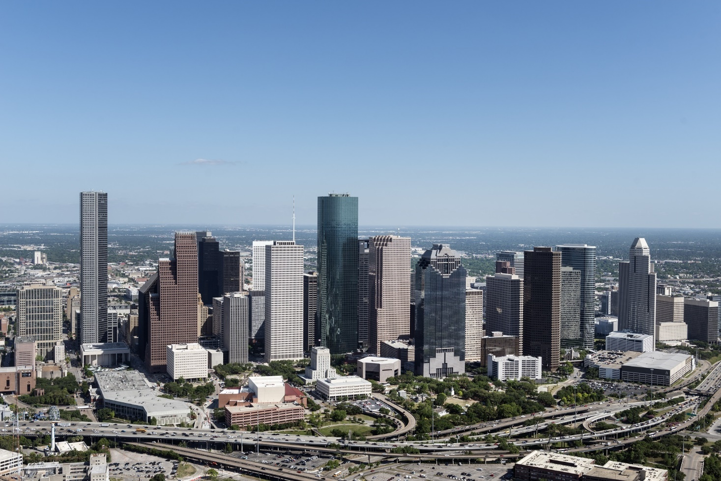
AGENDA
1 | OVERVIEW OF THE PROJECT
2 | PROJECT SCOPE AND PHASING
3 | WHAT TO EXPECT DURING CONSTRUCTION
4 | CONTACT INFORMATION

Slide 3
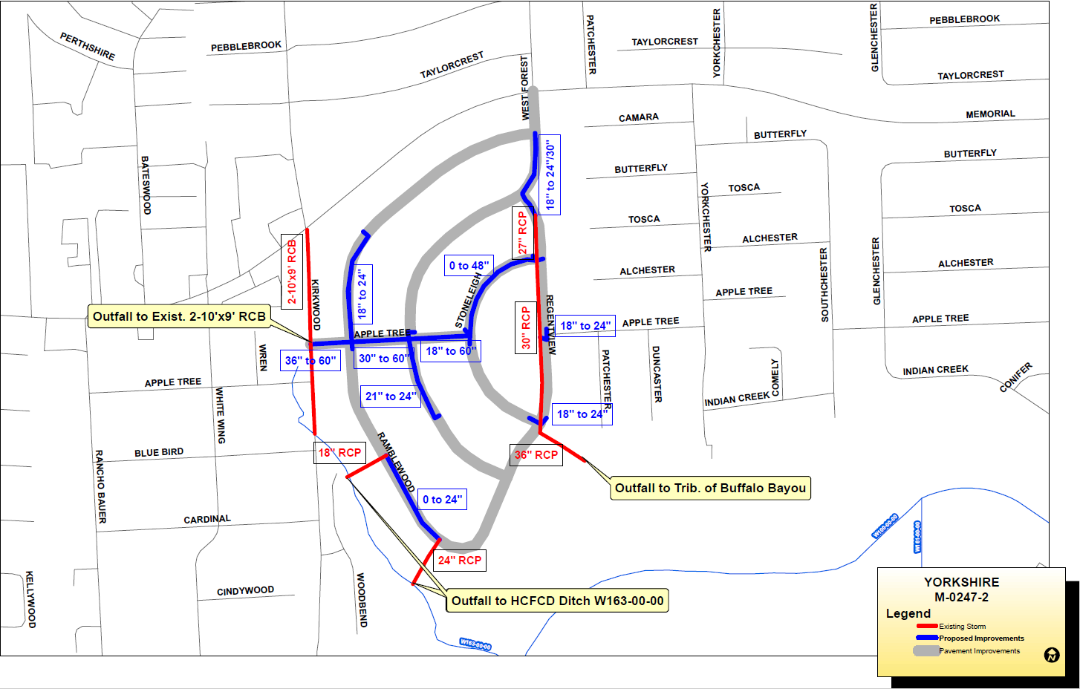
Yorkshire Drainage and Paving Subproject 2 (WBS NO. M-000247-0002-4)
Project Map
2018
2019
Winter
Construction Begins
Spring
Anticipated Completion
Notes:
Good Evening. It’s good to be back out here along Greenbriar Street. I’m excited to share with you where the City is on the Greenbriar Reconstruction Project. Hopefully most of you have had a chance to look at the various exhibits around the room. The layout of the full project is on that wall over there (gestures to wall). So, let’s get oriented and I can begin to walk you through the recommended plan.
Starting on the left, we are at the intersection of Greenbriar with West Holcombe. Traveling to the right, you would be driving north- passing Roberts Elementary on the right, through the intersection at University Boulevard, Rice Stadium and arriving at the northern end of the project at Rice Boulevard.

Slide 4
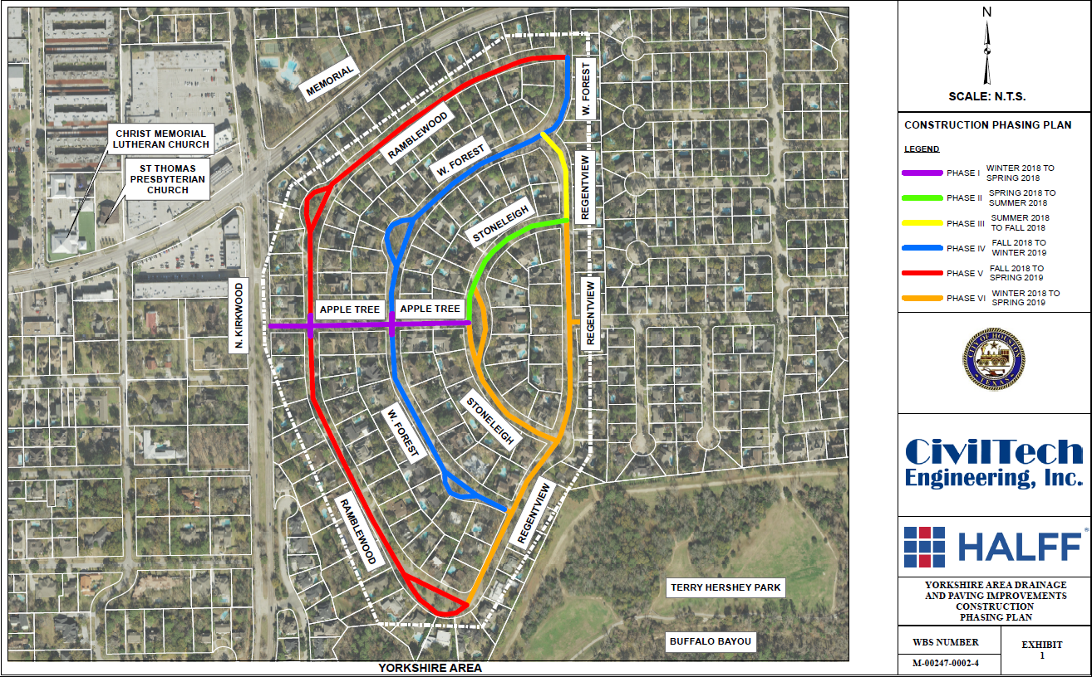
Construction Phasing Exhibit
Yorkshire Drainage and Paving Subproject 2 (WBS NO. M-000247-0002-4)
Yorkshire Drainage and Paving Subproject 2 (WBS NO. M-000247-0002-4)
NOTE: EXPECTED DATES ARE ESTIMATES, MAY CHANGE DURING CONSTRUCTION

Slide 5
Identified Improvement Needs
Yorkshire Drainage and Paving Subproject 2 (WBS NO. M-000247-0002-4)
Storm drainage
Pavement conditions and mobility
Water and wastewater as needed
Notes:
The project will include:
Reconstructed roadway with curbs and gutters
Reconstructed sidewalks, driveways and curb ramps
Reconstructed storm sewer, sanitary sewer, and waterlines
Improve mobility
The roadway improvements will enhance the area as well as the ride.
Reconstruct existing sidewalks and add new sidewalks
Sidewalks will be 5 feet wide (4 foot sidewalks will be constructed if possible in an effort to preserve trees)
Reconstruct drainage system, sanitary sewer and waterlines
Upsized storm sewer system
Updates to sanitary sewer mains and services in certain areas
Updates to water mains and services in certain areas

Slide 6
Construction – Project Info
Yorkshire Drainage and Paving Subproject 2 (WBS NO. M-000247-0002-4)
i
Keep your door hanger throughout the project
Lists phone numbers you need
Lists the Project Number
Number needed when you call or write us
Meet the City PM or Inspector
Will be your contact to resolve issues throughout construction
Construction will occur within the City right-of-way
City right-of-way generally extends 10 to 17 feet into your yard

Slide 7
Yorkshire Drainage and Paving Subproject 2 (WBS NO. M-000247-0002-4)
Construction – How to Report a Problem
Yorkshire Drainage and Paving Subproject 2 (WBS NO. M-000247-0002-4)
Contact 311
Report the project number
Request issue be directed to Public Works Capital Projects
Be as complete as possible with your concern
Contact us at: pwecip@houstontx.gov

Slide 8
What to Expect During Construction
Yorkshire Drainage and Paving Subproject 2 (WBS NO. M-000247-0002-4)
!
Prepare for Construction
Document the conditions of your yard and sprinkler head locations; the contractor will do the same.
Remove special landscaping features (i.e., fountains, lawn art)
Find alternative parking
Plan for water service interruption
Be mindful of protective barriers
Potential Service Impacts:
Potential water service impacts
Potential parking/driveway access impacts
Trash/recycling receptacle location impacts
Limited number of tree removals/replacement per plan
Potential for school bus re-routes

Slide 9
What to Expect During Construction
Yorkshire Drainage and Paving Subproject 2 (WBS NO. M-000247-0002-4)
P
Parking and Driveway Access
Short-periods of limited access to your driveway
Park elsewhere and walk to your home
Contact us immediately if needing handicapped access
Short-periods of no on-street parking
Construction will alternate each side of the street on different schedules
Suggest working with neighbors on the opposite side – they may need your help when it’s their turn.

Slide 10
What to Expect During Construction
Yorkshire Drainage and Paving Subproject 2 (WBS NO. M-000247-0002-4)
Driveways
Driveway aprons will be reconstructed
If construction is needed beyond the apron, the City will request a right-of-entry from property owner

Slide 11
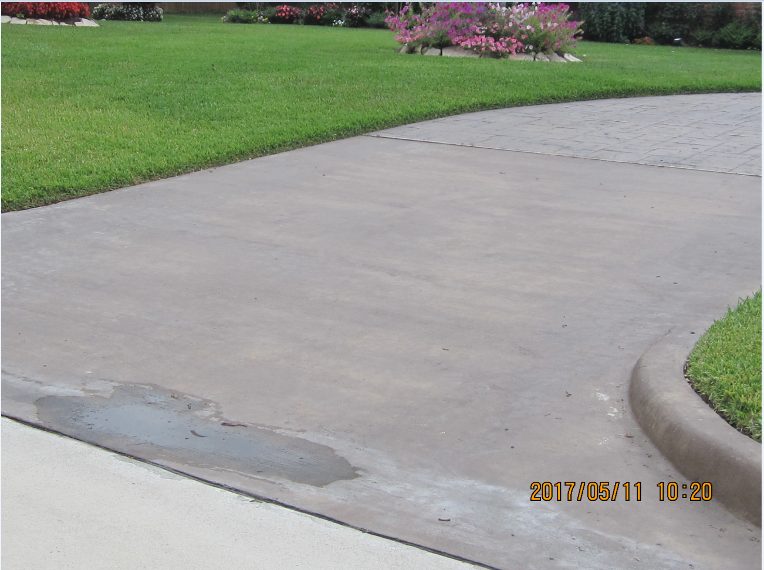
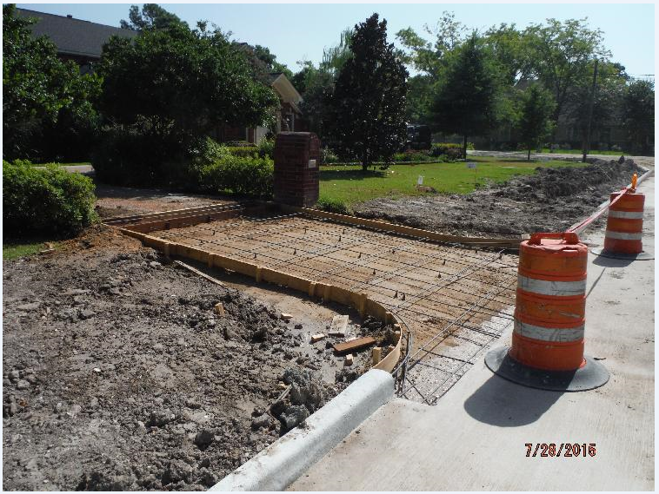
What to Expect During Construction
Yorkshire Drainage and Paving Subproject 2 (WBS NO. M-000247-0002-4)
Driveway Construction Options
Option 1: Replace the broken length and width of the driveway with plain reinforced cement concrete at no cost to the home owner.
Option 2: Grade the subgrade to proper slope and form the driveway to meet the new grades /slope. You would see the finished dirt with proper slope. Home Owner to finish the Driveway with their desired finish at their cost.
(Driveway must be finished 2 weeks after it’s been prepped by the City)

Slide 12
What to Expect During Construction
Yorkshire Drainage and Paving Subproject 2 (WBS NO. M-000247-0002-4)
Trash/Recycling Pick-up
Potential for service interruption:
Construction will alternate each side of the street on different schedules
Waste receptacles should be placed on the non-affected side of the street

Slide 13
What to Expect During Construction
Yorkshire Drainage and Paving Subproject 2 (WBS NO. M-000247-0002-4)
Trees
Our goal is to protect all trees during construction.
We accomplish this by working with the City Arborist.
Unhealthy trees will be removed.
Some trees may be removed as part of the project
New trees may be planted elsewhere in the project area, per plan.
Notes:
NEED TO ADD MORE SPECIFIC INFORMATION

Slide 14
What to Expect During Construction
Yorkshire Drainage and Paving Subproject 2 (WBS NO. M-000247-0002-4)
School Buses
The City of Houston and the Contractor work with all schools to minimize impacts to students, school bus schedules, and school bus stops
School buses may need to use different streets temporarily
Metro Buses
No metro bus stops will be affected or re-routed due to construction

Slide 15
What to Expect During Construction
Yorkshire Drainage and Paving Subproject 2 (WBS NO. M-000247-0002-4)
RESTORATION
Restoration of sprinkler systems, grass, etc. will be done when construction is complete.
City does not approve final payment to contractor until restoration is complete.
If you have concerns:
Document (writing, photo, etc.)
Call 3-1-1
Do not make the repairs yourself

Slide 16
Contact Information
Yorkshire Drainage and Paving Subproject 2 (WBS NO. M-000247-0002-4)
SER Construction (Contractor)
Moe Elahmad, Project Manager | (832)-405-2768
City of Houston Staff (oversight)
Artanya Mills, Inspector, TLC Engineering, Inc. | (713)-868-6900
Nupur Krishnan, Project Manager (COH) | (832)-395-2351
Notes:
Hien to update

Slide 17
Important Links
Yorkshire Drainage and Paving Subproject 2 (WBS NO. M-000247-0002-4)
i
For a complete listing of Frequently Asked Questions please visit:
https://www.publicworks.houstontx.gov/ecd/faqs.html
Today’s presentation and additional project information will later be posted on our website at:
https://rebuildhouston.org/community-engagement

Slide 18
THANK YOU
We will now begin the Q and A session.

