Slide 1


Let’s Talk Certification
Office of Business Opportunity Certification Team
John Whitmire, Mayor
Cylenthia Hoyrd, Director
611 Walker, 7th Floor
Houston, TX 77002
www.houstontx.gov/obo
T. 832-393-0600
F. 832-393-0646

Slide 2


Mission &
Mission
The Office of Business Opportunity (OBO) is committed to cultivating an inclusive and competitive economic environment in the City of Houston by promoting the success of small businesses and developing Houston’s workforce, with a special emphasis on historically underutilized businesses and disenfranchised individuals.
Vision
OBO’s vision is to eliminate systemic barriers to prosperity and economic opportunity in the Greater Houston region.
Vision

Slide 3
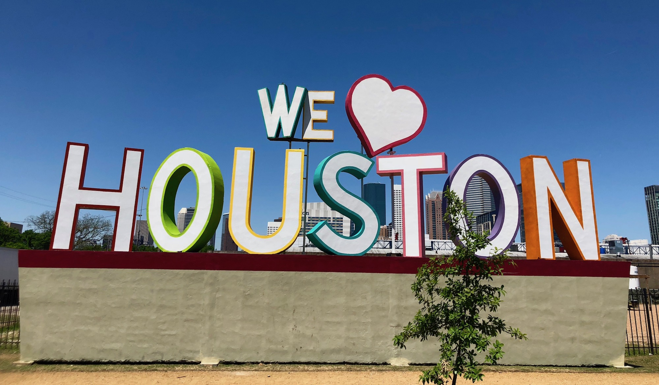

Certifications & Designations
There are four (4) City of Houston and two (2)
Federal certifications processed by OBO.
City Certifications
MBE – Minority Business Enterprise: Applies to firms
owned and operated by minorities. MBE goals may be
applied to any locally funded contract type.
WBE – Women Business Enterprise: Applies to firms owned and operated by females. WBE goals may be applied to any locally funded contract type.
SBE – Small Business Enterprise: Applies only to eligible firms in the construction-related industry. This certification is race and gender neutral.
PDBE – Persons with Disabilities Business Enterprise: Applies to eligible firms owned and operated by individuals with an existing, medically determined physical or mental impairment of a chronic or permanent character. Also includes U.S. Veterans with service-connected disabilities.

Slide 4


Certifications & Designations
Federal Certifications (US Department of Transportation)
DBE- Disadvantaged Business Enterprise (Federal Certification): Applies to firms owned and operated by socially and economically disadvantaged individuals. DBE goals apply only to U.S. Department of Transportation contracts that receive Federal financial assistance.
ACDBE- Airport Concessionaire Disadvantaged Business Enterprise firms are eligible to participate on concessions at airports that receive Federal funds. Concessionaires provide goods and services to the traveling public. Examples include: retail, food and beverage, advertisement and marketing, vending and Wi-Fi services.

Slide 5

Governing Regulations for the Certification Program
Local Certification Program
City of Houston Code of Ordinances, Chapter 15, Article V: Minority, Women, and Small Business Enterprises
Office of Business Opportunity Policies and Procedures in effect, found at https://www.houstontx.gov/obo/documents_and_forms.html
DBE and ACDBE Program
The Disadvantaged Business Enterprise and Airport Concessionaire Disadvantages Business Enterprise programs are governed by the Code of Federal Regulations (C.F.R.), as follows:
DBE: 49 C.F.R. Part 26
ACDBE: 49 C.F.R. Part 23

Slide 6
The Certification Process
Preliminary Screening of Application
Desk Audit
Financial Audit
Site Visit
Certification Approval or Denial
Committee Review
Pre-Certification Workshop
Complete Application Online
  Pre-Certification Workshop
  Complete Application Online
  Preliminary Screening of Application
  Desk Audit
  Financial Audit
  Certification Interview, where applicable
  Committee Review
  Certification Approval or Denial
All applications must be submitted online.
(Visit http://houstontx.gov/obo/ for instructions and details)

Slide 7
Requirements for Certification
Requirements | Certification Type
Must be at least 51% owned, managed and controlled by a minority (MBE), female (WBE), person with a disability or socially (ACDBE), and economically disadvantaged individual (DBE). | MBE, WBE, PDBE, ACDBE, and DBE
The minority, female, persons with disabilities owner, socially and economically disadvantaged owner, and small business owner must have the training/expertise to perform the work, and where required, have a license or certificate issued in his or her name. | All certification types
Firm must be for profit, independent, and currently functioning. | All certification types
Maintain a significant presence in Harris, Brazoria, Chambers, Fort Bend, Galveston, Liberty, Montgomery, Waller, Austin, or San Jacinto counties. | MWSBE and PDBE

Slide 8
Requirements for Certification
Requirements | Certification Type
Meet the Small Business Administration Size Standard(s) for its industry classification(s). | All certification types
Firm must be registered as a Vendor/Supplier with COH Strategic Purchasing Division. | All certification types
For Persons with Disabilities Business Enterprise (PDBE) certification requires that applicant submit a Disability Affidavit and an accompanying letter from a medical doctor. *Veterans applying for PDBE must demonstrate a service-connected disability by providing: Disability rating letter from the Department of Veterans Affairs or Disability determination from the Department of Defense. | PDBE only

Slide 9
Requirements for Certification
Requirements | Certification Type
For Small Business Enterprise (SBE) certification, it requires the applicant to be in a construction or construction related field. | SBE certification only
For Disadvantaged Business Enterprise (DBE/ACDBE) certification, applicant must have a Personal Net Worth less than $2.047 million – excluding value of primary home and ownership interest in the business. There is no local presence requirement for DBE/ACDBE certification. | DBE and ACDBE only

Slide 10

LGBT-Owned Business Enterprise Certification
The NGLCC (National Gay and Lesbian Chamber of Commerce) is the exclusive, third-party certification body that verifies that eligible businesses are majority-owned by LGBT individuals and subsequently grants Certified LGBT Business Enterprise® (Certified LGBTBE®) designation to such businesses as part of its LGBT Supplier Diversity Initiative.
Effective March 1, 2021, the City of Houston will recognize the NGLCC certification for Houston area businesses that meet the City’s size standards. Contractors can search the certified firm directory to identify these businesses.
Become a member of your local affiliate chamber to not only leverage local membership benefits but also to take advantage of complementary national certification. NGLCC waives the certification fee for businesses that choose to join their local affiliate chamber.
Visit https://www.nglcc.org/get-certified for Requirements and additional Information.

Slide 11

Texas HUB Certification
STATE OF TEXAS
HISTORICALLY UNDERUTILIZED BUSINESS (HUB) CERTIFICATION
The COH Certification team also facilitates State of Texas Historically Underutilized Business (HUB) certification.
At the firm’s election, MBE and WBE certification approval can also result in HUB Certification, if the firm meets the State’s HUB certification eligibility guidelines.

Slide 12
Eligibility for HUB Certification
Owner must be a U.S. Citizen.
Owner must be a Texas Resident.
Principal place of business must be located in the State of Texas.
Owner must have a proportionate interest and demonstrate active participation in the control, operations, and management of the entity's affairs.
Business must be at least 51% owned by one or more persons who are members of the following groups: American Women, Asian Pacific Americans, Black Americans, Hispanic Americans, Native Americans.

Slide 13
Advantages / Benefits of Certification
Goal credit for MWSDBE and ACDBE participation on City of Houston projects
Three (3) year MWSBE and PDBE certification approval period
Listing in the City’s Certified Online Directory.
https://houston.mwdbe.com/

Slide 14










Advantages / Benefits of Certification cont.
City of Houston Certification is also accepted by the following agencies:

Slide 15



Advantages / Benefits of Certification cont.
Certification enables a firm’s eligibility to participate on goal-oriented contracts, access resources to educate, connect and grow, and a wide variety of networking opportunities and events which include:
City of Houston’s Annual Meet the Buyer Event
The Interagency Mentor-Protégé Program
Turner School of Construction Management
Certified firms are also included on the OBO/Community Partner's list to receive notifications of business opportunities.

Slide 16
Certification Updates and Changes
City of Houston Certifications are updated every three (3) years
MBE
Federal certifications must be updated annually
DBE
ACDBE
Types of Changes
Ownership
Address
Emails
Phone/Fax Numbers
WBE
SBE
PDBE
All updates or changes to your certification are reported via the online application system at www.houston.mwdbe.com.

Slide 17
Expansion of Capabilities
If you expand your business to operate in areas where you are not currently certified, we encourage you to seek an expansion of certification codes.
Complete form via online application system at www.houston.mwdbe.com
  Add additional services to your current certification description
  Add North American Industry Classification System (NAICS) codes to your certification profile
  Required to be used for specific scopes of work on City projects
Requirements for expansion:
  Qualifying owner(s) must have training, expertise, and/or licensure to perform new work
  Work is performed by applicant firm (not subcontractors)

Slide 18

How Successful was the MWSBE Program?
Over $4 Billion has been awarded to Small, Minority, and Woman-owned businesses during the prior administration.

Slide 19
Grounds for De-certification
Any material misrepresentation in the certification application or in the execution of a contract may be reason for revocation of certification for a five-year period. The following are some examples of violations of the City’s MWSBE, PDBE, ACDBE, and DBE programs.
OBO discovers that the firm provided false or misleading information for the purpose of certification during the original application process or as part of the update process;
Allowing your company’s name to be submitted toward satisfying the MWSBE, PDBE, ACDBE and DBE goal for a scope of work for which you are not certified;
Allowing your company’s name to be submitted toward satisfying MWSBE, PDBE, ACDBE and DBE goal, but not actually performing, through your own workforce, the exact scope of work submitted in the prime’s contract documents; and/or
The company hired members of the prime contractor’s workforce and misrepresented them as his/her own employees.
This is not an exhaustive list.

Slide 20
How to Apply for Certification
and
Preparing a Successful Certification Application
All applications for certification must be completed and submitted online.
https://houston.mwdbe.com

Slide 21
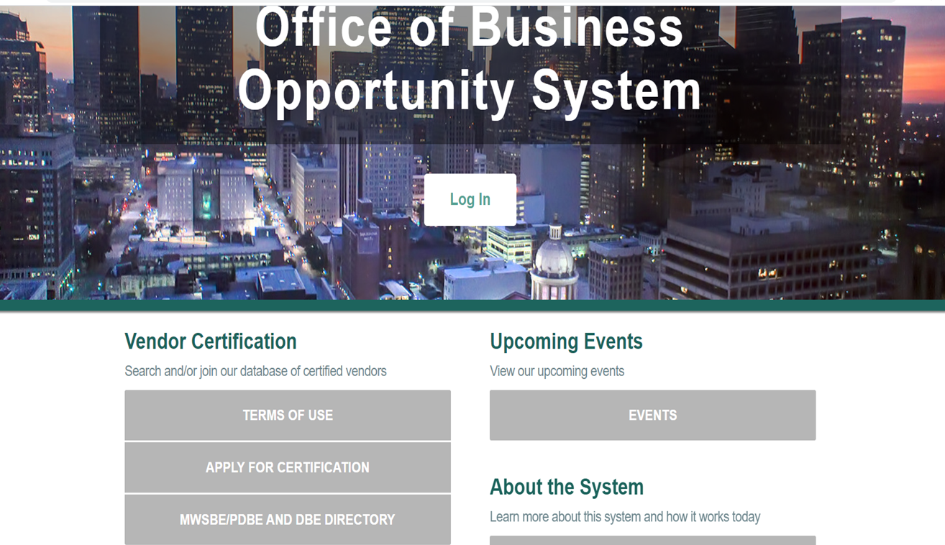

How to Apply

Slide 22
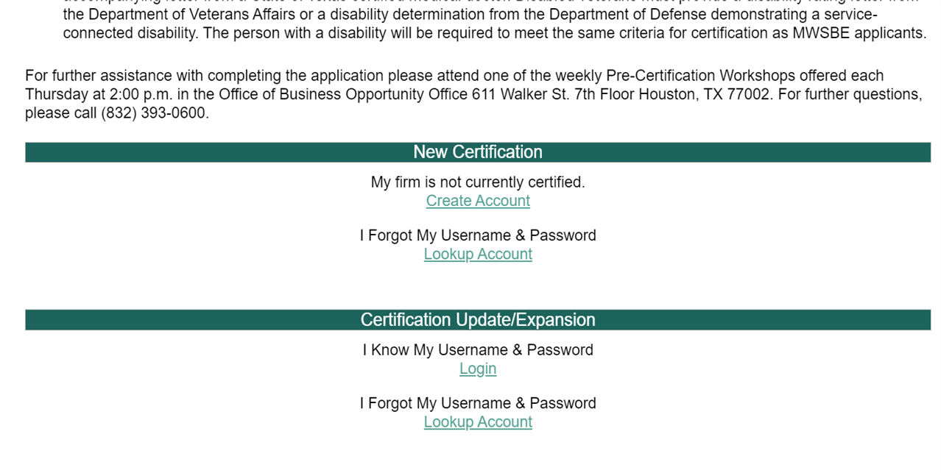
How to Apply

Slide 23
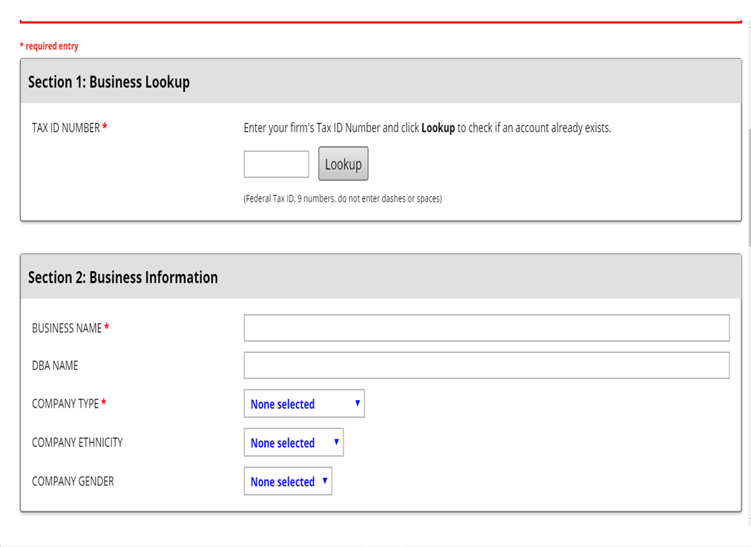
How to Apply

Slide 24
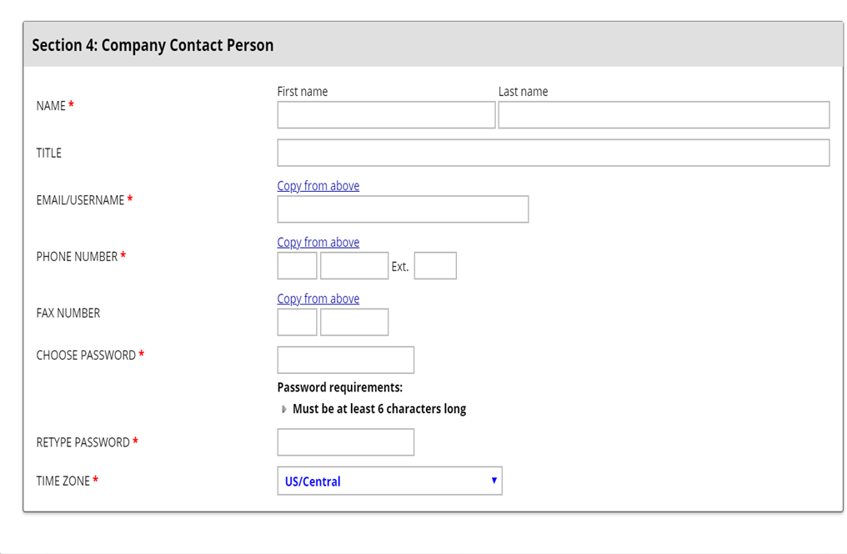
How to Apply

Slide 25
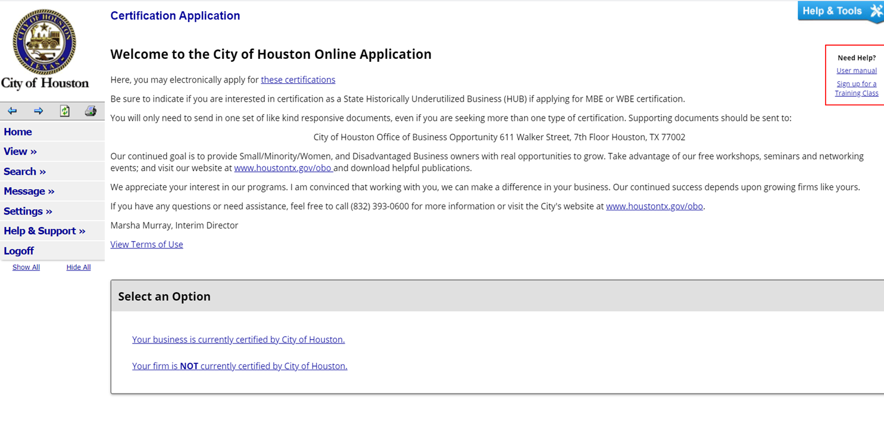
How to Apply

Slide 26
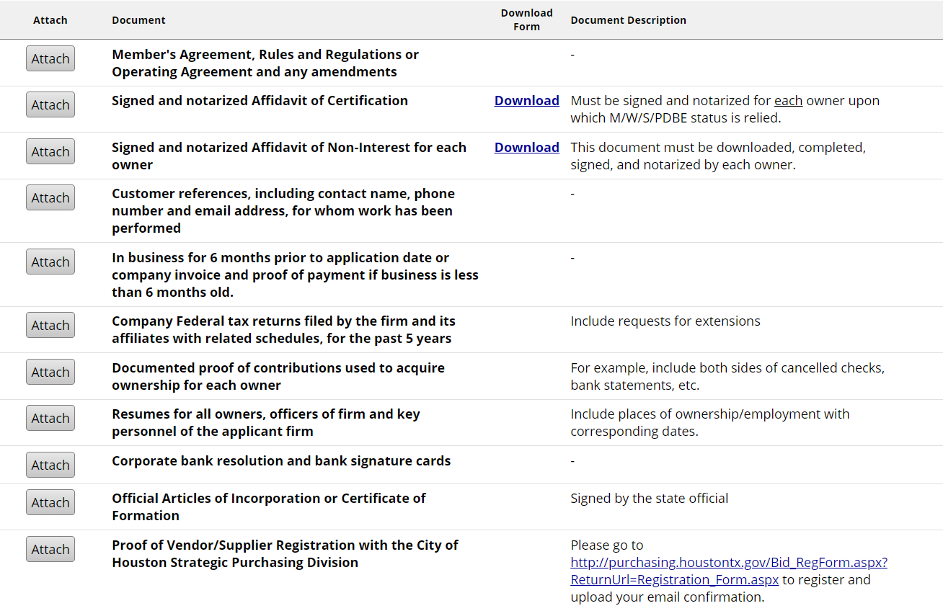
Mandatory Documents

Slide 27

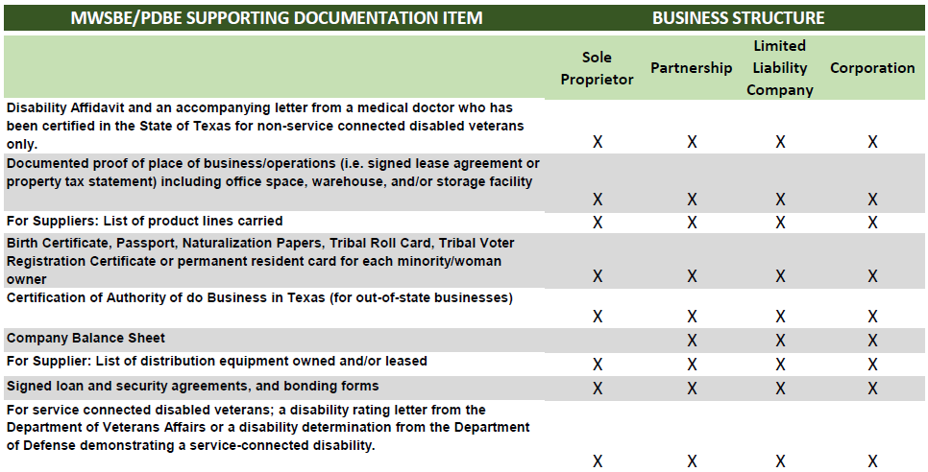
Document Checklist(s)- MWSBE/PDBE

Slide 28
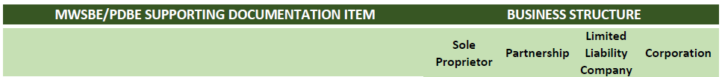
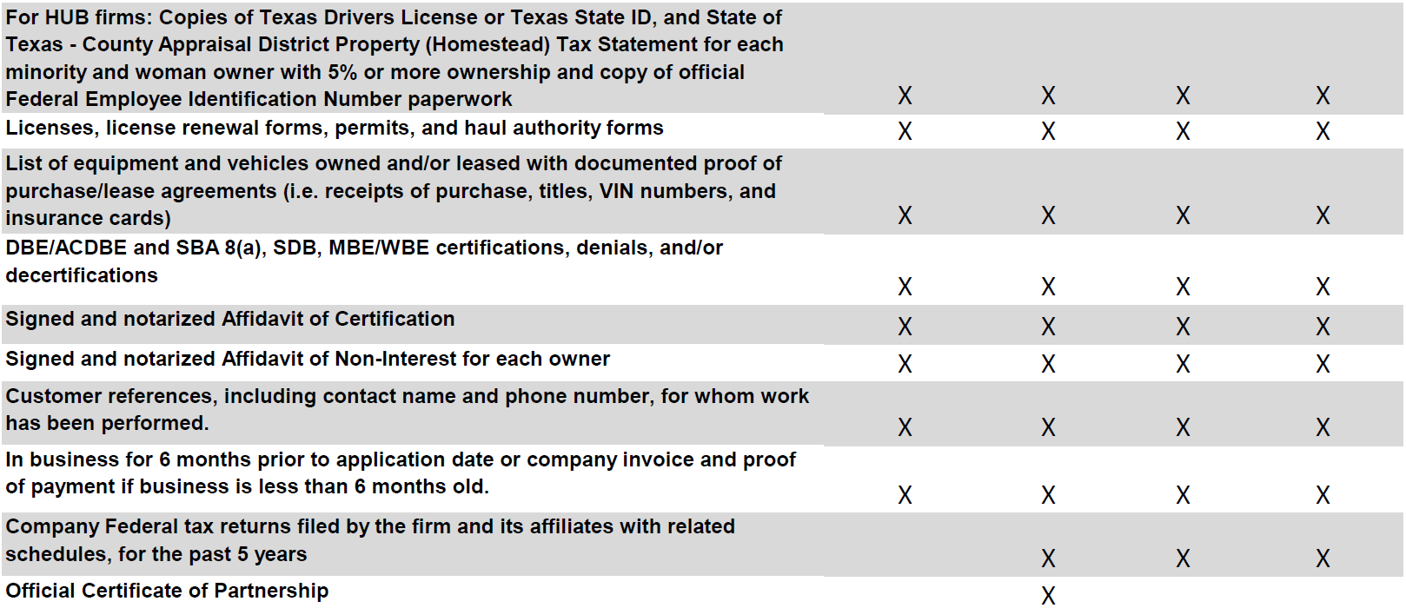
Document Checklist(s)- MWSBE/PDBE cont.

Slide 29
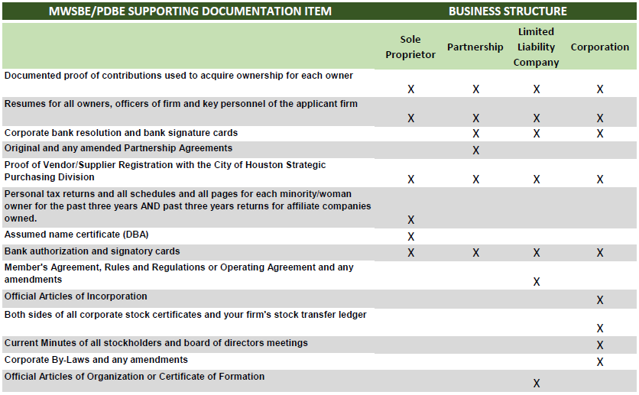
Document Checklist(s)- MWSBE/PDBE cont.

Slide 30

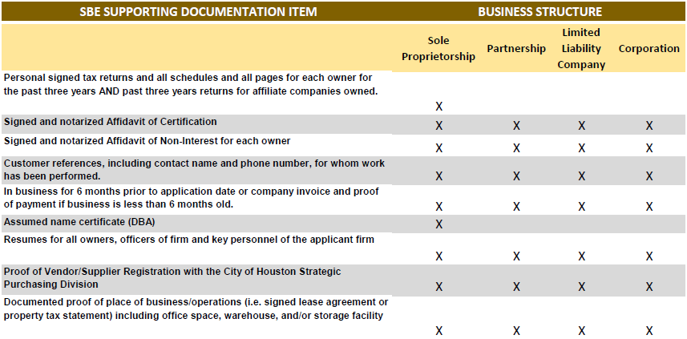
Document Checklist - SBE

Slide 31

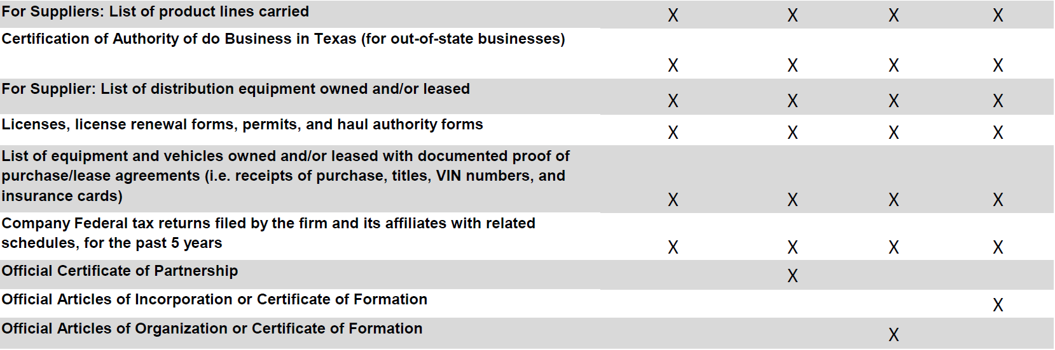
Document Checklist – SBE cont.

Slide 32
Document Checklist (DBE/ACDBE)
The DBE/ACDBE checklist mirrors OBO’s checklist with the addition of:
Personal tax returns for the past 3 years for each disadvantaged owner
Schedule of salaries (or other remuneration) paid to all officers, managers, owners, and/or directors
List of all employees, job titles, and dates of employment
Trust agreements held by any owner claiming disadvantaged status
Audit financial statements (if available)

Slide 33
Personal Net Worth
(DBE/ACDBE)
The DBE/ACDBE program requires applicants claiming disadvantaged status to complete an individual Personal Net Worth form (in application). OBO along with the Texas Uniform Certification Program (TUCP) requires supporting documents for all Assets valued on the PNW statement. Documents required are:
Assets | Supporting Documents
Cash and Cash Equivalents | Personal bank statements reflecting the value amount reflected on the PNW statement
Brokerage, Investment Accounts | Account statement(s) reflecting holder’s name and value
Assets Held in Trust | Copy of the Trust Agreement (all pages)
Loans to Shareholders & Other Receivables | Promissory notes and other receivable documents made by applicant to others.
Real Estate Excluding Primary Residence | Mortgage statements including equity and value
Life Insurance (cash surrender value only) | Insurance statement/letter reflecting the cash surrender value
Other Personal Property: Personal vehicles Fine art/jewelry Any other valued personal property | Kelly blue book value (print value page) Statements/insurance of value Statements/insurance of value
Business Interest Other Than the Applicant Firm | Valuation report of the affiliate business(es)

Slide 34
Tips
(Personal Net Worth Documents)
Applicant(s) have two options to upload PNW documents:
a. In PNW module
b. As “Additional supporting documents not listed above”

Slide 35
Tips
Online application checklist is divided into two sections:
Mandatory documents vs Required documents
Mandatory documents: Applicant must attach these documents for this entire section to be completed.
Required documents: Although the applicant is able to mark documents in this section as not applicable, we advise all applicants to refer to OBO’s checklist to ensure the documents are not required for processing.

Slide 36
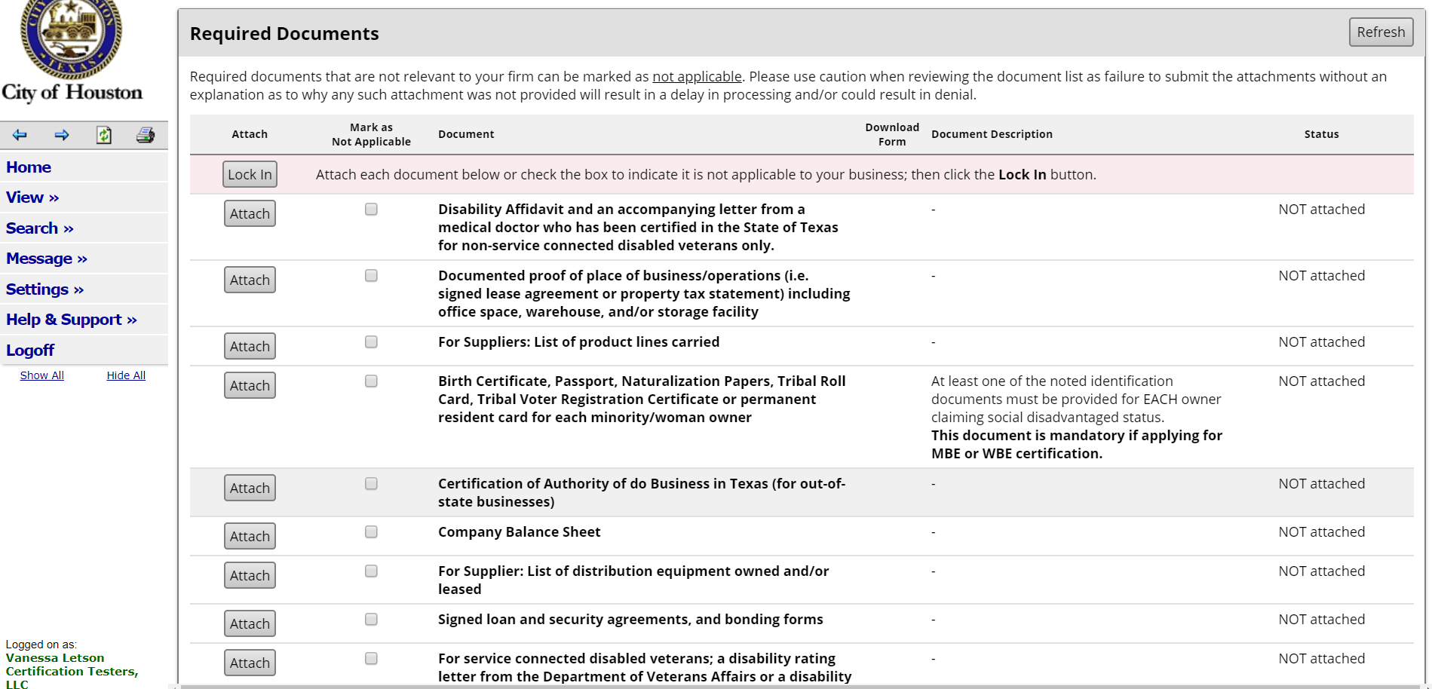
Tips
(example)
Documented proof of business location and Birth Certificate/Passports are always mandatory documents for OBOs certification.

Slide 37
Preliminary Screening of Application
Step 1: Review of application to ensure all sections are complete
  Physical addresses cannot be a P.O. Box or any other mailbox service (i.e., UPS mailbox service, etc.)
  Section 3: Ownership must be completed by all owners
  All owners must complete an Affidavit of Non-Interest
  Only the owners making 51% ownership should complete the Affidavit of Certification
Step 2: Review all attached documents for validity.

Slide 38
Review and Assignment of Application
For local certifications: Failure to submit a fully completed application will result in its rejection. In the event of rejection, the applicant must wait 90 days before reapplying with OBO. For detailed guidance, please consult the checklist available on the OBO website.
Once the application is deemed suitable for assignment to a Certification Officer, the applicant will be notified through the online application system at www.Houston.mwdbe.com.

Slide 39
Office of Business Opportunity – OBO
Certification Process
Due to the volume of certification applications, the average processing time for local applications is 4 – 6 months.
Processing time for DBE and ACDBE applications is 90 days from the time that the application is deemed Suitable for Evaluation, as defined in 49 C.F.R. Part 26.

Slide 40
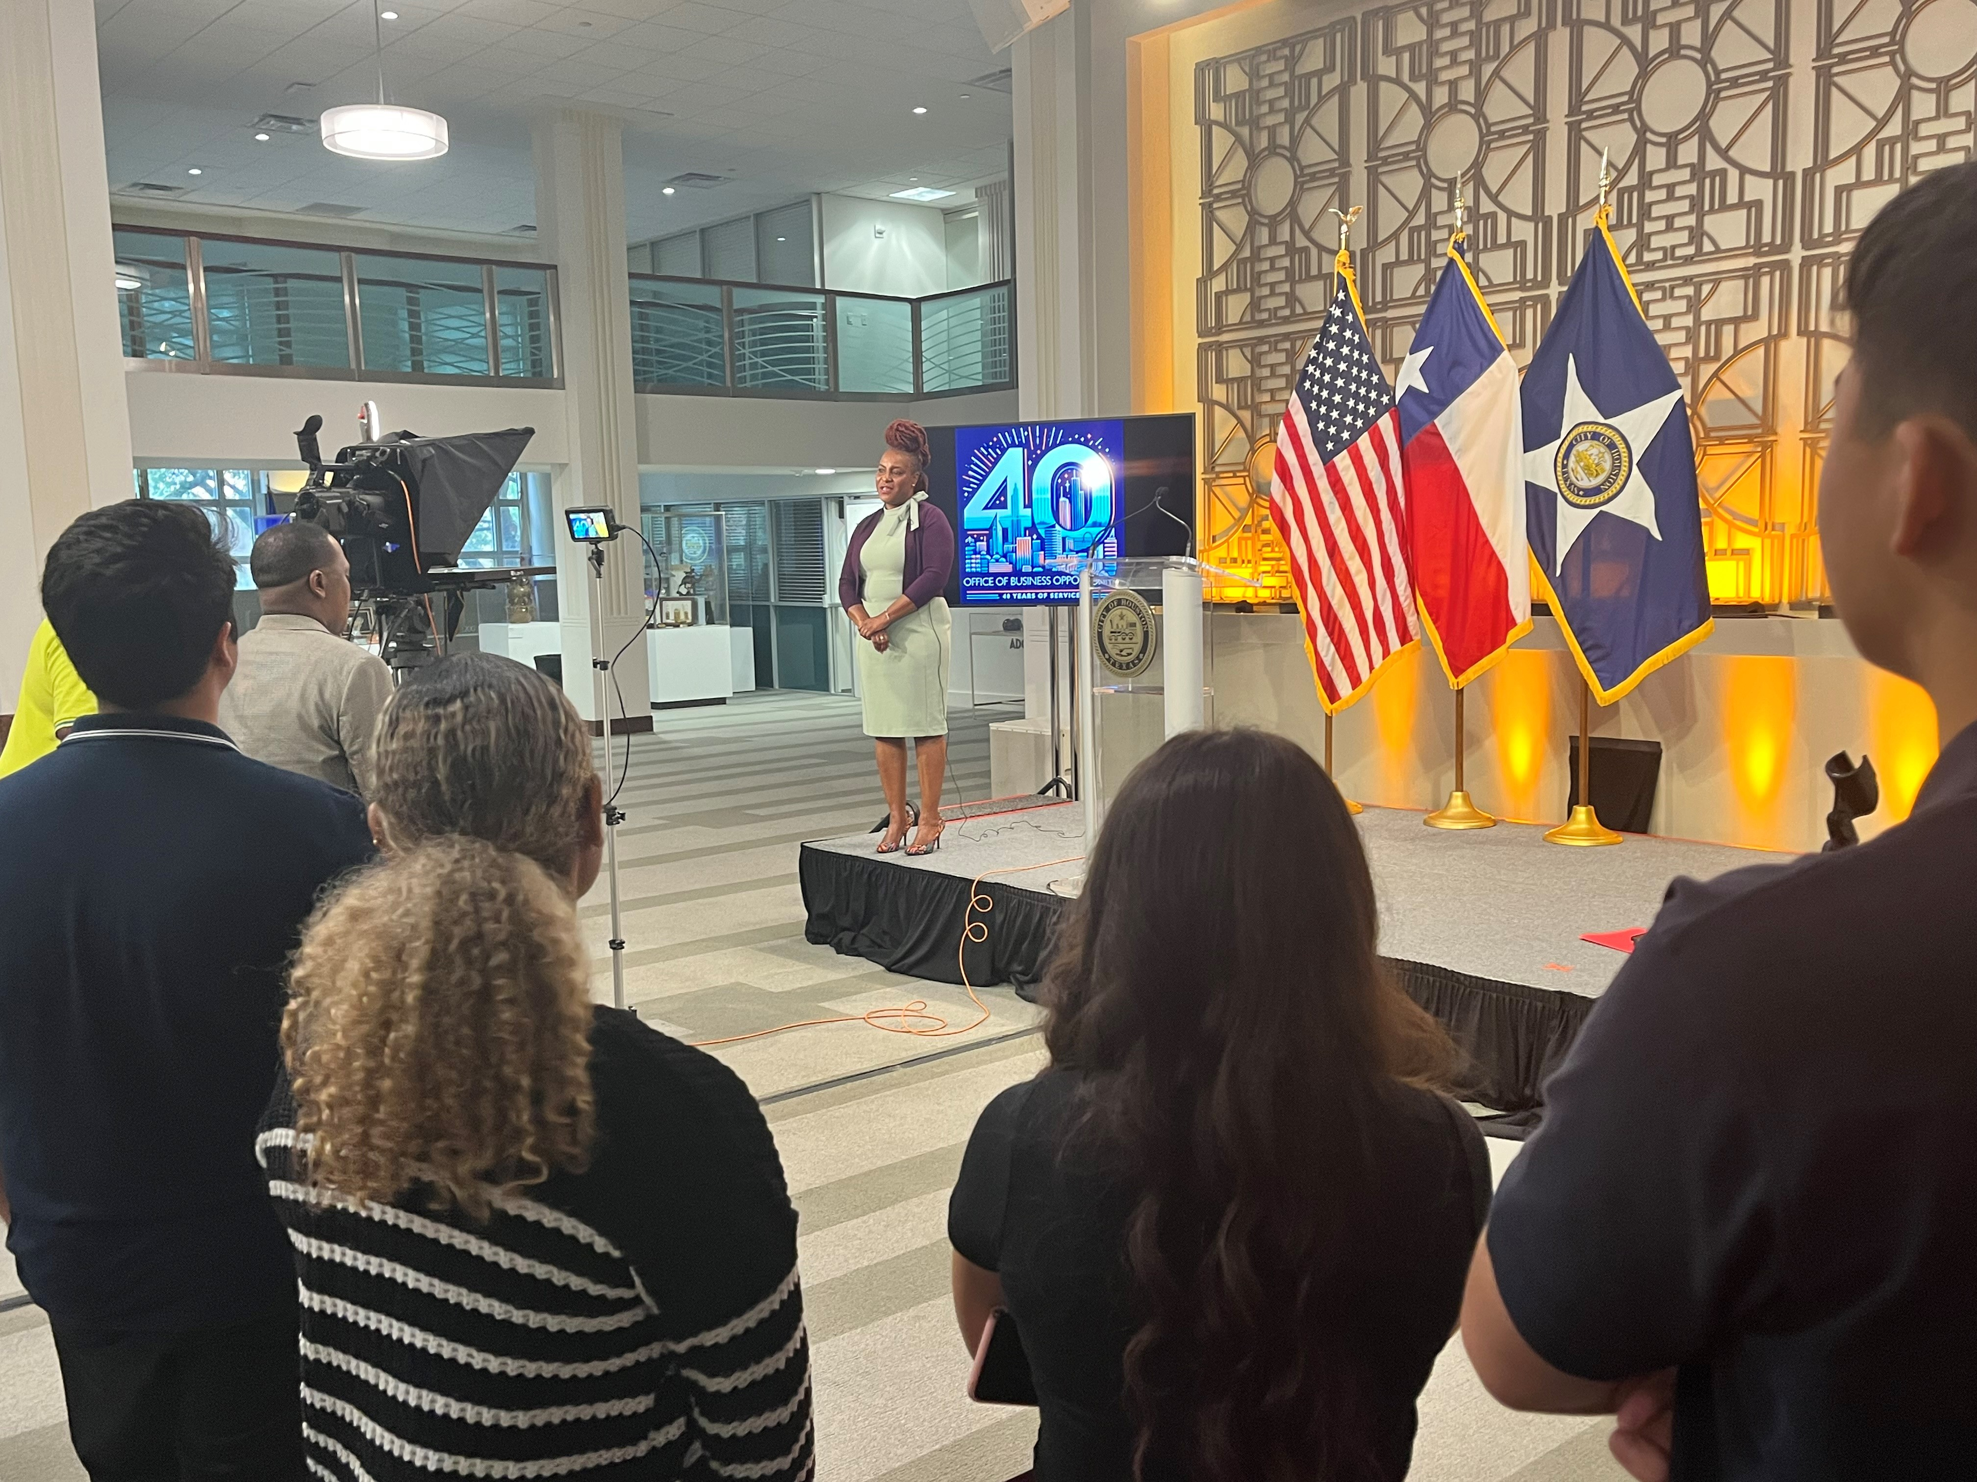
Thank You
John Whitmire, Mayor
Cylenthia Hoyrd, Director
611 Walker, 7th Floor
Houston, TX 77002
www.houstontx.gov/obo
T. 832-393-0600
F. 832-393-0646
Connect With Us:

