Slide 1
Overview Disabled Parking Volunteer Enforcement Program
May 13, 2019
Notes:
This template can be used as a starter file for presenting training materials in a group setting.
Sections
Right-click on a slide to add sections. Sections can help to organize your slides or facilitate collaboration between multiple authors.
Notes
Use the Notes section for delivery notes or to provide additional details for the audience. View these notes in Presentation View during your presentation.
Keep in mind the font size (important for accessibility, visibility, videotaping, and online production)
Coordinated colors
Pay particular attention to the graphs, charts, and text boxes.
Consider that attendees will print in black and white or grayscale. Run a test print to make sure your colors work when printed in pure black and white and grayscale.
Graphics, tables, and graphs
Keep it simple: If possible, use consistent, non-distracting styles and colors.
Label all graphs and tables.

Slide 2
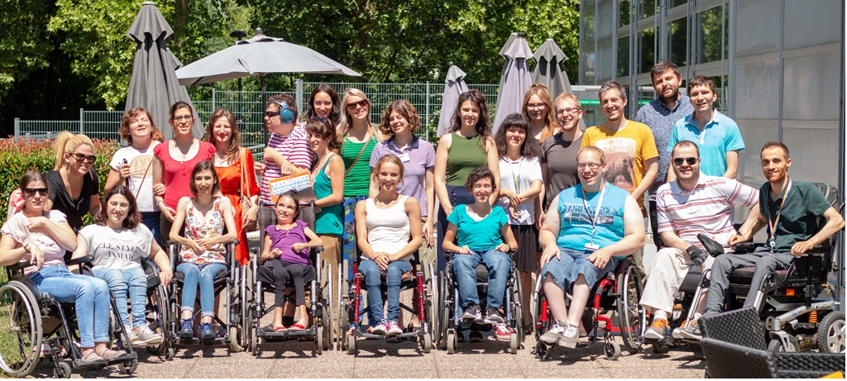
Program Purpose
Protect the parking rights of the disabled community
Reduce disabled parking space abuse
Work together to provide a public service
Empower citizens to be our partners in serving the community
Notes:
60 seconds is a minute to long to illegally park in a disabled parking space

Slide 3
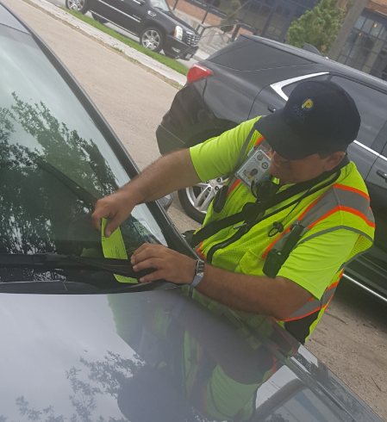
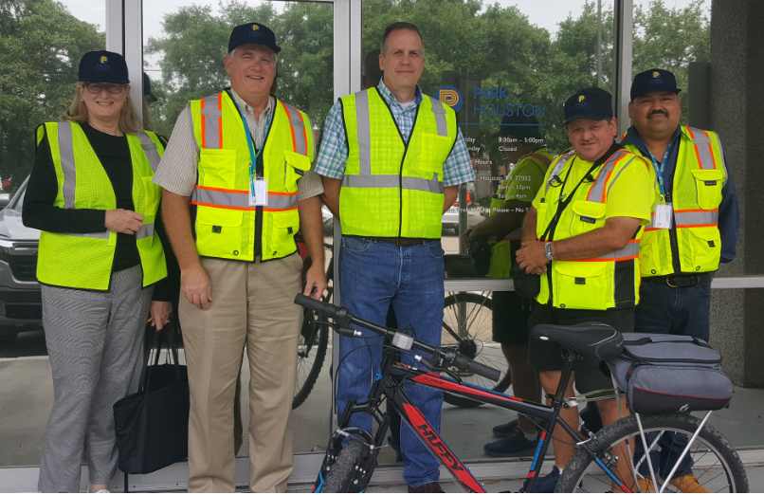
Texas Transportation Code 681.0101
Authorizes cities to empower volunteers to enforce disabled parking space abuse
Notes:
Ask the attendees if they can make this pledge? If not, thank them for their interest in the program.

Slide 4
Volunteer Requirements
Must be 18 years of age
Be a United States citizen
Take and subscribe to an oath of office
Successfully complete four-hour training program
Pass background check
Commit to always carry yourself in a professional and courteous manner
Respect the public we serve and never threaten a citizen
To adhere to program policies and procedures and ensure you protect the program’s continued success
Notes:
Proactive listening: is being a great listener by not projecting YOURSELF into what the other person is saying.
You are completely there, with no distractions, to hear the other person, and are listening beyond just there words for deeper meanings, feelings. etc. There is no right or wrong, no judgments made, no sharing of YOUR thoughts, feelings, or opinions. you're just letting THEM get it out.

Slide 5
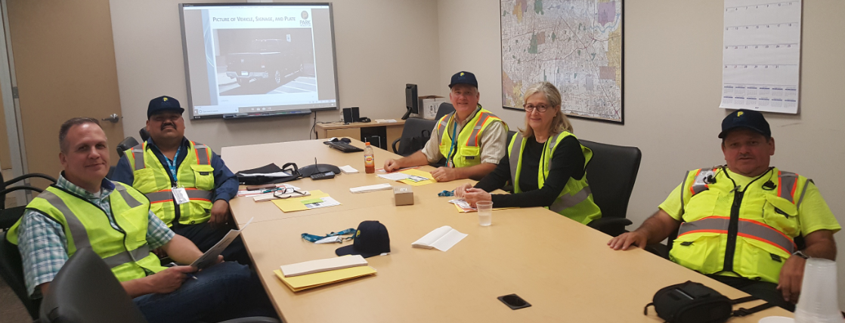
Volunteer Training
Volunteer Requirements
Customer-Friendly Service
Volunteer Code of Conduct and Limitations
ADA Laws and Requirements
Accessible Parking Spaces
Disabled License Plates and Placards
How to Issue a Citation
Writing a Citation
Submitting the Citation
Notes:
Right click picture to show video

Slide 6
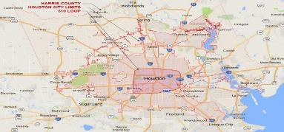
Volunteer Limitations
Even if you are licensed, you may not possess or carry weapons while serving
We are NOT peace officers and you must NEVER present yourself as a police officer
Do not get involved in police matters
Cannot enforce other civil, traffic or criminal laws
You may reside outside of Houston, but you are only allowed to issue citations within the City of Houston City Limits
No compensation
Notes:
Proactive listening: is being a great listener by not projecting YOURSELF into what the other person is saying.
You are completely there, with no distractions, to hear the other person, and are listening beyond just there words for deeper meanings, feelings. etc. There is no right or wrong, no judgments made, no sharing of YOUR thoughts, feelings, or opinions. you're just letting THEM get it out.

Slide 7
Volunteer Enforcement Program Graduation
Volunteer enforcement ID Badge
Volunteer Parking Citation Book
Volunteer ParkHouston Cap
Volunteer Enforcement Vest (optional)
Notes:
Is your presentation as crisp as possible? Consider moving extra content to the appendix.
Use appendix slides to store content that you might want to refer to during the Question slide or that may be useful for attendees to investigate deeper in the future.

Slide 8
For more information or to register to become a Volunteer
Call: (832) 393-8676
Email: volunteer.parking@houstontx.gov
Notes:
Is your presentation as crisp as possible? Consider moving extra content to the appendix.
Use appendix slides to store content that you might want to refer to during the Question slide or that may be useful for attendees to investigate deeper in the future.

