Slide 1
2021 patsa instructions

Slide 2
2021 patsa
The 2021 PATSA is substantially similar to the previous PATSA
This presentation highlights some of the changes and assists with completing the exhibits
All tow companies must sign a new PATSA. No company will be permitted to operate under the previous PATSA
Only one copy of the exhibits is needed, and will be kept at Auto Dealers

Slide 3
2021 PATSA
The new PATSA can be downloaded from our website.
It is a fillable PDF, which means you can fill it out on your computer or print it out and fill it out by hand
Place your TDLR tow company license number on the top of Page 1
Sign the last page before returning it
Only one copy needs to be turned in

Slide 4
Background checks
PATSA holders are now required to have a background check via Identogo
This must be done before submission of the new PATSA
If you have already had a background run with Auto Dealers you do not need another (e.g. for a wrecker license)
The forms can be found on the Auto Dealers website

Slide 5
Tow company name
The name of your tow company in Section 1.01 must be consistent throughout the contract and your paperwork, including insurance
The owner of the tow company can be an individual or a business entity
If it is a business entity, the corresponding paperwork (e.g. certificate of incorporation) must be included
Regardless of ownership, a DBA is required unless your tow company name is exactly the same as your business name

Slide 6
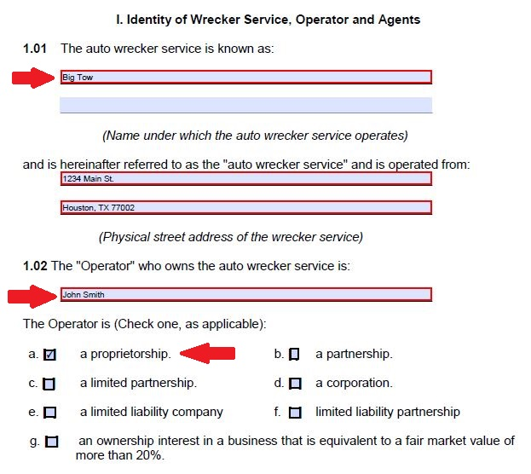
Tow company name (sole proprietor)

Slide 7
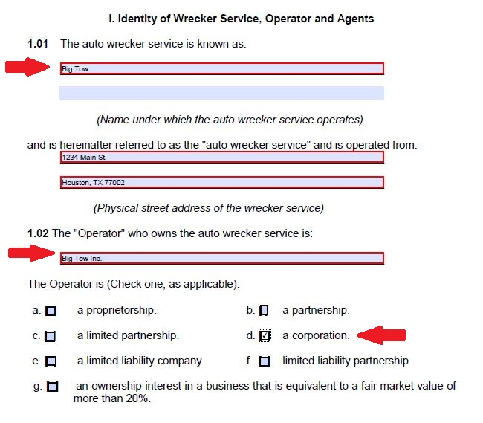
Tow company name (corporation)

Slide 8
Tow company name
Make sure to mark the proper business entity (i.e. if your company is an LLC, don’t mark corporation)
Remember, under the new contract, only your tow company name, city, and phone number can be on the front door of your trucks
  No body shops or affiliated tow companies are permitted
  This must be completed before you submit the PATSA
Drivers must wear a shirt or vest with the tow company name on it

Slide 9
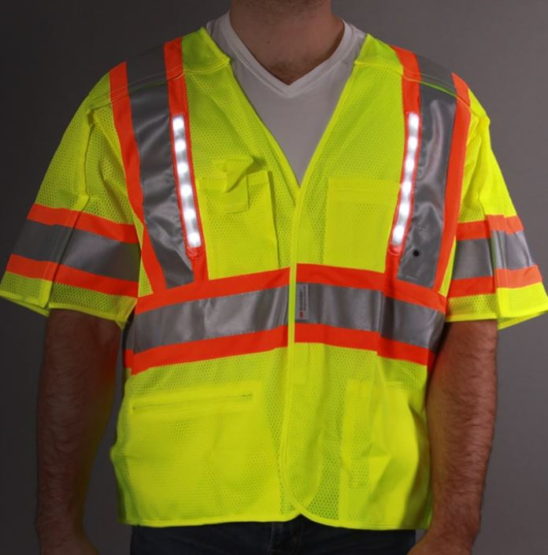
Level III vest
In case there was any question about the proper vest for drivers to wear on scenes, this is the only acceptable vest

Slide 10
Wrecker fees
If you already have an existing PATSA, you will not need to pay for your trucks, as they were paid for in March
However, upon submission of a first-time PATSA, you will be required to pay for one truck license, regardless of how many trucks you will have on the PATSA
  This fee is nonrefundable
  Payment for the rest of the trucks will be due after the contract is signed by all parties and before any inspections

Slide 11
Wrecker inspection
The equipment requirements have not changed
However, medallions must be mounted at the highest point of the cab and lighted
Tire tread must be at least 2/32”, which is industry standard
Don’t forget, the tow company name must be on the door. No other company will be accepted (e.g. body shops)

Slide 12
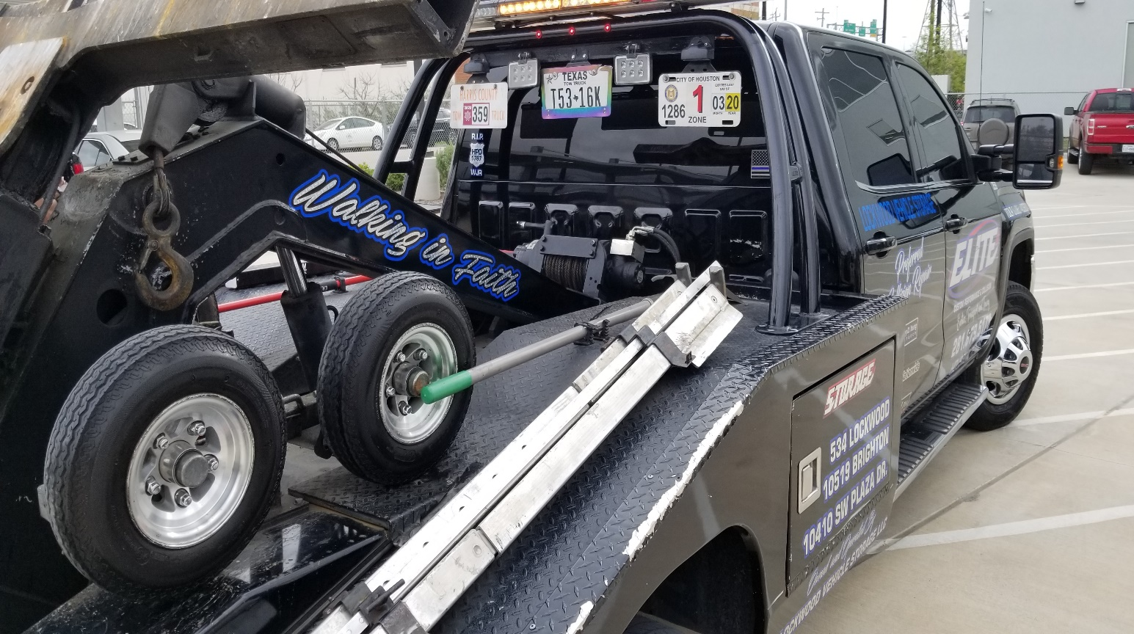
Proper medallion mount

Slide 13
Contact information
Please keep an updated email address on file. All correspondence will be sent via email
When this contract expires, extensions will be automatic, and notice of the extension will be emailed
  No more signed extensions

Slide 14
Contact information
Fill out Section 5.01 with your name and address
Your name will be auto-populated on the signature page

Slide 15
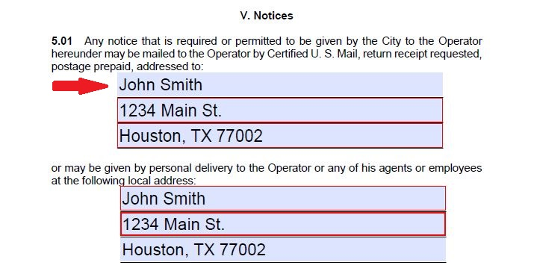
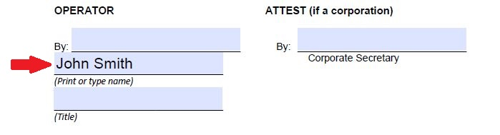
Contact information

Slide 16
Exhibit a
Exhibit A consists of all the trucks that will service the contract
Vehicle registration must reflect the tow company as the owner
  If leased, a signed lease must be included
Valid cab card and certificate of registration

Slide 17
Exhibit a
If a vehicle registration, cab card, or certificate is due to expire within 30 days of submission it must be renewed
  This is also required whenever a truck is added later

Slide 18
Exhibit b
When submitting Acord forms, the insured must match the tow company name exactly

Slide 19


Acord form

Slide 20
Exhibit b
Workers’ compensation is now required
  Occupational Safety will not be accepted
  Workers’ compensation is not needed if you have a sole proprietorship and you are the only driver
Cargo on hook minimum has been raised to $100,000
Liability remains at $1,000,000

Slide 21
Exhibit b
The City of Houston shall be an additional insured for cargo on hook and liability
HPD Auto Dealers shall be listed as a certificate holder on the policy, using the Auto Dealers P.O. box number

Slide 22
Exhibit c
Drop letter requirements have not changed
A wrecker may drop at more than one VSF in the same zone

Slide 23
Exhibit d
If the owner of the tow company is a business entity, the appropriate paperwork must be included
  This can be found on the Secretary of State’s website
An assumed name certificate (DBA) is required unless the name of the tow company is the same as the owner (e.g. Big Tow Inc.)
  In that case, Big Tow Inc. must be on the side of the truck

Slide 24
Exhibit e
The state inspection form must be included
If the vehicle is brand new, include the buyer paperwork that shows a vehicle inspection was completed

Slide 25
Exhibit f
The Drug Policy Compliance Agreement must be included
Your company’s drug test policy must be included
  A model policy can be found on TDLR’s website. Put your company’s name and information at the top

Slide 26
Exhibit G
The drug Policy Compliance Declaration must be included
It must be submitted to Auto Dealers every six months

Slide 27
Exhibit H
The new contract only requires that your company is found using an internet search, rather than the Yellow pages
  Include a copy of a search that shows the name, address, and phone number
Submit a letter showing which credit cards are accepted, and proof of acceptance of credit cards
  A letter merely stating you accept credit cars is not proof
  A letter from a merchant account or a bank statement showing credit card transactions must be included

Slide 28
Exhibit h
An application for each wrecker driver employed by you at the time of submission must be included
  This does not replace the application for a license that is completed annually

Slide 29
You may not continue to operate under the old PATSA
Failure to remit a new PATSA by November 1, 2021, will result in medallions being taken
Questions may be directed to an Auto Dealers supervisor

